Slide 1
ANRCB Training Module 9 Academic Writing Session 5: Writing the Methods Section
Dr. Ramya Ambikapathi
Department of Global Development
Cornell University
November 7, 2023 Applied Nutrition Research Capacity Building (ANRCB) project of the Lao American Nutrition Initiative (LANI)
This work is made possible through support from USAID as a supplement to a USAID Cooperative Agreement #7200AA18CA00009 (LASER-PULSE) to Purdue University. Contents reflect the views of the author and do not necessarily reflect those of USAID.

Slide 2
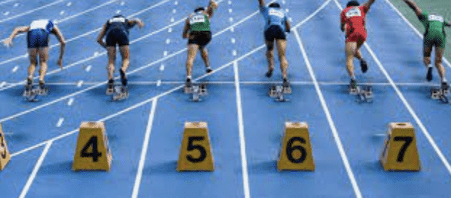
Methods race! Ready? Set! GO GO GO GO
Theoretical framework
Study design
Study setting, population, sampling
Exposure and outcomes variables
Data/Statistical analyses
What do you need: get your draft open, fingers, and laptop.

Slide 3
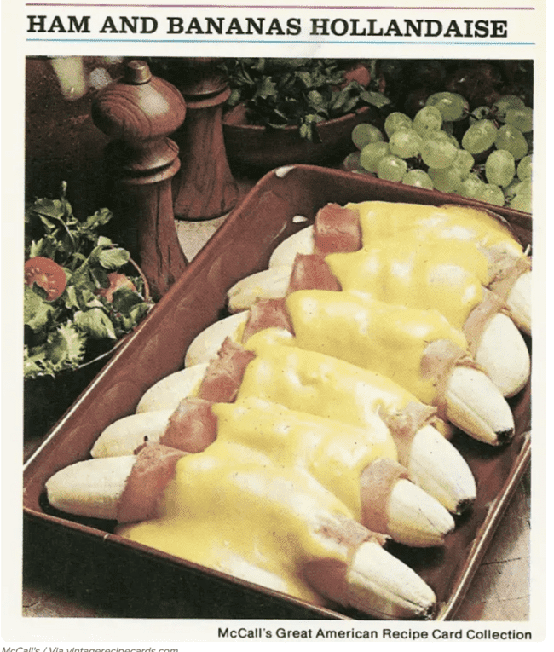
What is “the methods” = a recipe
FIRST PART OF THE WRITING PROCESS
Replicability
Validity
Notes:
https://guides.lib.uci.edu/c.php?g=334338&p=2249905#s-lg-box-6836190
https://amj.amegroups.org/article/view/5131/html
https://ehsanx.github.io/Scientific-Writing-for-Health-Research/methods-section.html#significance-of-the-methods-section-in-population-and-public-health-research-paper

Slide 4
What is methods = methods is recipe; ingredients and directions
Theoretical framework
Study design
Study setting, population, sampling
Exposure, and outcomes variables
Data/Statistical analyses

Slide 5
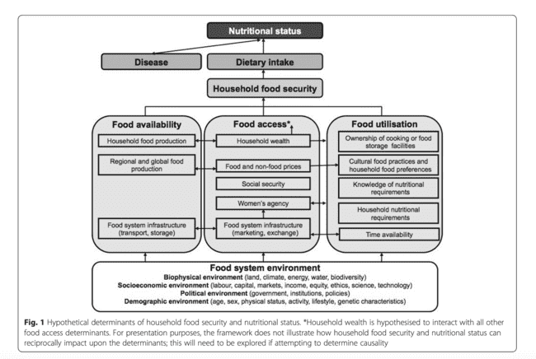
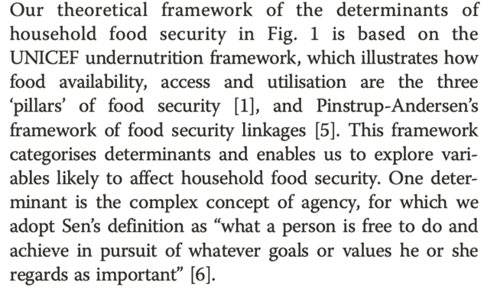
1.Theoretical framework
Harris-Fry et al. Journal of Health, Population and Nutrition (2015) 33:2

Slide 6
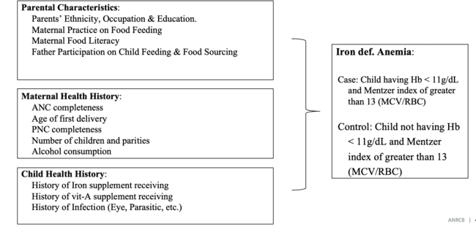
1.Theoretical framework – YOUR TURN
Conceptual framework
YOUR TURN:

Slide 7
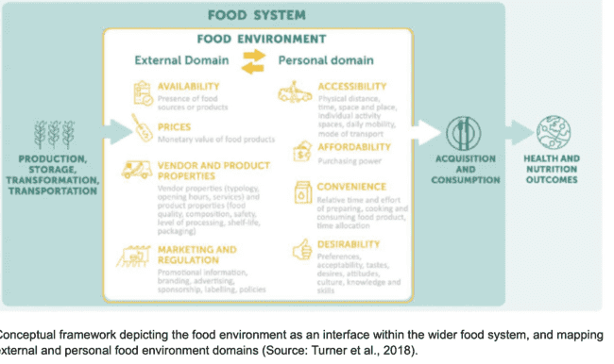
1.Theoretical framework – YOUR TURN – 5 mins!
Conceptual framework – Turner framework
My paper:
My paper:

Slide 8
What is methods = methods is recipe; ingredients and directions
Theoretical framework
Study design
Study setting, population, sampling
Exposure, and outcomes variables
Data/Statistical analyses

Slide 9
Study design
1-3 sentences on the study design to address the aim of the study
Cross-sectional, case-study, longitudinal, randomized control trial.

Slide 10
Study design – Example
1-3 sentences on the study design to address the aim of the study
Cross-sectional, case-study, longitudinal, randomized control trial.
https://gh.bmj.com/content/bmjgh/5/11/e002806.full.pdf

Slide 11
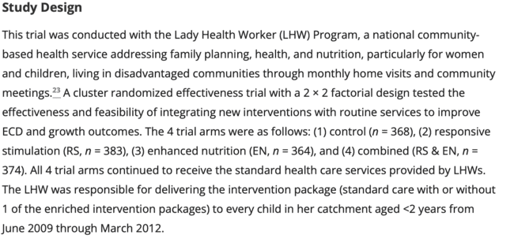
Study design – Example
1-3 sentences on the study design to address the aim of the study
Cross-sectional, case-study, longitudinal, randomized control trial.
Aisha K. Yousafzai, Muneera A. Rasheed, Arjumand Rizvi, Robert Armstrong, Zulfiqar A. Bhutta; Parenting Skills and Emotional Availability: An RCT. Pediatrics May 2015; 135 (5): e1247–e1257. 10.1542/peds.2014-2335

Slide 12
Study design – Your turn, 2 mins!
1-2 sentences on the study design to address the aim of the study
Cross-sectional, case-study, longitudinal, randomized control trial.
Your turn:
YOUR TURN:

Slide 13
What is methods = methods is recipe; ingredients and directions
Theoretical framework
Study design
Study setting, population, sampling
Exposure, and outcomes variables
Data/Statistical analyses

Slide 14
Study setting and population
1-2 sentences study setting and population
1-2 sentences on location of study sites
1-2 sentences on time frame of data collection
1-2 sentences on sampling design
1-2 sentences on ethical approval

Slide 15
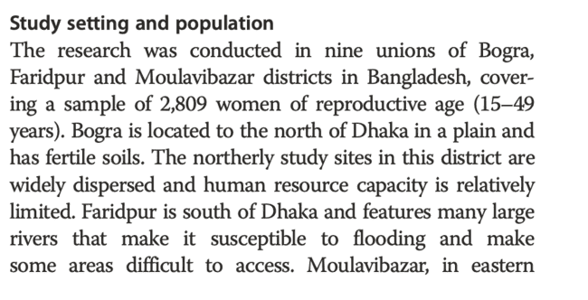
Study setting and population
1-2 sentences on study setting and population
1-2 sentences on location of study sites
1-2 sentences on time frame of data collection
1-2 sentences on sampling design
1-2 sentences on ethical approval
Harris-Fry et al. Journal of Health, Population and Nutrition (2015) 33:2

Slide 16
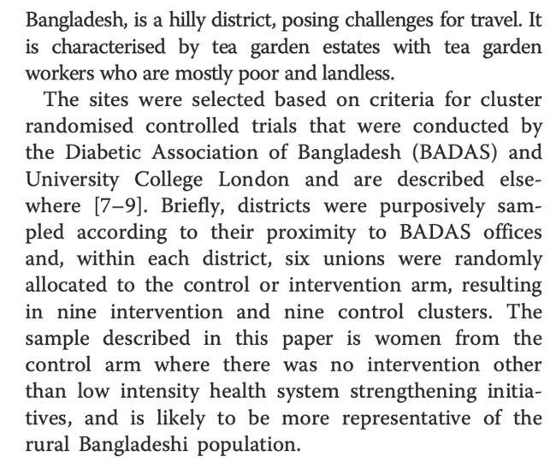
Study setting and population
1-2 sentences on study settings and population
1-2 sentences on location of study sites
1-2 sentences on time frame of data collection
1-2 sentences on sampling design
1-2 sentences on ethical approval
Harris-Fry et al. Journal of Health, Population and Nutrition (2015) 33:2

Slide 17
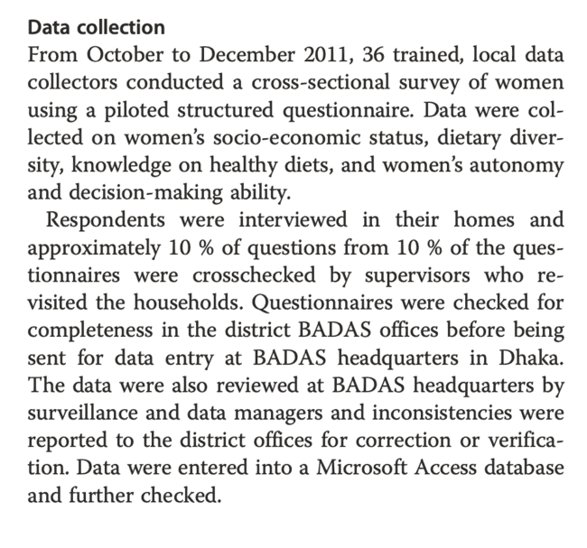
Study setting and population
1-2 sentences on study settings and population
1-2 sentences on location of study sites
1-2 sentences on time frame of data collection
1-2 sentences on sampling design
1-2 sentences on ethical approval
Harris-Fry et al. Journal of Health, Population and Nutrition (2015) 33:2

Slide 18
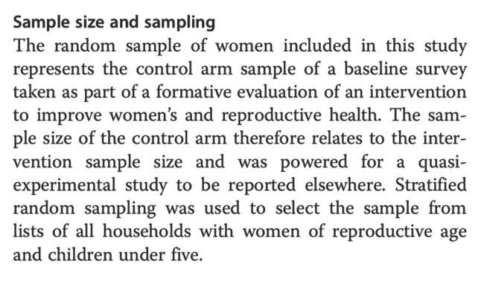
Study setting and population
1-2 sentences on study settings and population
1-2 sentences on location of study sites
1-2 sentences on time frame of data collection
1-2 sentences on sampling design
1-2 sentences on ethical approval
Harris-Fry et al. Journal of Health, Population and Nutrition (2015) 33:2
Great resource on sampling here: https://open.oregonstate.education/epidemiology/chapter/study-designs-revisited/

Slide 19
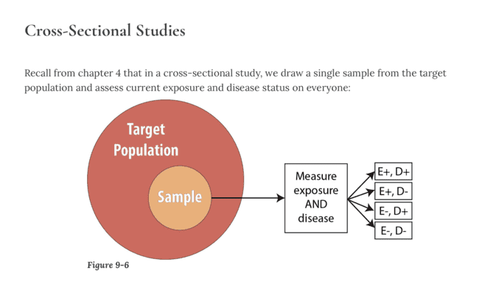
Study setting and population
1-2 sentences on study settings and population
1-2 sentences on location of study sites
1-2 sentences on time frame of data collection
1-2 sentences on sampling design
1-2 sentences on ethical approval
Great resource on sampling here: https://open.oregonstate.education/epidemiology/chapter/study-designs-revisited/

Slide 20
Study setting and population
1-2 sentences on study settings and population
1-2 sentences on location of study sites
1-2 sentences on time frame of data collection
1-2 sentences on sampling design
1-2 sentences on ethical approval

Slide 21
Study setting and population – YOUR TURN - 3 min!
1-2 sentences study setting and population
YOUR TURN:
“The study was conducted in….”
Harris-Fry et al. Journal of Health, Population and Nutrition (2015) 33:2

Slide 22
Study setting and population – YOUR TURN - 3 min!
1-2 sentences on location of study sites
YOUR TURN:
“The study was done in two schools, one in rural area and one in urban area.”
Harris-Fry et al. Journal of Health, Population and Nutrition (2015) 33:2

Slide 23
Study setting and population – YOUR TURN - 3 min!
1-2 sentences target population
YOUR TURN:
“We selected 5 classes from 6th grade. Among the 5 classes, two were randomly assigned to complete the survey online…”
Harris-Fry et al. Journal of Health, Population and Nutrition (2015) 33:2

Slide 24
Study setting and population – YOUR TURN - 3 min!
1-2 sentences on time frame of data collection
YOUR TURN:
Harris-Fry et al. Journal of Health, Population and Nutrition (2015) 33:2

Slide 25
Study setting and population – YOUR TURN - 3 min!
1-2 sentences on time frame of data collection
YOUR TURN:
Harris-Fry et al. Journal of Health, Population and Nutrition (2015) 33:2

Slide 26
Study setting and population – YOUR TURN - 3 min!
1-2 sentences on study settings and population
1-2 sentences on location of study sites
1-2 sentences on time frame of data collection
1-2 sentences on sampling design
1-2 sentences on ethical approval
YOUR TURN:

Slide 27
What is methods = methods is recipe; ingredients and directions
Theoretical framework
Study design
Study setting, population, sampling
Exposure, and outcomes variables
Data/Statistical analyses

Slide 28
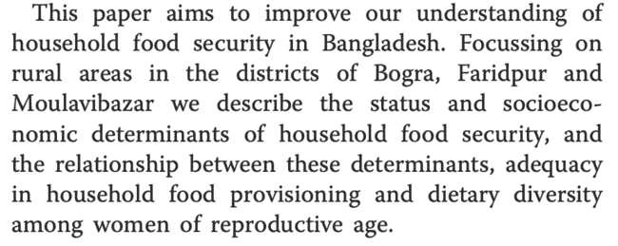
Exposure and outcomes variables
3-4+ sentences on exposure variables
3-4+ sentences on outcomes variables
What’s the exposure variables here?
What’s the outcome variables here?
Harris-Fry et al. Journal of Health, Population and Nutrition (2015) 33:2

Slide 29
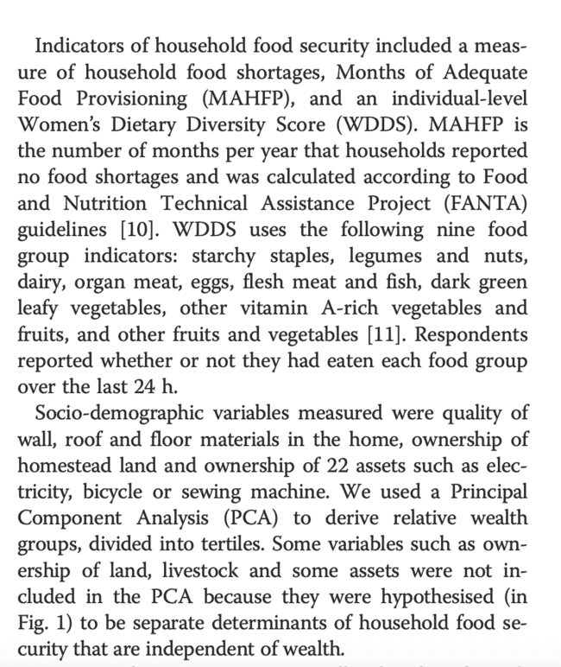
Exposure and outcomes variables
3-4+ sentences on exposure variables
3-4+ sentences on outcomes variables
Harris-Fry et al. Journal of Health, Population and Nutrition (2015) 33:2

Slide 30
Exposure and outcomes variables – YOUR TURN – 7 mins
3-4+ sentences on exposure variables
3-4+ sentences on outcomes variables
YOUR TURN:
Harris-Fry et al. Journal of Health, Population and Nutrition (2015) 33:2

Slide 31
What is methods = methods is recipe; ingredients and directions
Theoretical framework
Study design
Study setting, population, sampling
Exposure and outcomes variables
Data/Statistical analyses

Slide 32
Data and statistical Analyses
1-2 sentences overall analyses approach
1-3 paragraphs on models (linear/logistic regression, adjusted for other variables, other sensitivity analyses to support the results), software and packages used.
Harris-Fry et al. Journal of Health, Population and Nutrition (2015) 33:2

Slide 33
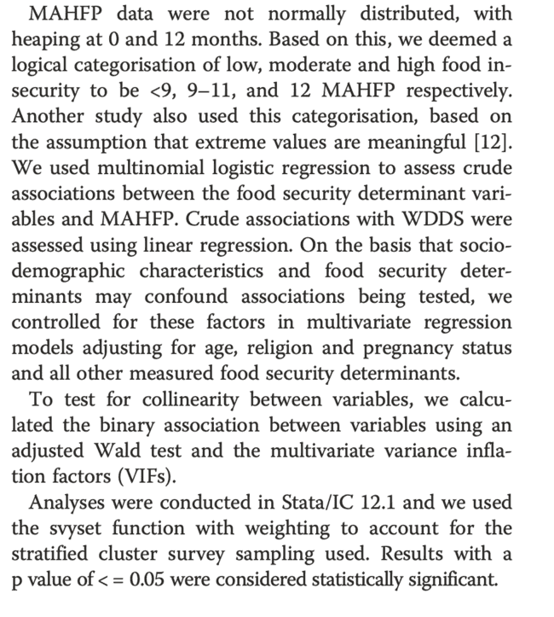
Data and statistical Analyses
1-2 sentences overall analyses approach
1-3 paragraphs on models (linear/logistic regression, adjusted for other variables, other sensitivity analyses to support the results), software and packages used.
Harris-Fry et al. Journal of Health, Population and Nutrition (2015) 33:2

Slide 34
Data and statistical Analyses – YOUR TURN – 2 mins
1-2 sentences overall analyses approach
1-3 paragraphs on models (linear/logistic regression, adjusted for other variables, other sensitivity analyses to support the results), software and packages used.
YOUR TURN:
Harris-Fry et al. Journal of Health, Population and Nutrition (2015) 33:2

Slide 35
Data and statistical Analyses– YOUR TURN - 5 min!
1-2 sentences overall analyses approach
1-3 paragraphs on models (linear/logistic regression, adjusted for other variables, other sensitivity analyses to support the results), software and packages used.
YOUR TURN:
Harris-Fry et al. Journal of Health, Population and Nutrition (2015) 33:2

Slide 36
Personal Writing strategies
Pomodoro technique, 30 mins a day
Writing accountability group
Sample of excellent paper
Reading = writing, so read, read read!
Visual learners
Write in iterations – ‘very rough first drafts’ – then edit!

Slide 37
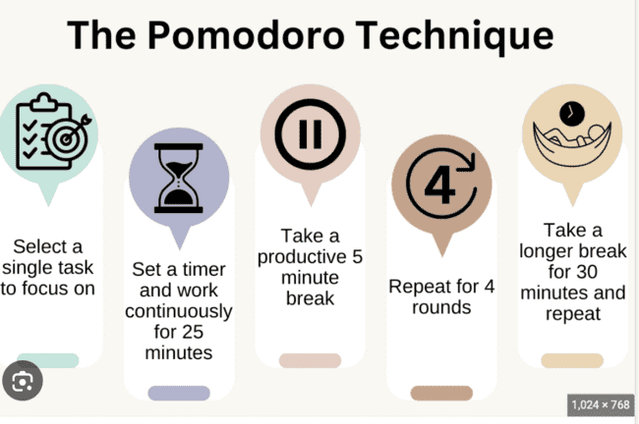
Pomodoro technique
30 mins, start and stop the timer; turn off EVERYTHING – email, whatsapp, facebook, phone messages
https://www.asundergrad.pitt.edu/study-lab/pomodoro-technique

Slide 38
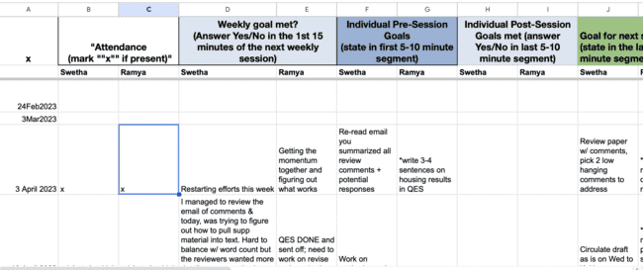
Writing accountability group
Get a group of 3-5
Meet weekly for 1 hour
Track your goals using Excel Template
Talk about what you want to do in the first 10 minutes and then write a goal and start Pomodoro
Finish and talk about why/why the goal was achieved.
Set goals for the rest of the week
BONUS – you can also do daily Pomodoro check-ins
BENEFITS: Support, talking through challenges, goals

Slide 39
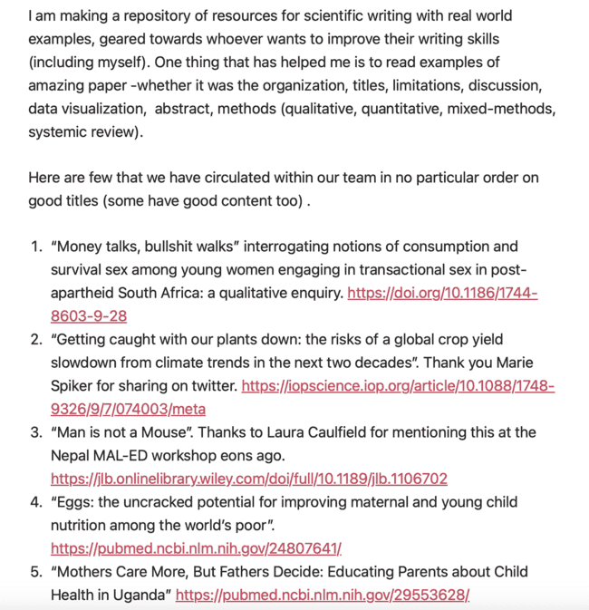
Strategies – KEEP GOOD writing examples
https://www.grammarly.com
https://ramyaambikapathi.com/top-favorite-titles-from-mostly-global-health-nutrition-papers/

Slide 40
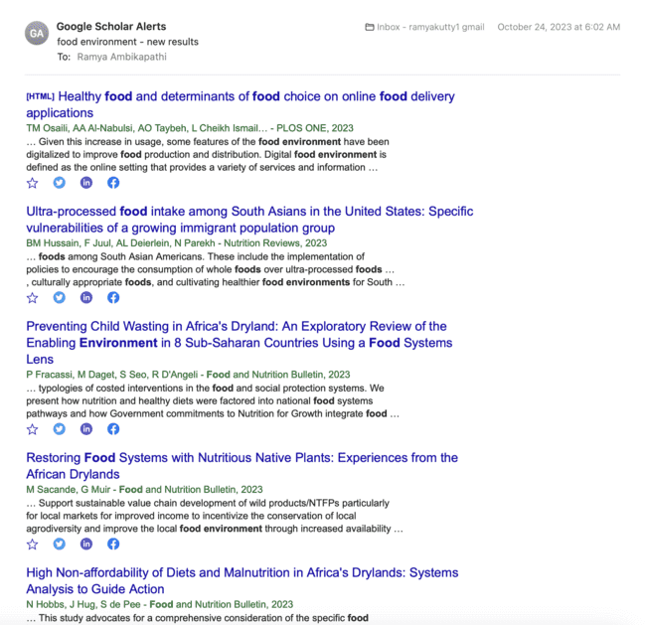
Reading = writing, so read, read read!
Google scholar alerts
https://ramyaambikapathi.com/top-favorite-titles-from-mostly-global-health-nutrition-papers/

Slide 41
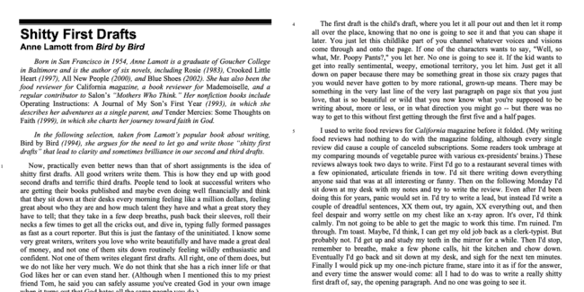
“Almost all good writing begins with terrible first efforts. You need to start somewhere. Start by getting something -- anything -- down on paper.”
https://ramyaambikapathi.com/top-favorite-titles-from-mostly-global-health-nutrition-papers/

Slide 42
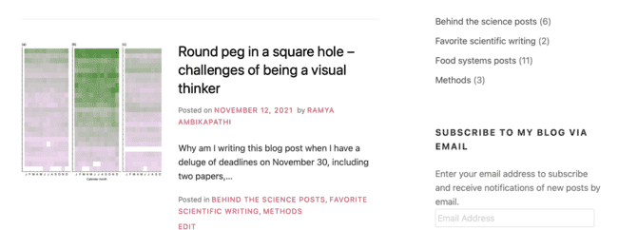
Visual learner – personal struggles with writing, started blogging!
https://ramyaambikapathi.com/top-favorite-titles-from-mostly-global-health-nutrition-papers/

Slide 43
Create orcid id, for login/submission
https://info.orcid.org/what-is-orcid/

Slide 44
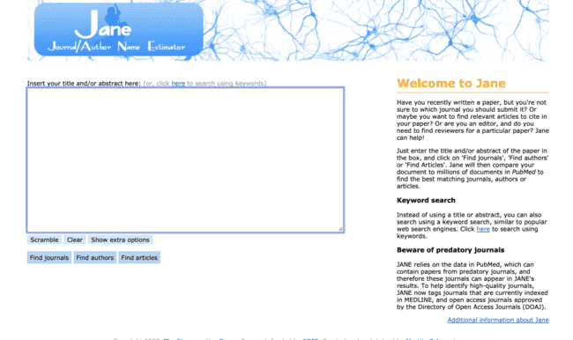
Where should I submit?

Slide 45
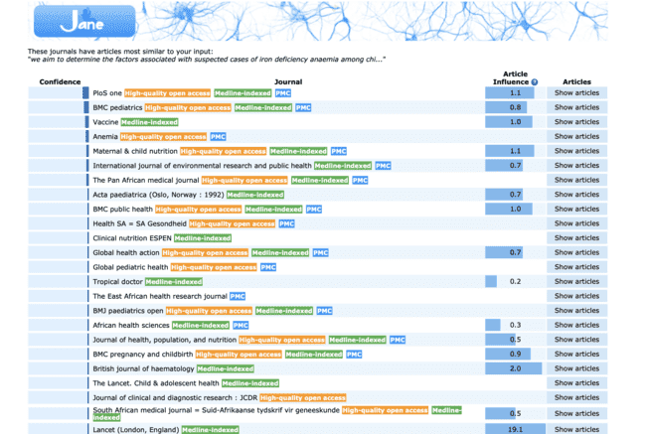
Where should I submit?
Searched: “we aim to determine the factors associated with suspected cases of iron deficiency anaemia among children under five years in Lao PDR.”
https://jane.biosemantics.org

Slide 46
Takeaway messages
Methods are recipes, follow the template, and give good details
Make writing a habit!
READ titles, read abstracts, read methods, read results!
Find good examples – write the sub-headings sections.
Find out what works for you!

Slide 47
Thank you!

