Slide 1
Dietary assessments in nutrition epidemiological studies
Carmen D. Tekwe PhD, Yuanyuan Luan PhD, Roger S. Zoh PhD
Department of Epidemiology and Biostatistics
Indiana University
Bloomington, Indiana

Slide 2
Assessments and screening by important demographic groups

Slide 3
Elderly Population
Mini Nutritional Assessment (MNA)
Subjective Global Assessment (SGA)
Children and Adolescents
Pediatric Nutritional Risk Score (PNRS)
Screening Tool for the Assessment of Malnutrition in Pediatrics (STAMP)
Pregnant Women
Pregnancy Nutritional Screen Tool (PNST)
Pregnancy Weight Gain Grid
Malnutrition Universal Screening Tool (MUST)

Slide 4
Assessments and screening in senior/elderly population

Slide 5
Unique Objectives
Older adults are at increased risk of malnutrition compared to younger individuals.
Thus, the primary objective of nutrition assessment and screening for the elderly is to identify and prevent malnutrition.
Popular Tools
Mini Nutritional Assessment (MNA)
Malnutrition Universal Screening Tool (MUST)
Seniors in the Community: Risk Evaluation for Eating and Nutrition (SCREEN)

Slide 6
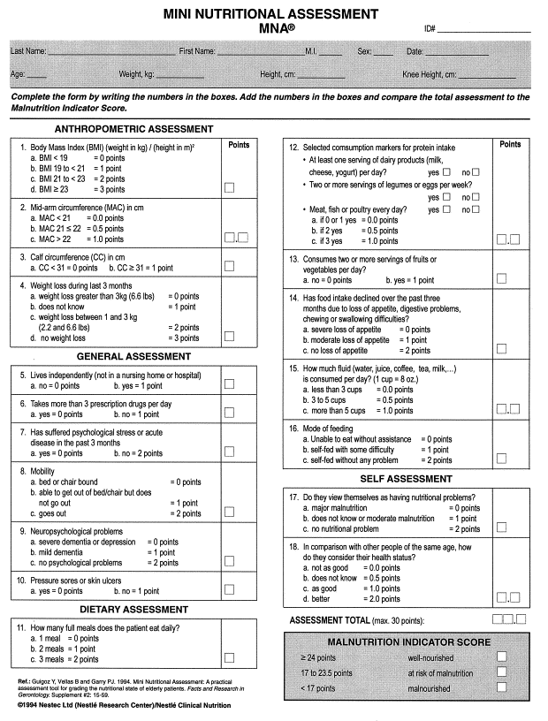
Mini Nutritional Assessment (MNA)
MNA is designed and validated to provide a single, rapid assessment of nutritional status in elderly patients in clinics, hospitals, and nursing homes.
Aims to evaluate the risk of malnutrition.
Includes a combination of assessments:
Anthropometric measurements (weight, height, and weight loss)
Global assessment (six questions related to lifestyle, medication, and mobility)
Dietary questionnaire (eight questions, related to number of meals, food and fluid intake, and autonomy of feeding)
Subjective assessment (self-perception of health and nutrition)

Slide 7
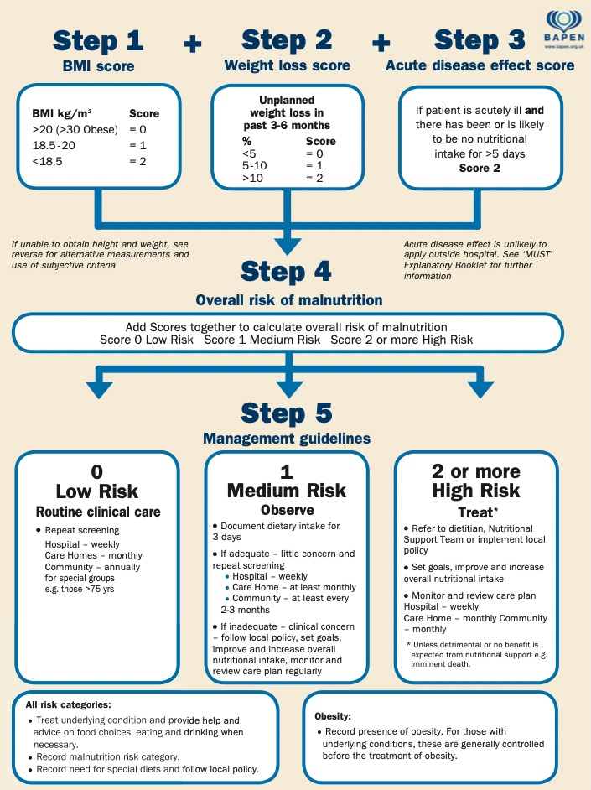
Malnutrition Universal Screening Tool (MUST)
MUST is used to identify adults at risk of malnutrition
MUST is a five-step screening tool:
Step 1 Measure height and weight to get a BMI score.
Step 2 Note percentage unplanned weight loss and score.
Step 3 Establish acute disease effect and score.
Step 4 Add scores from steps 1, 2 and 3 together to obtain overall risk of malnutrition.
Step 5 Get overall risk of malnutrition and use management guidelines and/or local policy to develop care plan.

Slide 8
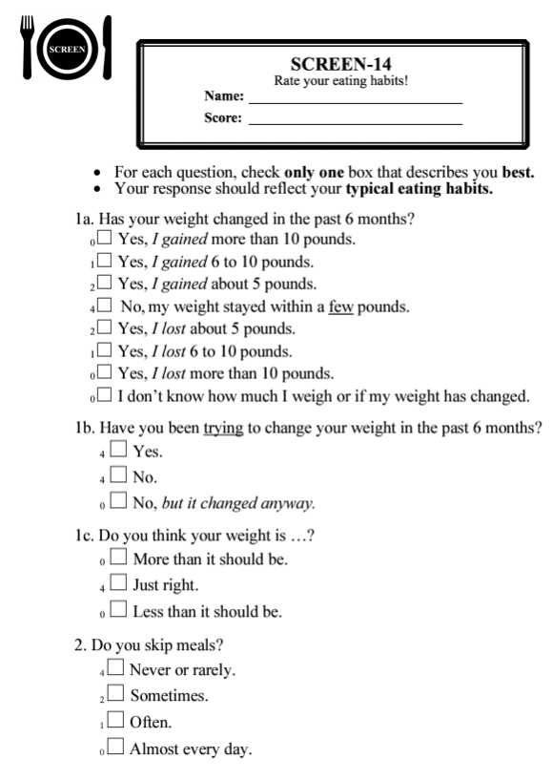
Seniors in the Community: Risk Evaluation for Eating and Nutrition (SCREEN)
SCREEN is a self-administered screening tool that assesses nutritional risk in community-dwelling older adults.
There are several versions of SCREEN, including SCREEN I, II, and III, each with a different number of questions and slightly varying designs.
For example, SCREEN II (also named SCREEN-14) consists of 14 items. These items cover various aspects of nutrition, such as:
Weight change
Appetite
Frequency of meals
Food intake
Difficulty with meal preparation and eating
Risk factors for malnutrition
Higher scores indicate better nutritional status.
The maximum possible total score of SCREEN II is 64. A score of 50 or below suggests that an individual is at nutritional risk and may require further assessment or intervention.

Slide 9
Assessments and screening in children and adolescents

Slide 10
Unique Objectives
Adequate nutrition is crucial for proper physical, cognitive, and emotional development during these critical life stages.
Thus, the primary objective of nutrition assessment and screening is to ensure optimal growth and development.
Popular Tools
The Pediatric Nutrition Screening Tool (PNST)
The Screening Tool for the Assessment of Malnutrition in Pediatrics (STAMP)

Slide 11
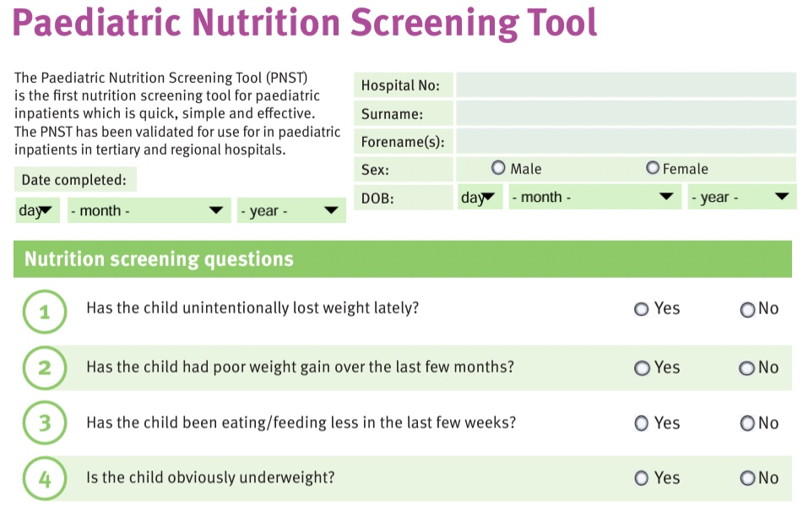
Pediatric Nutrition Screening Tool (PNST)
PNST was developed by a group of Australian dietitians and nurses in 2016 for hospitalized pediatric patients
PNST is a simple, four-item questionnaire:
Has child unintentionally lost weight lately?
Has child had poor weight gain over the last few months?
Has child been eating/feeding less in the last few weeks?
Is child obviously underweight/significantly overweight?
If “yes” to two or more questions above:
Might be at nutritional risk.

Slide 12
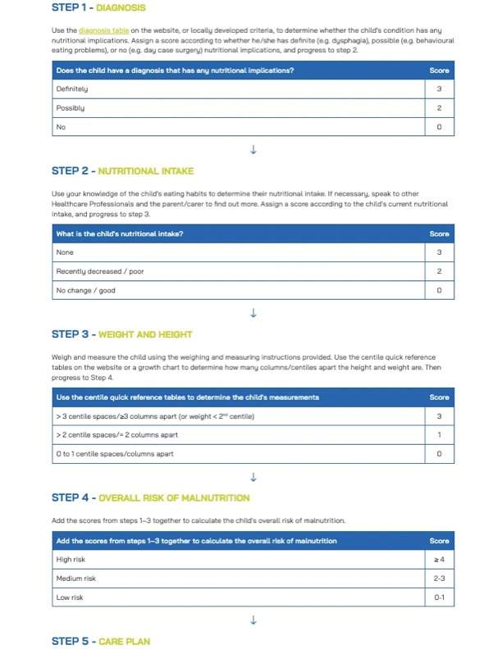
Screening Tool for the Assessment of Malnutrition in Pediatrics (STAMP)
STAMP was developed in the United Kingdom for hospitalized children aged 2–17.
STAMP incorporates three components:
Clinical diagnosis
Estimated nutritional intake
Weight and height percentiles
Includes five steps:
Step 1: Clinical diagnosis
Step 2: Nutritional intake
Step 3: Weight and height assessment
Step 4: Add the scores from steps 1–3 together to calculate the child's overall risk of malnutrition.
Step 5: Develop a care plan accordingly

Slide 13
Assessments and screening in pregnant women

Slide 14
Unique Objectives
Adequate nutrition during pregnancy is essential for optimal fetal growth and development, as well as for preventing maternal complications.
Thus, the primary objective of nutrition assessment and screening is to ensure the health and well-being of both the mother and the developing fetus.
Popular Tools
FIGO Nutrition Checklist
Prenatal Weight Gain Grid

Slide 15
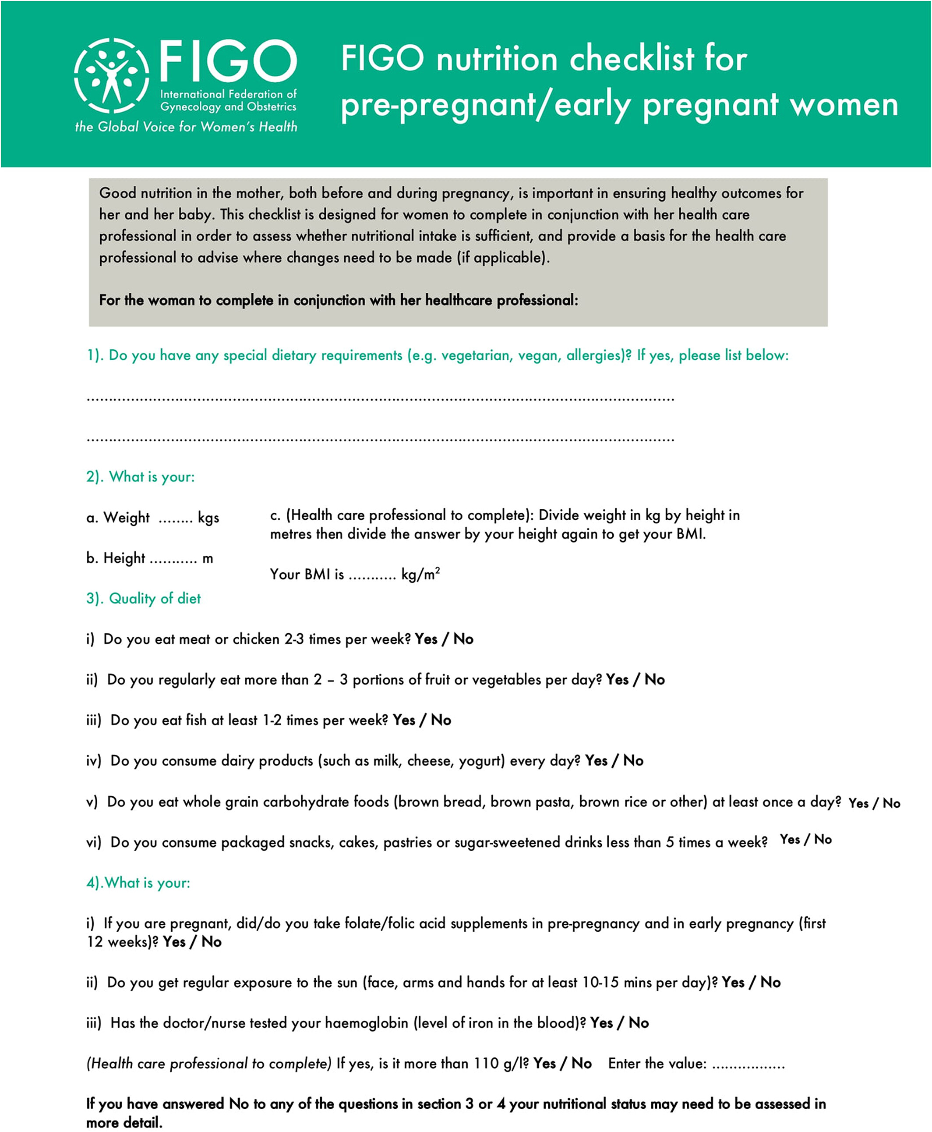
FIGO Nutrition Checklist
The FIGO (International Federation of Gynecology and Obstetrics) nutrition checklist was developed in 2015 by FIGO initiative on Adolescent, Preconception and Maternal Nutrition.
It consists of four sections:
Specific dietary requirements or special diets
Body mass index
Diet quality (number of servings or frequency of consumption of specific foods)
Micronutrients (folic acid, vitamin D, and iron)

Slide 16
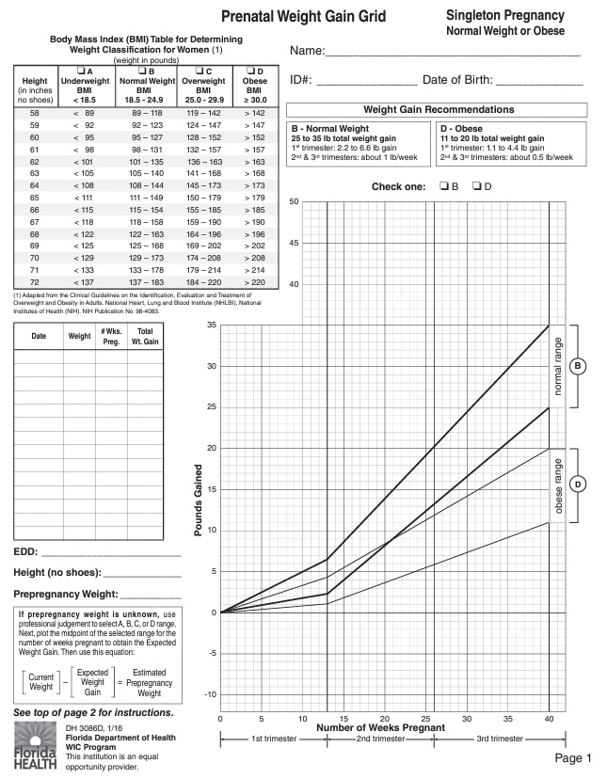
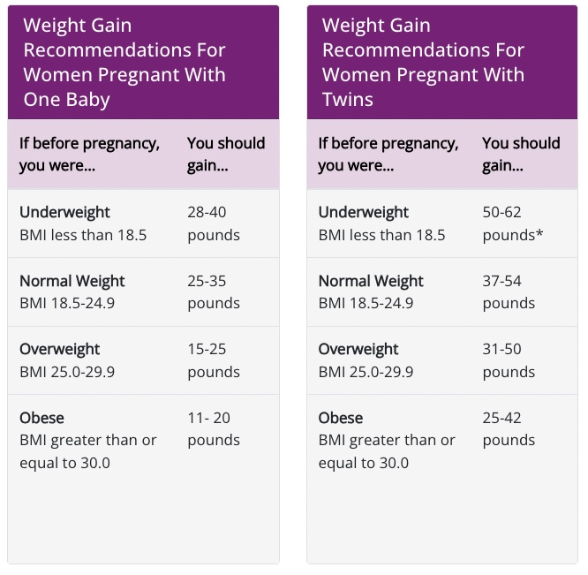
Prenatal Weight Gain Grid
The Pregnancy Weight Gain Grid is a tool developed by the Institute of Medicine (IOM) in the United States to:
Track a woman's weight gain throughout pregnancy.
Compare it to the recommended ranges.
The grid consists of a chart with four BMI categories:
Underweight (BMI < 18.5)
Normal weight (BMI 18.5-24.9)
Overweight (BMI 25.0-29.9)
Obese (BMI ≥ 30.0)

Slide 17
Some relevant references

Slide 18
Subar, A. F., Freedman, L. S., Tooze, J. A., Kirkpatrick, S. I., Boushey, C., Neuhouser, M. L., ... & Krebs-Smith, S. M. (2015). Addressing current criticism regarding the value of self-report dietary data. The Journal of nutrition , 145(12), 2639-2645.
Dietary Assessment Primer, 24-hour Dietary Recall. National Institutes of Health, National Cancer Institute. (https://dietassessmentprimer.cancer.gov/) [Accessed on: October 21, 2022].
Cantwell MM, Millen AE, Carroll R, Mittl BL, Hermansen S, Brinton LA, Potischman N. A debriefing session with a nutritionist can improve dietary assessment using food diaries. J Nutr 2006 Feb;136(2):440-5. [View Abstract]
Bailey, R. L. (2021). Overview of dietary assessment methods for measuring intakes of foods, beverages, and dietary supplements in research studies. Current Opinion in Biotechnology , 70, 91-96.

Slide 19
MOBLEY, C. C. (2008). Nutritional risk assessment. In Prevention in clinical oral health care (pp. 92-110). Mosby.
Capicio, M., et al. (2022). Nutrition Risk, Resilience and Effects of a Brief Education Intervention among Community-Dwelling Older Adults during the COVID-19 Pandemic in Alberta, Canada. Nutrients, 14(5), 1110.
Geirsdóttir, Ó., & Bell, J. (2021). Interdisciplinary Nutritional Management and Care for Older Adults: An Evidence-Based Practical Guide for Nurses (p. 271). Springer Nature.
Malik, D., Narayanasamy, N., Pratyusha, V.A., Thakur, J., Sinha, N. (2023). Nutritional Assessment. In: Textbook of Nutritional Biochemistry. Springer, Singapore.

Slide 20
Correia, M.I.T.D., 2018. Nutrition Screening vs Nutrition Assessment: What’s the Difference?. Nutrition in Clinical Practice 33, 62–72
Charney, P. (2008). Nutrition screening vs nutrition assessment: how do they differ?. Nutrition in Clinical Practice, 23(4), 366-372.
Keller, H. H., Goy, R., & Kane, S. L. (2005). Validity and reliability of SCREEN II (Seniors in the Community: Risk Evaluation for Eating and Nutrition, version II). European Journal of Clinical Nutrition, 59(10), 1149-1157
Sharma, S., Cao, X., Gittelsohn, J., Anliker, J., Ethelbah, B., & Caballero, B. (2013). Dietary intake and a food-frequency instrument to evaluate a nutrition intervention for the Apache in Arizona. Public Health Nutrition, 10(9), 948-956.
Procter, S. B., & Campbell, C. G. (2014). Position of the Academy of Nutrition and Dietetics: Nutrition and lifestyle for a healthy pregnancy outcome. Journal of the Academy of Nutrition and Dietetics, 114(7), 1099-1103.
Vellas, B., Guigoz, Y., Garry, P. J., Nourhashemi, F., Bennahum, D., Lauque, S., & Albarede, J. L. (1999). The Mini Nutritional Assessment (MNA) and its use in grading the nutritional state of elderly patients. Nutrition, 15(2), 116-122.
Stratton, R. J., Hackston, A., Longmore, D., Dixon, R., Price, S., Stroud, M., King, C., & Elia, M. (2004). Malnutrition in hospital outpatients and inpatients: Prevalence, concurrent validity and ease of use of the 'malnutrition universal screening tool' ('MUST') for adults. British Journal of Nutrition, 92(5), 799-808.
Keller, H. H., Goy, R., & Kane, S. L. (2005). Validity and reliability of SCREEN II (Seniors in the Community: Risk Evaluation for Eating and Nutrition, version II). European Journal of Clinical Nutrition, 59(10), 1149-1157.
White, M., Lawson, K., Ramsey, R., Dennis, N., Hutchinson, Z., Soh, X. Y., Matsuyama, M., Doolan, A., Todd, A., Elliott, A., Bell, K., & Littlewood, R. (2016). Simple nutrition screening tool for pediatric inpatients. Journal of Parenteral and Enteral Nutrition, 40(3), 392-398.
McCarthy, H., Dixon, M., Crabtree, I., Eaton-Evans, M. J., & McNulty, H. (2012). The development and evaluation of the Screening Tool for the Assessment of Malnutrition in Paediatrics (STAMP©) for use by healthcare staff. Journal of Human Nutrition and Dietetics, 25(4), 311-318.
Institute of Medicine. (2009). Weight Gain During Pregnancy: Reexamining the Guidelines. Washington, DC: The National Academies Press
Killeen, S. L., Donnellan, N., O'Reilly, S. L., Hanson, M. A., Rosser, M. L., Medina, V. P., ... & FIGO Committee on Impact of Pregnancy on Long‐term Health and the FIGO Division of Maternal and Newborn Health. (2023). Using FIGO Nutrition Checklist counselling in pregnancy: A review to support healthcare professionals. International Journal of Gynecology & Obstetrics, 160, 10-21.

