Slide 1
Topic 11.4 Behavior Change Models: Individual and Intrapersonal Levels
Training developed by Kate Eddens, PhD, MPH
Indiana University School of Public Health
Department of Epidemiology and Biostatistics
In collaboration with the Ministry of Health Lao PDR
Training by Applied Nutrition Research Capacity Building (ANRCB), a project of the Lao American Nutrition Initiative (LANI)
This work is made possible through support from USAID/Laos as a supplement to a USAID Cooperative Agreement #7200AA18CA00009 (LASER-PULSE) to Purdue University. Contents reflect the views of the author(s) and do not necessarily reflect those of USAID.
For more information, please contact Catholic Relief Services Laos.

Slide 2
Introduction
Stage theories are a subset of value-expectancy theories (described in Chapter 5).
There are two stage theories that predominate in health promotion research and practice:
Transtheoretical Model of Change (TMC)
Precaution Adoption Process Model (PAPM)

Slide 3
Introduction
Stage theories: behavioral change occurs as a result of individuals passing through a series of sequential stages
culminate either in the elimination of a health-risk behavior (e.g., smoking) or
the long-term adoption of a health-protective behavior (e.g., adherence to a low-fat diet).

Slide 4
Introduction
Need to successfully complete each stage
Start where people are!
Intervention programs should move individuals one step (one stage) closer to lasting behavior change.
“Stage-matched or stage-targeted intervention”
Notes:
For lasting behavior change, a person needs to sequentially complete each stage.

Slide 5
Stage Models

Slide 6
Transtheoretical Model of Change
The Transtheoretical Model of Change (TMC) describes how people change their behavior.
Stages of change: phases that people go through
Processes of change: mechanisms that people use, e.g., decisional balance, efficacy
Notes:
The TMC describes the phases people go through and the mechanisms people use to move through those stages.
Also, something you see here that you don’t see in most other theories is the inclusion of relapse or backsliding. Understanding that people don’t always change a behavior and then adhere to it forever.

Slide 7
Transtheoretical Model of Change
The model assumes that there are 5 stages of change:
Precontemplation
Contemplation
Preparation
Action
Maintenance

Slide 8
Transtheoretical Model of Change
Stage 1: Precontemplation
No intention to take action in the foreseeable future (usually defined as the next six months)
May be:
uninformed or under-informed
tried to change but became demoralized
may not recognize they need to change behavior

Slide 9
Transtheoretical Model of Change
Stage 2: Contemplation
People engage in cognitive processes about the behavior.
Decisional balance: “mental weighing” of pros and cons associated with changing behavior.

Slide 10
Transtheoretical Model of Change
Stage 3: Preparation
People intend to adopt a new behavior in the immediate future (usually defined as the next month)
Lasting change requires skills and resources, both of which take time to acquire.

Slide 11
Transtheoretical Model of Change
Stage 4: Action
People have made specific overt modifications in their lifestyles within the past six months.
Not all behavioral changes qualify as action.
The action criterion should reflect the degree of behavior change that is significant from a public health (epidemiological) standpoint.

Slide 12
Transtheoretical Model of Change
Stage 5: Maintenance
Sustaining specified behavior for 6 months or longer
Work to prevent relapse
Don’t need to apply change processes as frequently as people in the action stage.
Less tempted to relapse
More confident in maintaining the change.

Slide 13
Transtheoretical Model of Change
Time spent in each stage varies across populations.
Progress may not be linear
(e.g. relapse, cycling/recycling through stages).
Stage movement can be the goal of health promotion efforts
Notes:
Stage movement can be a goal alone. You may not be able to move people completely into action, but if you can move them along the continuum, that can be a success.

Slide 14
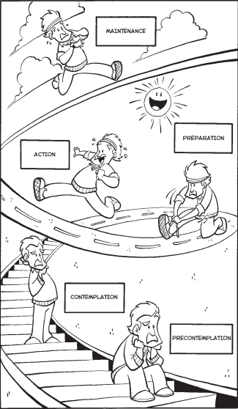
Stages of Change for Exercise Beavior

Slide 15
Notes:
Include relapse as a stage

Slide 16
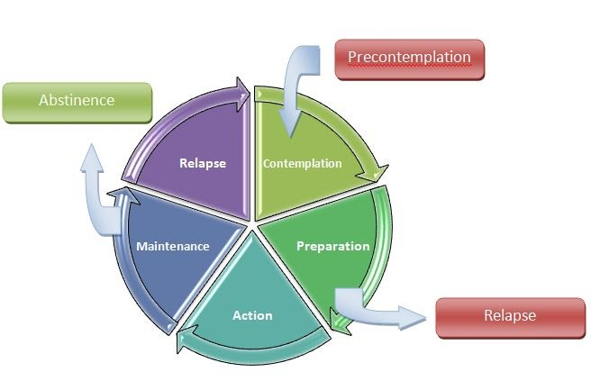
Notes:
Consider precontemplation as before entry to the wheel

Slide 17
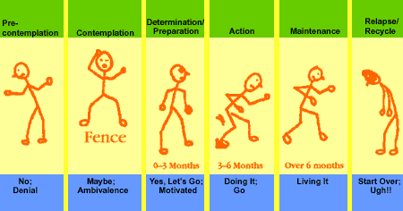

Slide 18
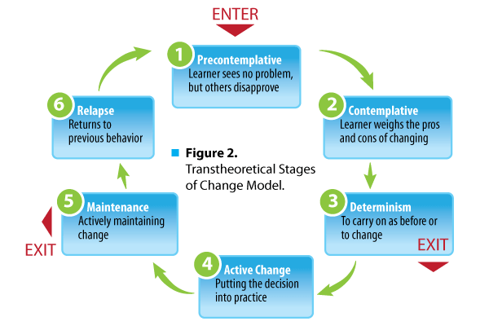

Slide 19
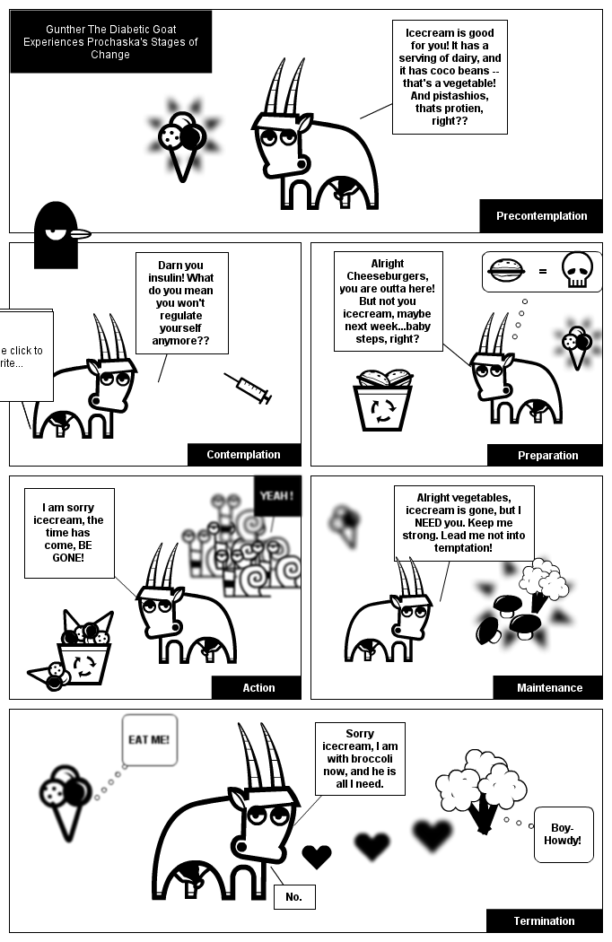
Gunther, The Diabetic Goat
Notes:
http://s3.amazonaws.com/stripgenerator/strip/58/81/24/00/00/full.png

Slide 20
Transtheoretical Model of Change
Stage-matching
People can be “staged.”
Interventions can be tailored to stage
Notes:
People can be determined to be at a particular stage of change for a specific behavior (i.e., they can be ‘staged’).
stage-matching allows interventions to be designed with greater specificity.

Slide 21
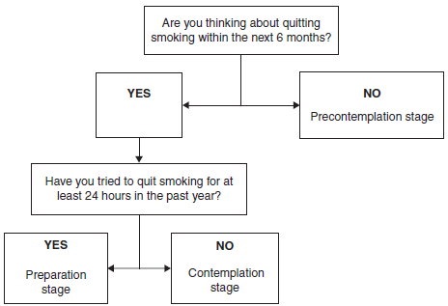
Transtheoretical Model of Change
How do you determine a person’s stage?
An example:
Notes:
Typically, there are sets of standard questions that can identify what stage a person is currently in given a behavior.

Slide 22
Transtheoretical Model of Change
The 5 stages create at least 4 distinct transition challenges
Understanding the processes of change is crucial.
Processes of Change: 10 essential principles that promote change.

Slide 23
Processes of Change
Experiential Processes
Consciousness Raising | Get the Facts.
Dramatic Relief | Pay Attention to Feelings.
Environmental Reevaluation | Notice Your Effect on Others.
Self-Reevaluation | Create a New Self-Image.
Social Liberation | Notice Social Trends.
Behavioral Processes
Self-Liberation | Make a Commitment.
Counter-Conditioning | Use Substitutes.
Helping Relationships | Get Support.
Reinforcement Management | Use Rewards.
Stimulus Control | Manage Your Environment.

Slide 24
Transtheoretical Model of Change
Stage-Matched Interventions: matching strategies that are most likely to produce movement through the stages of change given the current level of a person’s readiness.
Important because change processes are not universally applicable across all stages.
Notes:
Each stage has a different set of processes that will move the person to the next stage. This is why it is so important to understand where people are in the stages when intervening. In early stages, the processes that people apply to move through the stages are more cognitive, affective, and evaluative. In later stages, they use conditioning, commitments, contigencies, environmental controls, and support to take action and maintain behavior change. So these are all very different.
It’s common in health communication interventions to tailor materials specifically to an individual’s stage of change. Does anyone (beside Molly) know the difference between targeting and tailoring?

Slide 25
Transtheoretical Model of Change
Tailoring based on stage WORKS.
Noar, et al: Meta-analyses of 57 studies
Tailoring to TCM stages
Tailoring to pros and cons
Tailoring to self-efficacy
Tailoring on processes of change
Noar SM, Benac CN, Harris MS. Does tailoring matter? Meta-analytic review of tailored print health behavior change interventions. Psychological Bulletin. 2007;4:673-693

Slide 26
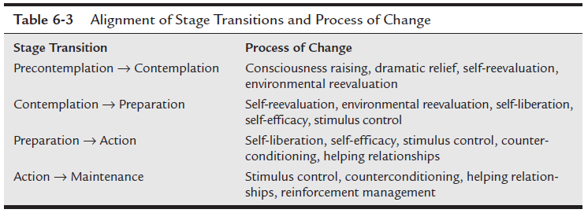
Transtheoretical Model of Change
Notes:
See the shift between early stage processes (cognitive, affective, and evaluative) to later stage processes (conditioning, commitments, contigencies, environmental controls, and support)

Slide 27
Transtheoretical Model of Change
Processes of change should not be conceptually equated with techniques used to promote change.
Techniques are strategies, methods, or planned activities that are used to amplify a process of change.
Examples of techniques that can be used to enhance each process of change can be found in Table 6-4.

Slide 28
Notes:
Examples of techniques – let’s apply them to a given behavior change

Slide 29
Processes of Change
Experiential Processes
Consciousness Raising | Get the Facts.
Dramatic Relief | Pay Attention to Feelings.
Environmental Reevaluation | Notice Your Effect on Others.
Self-Reevaluation | Create a New Self-Image.
Social Liberation | Notice Social Trends.
Behavioral Processes
Self-Liberation | Make a Commitment.
Counter-Conditioning | Use Substitutes.
Helping Relationships | Get Support.
Reinforcement Management | Use Rewards.
Stimulus Control | Manage Your Environment.

Slide 30
Transtheoretical Model of Change
Decisional balance:
Involves a “mental weighing” of the pros and cons associated with changing behavior.
The goal of intervention is to maximize the pros of adopting a new, healthier behavior or eliminating a health-threatening behavior, and minimize the cons associated with change.
Notes:
The strong principle of progress means that the pros of the health behavior change must increase by about one standard deviation from precontemplation to action. Similarly, the weak principle means that the cons of the health behavior change must decrease by one-half a standard deviation from precontemplation to action. So there is a tipping point for people to take action to engage in behavior change. So your job as health promoters is to move people toward that tipping point.

Slide 31
Transtheoretical Model of Change
Resilient self-efficacy: Confidence to cope with high-risk situations without relapsing and temptation
High confidence and low temptation interact to provide optimal conditions favoring successful progress to lasting behavior change.
Notes:
The term resilient self-efficacy describes people that have high levels of self-efficacy so that the behavior can be performed even in the most challenging situations.

Slide 34
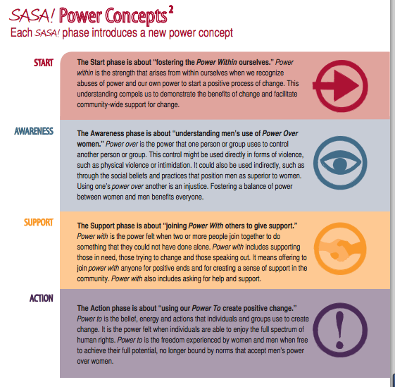

Slide 35
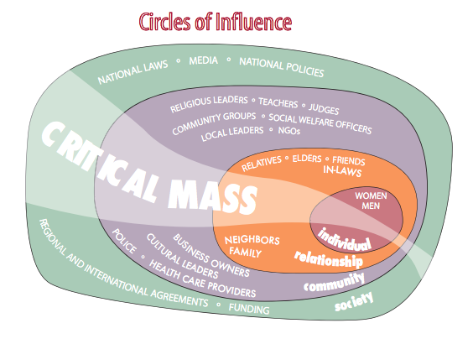

Slide 36
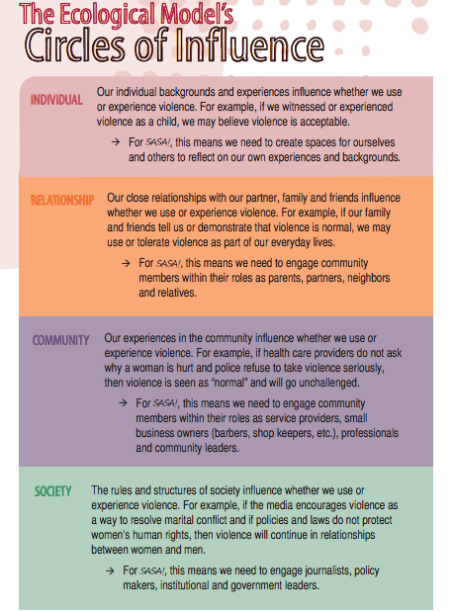

Slide 37
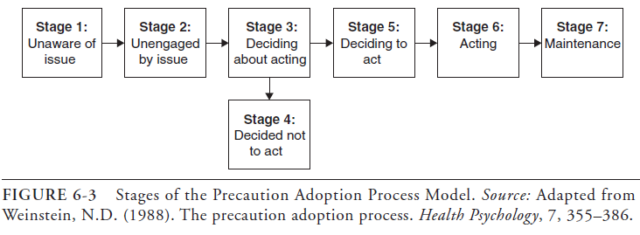
Precaution Adoption Process Model
The PAPM is similar to the TMC but involves a more fine-grained approach to the concept of the 5 stages of change.

Slide 38
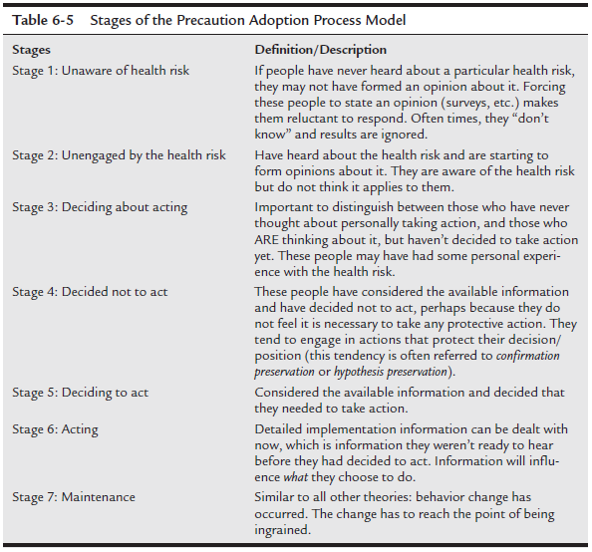

Slide 39
Precaution Adoption Process Model
According to the PAPM, the TMC’s stage of Precontemplation comprises two stages:
unaware of the issue
unengaged by the issue
People who are unengaged may have an optimistic bias:
Don’t see themselves as being as vulnerable to the adverse consequences of health-risk behaviors as their peers, who engage in the same risk behaviors.
Notes:
SO PAPM essentially breaks down Precontemplation into unaware and unengaged. With optimistic bias, people who are in stage 2 are aware of the threat (stage 1), but don’t think it applies to them. What are some examples of this?

Slide 40
Precaution Adoption Process Model
The ‘unaware’ and ‘unengaged’ distinction has important implications for intervention.
Unaware → awareness-raising interventions
Unengaged → interventions that promote perceived susceptibility.
Notes:
This distinction is important precisely because the point of stage models is to be able to target interventions to stage of change.

Slide 41
Precaution Adoption Process Model
Other important differences between the TMC and PAPM include:
The PAPM includes a stage for those who ‘decide not to act’(TMC does not).
PAPM does not prescribe change processes.
Notes:
The decides not to act stage is important because it includes those who attempt and then reject change. These folks might be very different, and much more difficult to move, then those who just relapse but want to try again.
Though the concept of stage-targeting or stage-matching is important in PAPM, the PAPM doesn’t prescribe change processes.

Slide 42
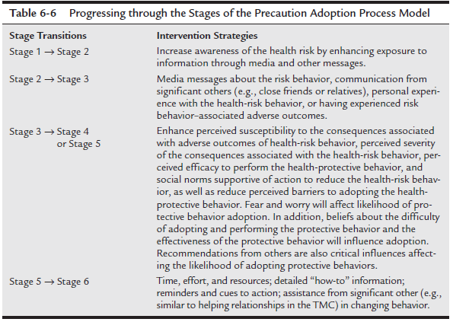
Precaution Adoption Process Model

Slide 43
Precaution Adoption Process Model
Stage theories are useful for designing targeted and matched interventions based on people’s readiness to change their behavior.
The TMC has five stages that describe people’s intention to change behavior along with processes of change that facilitate progression through the stages and ultimately to behavior change.
The PAPM has similar stages to the TMC; however, it adds additional stages and precision.
Notes:
What, specifically, are the main differences in the PAPM and the TMC?

Slide 44
Social Cognitive Theory

Slide 45
Introduction
Social Cognitive Theory (SCT) was developed and refined by Bandura
It asserts that the social environment, the personal characteristics of the individual, and behavior interact with and influence each other and that behavior is influenced by the social environment
“Human health is a social matter, not just an individual one. A comprehensive approach to health promotion also requires changing the practices of social systems that have widespread effects on human health”

Slide 46
Introduction
SCT evolved from Bandura’s Social Learning theory
Social Learning Theory was developed to explain how learning is a process that occurs within a social context and involves observing behaviors, modeling reinforcement, and cognition
At the basic level, it suggests that people learn new behaviors through observing others, imitating their behaviors, and reinforcement through outcomes
Notes:
This theory was expanded to suggest that the social context, environmental factors, the individual and the individual’s behavior are intertwined

Slide 47
Introduction
Review the five key constructs of SCT
Explore how these constructs are related to interactions among person, environment, and behavior
Describe the process for implementing SCT in research

Slide 48
SCT: Five Key Constructs
While the SCT is broad in scope, it contains five key constructs:
Knowledge
Perceived self-efficacy
Outcome expectations
Goal formation
Sociostructural factors

Slide 49
SCT: Knowledge Construct
According to Bandura, knowledge is a precondition for behavior change, a “gateway” for it
“Knowledge is a necessary, but not sufficient,
basis for behavior change”
Content knowledge involves understanding the advantages and drawbacks of a health behavior
Procedural knowledge involves understanding how to engage in a given health behavior
Knowing how to do something & doing it are different

Slide 50
SCT: Self-Efficacy Construct
Perceived self-efficacy is a person’s perception of his or her ability to perform a specific behavior
Is task-specific, someone’s self-efficacy may be strong for one task but weak for another
Is a perception
Low self-efficacy generates fleeting or no efforts to perform a behavior. On the other hand, resilient self-efficacy is the concept of perseverance even when conditions are not ideal

Slide 51
SCT: Self-Efficacy Construct
According to SCT, people can increase perceptions of self-efficacy based on four methods of learning:

Slide 52
SCT: Self-Efficacy Construct
According to SCT, people can increase perceptions of self-efficacy based on four methods of learning:
Physiological state – diminish fear and other negative emotions
You rely on somatic/emotional states to gauge capability
Anxiety is interpreted as vulnerability to poor performance
Positive mood enhances self-efficacy
Is the weakest source of self-efficacy

Slide 55
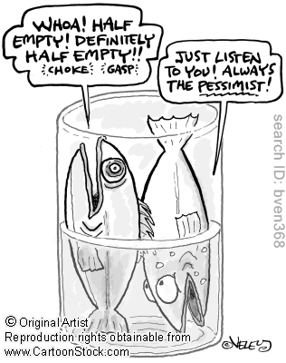

Slide 56
SCT: Self-Efficacy Construct
Verbal persuasion – convince people they can perform the behavior
You can do it!
Needs to reflect actual ability
Must be believable and delivered by someone trustworthy
http://youtu.be/VZ2HcRl4wSk
Notes:
<iframe width="420" height="315" src="//www.youtube.com/embed/VZ2HcRl4wSk" frameborder="0" allowfullscreen></iframe>

Slide 57
SCT: Self-Efficacy Construct
Vicarious experience – learn by watching others
You, okay?! I learned it by watching you!
Observe someone similar to themselves successfully performing a behavior
Someone who has struggled imperfectly but ultimately succeeded in a similar task
http://youtu.be/CFl4Yse0xuI

Slide 58
SCT: Self-Efficacy Construct
Enactive attainment – physically guiding or coaching someone through the behaviors
I’ll show you; now you show me. You have what it takes!
Walk someone through the process and provide feedback along the way
Avoid the experience of repeated failure
Break down difficult steps into small steps that are relatively easy
Is the strongest and most effective source.
http://youtu.be/pN0Y2EZuvTU (okay, not really)
Notes:
Want to avoid the experience of repeated failure

Slide 59
SCT: Self-Efficacy Construct
Behavioral capacity is the actual ability a person has to perform a given behavior
can include whether the environment provides opportunity for the behavior
Interventions → increase both self-efficacy & behavioral capacity
The initial adoption of a behavior is a “fragile period”
Notes:
Fragile period that can benefit greatly from intervention attempts

Slide 60
SCT: Outcome Expectations
Outcome expectations: the anticipated outcomes that stem from engaging in the behavior
Must be a belief that the behavior will “pay off”
Prevention paradox: difficult to convince people that their actions are paying off because seemingly nothing (as in no heart attack or stroke) is happening
Notes:
Before behavior change occurs, there must be a belief in the pay off

Slide 61
SCT: Outcome Expectations
Outcomes thought of along a range of observability & a level of immediacy
Observability: the ability to learn through watching others (vicarious learning), as well as learning directly through personal experience
Level of immediacy: short-term to long-term
Outcome expectations can range from highly observable and immediate (ideal for behavior change) to not observable and long-term

Slide 62
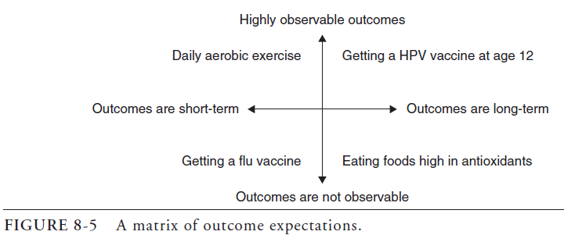
SCT: Outcome Expectations
Health promotion efforts can create shorter-term, highly observable substitutes to long-term, elusive outcomes
Notes:
Other examples? I don’t like this one.

Slide 63
SCT: Expectancies vs. Expectations
Expectancies: include the personal evaluation of anticipated outcome
Therefore, while outcome expectations are value-free, outcome expectancies are value-laden
Y will occur following X (expectation), and a positive or negative value is attached to Y (expectancy)
The last several letters in the term expectancies “ncies” can be made into the word “nices”. If something is considered “nice”, then there is a value attached

Slide 64
SCT: Expectancies vs. Expectations
Expectancies is relevant to the concept of reinforcement- which can take the form of adding something good (positive) or subtracting something bad (negative)
Reinforcement always involves an increase in behavior
When reinforcements are socially structured, they are termed extrinsic
If not socially structured, reinforcements are intrinsic

Slide 65
SCT: Outcome Expectancies & Self-Efficacy
These two constructs work together to determine the level of motivation a person may have towards adopting a health-protective behavior.
Motivation is the product of expectancies & self-efficacy. It involves answering two questions:
(1) Will adopting the health-protective behavior reliably lead to a valued outcome?
(2) Can I realistically perform the necessary behaviors?

Slide 66
SCT: Goal Formation
According to SCT, behavior change is best achieved by breaking goals down into progressive series of sub-goals
Well-defined and easy-to-measure behaviors should be the sub-goals that lead to a grander (but perhaps elusive) behavioral change goal
The sub-goals may just enhance self-efficacy & expectancies, thus motivating the continued behavior that will eventually lead to clinically meaningful outcomes

Slide 67
SCT: Sociostructural Factors
Goal attainment through motivated behavior is a function of the supporting factors, as well as the impeding factors, of a person’s environment
The world people live in enables and limits their ability to effectively engage in goal-directed behavior
Parallel to the concept of perceived behavioral control in the Theory of Planned Behavior

Slide 68
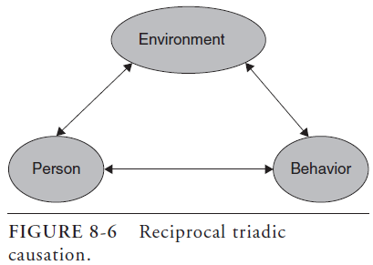
SCT: Reciprocal Triadic Causation
Reciprocal triadic causation: relationships between individuals’ cognitions, behaviors, and environment are reciprocal.
Notes:
The triangle operates as a whole, never as independent parts.

Slide 69
SCT: Reciprocal Triadic Causation
Person in the triad represents the sum of all cognitive attributes (e.g., self-efficacy, outcome expectations, outcome expectancies, etc.)
Considering the relationship of person to environment, person is usually conceptualized as the collective cognitions of a community that define the sociocultural environment
Collective self-efficacy is a community’s perceived ability to shape the environment

Slide 70
SCT: Levels of Readiness
Bandura distinguished three levels of readiness to adopt a given health behavior
These are centered upon self-efficacy and outcome expectations, making them different from the other stage models

Slide 71
SCT: Levels of Readiness
Level 1: High self-efficacy & strong outcome expectations. Little, if any, intervention is needed
Level 2: Doubts about self-efficacy & weak outcome expectations. Multiple intervention points will be required to move them to level one so they can progress to behavior change
Level 3: Belief that personal control over behavior is lacking. Intensive intervention required, the goal involves personal agency- the perception of having any control in performing the behavior

Slide 72
SCT & Research
A common misuse of SCT is to use isolated parts and pieces of the theory instead of using it as a whole
SCT can be seen as a set of principles for designing a health promotion program
Use the five constructs (including sociostructural) to achieve adoption of a specific health behavior
Address self-efficacy building and outcome expectations for those at “level 2” and “level 3”
Devote time to knowledge and developing goals

Slide 73
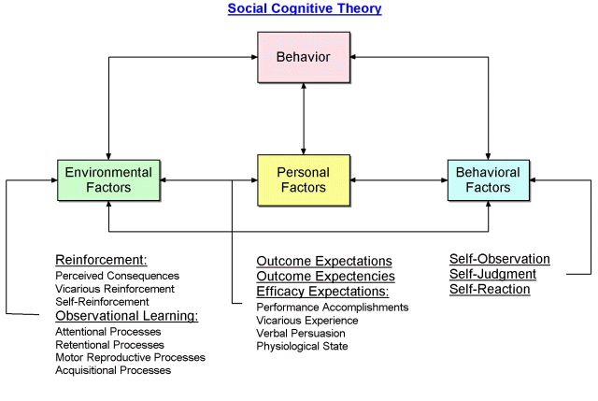

Slide 74
Group exercise – choose a health behavior
Knowledge
Content
Procedural
Perceived self-efficacy
Physiological state
Verbal persuasion
Vicarious experience
Enactive attainment
Outcome expectations and expectancies
Observability & immediacy
Reinforcement
Level of motivation
Goal formation
Well-defined and easy to measure
Sociostructural factors
Identify factors that may enhance or impede adoption of a behavior

Slide 75
Atomic Habits

Slide 76
Final Thoughts: Thank you!
Notes:
Final Thoughts: Taking time to carefully plan all aspects of data collection and study implementation and thoroughly training study staff before you ever begin collecting data will save time and resources spent on correcting errors later. Thank you!

