Slide 1
Topic 11.5
Behavior Change Models Part 3:
Social Networks and
Diffusion of Innovations
Training developed by Kate Eddens, PhD, MPH
Indiana University School of Public Health
Department of Epidemiology and Biostatistics
In collaboration with the Ministry of Health Lao PDR
Training by Applied Nutrition Research Capacity Building (ANRCB), a project of the Lao American Nutrition Initiative (LANI)
This work is made possible through support from USAID/Laos as a supplement to a USAID Cooperative Agreement #7200AA18CA00009
(LASER-PULSE) to Purdue University. Contents reflect the views of the author(s) and do not necessarily reflect those of USAID.
For more information, please contact Catholic Relief Services Laos.

Slide 2
Learning Objectives
Understand what social networks provide in structure, content, and function, including:
  Access to resources, information
  Transmission/imposition of norms and values
  Selection vs. influence
Describe how networks influence individual and community behavior
Explain the social determinants of our social networks
Know how network interventions can influence behavior change
Notes:
Use de la Haye dietary intervention?
Exercise: draw your eating network

Slide 3
Social Networks

Slide 4
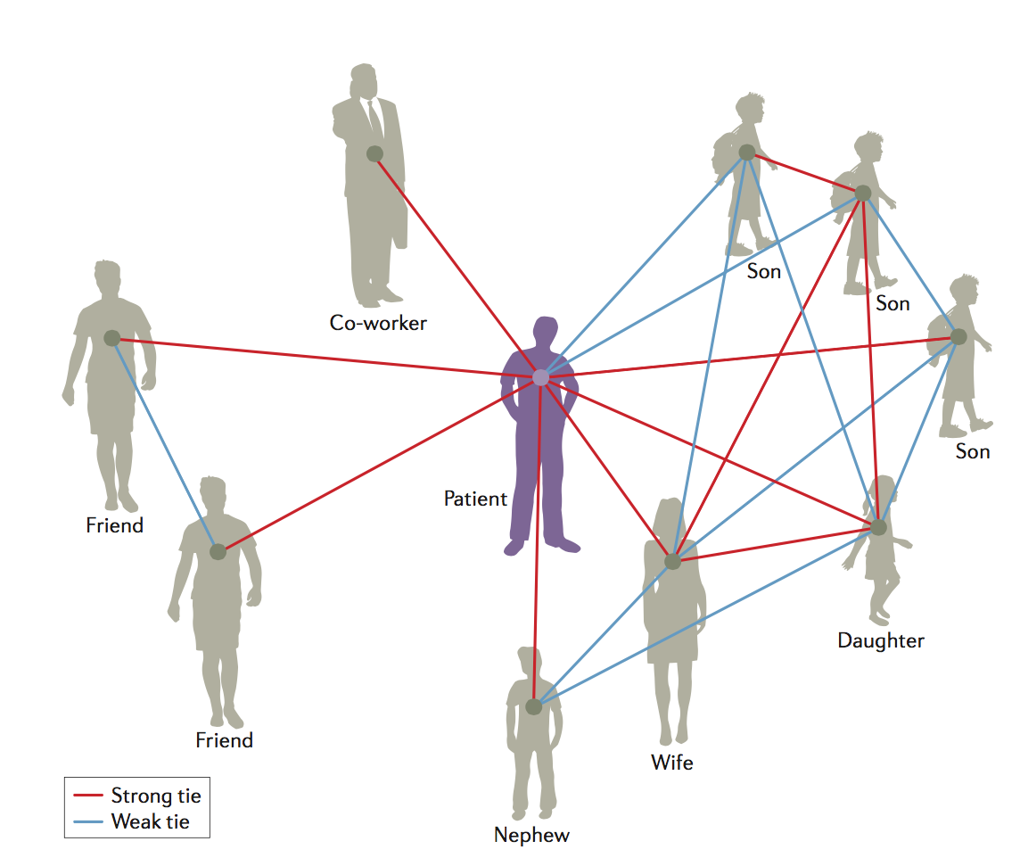
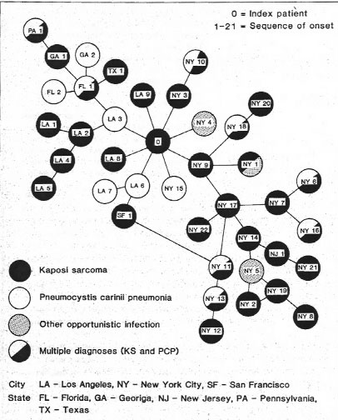








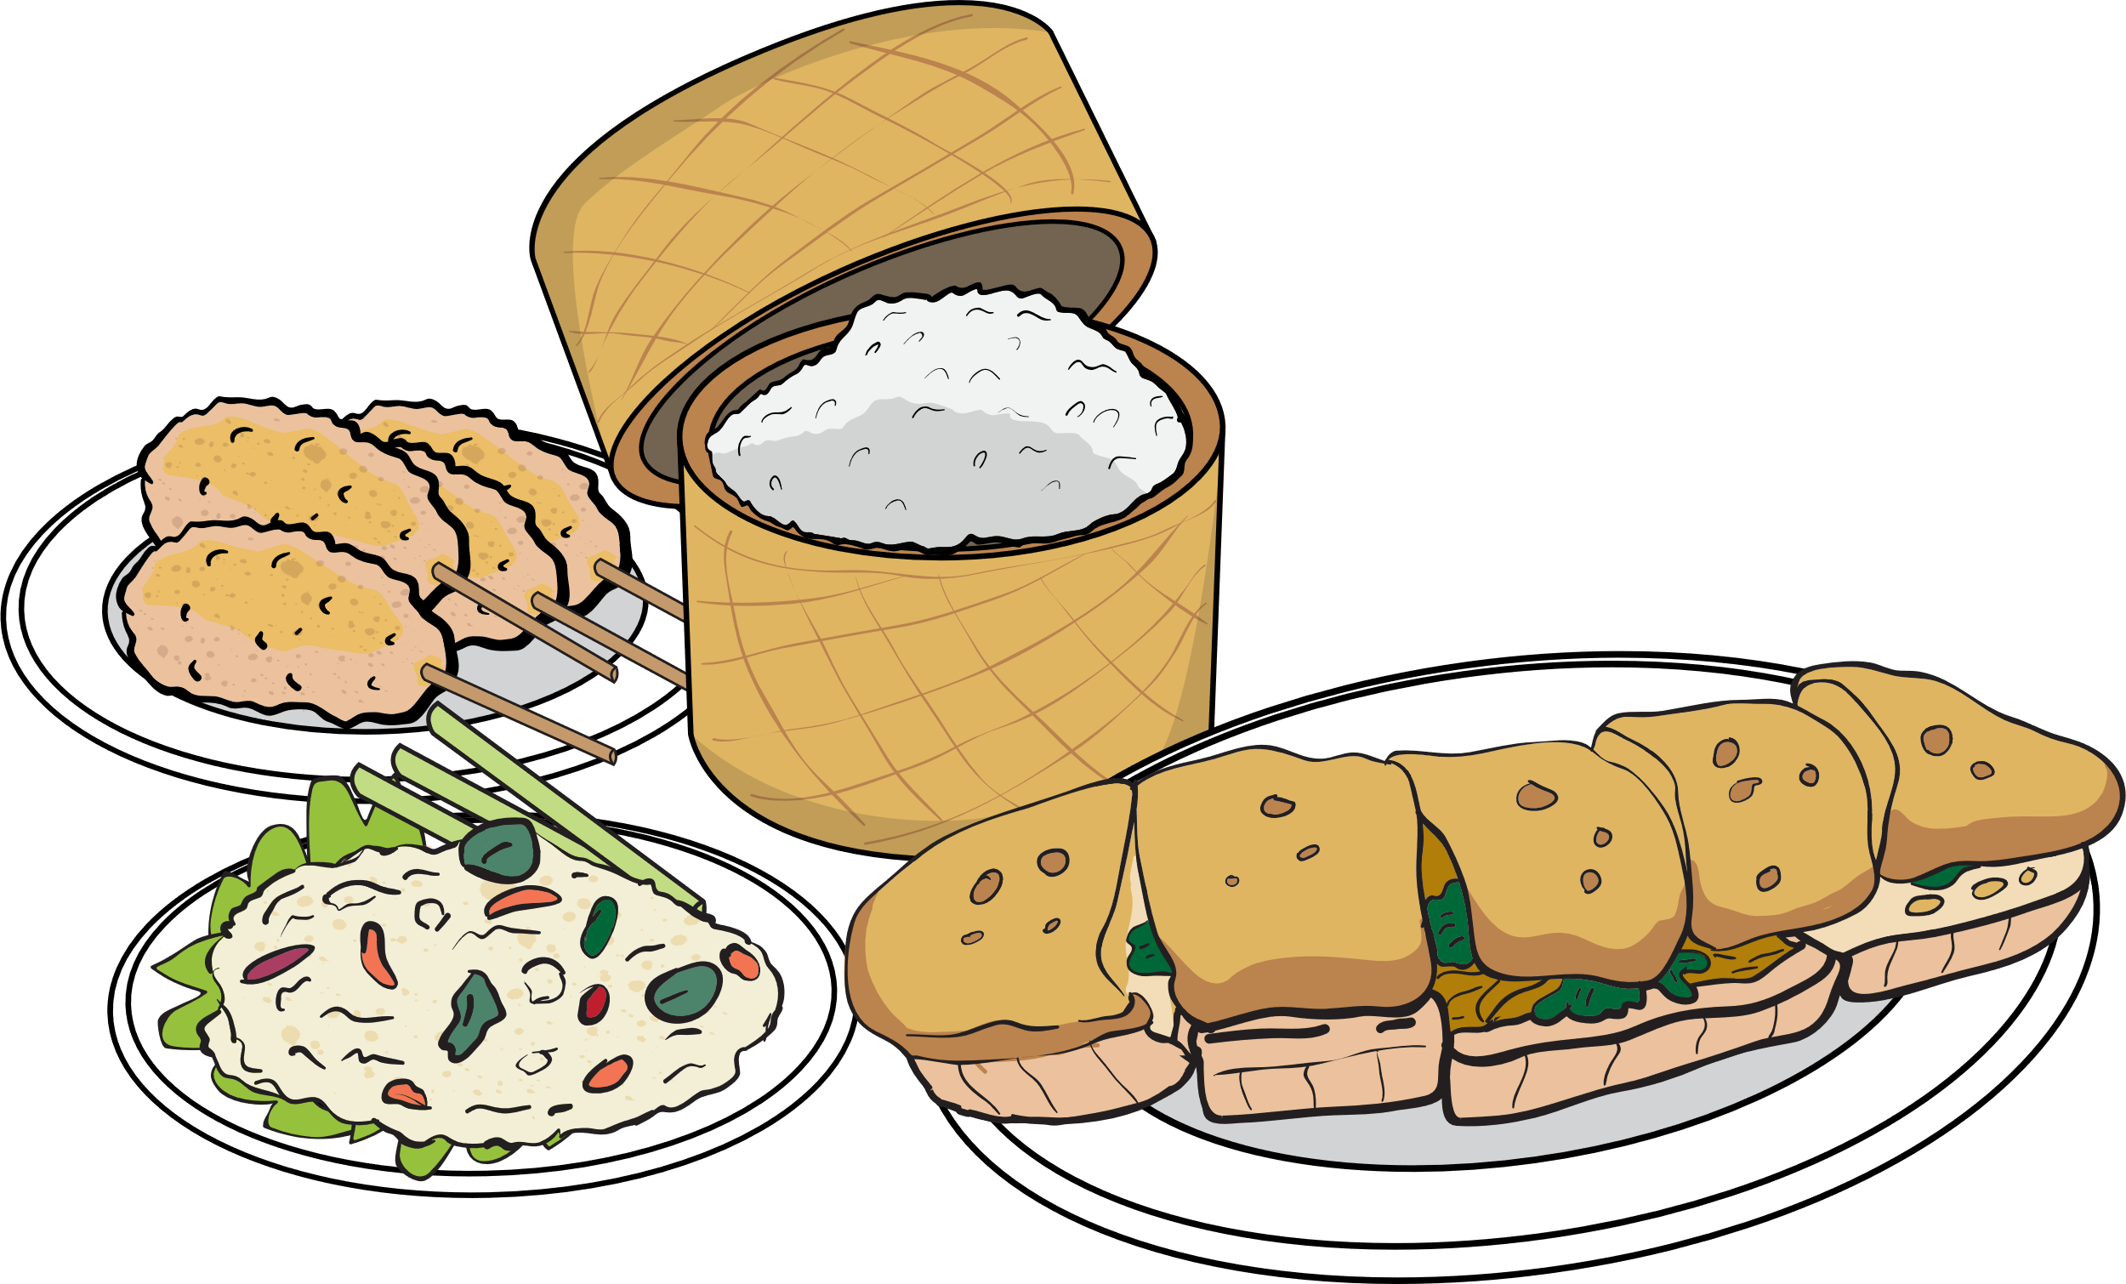
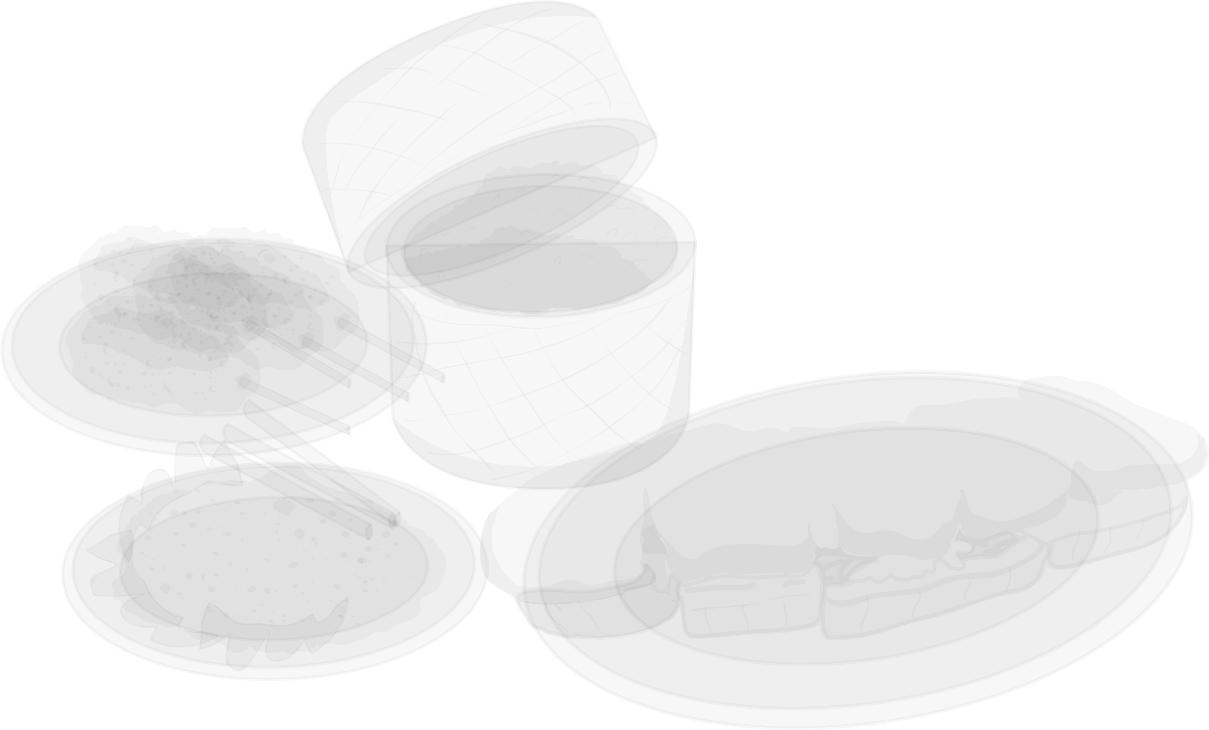
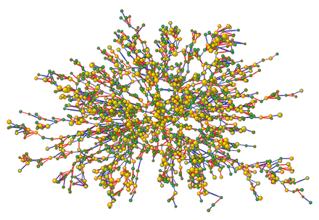
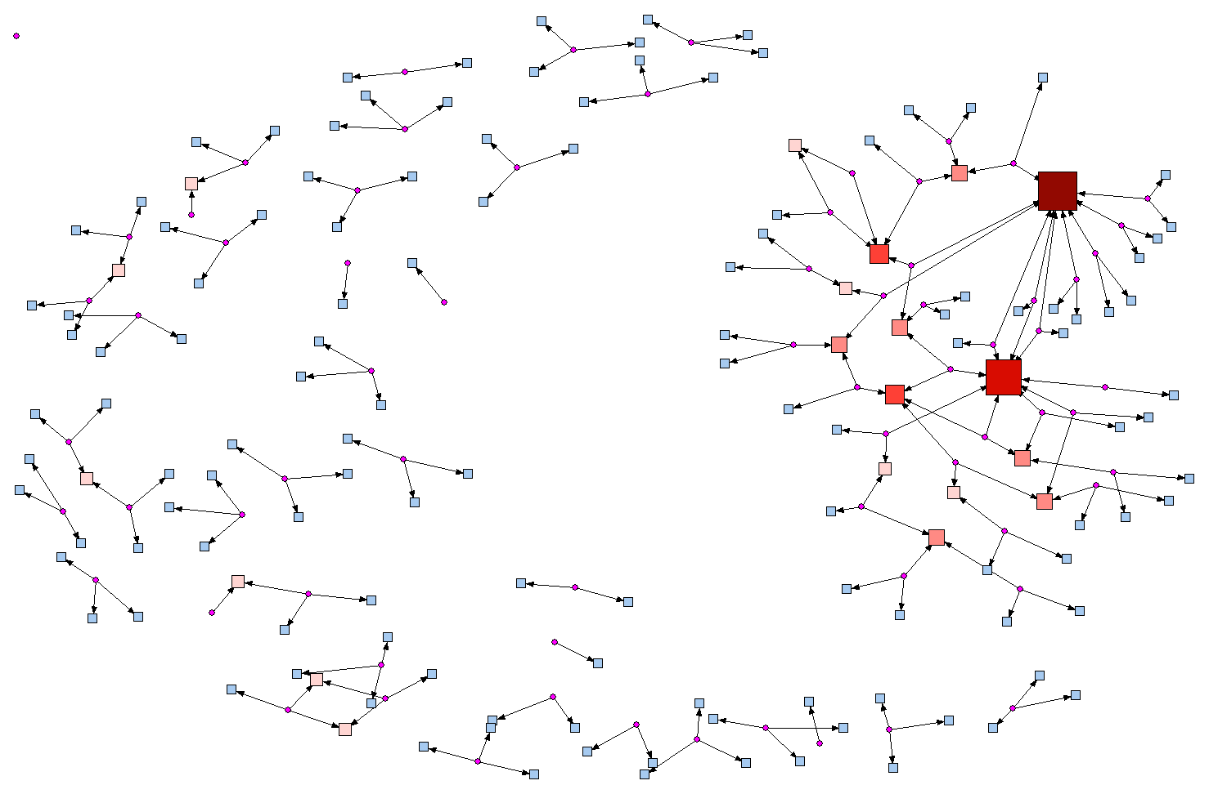
Social Networks in Public Health
Notes:
Networks are an important component of understanding both problems and solutions in public health. We use networks to understand transmission of infectious diseases (click) such as this network of the first cases of HIV in North America, or the spread of behaviors or risks (click) such as this network tracing obesity in participants in the Framingham Heart Study. We can also use networks to understand social support and social resources (click) such as this network of important people in the life of a stroke patient, or (click) this network of trusted sources of health information among men and women in rural Kentucky, USA.

Slide 5
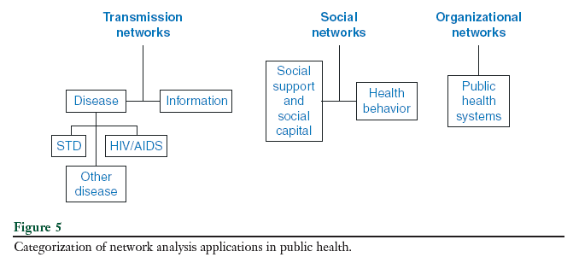
Uses of network analysis in public health
From Luke & Harris (2007)
Notes:
While we use network to understand transmission networks, social networks, and organizational networks in public health…

Slide 6
Network theory & analysis in public health
Structure matters!!!!
“…a node’s position in the network determines in part the opportunities and constraints that it encounters, and in this way plays an important role in the node’s outcomes.”
Borgatti, Science, 2009, p. 894
Notes:
One of the most important points to remember in the role of networks in public health are that structure matters! A node in network terms is usually a person, or an organization, and the node’s position in the network determines the opportunities and constraints that it encounters, which play an important role in the node’s outcomes. In our field, this means where a person is in their network and what their network looks like play are an important influence on our health outcomes.

Slide 7
Berkman & Glass, 2000
Notes:
This is a model of social determinants of health outcomes by Lisa Berkman and XXX Glass. The model shows that upstream factors such as our sociostrucural conditions condition the extent, shape, and nature of our social networks, which provide opportunities for psychosocial mechanisms to impact our health through multiple pathways. Networks operate on health behavior through several pathways: 1) provision of social support, 2) social influence, 3) social engagement and attachment, 4) person-to-person contact, and 5) access to resources and material goods.

Slide 8
How can social networks help us understand and address health disparities?
Notes:
We know that our social networks and our environment are powerful influences on what we know, what we think, what we have, and what we do.

Slide 9
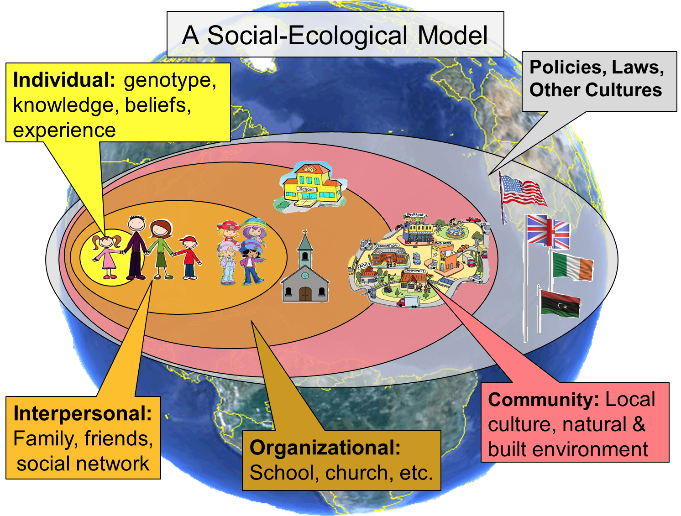
Notes:
We don’t exist in a vacuum. We are influenced, knowingly or unknowingly, by the people around us, the organizations we belong to, the communities we live within, and the policies, laws and culture of our society.

Slide 10
Society
Community, institutions
Social networks
You
Notes:
This is a dynamic relationship, but much of the influence flows from the society and policy level down to shape our communities and institutions, which shape our social networks, which shape us.

Slide 11
Social Conditions
Social Networks
Support
Resources
Information
Health Outcomes
Racism
Sexism
War
Size
Reach
Homogeneity
Social support
Norms, values
Peer influence
Behavior
Risk
Poverty
Geography
Laws
Economy
How often you see each other or talk
Structure
Constraint
Social contact
Physical contact
Access to material goods, information
Psychological
Physiologic
Notes:
However, this doesn’t work equally for everybody. Social conditions like racism, geographic isolation, war, sexism, or poverty can make some people’s networks (click) smaller, or constrained, or tight-knit and comprised of people who are pretty much just like them. (click) This is sometimes very helpful for when you need social support and emotional support, but not great when you need the opportunity to access new information and resources that are different then what everyone in your network already has or knows. When the norms, values, or beliefs of most of your network are harmful -- such as believing a vaccine doesn’t work, or when everyone you know smokes cigarettes – this can have a negative influence on your behavior or can create barriers to your ability to hold differing beliefs or to engage in different behaviors that would be healthier for you. We will talk more about the aspects of this part of the model – what your network provides – later in this presentation. And finally (click), this network support and access to resources and information then greatly influences your health behaviors, your health risks, and both psychological and physiologic aspects of health, like stress or malnutrition.
If your network is healthy and filled with lots of diverse people who give you support and access to new information and opportunities so that you’re constantly evolving, great! If you don’t have a network like that, it can really hurt your opportunities to be healthy.

Slide 12
Social Conditions
Social Networks
Support
Resources
Information
Health Outcomes
Adapted from:
Berkman LF, Glass T. Social Integration, Social Networks, Social Support, and Health. In: Berkman LF, Kawachi I, eds. Social Epidemiology. New York: Oxford University Press; 2000:137-173.
Ackerson L, Viswanath K. The social context of interpersonal communication and health Journal of Health Communication. 2009;14:5-17.
Notes:
I view health inequities through a lens that is derived from Berkman and Glass’s model of social determinants and health coupled with Ackerson and Viswanath’s Structural Information Model of Communication. Essentially, that social conditions shape our social networks, which then create differential opportunities to be exposed to, access, and
Our social networks and our environment are powerful influences on what we know, what we think, what we have, and what we do.

Slide 13
Social Conditions
Social Networks
Support
Resources
Information
Health Outcomes
To access social capital, you must:
Have the resources in your network
Know these resources exist
Activate them!
Notes:
Many people are also unaware of resources embedded in their networks or environment and how they can leverage these resources to support their physical and mental health and well-being. When we think about social capital, for instance, there are three conditions that need to be met: You must HAVE the resources in your network, KNOW those resources exist, and then ACTIVATE them. With my health communication background, I was trained to address health inequities with…

Slide 14
Social Conditions
Social Networks
Support
Resources
Information
Health Outcomes
Reach
Effectiveness
Connections
Notes:
Reach, effectiveness, and connections. The key to this approach is that in order for communication to address health inequities, we have to do a better job of reaching populations affected by inequities, providing information that is meaningful for people in the context of their lives (which is effectiveness), and then go beyond providing information to connect people to services and solutions.

Slide 15
Why are networks important?
Theory – understanding complex systems in nature, society, and science
  Ecological model
  Systems science
    Whole is greater than the sum of its parts
Mechanism
  Reciprocal influence
  Who is in network
  STRUCTURE MATTERS!
Notes:
field of science that studies the nature of complex systems in nature, society, and science.
individuals shape their networks, and their networks shape them
it matters who is in your network
Social networks are not random, particular structures allow or inhibit certain effects
Transmission, adaptation, binding, exclusion

Slide 16
Network theory & analysis in public health
Influence of networks on:
  Mortality
  Disease incidence
  Health-related behaviors
  Opportunity for information, resources, and support
Social epidemiology
Social determinants of health and health behaviors
Effective ways to intervene on health behaviors

Slide 17
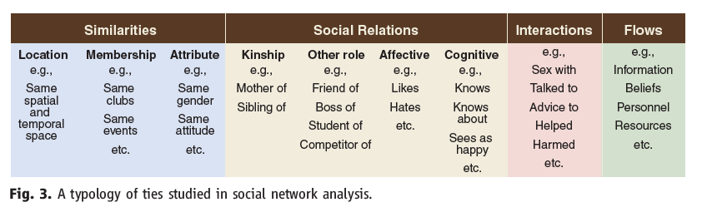
Actor and relationship characteristics
Borgatti et al, Science, 2009
Similarities – how nodes are alike
Social relations – what type of relationship
Interactions – what actions occur between the nodes
Flows – what is transmitted between the nodes
Notes:
Similarities – how nodes are alike
Duration of relationship and reciprocity
Social relations – what type of relationship characterizes the dyad
Interactions – what actions occur between the nodes
Frequency and duration of interaction
Flows – what is transmitted between the nodes
Varying amounts
Multiplexity

Slide 18
Mechanisms of influence
Transmission – direct flow
Adaptation – nodes become more similar
Binding – whole is not the sum of the parts
Exclusion – competition

Slide 19
Mechanisms of influence in public health
Interpersonal influence
Social capital
Transmission
Adaptation
Binding
Exclusion

Slide 20
Network pathways to health behavior
Person-to-person contact
Access to resources and material goods
Provision of social support
Social influence
Social engagement and attachment (selection)

Slide 21
Network pathways to health behavior
Upstream factors
Mechanism of action
Person-to-person contact
Access to resources and material goods
Provision of social support
Social influence
Social engagement and attachment (selection)
Transmission
Adaptation
Binding
Exclusion

Slide 22
Network pathways to health behavior
Upstream factors
Mechanism of action
Person-to-person contact
Access to resources and material goods
Provision of social support
Social influence
Social engagement and attachment (selection)
Transmission
Adaptation
Binding
Exclusion

Slide 23
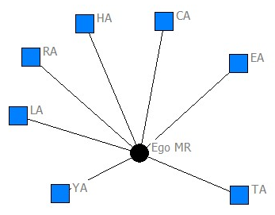

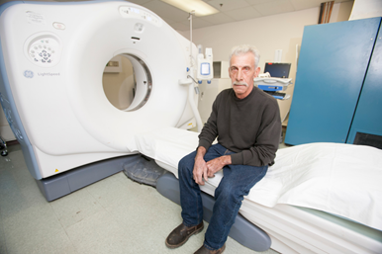
Networks, diffusion, health
Understanding diffusion of a novel test for HPV in Appalachian women
Networks and knowledge of the Affordable Care Act in a low-income 211 calling population
Building a predictive model of acceptance of lung cancer screening in rural Appalachian men and women

Slide 24
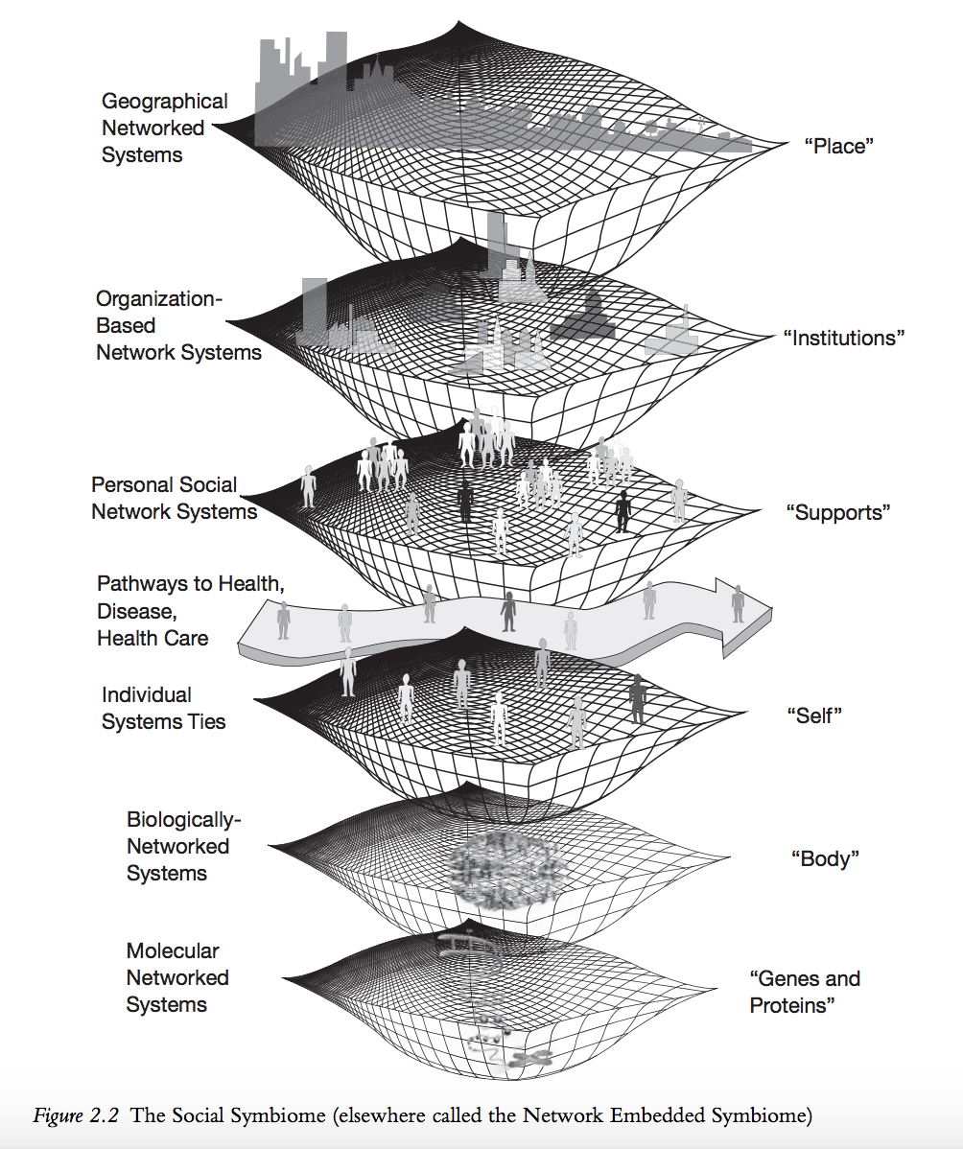
PHI Precision-Medicine to Population-Health (P2P) Study
Over 2,000 Hoosiers
State representative
Multi-level influences on health from gene to environment
Pescosolido, B. A., Olafsdottir, S., Sporns, O., Perry, B. L., Meslin, E. M., Grubesic, T. H., ... Shekhar, A. (2016). The social symbiome framework: Linking genes-to-global cultures in public health using network science. In Handbook of Applied System Science (pp. 25-48). Taylor and Francis Inc.. DOI: 10.4324/9781315748771
Notes:
This framework looks at how at every level of influence on health, there are networks

Slide 25






Eddens K, Kreuter M, Snider R. Screen for Life: Using Targeted Health Messages to Increase Participation in a State Colorectal Cancer Screening Program. Cases in Public Health Communication & Marketing. 2007 June.
Eddens KS, Alcaraz KI, Kreuter MW, Rath S, Greer R. A 2-1-1 research collaboration: participant accrual and service quality indicators. American Journal of Preventive Medicine. 2012;43(6S5):S483–S489.
Alcaraz KI, Arnold LD, Eddens KS, et al. Exploring 2-1-1 service requests as potential markers for cancer control needs. American Journal of Preventive Medicine. 2012;43(6S5):S469 –S474.
Eddens KS. Guiding principles for collaborative research with 2-1-1. American Journal of Preventive Medicine. 2012;43(6S5):S512–S517.
Hall KL, Stipelman BA, Eddens KS, et al. Advancing collaborative research with 2-1-1 to reduce health disparities: challenges, opportunities, and recommendations. American Journal of Preventive Medicine. 2012;43(6S5):S518 –S528.
Purnell JQ, Kreuter MW, Eddens KS, Ribisl KM, Hannon P, Fernandez ME, Jobe D, Gemmel S, Morris M, and Fagin D. Cancer Control Needs of 2-1-1 Callers in Missouri, North Carolina, Texas, and Washington. Journal of Health Care for the Poor and Underserved. 2012;23(2):752-767.
Eddens K, Kreuter MW, Archer K. Proactive Screening for Health Needs in United Way’s 2-1-1 Information and Referral Service. J of Social Service Research. 2011;37(2):113-123.
Notes:
Sometimes this is through communication materials….sometimes through more direct referrals….
I led three projects that focused primarily on increasing the reach and effectiveness of cancer communitcation to raciela dn ethnic minorties and low-income popualtions in missouri
randomized intervention trial with united way 2-1-1 missouri to understand whether we could deliver cancer control referrals through 2-1-1, and how much of an intervention was needed to get callers to act on the referrals.
The importance of developing the partnership, etc, but one of the most important outcomes of the study is that callers who had the reason they called 20101 resolved had higher odds of contacting the received referrals to cancer prevention and control services. Which leads me back to the idea that it’s challenging and sometimes impossible for people to take care of their health when their basic needs – instrumental and emotional – are not being met.

Slide 26
>
Thompson T, Kreuter MW, Boyum S. Promoting Health by Addressing Basic Needs: Effect of Problem Resolution on Contacting Health Referrals. Health Education & Behavior 2016;43(2):201–207
Notes:
but one of the most important outcomes of the study is that callers who had the reason they called 20101 resolved had higher odds of contacting the received referrals to cancer prevention and control services. Which leads me back to the idea that it’s challenging and sometimes impossible for people to take care of their health when their basic needs – instrumental and emotional – are not being met. In fact, in the 211 RCT we found that those who had all of their needs resolved had higher odds of contacting referrals than those who did not have all their needs resolved. And, those who were in the navigator condition had higher odds of contacting referrals than those who were in the tailored materials or referral only conditions.

Slide 27
Unmet basic needs
Social support
Provider recommendation
(mammogram)
Kreuter MW, Eddens KS, Alcaraz KI, et al. If you refer them, will they call? Use of cancer control referrals by 2-1-1 callers: a randomized trial. American Journal of Preventive Medicine. 2012;43(6S5):S425–S434.
Notes:
The navigation arm was most important for those with a high number of unmet basic needs, with low social support, and who did not receive a provider recommendation. This is important as a network person – people who have low network support and network resources (in provider recs) need the navigator to act on these referrals. this indicates to me that the navigator is serving a role in the participant’s social network – they need this extra help that may not exist in their network.

Slide 28






Unmet basic needs
Social support
Provider recommendation
(mammogram)
Kreuter MW, Eddens KS, Alcaraz KI, et al. If you refer them, will they call? Use of cancer control referrals by 2-1-1 callers: a randomized trial. American Journal of Preventive Medicine. 2012;43(6S5):S425–S434.
Notes:
The navigation arm was most important for those with a high number of unmet basic needs, with low social support, and who did not receive a provider recommendation. This is important as a network person – people who have low network support and network resources (in provider recs) need the navigator to act on these referrals. this indicates to me that the navigator is serving a role in the participant’s social network – they need this extra help that may not exist in their network.

Slide 29
Social Conditions
Social Networks
Support
Resources
Information
Health Outcomes
Interventions
Notes:
IF we revisit this model, the 2-1-1 studies focused on reach by integrating referrals into an existing system that already reaches people in need. Social services can be effective ways to reach low-income populations. Reaching populations, particularly women – through services such as food stamps, WIC, or unemployment office can be very effective. Then we can immediately connect these folks to cancer prevention and control services. If you’d like to hear about other interventions using social services, please contact me.

Slide 30
Early work – Social support & mortality
Social connectedness or integration
Fewer links, or more isolation = higher mortality
Social support
M
K
L
B
A
C
E
N
D
Notes:
Between 1979 and 2010, there were at least 17 prospecitve cohort studies inking social isolation and all-cause mortality, and many more showing increased risk of mortality from CVD, stroke, diabetes, cancer, and more. Most used the Berkman-Syme Social Netowrk Index, which is really a measure of social support and connections with organizations.

Slide 31

Network measurement in public health
Proxies for networks
Egocentric networks
Sociocentric networks
Berkman-Syme Social Network Index
Marital status
Sociability
Church member
Other membership

Slide 32
Network Terminology

Slide 33
Network characteristics
M
Actor
Relationship
Network
K
L
B
A
C
E
D
N

Slide 34
Network characteristics
M
Actor, node
K
L
B
A
C
E
D
N
Notes:
Size, or the number of people in a network;

Slide 35
Network characteristics
M
Actor, node
Lines, edges, ties
  Undirected
K
L
B
A
C
E
D
N

Slide 36
Network characteristics
M
Actor, node
Lines, edges, ties
  Undirected
  Directed
K
L
B
A
C
E
D
N

Slide 37
Network characteristics
M
Dyad
K
L
B
A
C
E
D
N

Slide 38
Network characteristics
M
Dyad
Triad
K
L
B
A
C
E
D
N

Slide 39
Network characteristics
M
Dyad
Triad
Clique
K
L
B
A
C
E
D
N

Slide 40
Network characteristics
M
Dyad
Triad
Clique
Groups
K
L
B
A
C
E
D
N

Slide 41

Ego
Notes:
In egocentric/ego networks/personal networks you start with one person, who is the ego

Slide 42



Ego
Alters
Notes:
You then ask them to name people in their network, called alters. Using a name generator question

Slide 43
Ego
Ties to alters
Notes:
You ask about the ego’s ties to the alters, which usually represent some kind of relationship or transaction

Slide 44
Ego
Ties between alters
Alters
Ties to alters
Notes:
You can also ask about the ties between alters in the network, or how the people you know know one another

Slide 45
Ego
network
Notes:
What results is a personal network or ego network. You can ask questions to further characterize the people in the network as well as the relationships, and then look at how these network members affect the ego in some way

Slide 46
Tie characteristics
Direct or indirect links
Frequency
Stability
Multiplexity
Strength
Direction
Reciprocity

Slide 47
Interpersonal communication and health
Reproductive health campaigns
HIV/AIDS peer influence campaigns
Interventions in social networks
  Opinion leaders
  Popular opinion leaders
  Lay health advisors
  Market mavens

Slide 48
Structural Influence Model of Communication (SIM)
Ackerson & Viswanath, 2009
Notes:
Health communication disparities in access, understanding, generation, manipulation, and distribution of info, as well as access to and ability to take advantage of info

Slide 49

Social support and social capital
Notes:
Most early social network and mortality studies are actually measuring social support.
SS – individual level support from friends, family members
How social structure and relationships act to promote or influence health and health behavior
Social Support
Social Capital
SC -- membership in larger social networks that facilitate access to resources (church, neighborhood, community, state, etc)

Slide 50
Social support
Individual level measure of the
amount of perceived or actual resources
available to a person
through the quality and quantity
of his or her social ties
Notes:
1) emotional support providing love, caring, and understanding; 2) instrumental support, providing assistance with tangible needs such as transportation, money, or other aid; 3) appraisal support, or help in decision making and feedback; and 4) information support, or giving information and advice for particular needs

Slide 51
Social support
Four dimensions:
Emotional support
Instrumental support
Appraisal support
Informational support
Notes:
1) emotional support providing love, caring, and understanding; 2) instrumental support, providing assistance with tangible needs such as transportation, money, or other aid; 3) appraisal support, or help in decision making and feedback; and 4) information support, or giving information and advice for particular needs

Slide 52
Social support benefits
Greater social support =
  Greater mental health
  Greater self-reported health
  Greater well-being
  Reduced mortality
Notes:
Risk of death was 2.3 times higher for men and 2.8 times higher for women considered “isolated” by limited ties (Berkman & Syme, 1979)
Having a large social network reduced the risk of family homelessness for low-income single mothers (Bassuk et al, 1997)
Couples – spouses mortality/ morbidity after partner death, also depression
Dynamic process…

Slide 53
Disadvantaged social support networks
Burn-out:
  Social support networks for mental health patients “burn out” over time (Biegel et al, 1995)
Size:
  Social support networks for HIV patients are smaller than for other groups (Shelley et all, 1995)
Homogeneity:
  Networks of low-income HIV+ IDUs consist primarily of other low-income HIV+ IDUs (Knowlton, 2003)
Notes:
Individuals experiencing mental and physical health problems have disadvantaged networks: Burn-out:
Social support networks for mental health patients “burn out” over time (Biegel et al, 1995)
Size:
Social support networks for HIV patients are smaller than for other groups (Shelley et all, 1995)
Homogeneity:
Networks of low-income HIV+ IDUs consist primarily of other low-income HIV+ IDUs (Knowlton, 2003)

Slide 54
Social capital
Resources embedded
in a social structure which are
accessed and/or mobilized
in purposive actions
(Lin, 1999)
Notes:
Cognitive components include norms, values, trust, obligations, reciprocity, attitudes and beliefs
Structural components include visible aspects, such as density of social networks, civic associations, and patterns of civil engagement.⁵⁵
Cognitive social capital is thought affect health by shaping behavioral norms through controlling risk behavior, and the mutual exchange of information, aid, and support.^{55, 56}
Structural social capital, in turn, is shaped by macro-level policies, institutions and culture.

Slide 55
Social capital
Structural -- resources embedded in a structure
Opportunity -- accessibility to the resources
Use - use of or mobilization of resources
Notes:
Cognitive components include norms, values, trust, obligations, reciprocity, attitudes and beliefs
Structural components include visible aspects, such as density of social networks, civic associations, and patterns of civil engagement.⁵⁵
Cognitive social capital is thought affect health by shaping behavioral norms through controlling risk behavior, and the mutual exchange of information, aid, and support.^{55, 56}
Structural social capital, in turn, is shaped by macro-level policies, institutions and culture.

Slide 56
Social capital
Is a collective, or group-level dimension
Cognitive components
  Norms, values, trust, beliefs
Structural components
  Civic associations
  Density of social networks
Notes:
Cognitive components include norms, values, trust, obligations, reciprocity, attitudes and beliefs
Structural components include visible aspects, such as density of social networks, civic associations, and patterns of civil engagement.⁵⁵
Cognitive social capital is thought affect health by shaping behavioral norms through controlling risk behavior, and the mutual exchange of information, aid, and support.^{55, 56}
Structural social capital, in turn, is shaped by macro-level policies, institutions and culture.

Slide 57
Social capital and well-being
Influence health related behaviors
Influence access to services
Affect psychosocial processes
Social capital is associated with better health:
Regular involvement in informal networks (neighborhoods, churches) was positively associated with better mental health (Ziersh, 2005)
Social cohesion in neighborhoods predicted lower rates of violence (Sampson et al, 1997)
Notes:
Broken windows theory; social capital leads to more advocacy, leads to better access to health like clinics, etc.

Slide 58
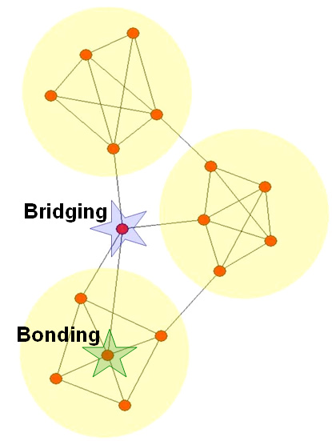
Bonding and bridging patterns
Leadership roles based on position in network
  Bonding
  Bridging
From Hoppe & Reinelt (2006), based on Robert Putnam

Slide 59
Social networks and health behavior
Notes:
Most early social network and mortality studies are actually measuring social support.
SS – individual level support from friends, family members
How social structure and relationships act to promote or influence health and health behavior
Social Support
Social Capital
SC -- membership in larger social networks that facilitate access to resources (church, neighborhood, community, state, etc)

Slide 60
Network-level characteristics and health behavior
Network variables explain
individual behavior
Positively related to behavior change:
Connectedness
Integration
Diversity
Notes:
Network variables explain individual behavior as mediator between non-network variables and behavior change. SO, non-network INDIVIDUAL variables like age, or SES and characteristics of the network links (such as spatial distance or homophily) are d
One’s personal communication network forms a social environment that influences the individual’s behavior. Specifically:
-Individual Connectedness positively related to behavior change
-Individual integration is positively related to individual behavior change
-Individual Diversity is postively related to behavior change

Slide 61
Network-level characteristics and health behavior
Network variables explain
individual behavior
Positively related to behavior change:
Connectedness
Integration
Diversity
Radial vs. Interlocking
Notes:
Radial networks...

Slide 62
Network-level characteristics and health behavior
Network variables explain
individual behavior
Positively related to behavior change:
Connectedness
Integration
Diversity
Radial vs. Interlocking
Notes:
like a star, with ties to others but not between those one others, are information rich.

Slide 63
Network-level characteristics and health behavior
Network variables explain
individual behavior
Positively related to behavior change:
Connectedness
Integration
Diversity
Radial vs. Interlocking
Notes:
Interlocking networks, with dense ties connecting everyone to one another, are influential.

Slide 64
Network-level characteristics and health behavior
Structure matters!
  Isolates: Risky behavior
  Cliques: Popular students & norms
  Perceived risk: Cliques, bridges & STD risk
  Perceived norms: Social group norms and mammography
Notes:
Position of an individual within their social network is associated with their health behavior:
Adolescents in isolated positions have higher odds of smoking (Ennett & Bauman, 1993), Smoking, alcohol
Popular students (in cliques) were more likely to follow the behavioral norms of the school (Alexander et al, 2001), and membership in cliques is influential on behavior IF membership in that clique is important to you
Threshold effect – you won’t chang your behavior until enough others in your network do
Individuals in cliques or in bridge positions were less likely to use condoms than isolates because they perceived a lower level of risk (Bettinger et al, 2004)
Women whose social groups consider mammograms as normative are more likely to have mammograms (Allen et al, 1999)

Slide 65
Social influence versus social selection
Q
U
Green = smokers
Blue = non-smokers
R
P
M
K
T
L
S
O
B
A
C
E
N
D

Slide 66
Social influence versus social selection
Q
U
Green = smokers
Blue = non-smokers
K = social influence
N = social selection
R
P
M
K
T
L
S
O
B
N
A
C
E
D
Notes:
Similar results for alcohol, risk-taking, and obesity. BUT, less so if you don’t care what other people think, and also, smoking status is more important in CHOOSING friends than in maintaining friends.
Similar results in adults for weight-loss. Interventions in individuals trigger weight loss in friends, and peer norms are important predictors od health behaviors in adulthood. This is important when you think of what norms are in select groups. For example African Americans were less likely to know someone who had knee replacement surgery, and were less likely to think this surgery was beneficial.
BOTH are evident, both are important

Slide 67
Empirical evidence of network size/position on health behavior
Size/connectedness inversely related to risky behaviors
Levels of social support related to health promoting behaviors
Social position related to behaviors
  Substance use
  Delinquency
  Bullying
  STD risk
  Health care utilization
  Weight gain and loss
Notes:
Risky behaviors = tobacco and ETOH use, physical inactivity, obesity
Health promoting behaviors such as exercise and smoking cessation
And social position – being central to a network, being a bridge or a broker, etc --

Slide 68
Empirical evidence – Peer influence
Isolates
  Smokers, risk-takers, smoked if best friend did
  Drifted towards risk-taking groups
Cliques
  Less smoking, less affected by friend or BFF smoking
  Shifted to risk-taking behaviors over time
Liaisons
  Less smoking, more risk for abuse b/c norm exposure
Popular kids
  More smokers, or reflected norms of the school
Notes:
In primarily cross-sectional and longitudinal studies of adolescents, we see that the behavior of adolescents’ friends influence the initiation, continuation, and cessation behavior for tobacco and alcohol use.

Slide 69
Social selection vs. social influence?
Influence and selection matter in group smoking
Similarity in smoking important in choosing friends
Peripheral members select into smoking groups
Peer smoking important when concerned about friend reaction
Popular kids and school norms
Friend smoking assoc. w/ smoking and not quitting
Marrying nonsmoker/decreasing smoking friends
Notes:
So, when looking at primarily longitudinal studies, we find that there is evidence for social selection as well as social influence. Both matter when looking at peer group smoking homogeneity.
Similarity in smoking status is more important in choosing friends than in maintaining friendships.
There is similar evidence of peer influence in bullying and weight gain/loss.
It’s still difficult to discern social influence and social selection, but as SNA techniques progress, we’re able to find more reliable methods of network modeling and using longitudinal sociometric data.

Slide 70
What does it mean?
In adolescents:
  Isolates are more likely to engage in risky behavior
  Belonging to a clique influences norms...behavior
  May choose to belong to a group with similar norms
Interventions in adolescents
  Change norms of network
  Increase involvement in network
Notes:
So interventions designed to change the norms of an individual's network or to increase involvement in a network that supports the target norm may be more effective in influencing that individual’s behavior in adolescents.

Slide 71
What does it mean?
In adults:
  Weight-loss in friends/networks
  Alcohol and tobacco in siblings
  Peer perception of BC screening as a norm
  Close friends predictor of mammography
  Knowing someone with knee surgery
Notes:
We see similar results in adults. In a meta-analysis of weight-loss interventions in adults, interventions in individuals have been shown to trigger weight loss in friends. Another review of weight-loss literature found intervnetions targeted to social networks are more effective than those that target individuals.
There are sibling effects of alcohol and tobacco use that are independent of genetic risk, and non-supportive family members can hinder an individual’s efforts to engage in healthy behaviors.
In a worksite based cross-sectional study, peer perception of breast cancer screening as the norm was predictive of regular screening, and in a network study of low-income, older Mexican-American women, the number of close friends was the most important predictor of mammography.
Finally, a sample of African Americans, who were less likely to know someone with a hip or knee replacement, were less likely to believe these surgeries would be beneficial.

Slide 72
Notes:
http://content.nejm.org/cgi/content/full/357/4/370/DC2

Slide 73
Selection / Assortative mixing
Assortative mixing: you choose others like you
Adaptation: you become more like others around you
Which is it?
Bearman, Moody, Stovel, Chains of affection: The structure of adolescent romantic and sexual networks, American Journal of Sociology 110, 44-91 (2004).
Notes:
People tend to choose similar others or relationships, which is known as homophily, or assortative mixing. In studies of social relationship choice, attitudinal homophily tends to be more important than demographic homophily. But this can lead to very homogenous networks.
It’s difficult for studies to distinguish between the effects of homophilous selection and the effects of similarity through adaptation on health behaviors and outcomes.
But it’s usually BOTH.

Slide 74
Interventions
Observe networks over time
Use networks to identify risky subsets
Incorporate peer networks
  for marginalized populations; IDUs and HIV prevention
  Smoking and EtOH cessation in peers
  Social norms campaigns
PA, condom use, smoking = effective
Breastfeeding, medication adherence ≠ effective
Notes:
Perhaps the most important implication of identifying network characteristics and their influence on behavior is the development of appropriate and effective interventions.

Slide 75
Interventions with interpersonal components
Who delivers message as important as message
Interpersonal communication important influence
Differential access to information leads to health disparities
Notes:
Health interventions with interpersonal components have been very effective.

Slide 76
Interpersonal communication and contraception
Women discuss with similar women, but not men
Number of known methods increased as women acquire information
Association between method used and perceived method used by network members
More likely to use contraception if network norm
Social learning and social influence differences
Kohler, Behrman & Watkins, Demography. 2001;38(1):43-58
Notes:
Evidence primarily from international-based studies shows that interpersonal network communication about family planning or sexual risk-reduction is overall, associated with increased use of contraception and risk-reduction behaviors.
Both social learning -- learning about others’ experiences through information, thereby reducing uncertainty – and social influence – adopting behaviors that are norms of their peers – are effective, social LEARNING seems to dominate in family planning.
Overall, family planning was discussed more with similar or homophilous others, and ideas and experiences were transmitted through IPC networks. Women who had contracpetive users and advocates in their networks were more likely to use contraceptives, and to use similar methods as those in their network. Having more links OUTSIDE their network led to more knowledge and approval of family planning methods.
Participation in market activities lowers the importance of having contraceptive users in ones’ network on influencing use. If she goes to the market (where she’s exposed to more information) fewer network partner users of contraception are needed to positively influence contraceptive adoption. In contrast…

Slide 77
Interpersonal communication and contraception
Homophilous, restricted, segmented sexual communication networks in Channai, India
Unmarried women only talk to one another and family members
Men talk to married men, unmarried men, and married women
Spread of health-damaging behaviors and advice
Sivaram, et al. Health Promotion International, 2005;20:327-333

Slide 78
Interpersonal communication and contraception
Learn about options and experiences
Learn where to get the method
Source of social approval and support
In contraception, social learning > social influence
Notes:
So what we found here is that IPC about contraception serves as a source of information to LEARN about options and EXPERIENCES with the contraception, a means of learning where to GET the method, a source of social APPROVAL and SUPPORT for adoption and use.
There’s a recurring theme that social learning tends to have more influence in cntracpetive knowledge and adoption than social influence – it’s the sharing of information and experiences in uncertain situations with something unknown that is influential, not necessarily the social norms surrounding an innovation.

Slide 79
Peer-based and opinion-leader interventions
Popular opinion leaders
Opinion leaders
Lay health workers
Market mavens
Notes:
POLS: Very effective for STD/HIV interventions, initiate conversations, change norms of the community,
Peer-led IDU harm-reduction interventions to use IPC and model risk-reduction behaviors for IDUs. Use former IDUs to do it.

Slide 80
Peer-based and opinion-leader interventions
Trusted community members
Trained to deliver information and affect behavior and norms
Similar to network members in attitudes, values and demographics
Motivated by altruism and having knowledge or position
Notes:
HIV prevention interventions that change group norms are effective. One of the more effective MSM HIV prevention intervnetions – the Mpowerment project – focused on changing the behavior of network leaders, leading to changes in behavioral norms.
Valente found that implementing a tobacco prevention intervetion using peer-nominated leaders had the effect of accelerating peer influence – those networks that supported NON-use decreased use, but those that supported use INCREASED use.

Slide 81
Network interventions
Know and understand networks and behavior
Identify subgroups for focused interventions
Use peer networks and peer leaders
Sociometric tailoring
Notes:
Perhaps the most important implication of identifying network characteristics and their influence on behavior is the development of appropriate and effective interventions.
Sociometric – tailor on position; hubs for some behaviors and isolates for others

Slide 82

Final Thoughts:
Thank you!
Notes:
Final Thoughts:
Taking time to carefully plan all aspects of data collection and study implementation and thoroughly training study staff before you ever begin collecting data will save time and resources spent on correcting errors later.
Thank you!

