Slide 1
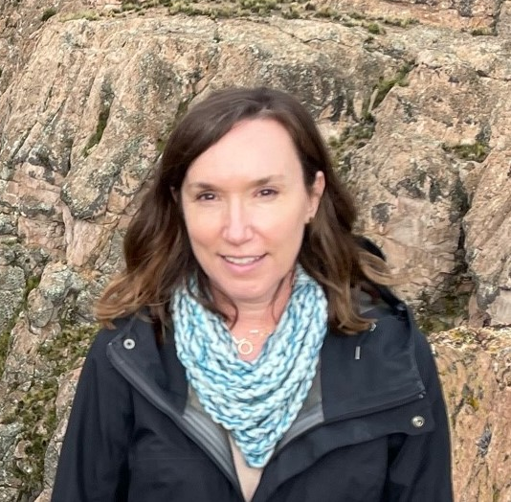


The Arequipa NEXUS Institute
What is it, what have we accomplished, how are we are trying to build on our success moving forward, and how can you get involved in projects in Peru?
Lori Hoagland, PhD
Professor, Soil Microbial Ecology, Dept. of Hort. & Land. Arch.
Co-Director, Arequipa NEXUS Institute
Faculty Fellow, Office of Global Partnerships

Slide 2

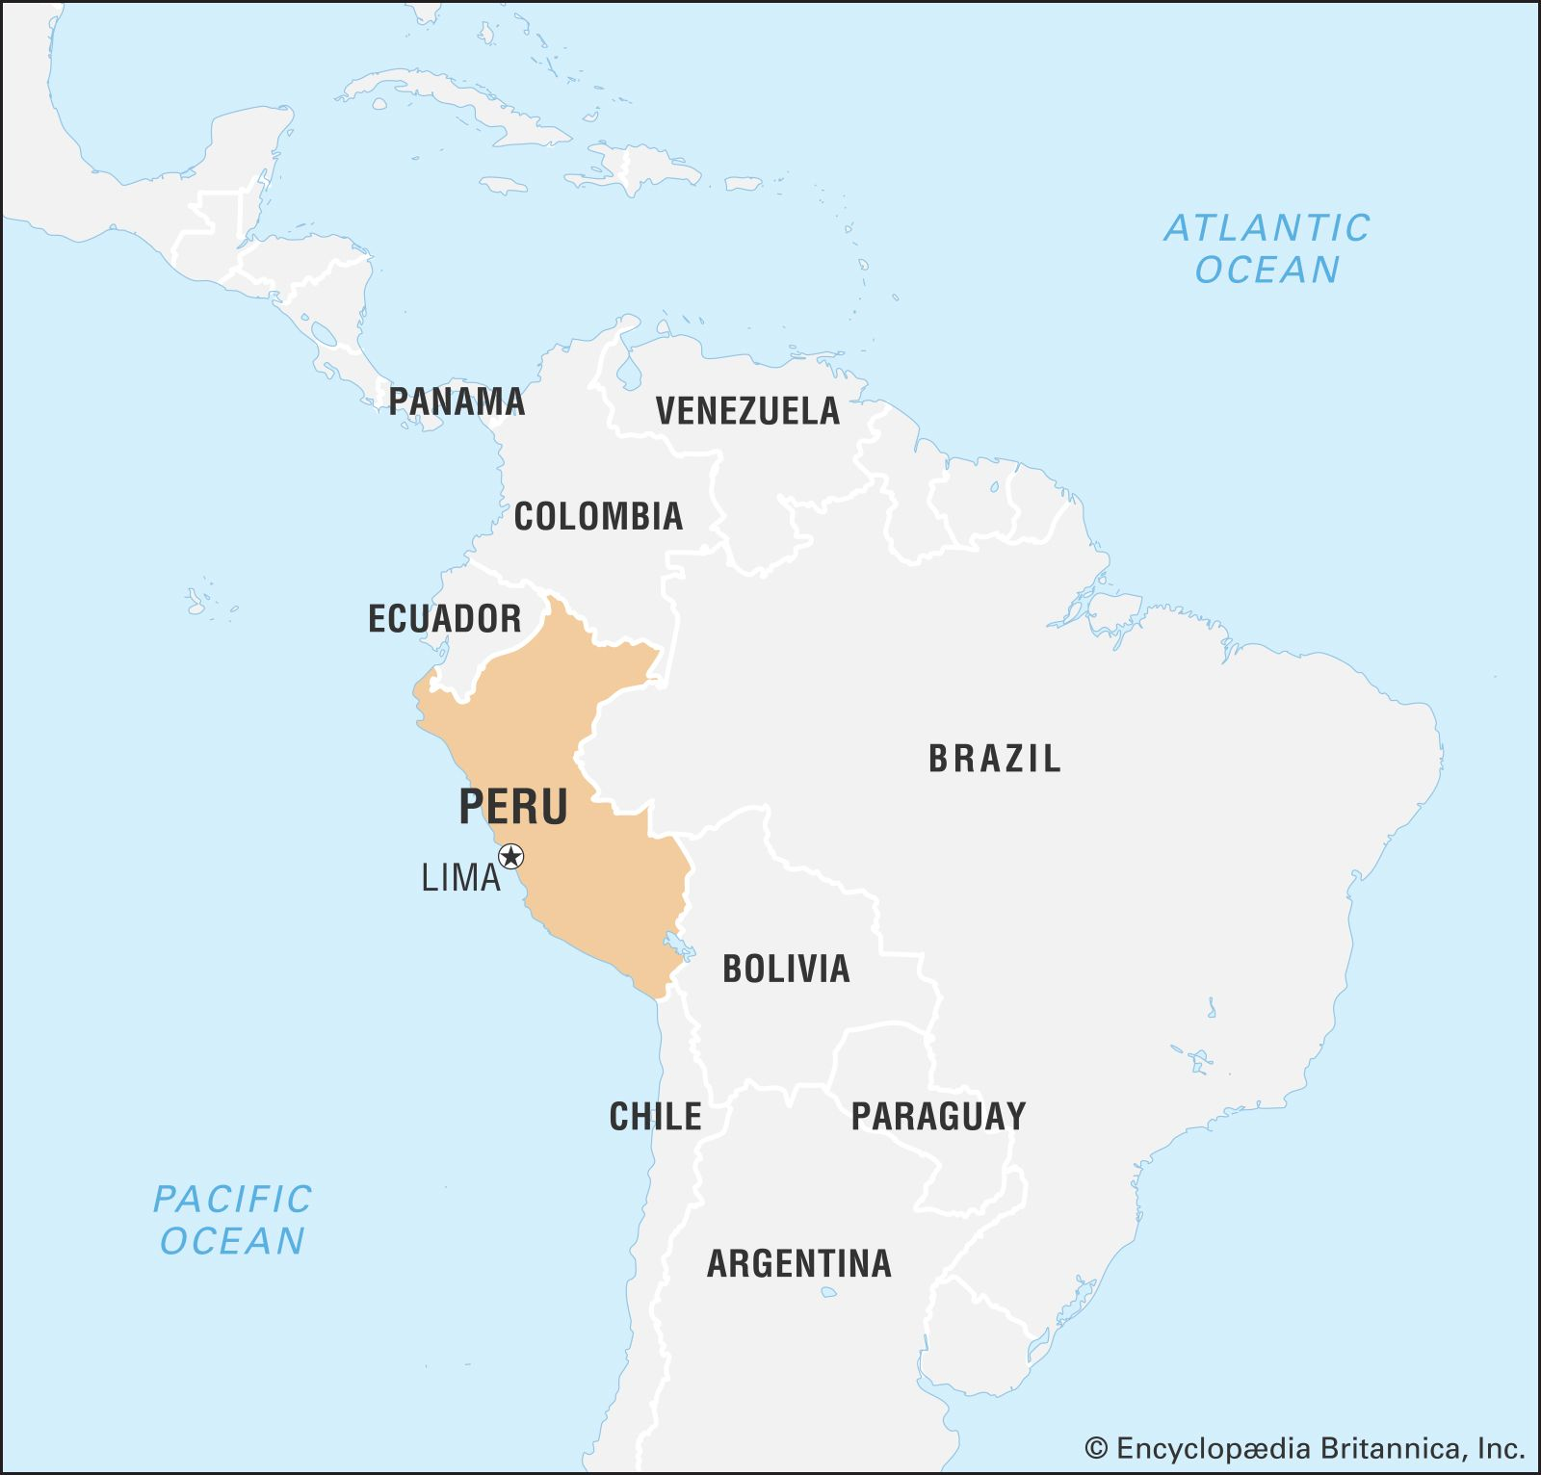
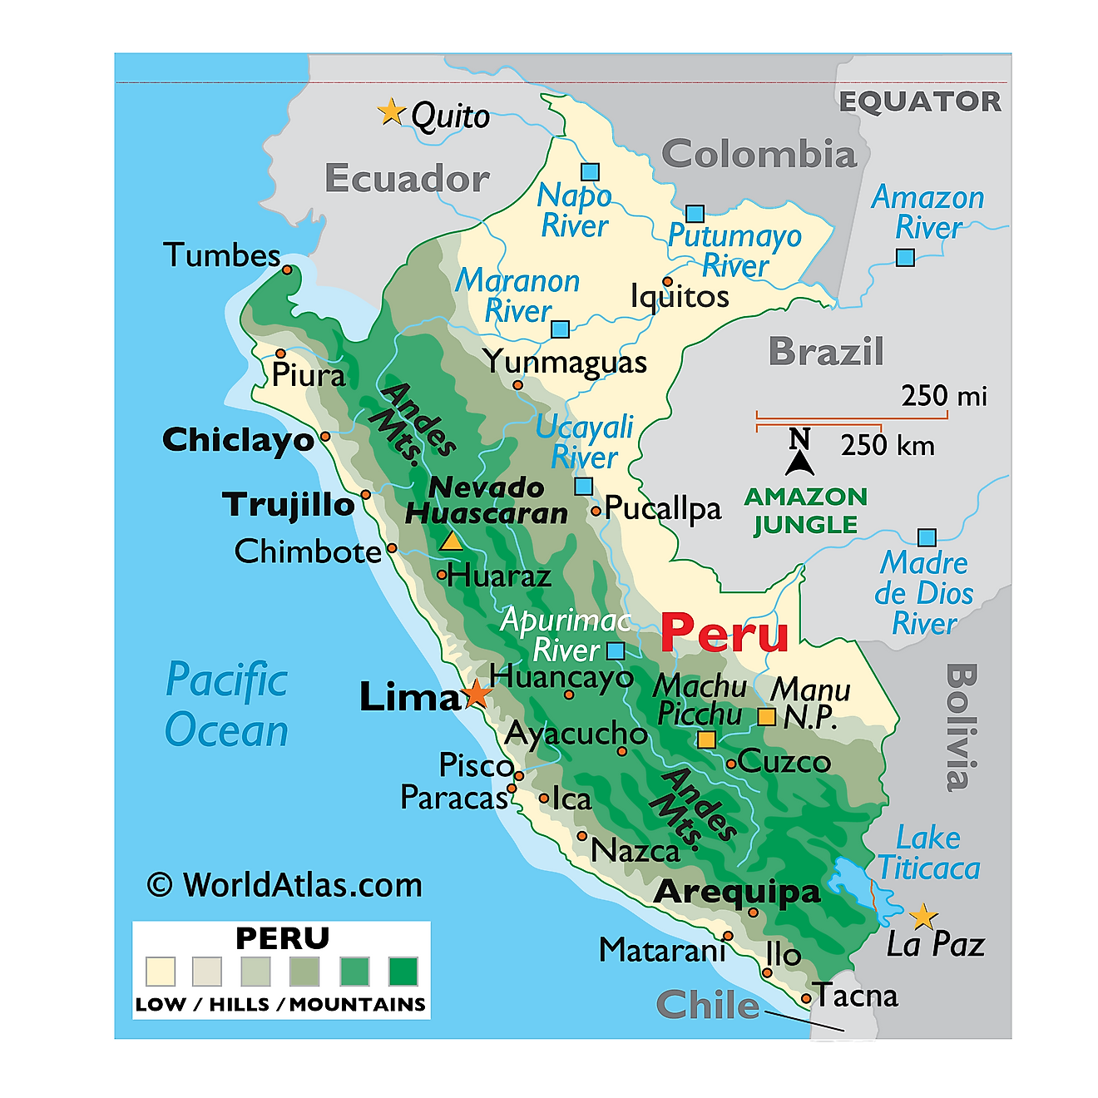
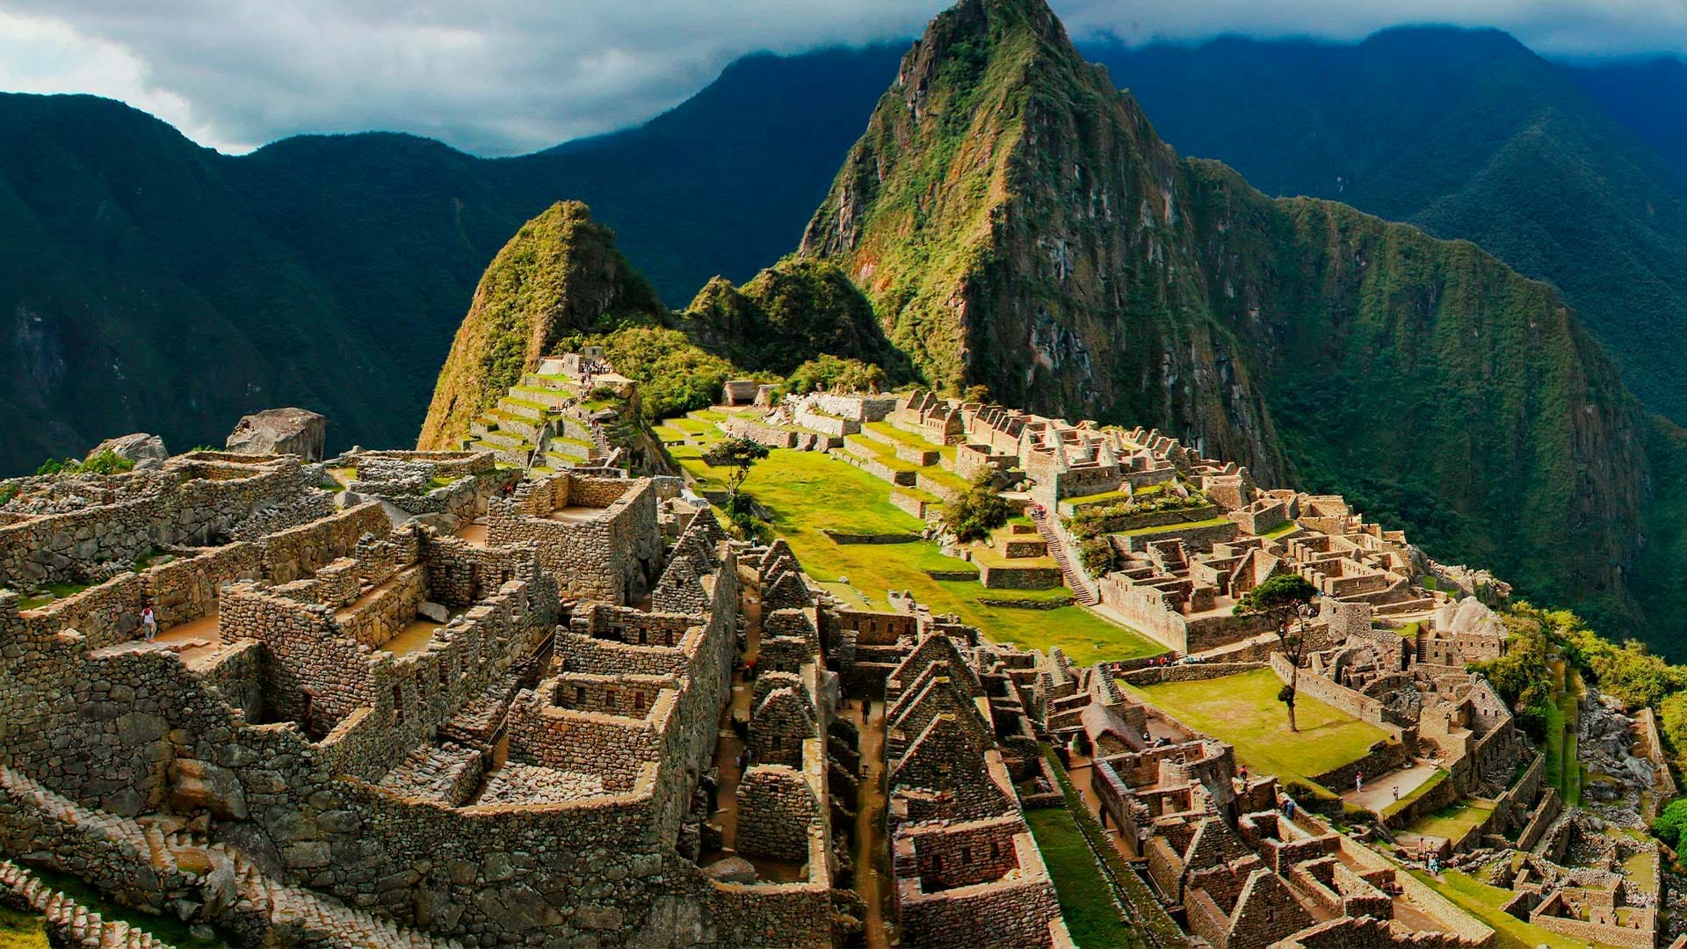

Peru
Country in South America
Third largest country in S. America
1,285,216 sq.km (496,225 sq mi)
Rugged Andes Mountains cover almost 40%
Mount Huascaran at 22,205ft (6,768 m)
Diverse landscapes and cultures
First female president appointed last week (Dina Boluarte)
32,510,453 people
Republic of Peru is divided into 25 regions and 1 province (Lima)

Slide 3

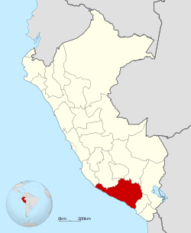
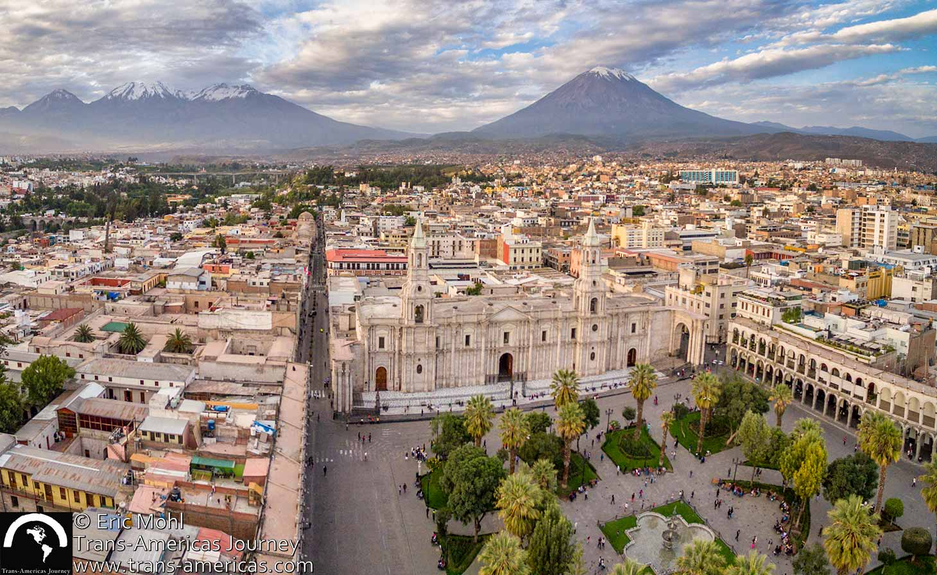
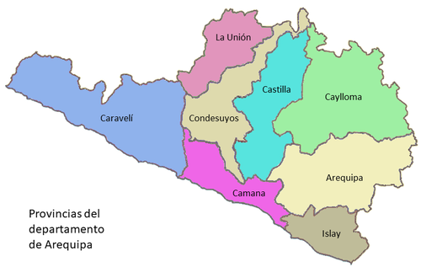
Arequipa, Peru
Region in the southwest of the country
Includes 8 provinces and lots of volcanoes
Arequipa is the capital – “The White City”
- inhabited by indigenous people/Spanish in 1540
- “City of Eternal Spring” – sunny/dry climate
Notes:
Second largest city and one of the oldest in peru (settled by Spanish in 1540)
White city – from white volcanic stones called sillar
Misti – 19,101
Chachani – 19,872
Denali (20,310)/Mt. Whitney (14,494)

Slide 4

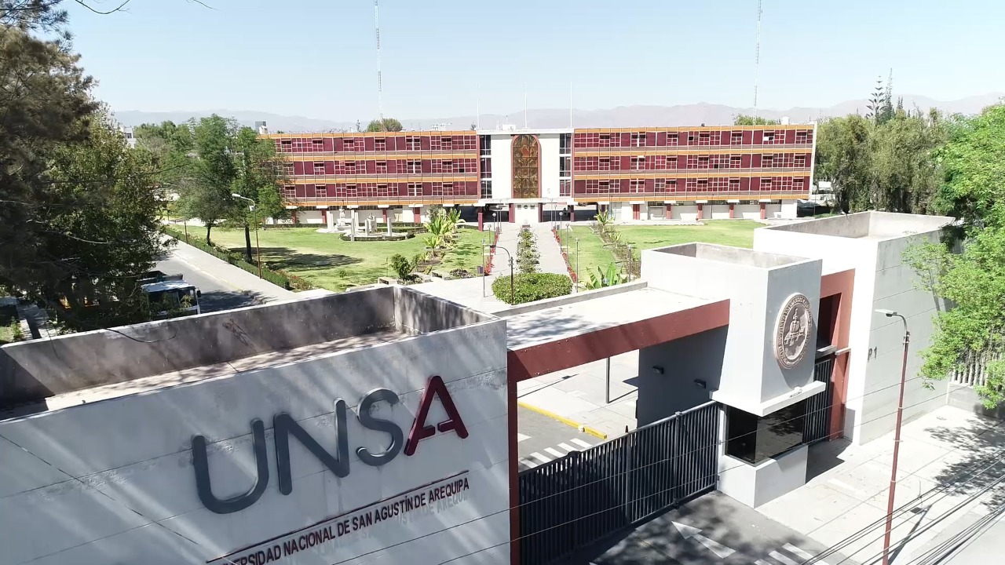
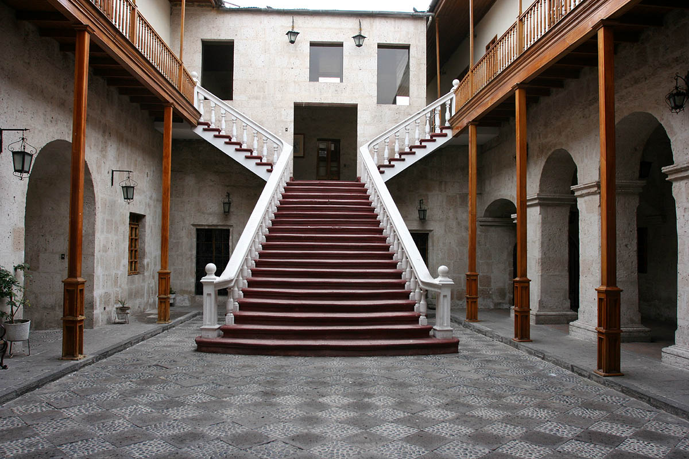
Universidad Nacional de San Augustin (UNSA)
One of the top public universities in Peru
One of the oldest public universities in Latin America (est. in 1828)
27,300 students
3 campuses, 17 colleges, & 45 professional schools from the fields of humanities, natural sciences, biological, social sciences and engineering
College of Biology (agronomy, biology, nutritional sciences, farming engineering)

Slide 5
The Arequipa NEXUS Institute
What is it, how did it start, and how has it changed since its establishment?

Slide 6
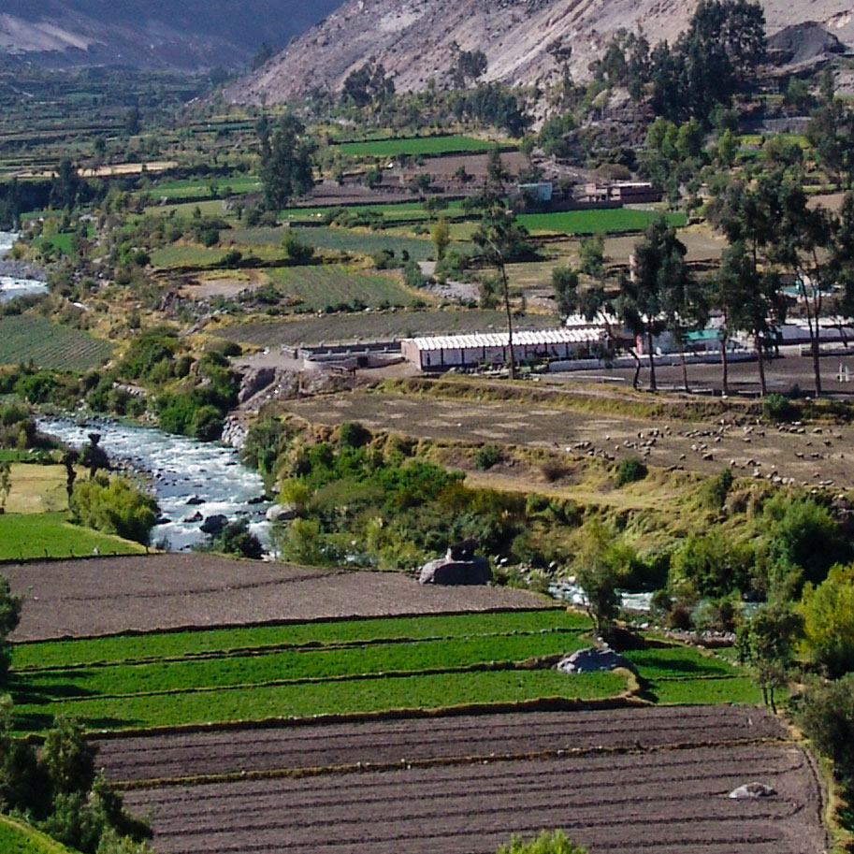
What is the Arequipa NEXUS Institute?
First of its kind technical cooperation between two world-class universities in Peru and the United States
Broad, overarching goal:
Build capacity and establish the long-term collaborations needed to support the development of adaptive, profitable, and sustainable food-energy-water systems in the Arequipa region of southern Peru
Funding provided by UNSA/Mining Taxes

Slide 7

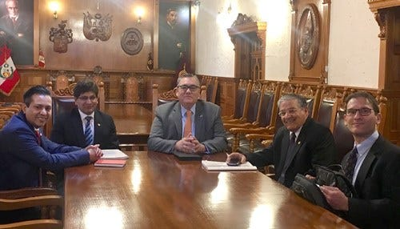
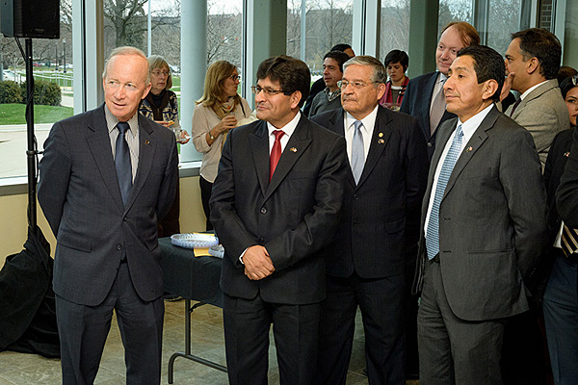
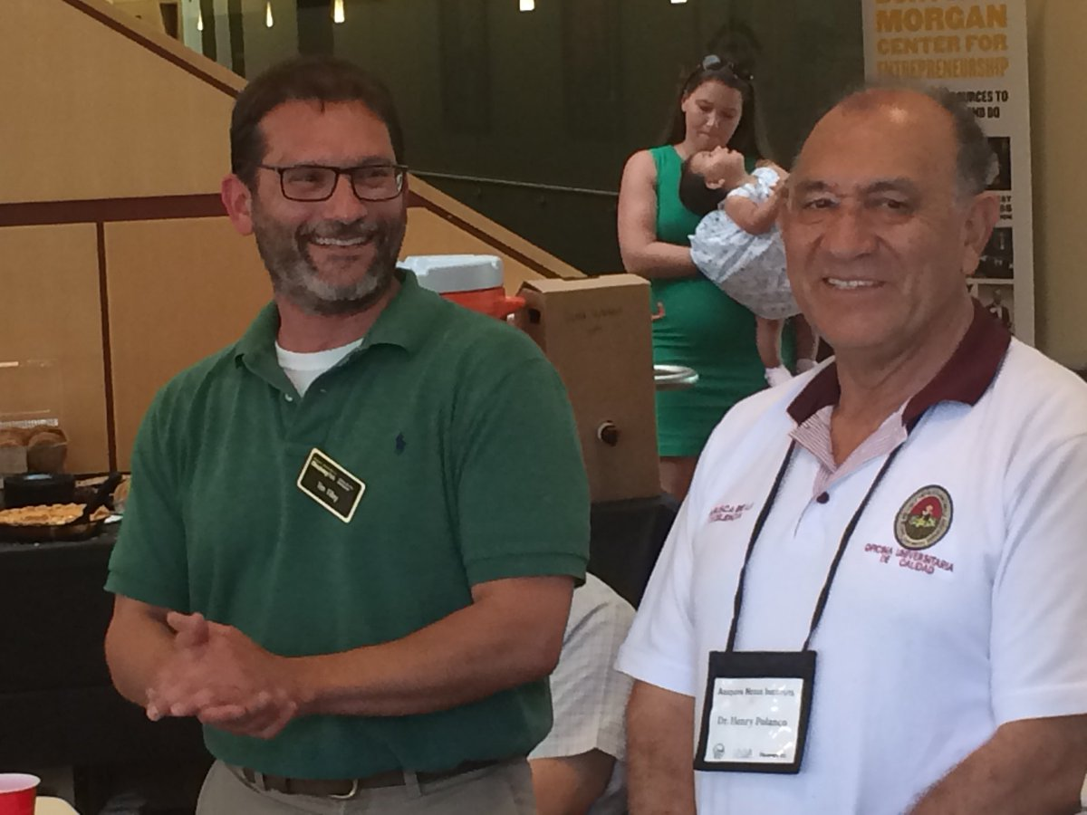

Establishment
The institute was formally established in 2018
Governor to Purdue President / UNSA Rector to Governor
Inaugural co-directors: Tim Filley (Purdue) & Henry Polanco (UNSA)
Inaugural project manager/coordinator – Victor Maqque
Inaugural project assistant – Renata Ximenes

Slide 8
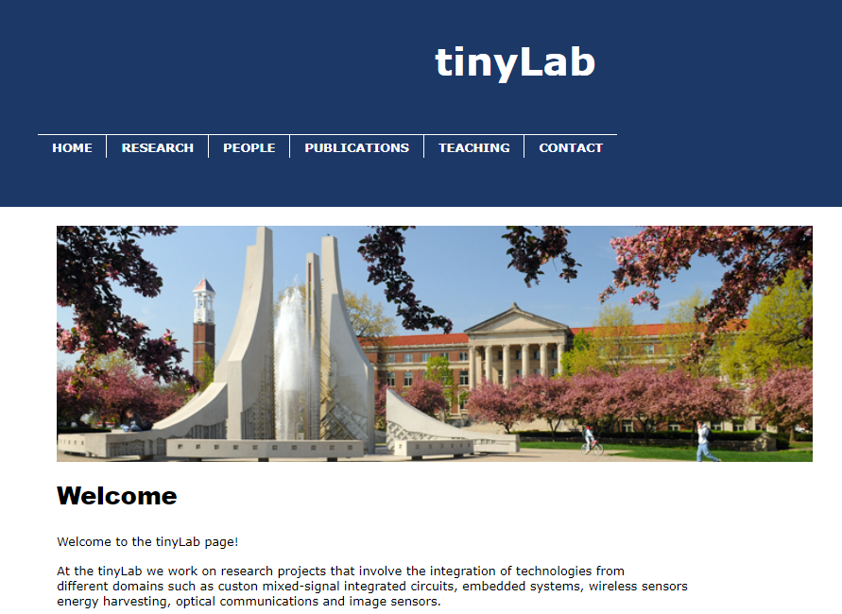
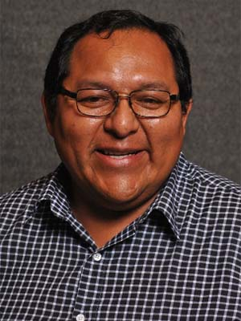
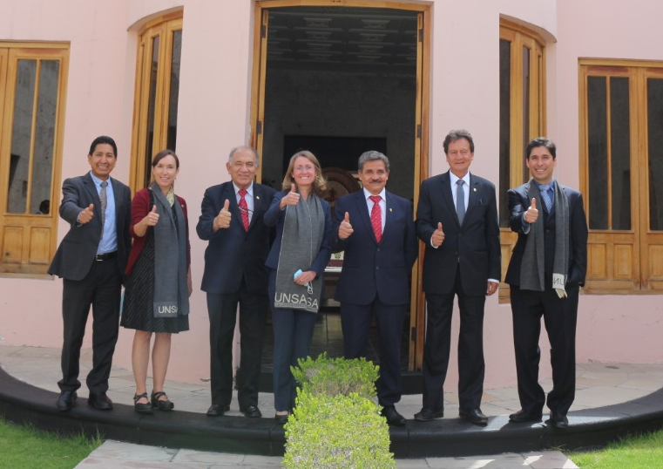
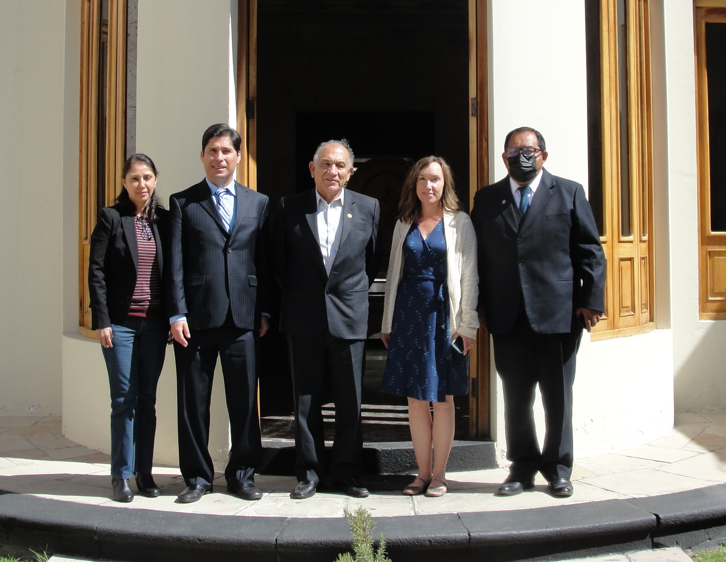

Changes in 2021
New administration teams at UNSA and Purdue
Henry Polanco became Vice-Rector for Research / Theresa Mayer at Purdue
New Co-Directors at Purdue
- Daniel Leon-Salas (Assoc. Professor in Purdue’s Polytechnic Institute) & me
New Co-Director at UNSA – Dennis Macedo (Assoc. Prof. in Agronomy at UNSA)
New Project Coordinator at Purdue – Rosa Cossio
New Project Assistant at Purdue – Lucy Tascon-Villa

Slide 9
Phase I/II
2018-2022
What did the institute do and what has it accomplished?

Slide 10
Phase I and II
21 short-term/pilot projects initiated in 2018 & 2019 and completed in 2022
Engaged 170+ faculty/staff, 38 post-docs. and 50+ graduate and undergraduate students
Project goals:
- Build research and
engagement capacity
- Identify specific needs
- Obtain foundational data
for future research
- Establish partnerships for
longer-term projects
- Provide advice for program
management at UNSA
Natural Resources (7)
Agriculture and Food (5)
Sustainable Design and Teaching (3)
Community Engagement (1)
Technology (3)
Administration (2)

Slide 11
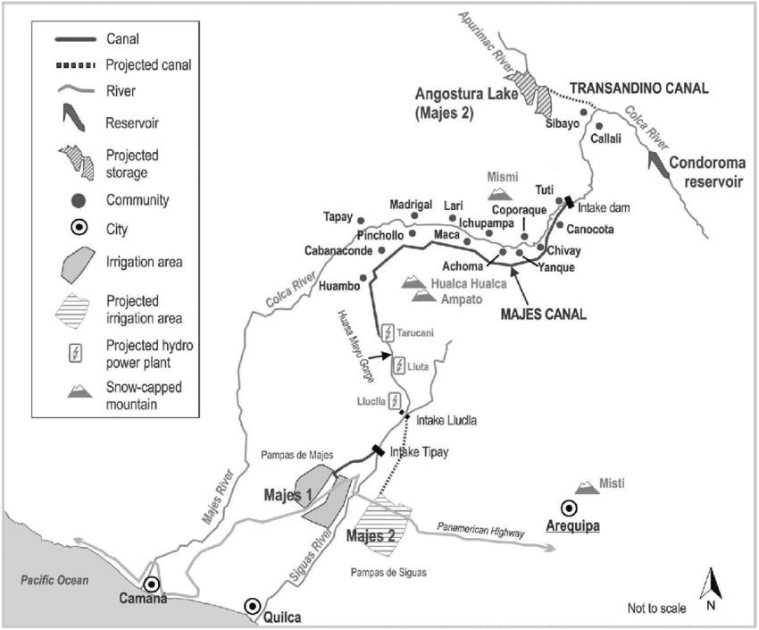

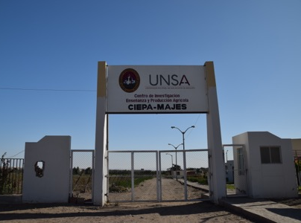
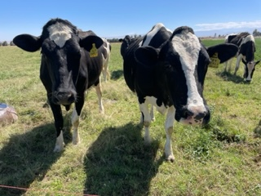
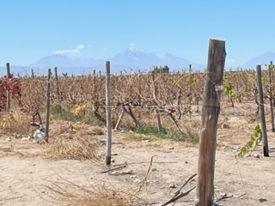
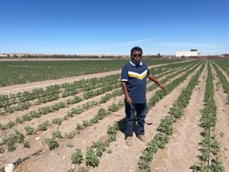
UNSA’s CIEPA Research Station in Majes
Dairy
Grapes
Quinoa

Slide 12
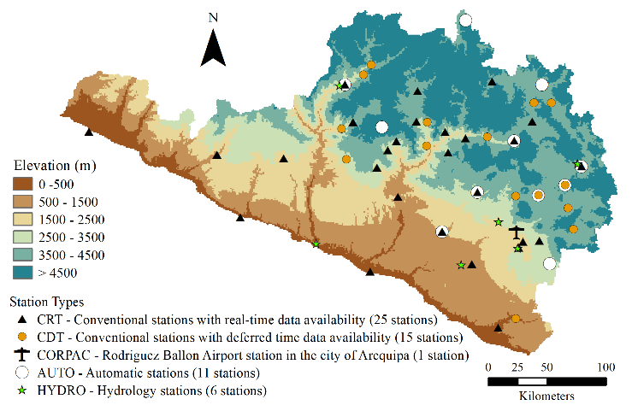
Natural resources
A Framework for Sustainable Water Management in the Arequipa Region (SWM)
Estimating Relative Inputs of Glacial Melt-Water, Groundwater, and Irrigation Runoff in Rivers of Arequipa, Peru (WO)
Water management (2 projects)
Identified the source and flowpaths of water (i.e., glacier meltwater, groundwater) in watersheds around Arequipa
Created new datasets characterizing geophysical and vegetation characteristics to inform hydrogeologic models that can predict water flows under changing environments
Developed stakeholder-driven land-use
and water management tools
Findings will help local resource
managers better manage water and
respond to climate change
Weather stations installed in Arequipa

Slide 13
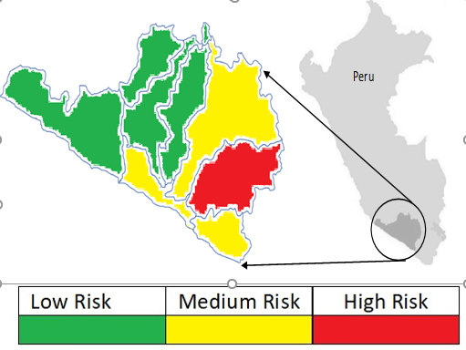
Natural resources
Seasonal Heavy Metal Concentrations in Streams in the Arequipa Region (MIR)
Toward Clean Water: Avoid Intrusion of Contaminants into Water Systems (TCW)
Water quality (2 projects)
Worked with local agencies (i.e., ANA, SENAMHI) to collect water samples and quantify heavy metals in multiple rivers across Arequipa
Determined that some metal contaminants are coming from groundwater (i.e., As, B) and others (i.e., Cd, Cr) from local industries
Designed a model to predict risks and decrease
the risk of contamination in water pipelines
Findings will help decision-makers
develop new monitoring and remediation
strategies, and allocate funding most
effectively to reduce human health risks
Risk map of water distribution network in the Arequipa Region

Slide 14
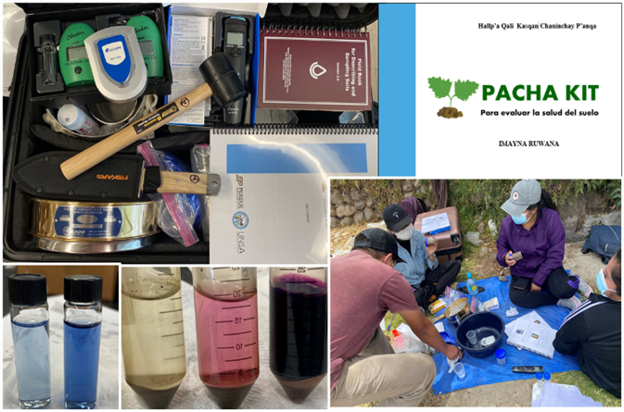
Natural resources
Soil Health, Impairment, and Vulnerability Assessment (SHIVA)
Plant-Microbe Interactions in Agricultural Soils with Heavy Metals Contamination (PMI)
Soil quality (2 projects)
Collected samples from farms across Arequipa and the CIEPA research station and quantified threats due to salinity, heavy metals, and soilborne pathogens that cause crop diseases
Identified beneficial soil microbes and quinoa cultivars that can reduce salinity and pathogen stress, and prevent heavy metal uptake into edible plant tissues
Developed new laboratory and field-
based tools to monitor soil properties
Findings and new tools developed will
help Arequipa’s farmers improve the
productivity and safety of their crops
Pacha Soil Health Assessment Kit

Slide 15
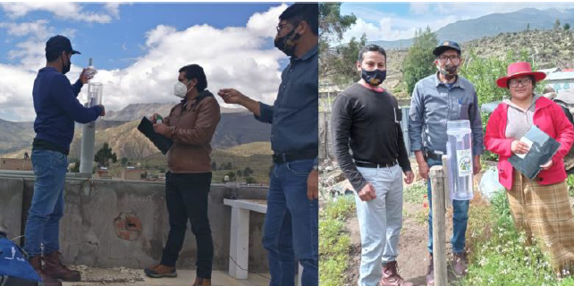
Natural resources
Determining the Sources of Particulate Air Pollution in Arequipa, Peru (ARQ)
Air quality (one project)
Worked with local agencies (ie. SENAMHI and INGEMMET) to collect and analyze particulate matter (PM) from the atmosphere and demonstrated that air-quality is a problem in Arequipa city
Collected and analyzed aerosols from the coast and near the
Sabancaya volcano, and established
a regional rain collection network
with volunteers to identify potential
sources of contamination
Findings provide the foundational
data needed to begin to address
air quality issues in Arequipa
Rainwater collection by citizen scientist volunteers
Notes:
This project produced the first publicly available data on air quality for the city of Arequipa and demonstrated that air quality improvement is needed. Collaborative contacts with scientists at SENAHMI and INGAMET were generated that will ensure collective research in the future to address this challenge.

Slide 16
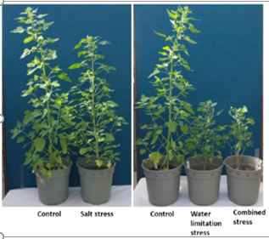
Agriculture and Food
Elevating the Peruvian Grape and Wine Industry into a Global Competitor (GWI)
CRISPR and Phenomics: Capacity Building for Crop Science at UNSA (CRISPR)
Crop improvement & management (2 projects)
Identified challenges facings Arequipa’s grape growers and wine producers, and opportunities to help address these challenges through better water management
Identified traits mediating water and salinity stress in garlic and quinoa
Established protocols to genetically
modify quinoa, wheat and garlic using
CRISPR technology
Findings provide the foundational
knowledge needed for future research
to help farmers improve profitability
and deal with climate change
Quinoa plants subject to salt and water stress

Slide 17
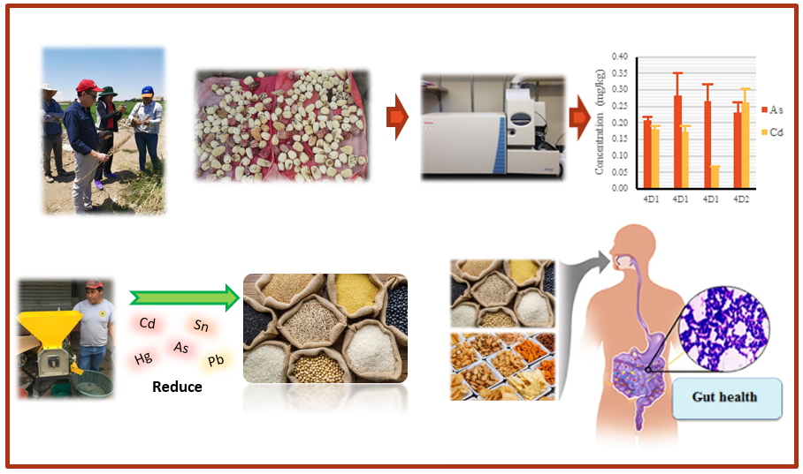
Agriculture and Food
Food Safety Training for Growers and Food Processors in Arequipa, Peru (IFS)
Low Heavy Metal, Staple Crops in Arequipa (SHMF)
Postharvest Handling and Storage in Peru (POHO)
Food safety & preservation (3 projects)
Documented foodborne pathogens in fruit, vegetables and water from farms and local markets and conducted trainings to help reduce risks
Determined that some grains and processed products contain heavy metals and identified post-harvest practices to reduce contamination
Demonstrated how to reduce loss from insect pests in grains after harvest using specialized storage bags
Findings will help reduce human health
risks associated with contaminants,
and increase food security and the
profitability of Arequipa’s farmers
Milling reduces heavy metals in grains

Slide 18
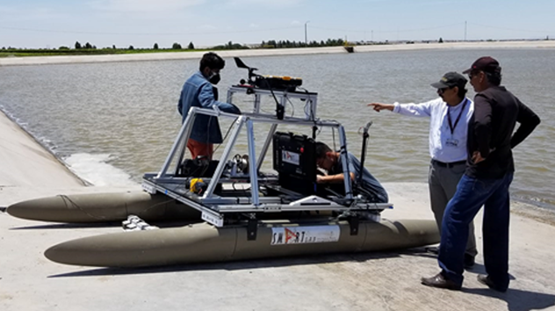
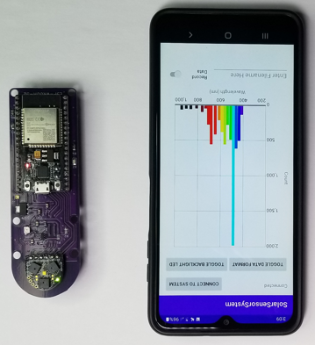
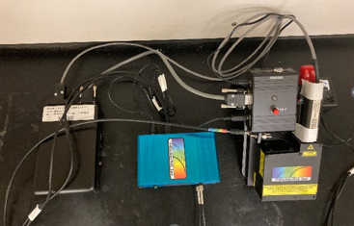
Technology
Robotic Water Quality Monitoring and Distribution Systems (RWQM)
Harnessing Luminescent Radiation from Solar Cells (OFID)
Sensing Systems for Heavy Metal Detection (DHMC)
New tools (3 projects)
Developed new low-cost robotic water quality monitoring and smart irrigation systems
Developed a new approach to estimate heavy metal concentrations in soils, water and plants
Developed new sensors to monitor solar radiation and enhance wireless
communication in solar cells
The tools will help scientists and
local agencies better monitor
environmental conditions, and
conduct research aimed at solving
grand challenges in Arequipa
The SMARTBoat
Photosynthetic photon flux sensor
Laser-based spectroscopy system
Notes:
Develop new types of agricultural and environmental sensors to monitor solar radiation (i.e., photosynthetically active radiation and UV radiation) and modulate the photo-luminescence of high-efficiency GaAs solar cells for wireless communications.

Slide 19
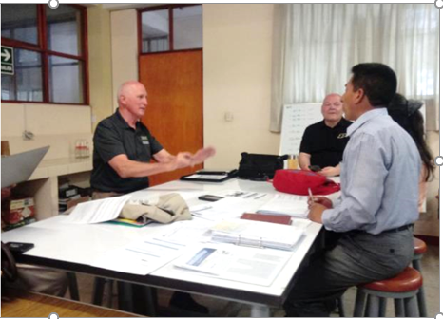
Sustainable design
Net Zero Energy Building-Pilot Project (NZE)
Energy Efficiency & Sustainability (CEE)
Sustainable Development for the Water, Energy and Food Nexus (CSD)
Building & Instruction
(2 projects)
Evaluated the potential for, and provided the training and technical support needed to design, construct, and manage net-zero energy buildings
Designed new engineering courses focused
on sustainable development and energy
efficiency that can be taught using new
on-line educational formats
Products will help UNSA faculty and
contractors lower the carbon footprint of
Arequipa’s infrastructure, and instructional
resources can be used to design other
online courses covering a range of topics
Discussing strategies for graduate courses on sustainability

Slide 20
Community engagement
Equitable Co-existence of Agriculture, Mining, and Regional Development in Arequipa: Realities, Barriers, and Opportunities (COEX)
Social science (1 project)
Conducted surveys in four districts (Caylloma, Madrigal, Cabanaconde, and Majes) to determine how stakeholders perceive local challenges, and identified strategies to help promote co-existence of mining, agriculture, and local communities
Conducted several workshops and produced
field-based training modules describing
how to connect and collaborate with
local stakeholders
Activities have provided the foundation for a
new “Extension Hub” at UNSA that can help
all researchers better connect with local
stakeholders to identify and address
critical challenges in the region
The Nexus “Extension Hub”

Slide 21
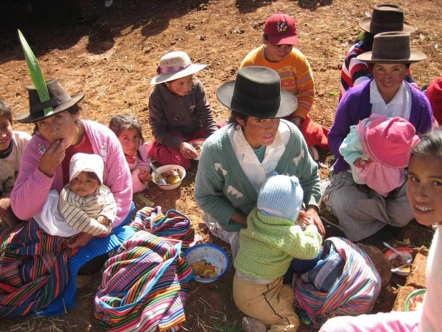
Administration
A Purdue-UNSA Initiative to Establish a Center on Food Security in Peru (CFS)
UNSA’s Agricultural Experiment Station: a Strategic Plan (AES)
Centers & Stations (2 projects)
Identified critical factors influencing food and nutritional insecurity in urban and rural communities across Arequipa
Identified critical agronomic and economic challenges facing farmers in the Majes irrigation district
Outlined strategies to support integrated
research and outreach programs at UNSA
Findings will help UNSA establish
initiatives that can help faculty conduct
integrated research and engagement
programs aimed at solving problems and
increasing adoption of improved practices
Small producers in rural and urban communities participated in surveys to identify needs

Slide 22
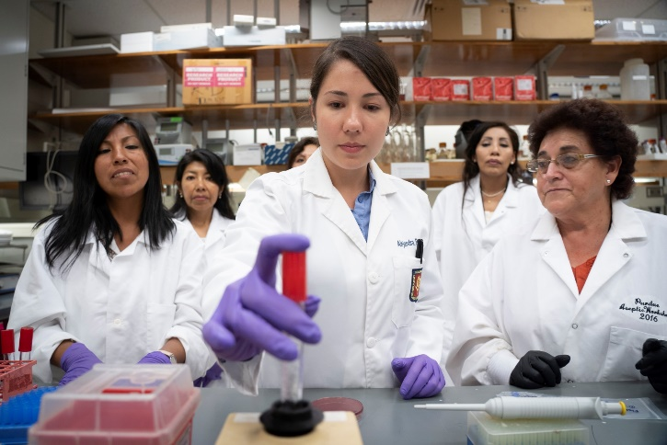
What did the Institute achieve during phase I/II?
Training workshops increased capacity to establish meaningful and productive scientific collaborations and increase research outputs
The projects increased capacity to partner with researchers across cultures to address grand challenges
All project participants at both institutions felt NEXUS research:
Training Workshop at Purdue
- was responsive to Peruvian social and political culture
- had established strong connections with local stakeholders
- could provide evidence-based results for addressing local/regional problems

Slide 23
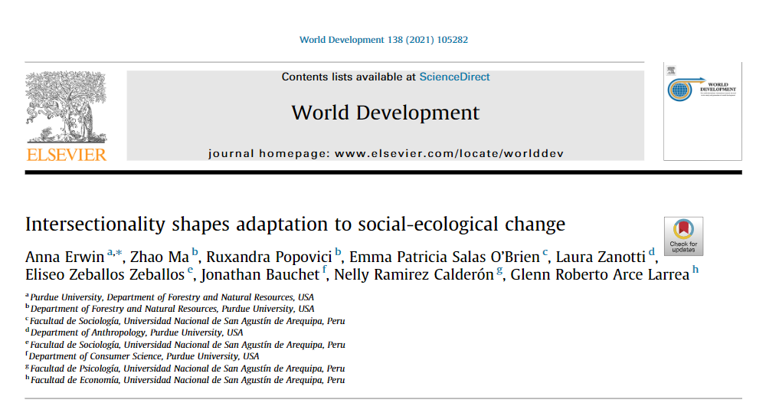
What did the institute achieve during phase I/II?
UNSA affiliates experienced large and positive influences on their education and career trajectories with publications, etc., that increased their visibility and rank within CONCYTEC
60 articles in international scientific journal articles published or are currently under review and many additional articles are in prep
5 theses, reports and book chapters completed and published
116 presentations given at international
scientific conferences
43 webinars presented and archived
77 capacity-building videos created
35 scientific tools generated
4 large datasets archived
Example of one article published in a top-tier (Q1) international journal

Slide 24
Moving forward
Phase III
How can we build on the success of phase I/II while being responsive to the needs of UNSA and local stakeholders?

Slide 25
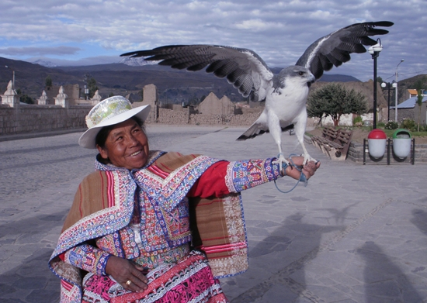
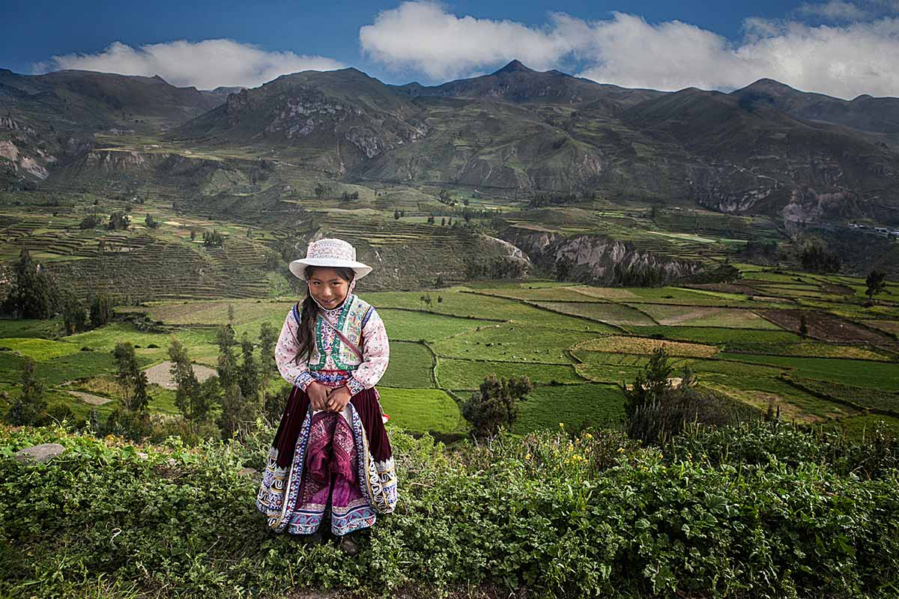
The Colca Canyon
One of the deepest canyons in the world
Popular tourist destination
Pre-Incan agricultural terraces
Economic challenges
Opportunities to enhance livelihoods:
1) alpaca genetics
2) organic agriculture
3) renewable energy
working on additional projects

Slide 26
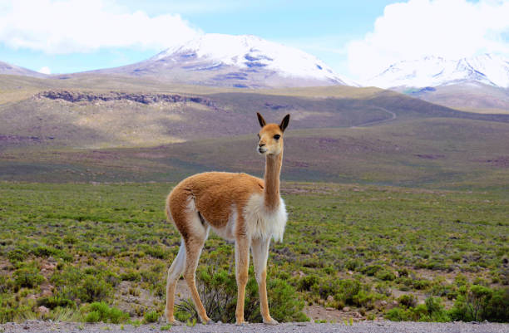
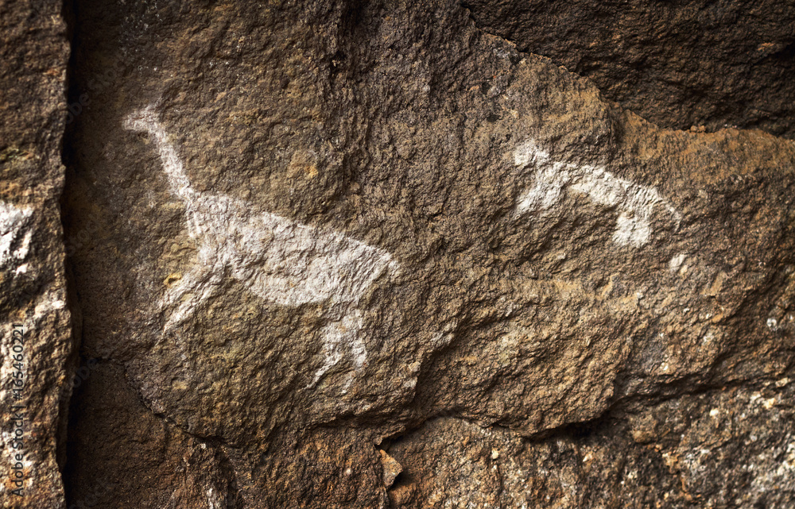
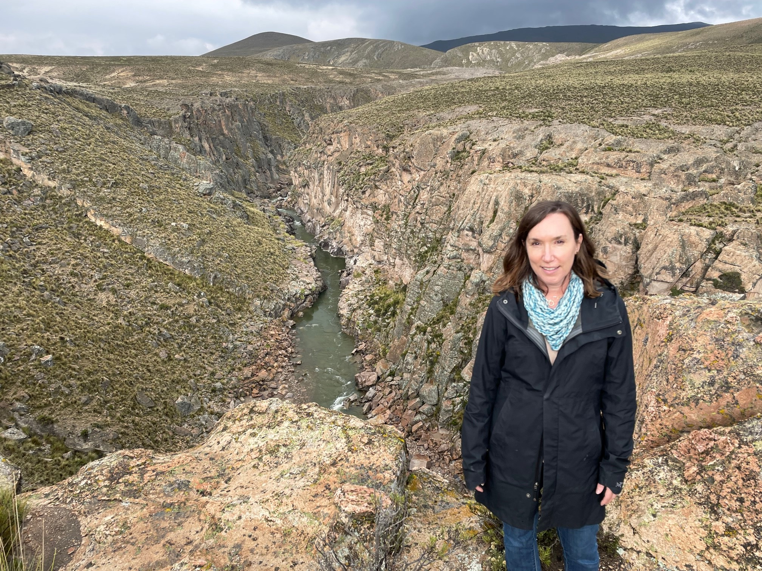
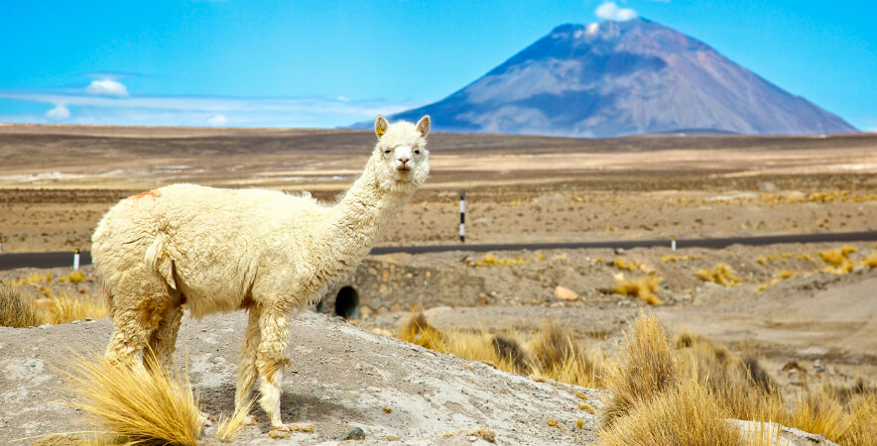
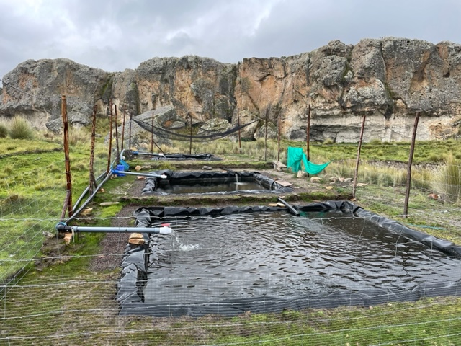
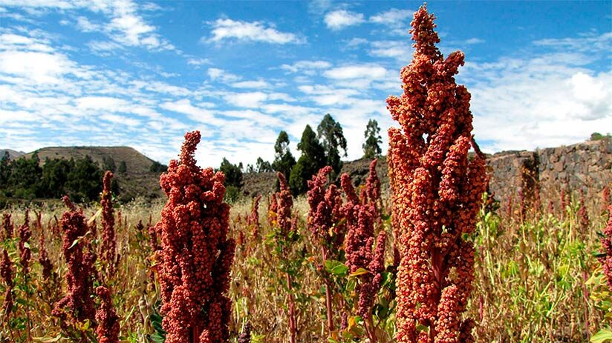
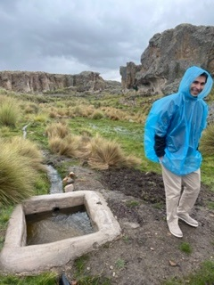
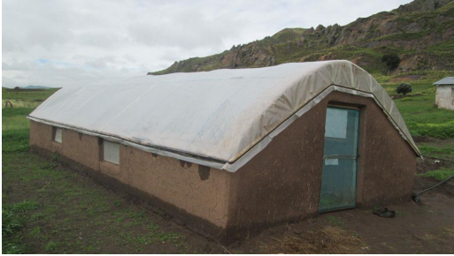
CIBSI– UNAS’s new high-mountain research station at Sumbay
Natural and culturally significant area / opportunities to showcase new innovations
Vicuna Nature Reserve nearby
Cave paintings on the property
Headwaters of the Chili River
Llamas and Alpacas
Trout Farming
Traditional and New Crops
Infrastructure

Slide 27
Opportunities to stay or get involved

Slide 28

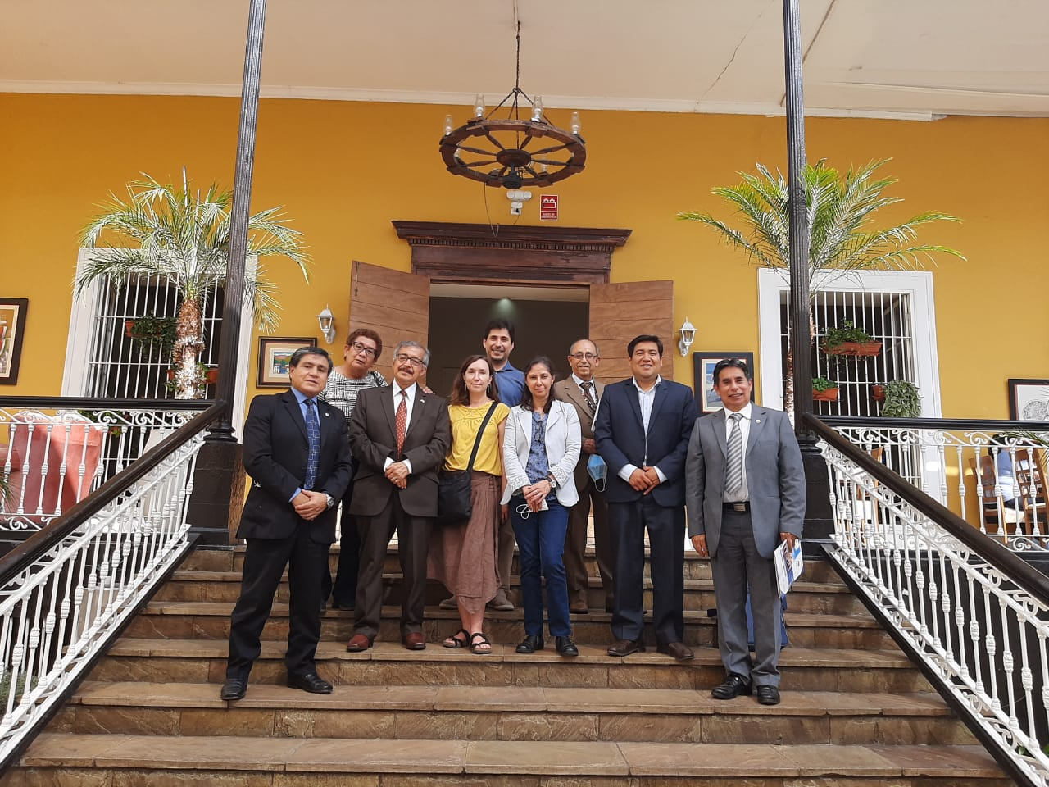
How can the Arequipa NEXUS Institute help you?
We are available to help NEXUS participants build on their established partnerships and apply for additional funding through other sources
Working on developing similar partnerships with other universities in Peru
Contact Daniel, Rosa or me to tell us about your research and interests in working in Peru
wleonsal@purdue.edu
rcossio@purdue.edu
lhoaglan@purdue.edu
Join our Peru E-mail List Serve/sign-up for our Newsletter
contact Lucy at: ltasconv@purdue.edu

Slide 29
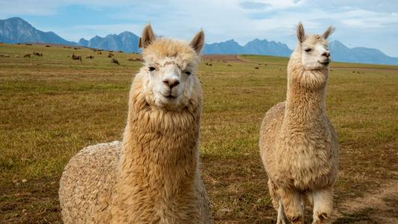
Thank you for your attention
Questions?

