Slide 1
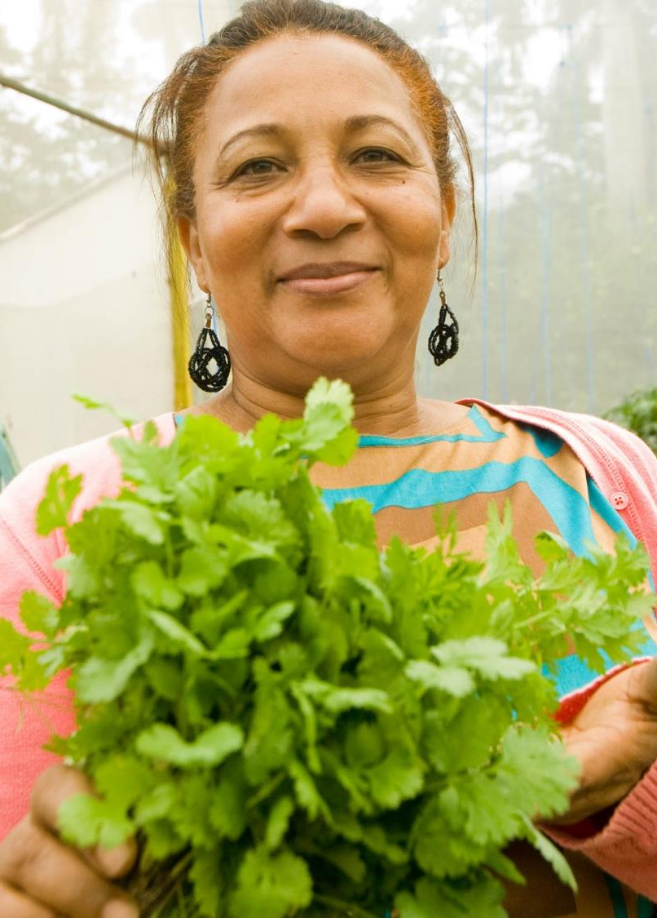
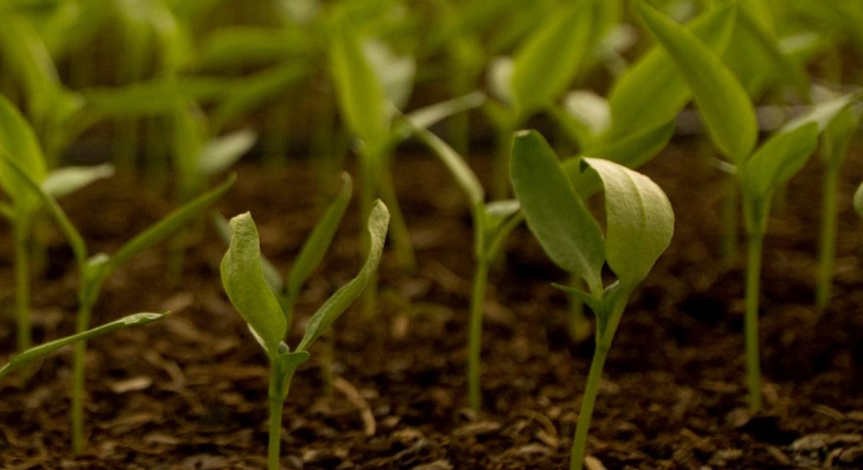


Farmer-to-Farmer
The John Ogonowski and Doug Bereuter
Farmer-to-Farmer Program
International Development Working Group
March 2022
Amanda Dickson,
Farmer-to-Farmer Program Director

Slide 2








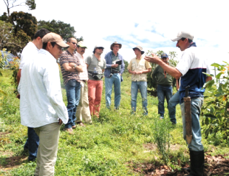
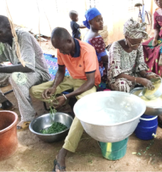
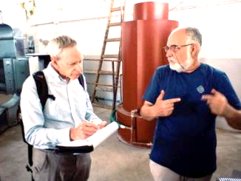

F2F Background
Eight Program Implementers
Started with 1985 Agricultural Development and Trade Act (Farm Bill), proposed by Representative Bereuter of Nebraska
Farm Bill provides authorization in 5-year periods
Managed by USAID
Currently in the 2019-2023 cycle
Notes:
The program started in the 1985 farm bill under the Agricultural Development and Trace Act proposed by Representative Bee-Writer of Nebraska.
There are 8 program implementers of the f2f program and we are a sub award recipient under Partners of the Americas.

Slide 3
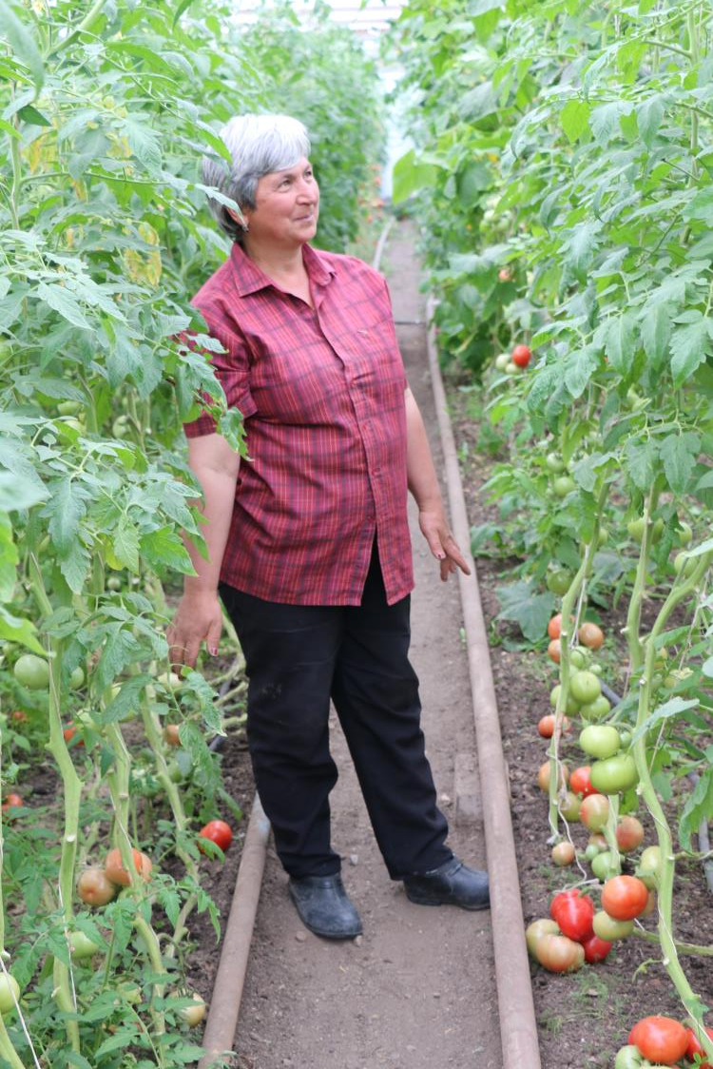

About Farmer-to-Farmer
Goals
To generate rapid, sustained economic growth in the agricultural sector
To increase the American public’s understanding of international development issues and programs and international understanding of the U.S. and U.S. development programs
Notes:
The main goals of the program are to generate sustainable, broad-based economic growth in the agricultural sector through voluntary technical assistance and to facilitate an exchange of understanding of international issues and cultures between the US public and foreign countries.

Slide 4

About Farmer-to-Farmer
Short-term consulting assignments by American volunteers from …
  Farms
  Agribusinesses
  Cooperative extension services
  Universities
  Food processing companies
  Consulting firms
  Banks
… to strengthen the capacity of:
  Farmer Organizations
  SME Agribusinesses
  Local NGOs
  Universities
  Banks, MFIs
  Government Staff
  Industry Associations
  Individual Farmers
  Environmental Organizations
Notes:
The Farmer-to-Farmer Program provides voluntary technical assistance to farmers, farm groups, agribusinesses and other agriculture sector institutions in developing and transitional countries to promote sustainable improvements in food security.
Over the course of a 2 to 4 week assignment, the volunteer works with a local group to develop it’s capacity and skills.

Slide 5





Farmer-to-Farmer:
Trinidad & Tobago

Slide 6
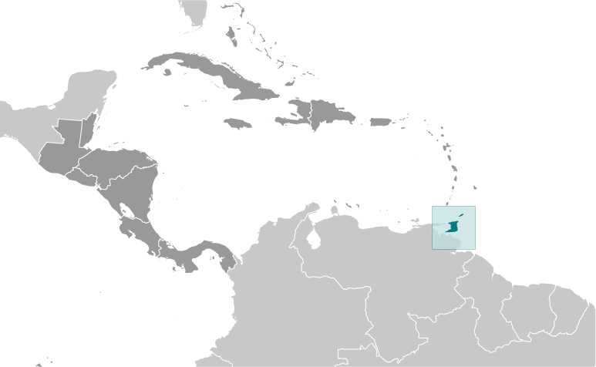

F2F Trinidad & Tobago
3 years; 2020 - 2022
35 volunteer assignments
Strengthen Extension System through Capacity Building
Increase Food & Nutrition Security through Increased Productivity, Safety, and Profitability
Notes:
Why Trinidad and Tobago? Where is it located? Quick info about project

Slide 7
Who Are We Working With? Host Groups
  Tobago Agricultural Society
  Cocoa Development Company of Trinidad and Tobago (CDCTT)
  Ministry of Agriculture, Land and Fisheries’ (MALF) Extension, Training, and Information Services Division (ETISD)
  Green Market Santa Cruz Ltd
  Tri Valley Cluster
  Unemployment Relief Programme (URP) – Tobago
  National Agricultural Marketing and Development Corporation (NAMDEVCO)
  Network of Rural Women Producers Trinidad and Tobago (NRWPTT)
  Vision On Mission

Slide 8
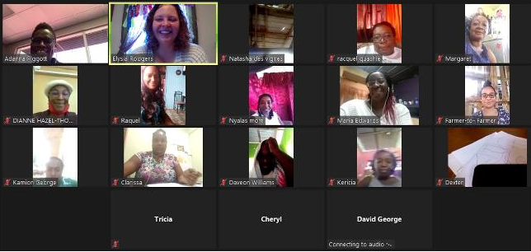
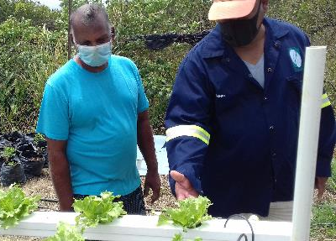
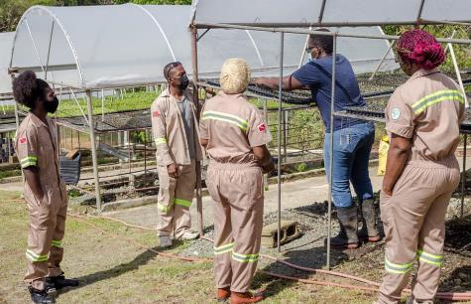
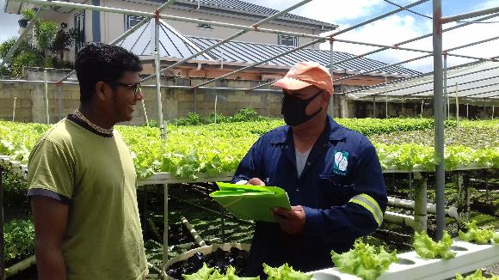
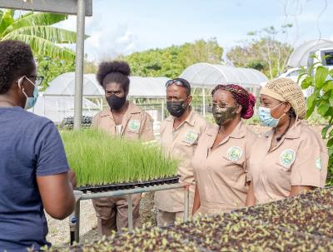
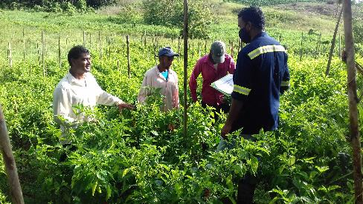
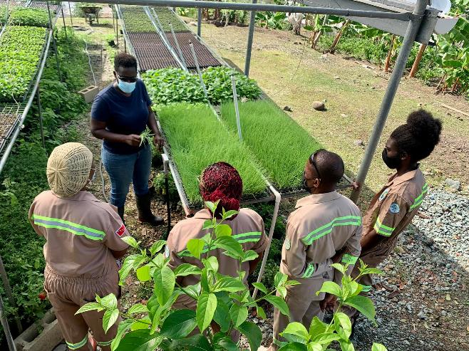
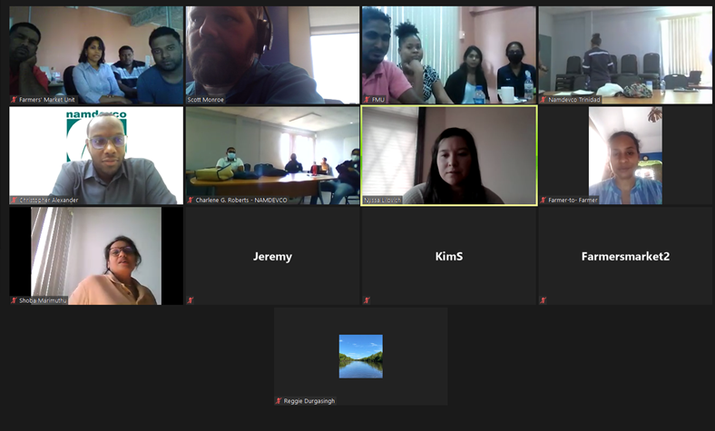
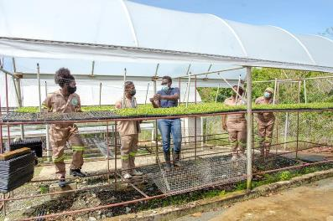
Farmer-to-Farmer Goes Virtual!

Slide 9
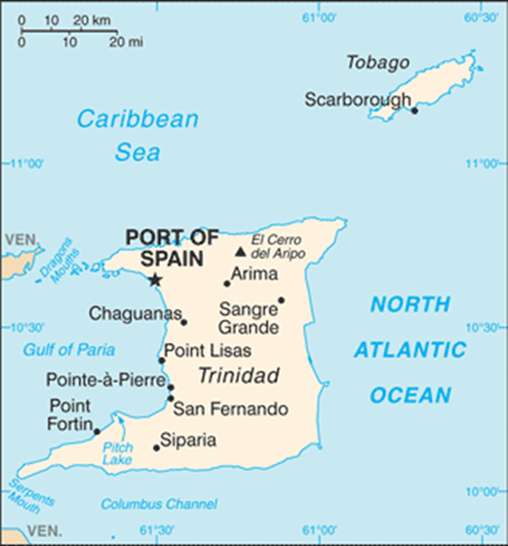
Farmer-to-Farmer Assignments FY2021
Multimedia Skills for Virtual Extension Programming
Introduction to Good Agricultural Practices (GAP)
Good Agricultural Practices (GAP) Certification System
Extension Program Monitoring and Evaluation
Farm Business Management
Farm Record Keeping
Pest and Disease Identification and Treatment for Tropical Crops
Alternative Methods for Fertilization, Disease, and Pest Control
Technical Writing
Introduction to Aquaponics
NGO Board Administration and Effectiveness
Urban Farming
Value-Added Food Products
Rainfall Runoff Management Techniques
Development and Fundamentals of a Successful Cooperative
Collaborative Group Development

Slide 10
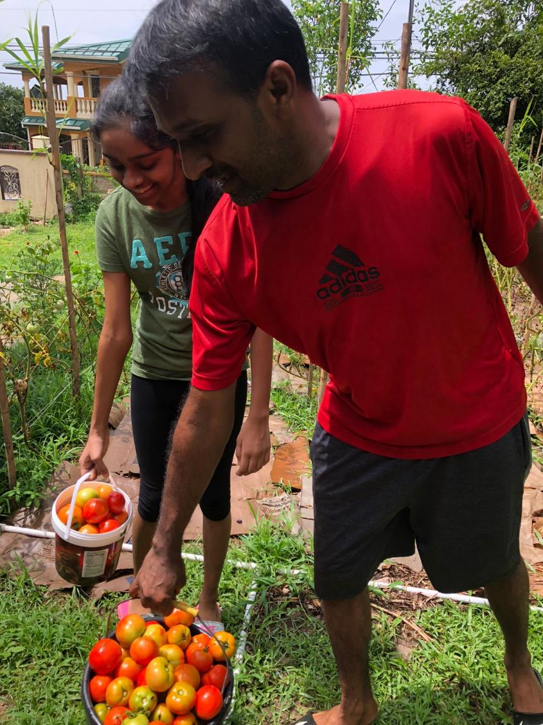
FY21 Impact in
Trinidad & Tobago
214 Participants (112 females, 62 males, and 40 youth)
6 Host groups
48% of recommendations implemented
Sample recommendations:
Choose and implement 1 or 2 methods learned (no till farming, ground cover, gabions, dams, vermicomposting, composting, water bars/wing ditches, cisterns, rain barrels
Move trays and pots to areas of the nursery benches where the pots have better drainage and airflow to the roots system. For example, if trays are placed on wood slats, orient the tray in such a way that as much of the bottom is exposed as possible without the tray falling through.
Use digital tools, such as polls and quizzes, to break-up online meetings, hear from your audience, and reinforce content. Examples used during our assignment include: Mentimeter, PollEverywhere, and Quizizz. Use tools for 50% of education workshops.

Slide 11
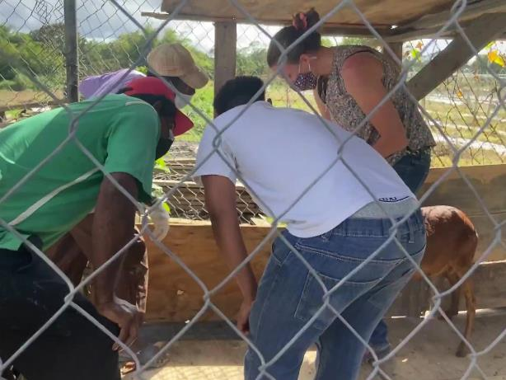
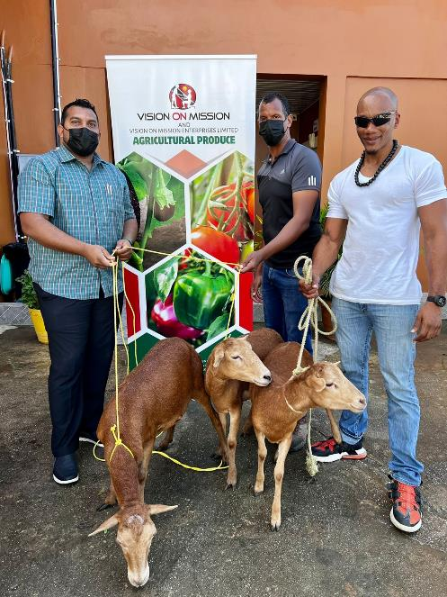
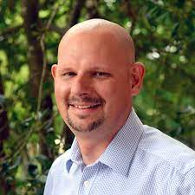
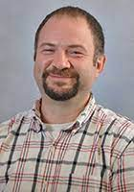
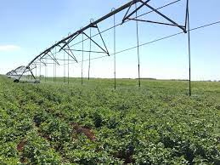
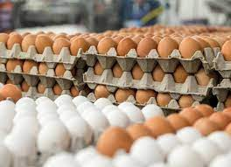
FY2022
Sheep Production
Traditional assignments
Limit virtual assignments
End of Project Showcase
Alternative Methods of Irrigation
Increase Egg Production
Notes:
Already completed 80% of the virtual assignments

Slide 12
What are the benefits for Purdue/Hoosiers/US citizens?
  Learn about a new culture
  Work with Trinbagonians
  Dedicated time to focus on real time issues
  Strengthen creative, adaptable, flexible, and resourceful muscles
  Professional development opportunity
Cross cultural skills
Work with low-income/resource population
Better understanding of the global agricultural market
All travel costs are covered
Recognized as an expert in topic area

Slide 13
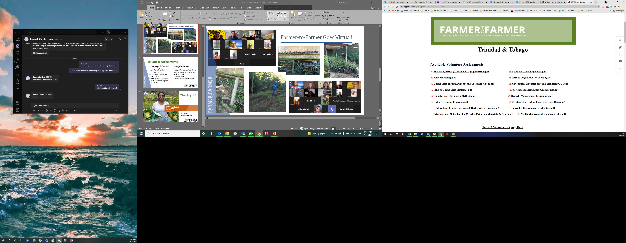
Interested?
https://ag.purdue.edu/ipia

Slide 14
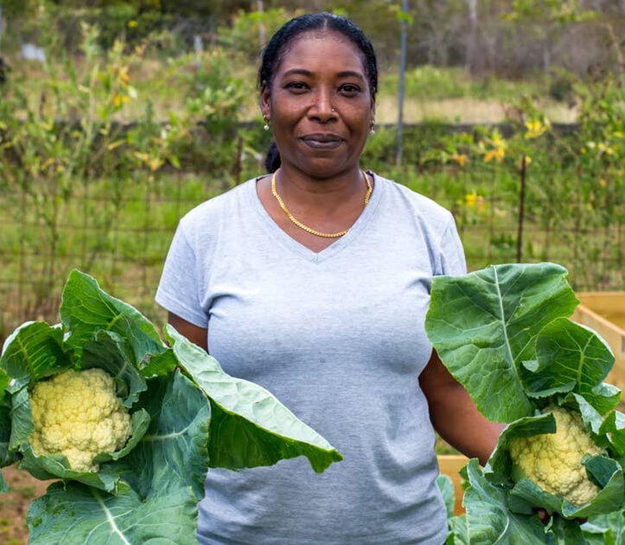
Questions?
IDWG
March 2022
Amanda Dickson
dicksona@purdue.edu

