Slide 1

Purdue Applied Research Institute
Global Development and Innovation Division

Slide 2
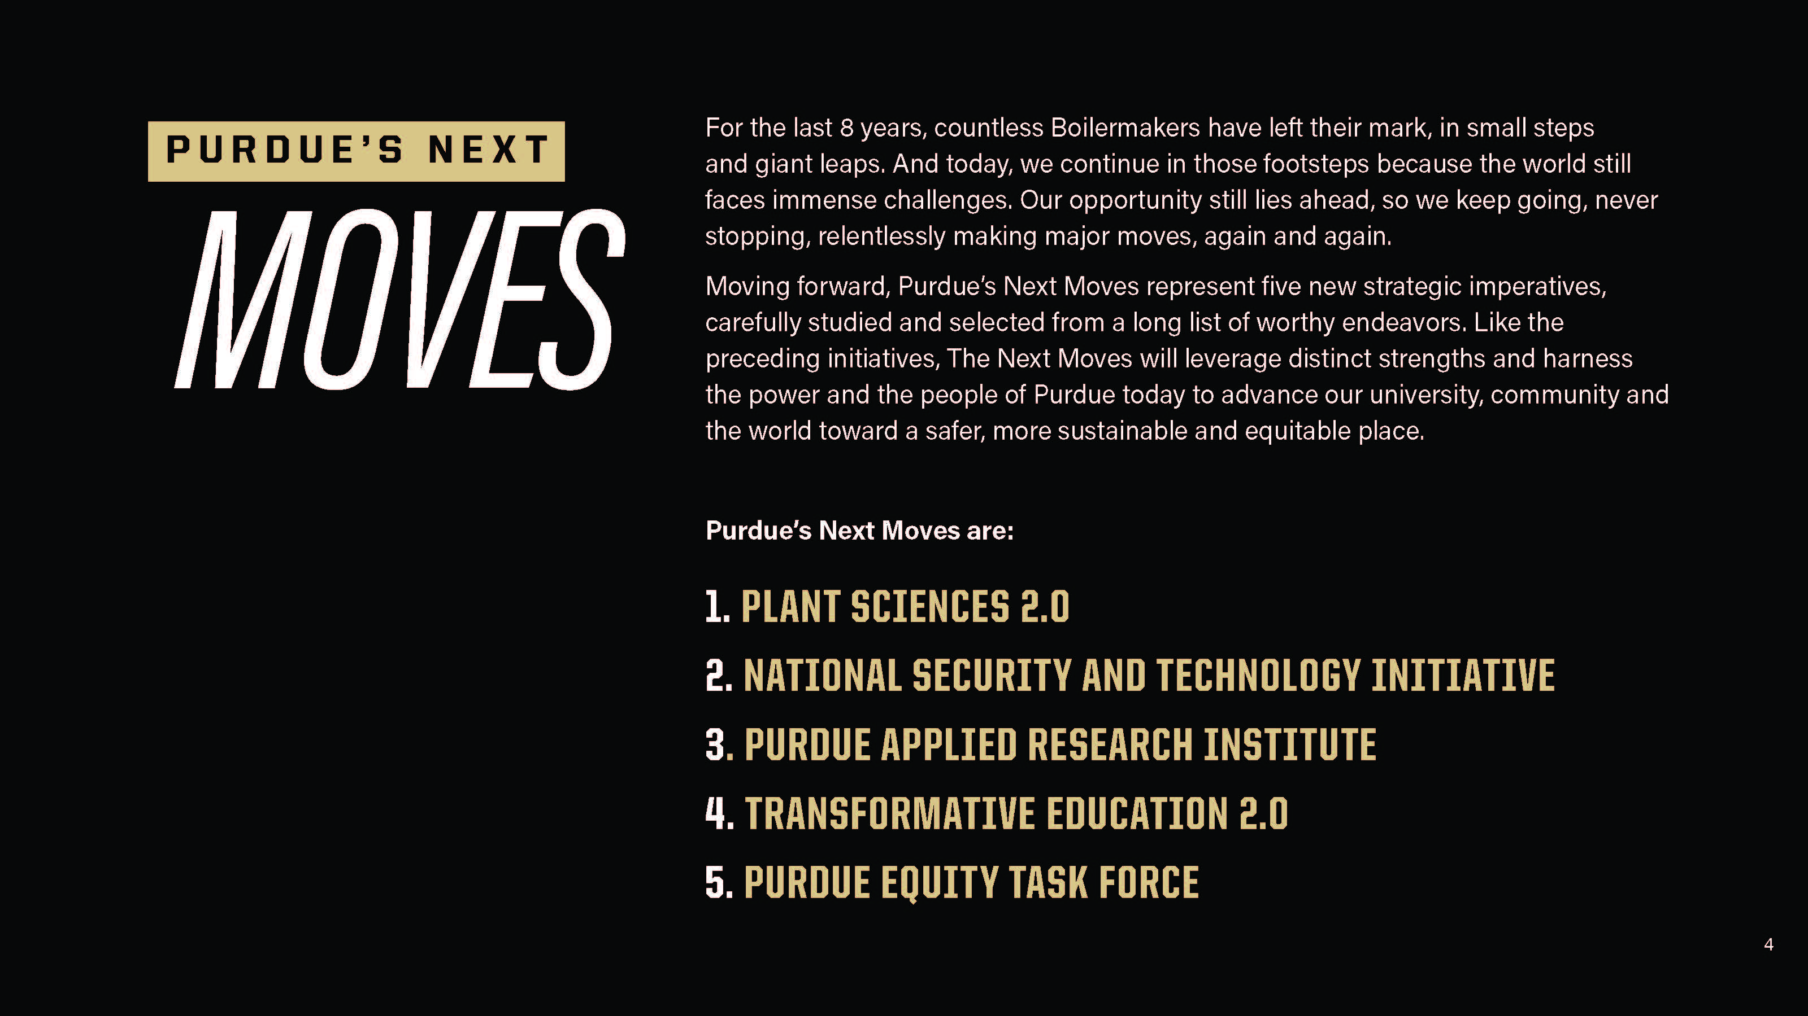
Notes:
-can’t talk about PARI-GDI without first talking about Purdue Moves
Launched about 9 years ago, Purdue Moves was a campaign to organize and focus the University’s resources to achieve goals that impacted the entire campus such as affordability/accessibility, online education, among others.
To build on the success of Purdue Moves, the President, EVPRP and Board of Trustees announced last April (2021) Purdue’s NEXT Moves focused on these 5 priorities.

Slide 3
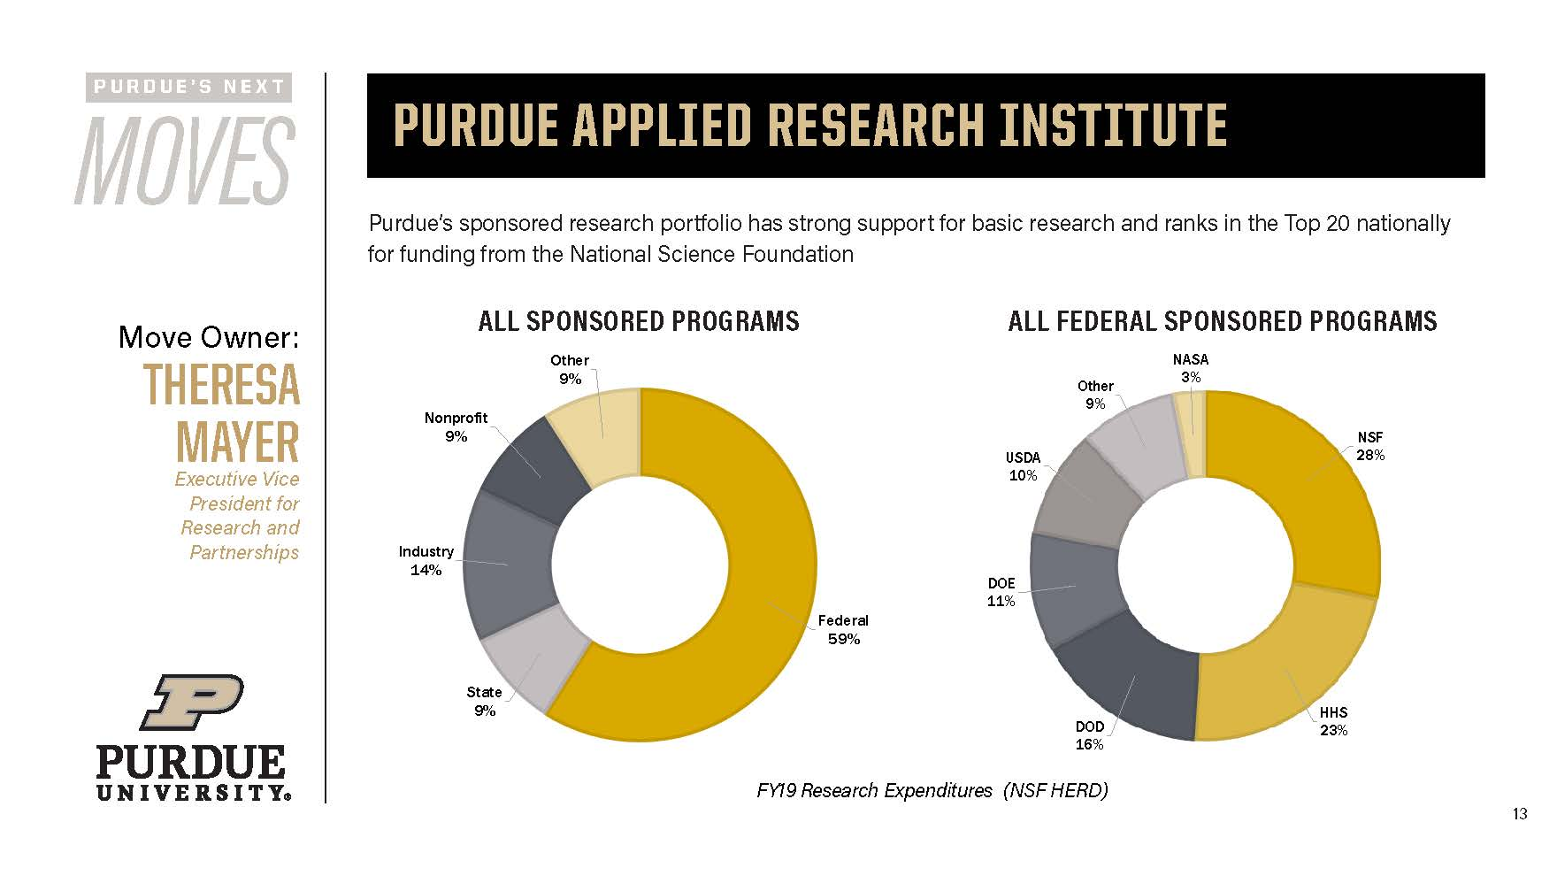
Wholly owned subsidiary of Purdue University
Tax exempt, 501(c)(3)
Domestic (Indiana), Limited Liability Company
Organized as an “other than small business”
Registered separately from Purdue University in US government funding databases
Could be described as an NGO
Notes:
Being able to adapt to funder needs and diversify Purdue’s funding sources is one of the reasons PARI was created.
Allows faculty to work within a structure that is not limited by public university guidelines
PARI’s structure will enable faculty, students and staff to diversify the funding sources and opportunities that you could pursue.

Slide 4
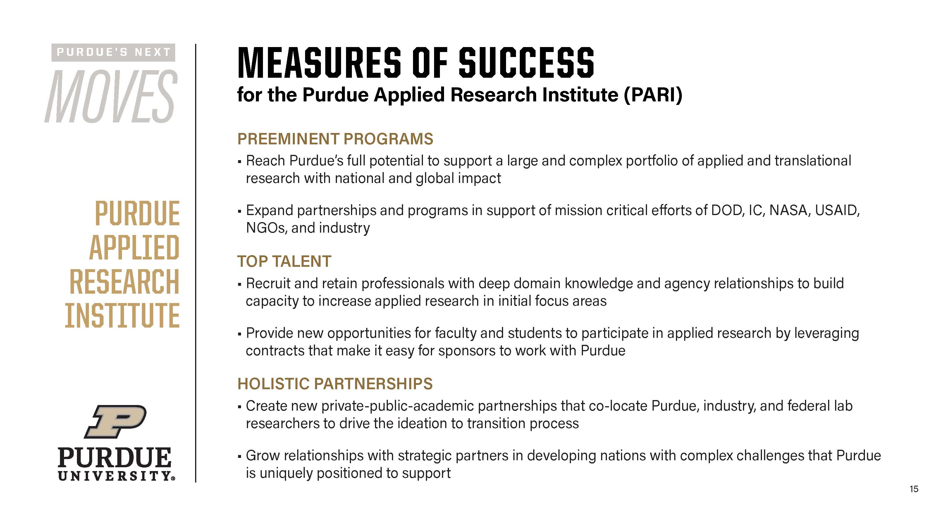
Notes:
Generally PARI’s success will be measured by these elements

Slide 5
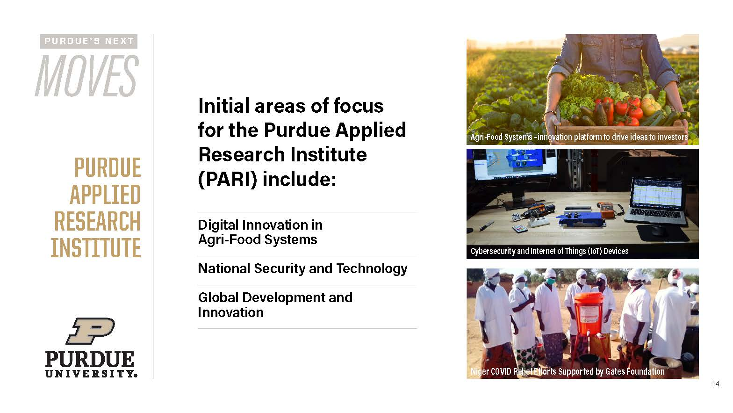
Notes:
PARI will have three divisions….
We can certainly connect you to the teams in these other divisions if you have an interest

Slide 6

USAID Commitments to Universities 2013-2019
$643 million
$81 million
$61 million
$42 million
$33 million
Purdue Applied Research Institute
Notes:
To continue to explain the rationale for creating a Global Development Division in PARI…..
You’ll note that Purdue captured $42 million in funding between 2013-2019 which at first appears to pale in comparison to Johns Hopkins, UNC, etc. but an important differentiator is that those top 7 universities have medical schools and are best know for their work in global health priorities.
With that context, as you can see – even without a medical college Purdue is in the top tier of USAID funding recipients given the strength of our programs (engr. and ag among others) and our long standing commitment to international development.
In 2019 alone, Purdue was ranked 3rd in 2019 for USAID funding receipt
Thanks in large part to the Feed the Future Innovation Lab program Dr. Haley Oliver is working on and of course LASER PULSE

Slide 7
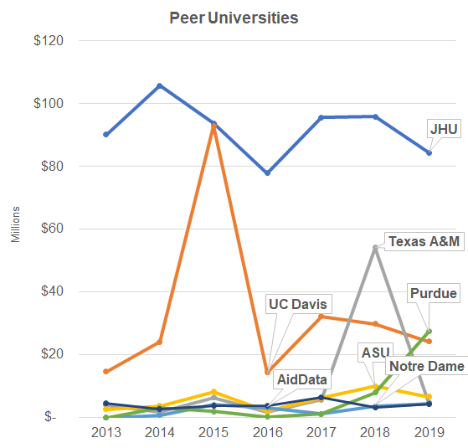
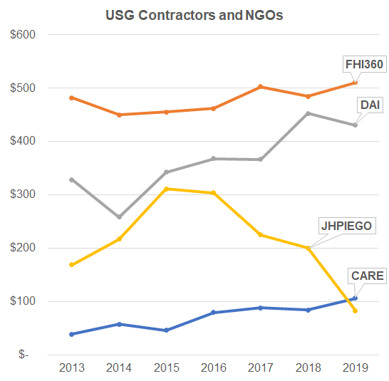
USAID Commitments to Universities and Contractors
2013 to 2019
Purdue Applied Research Institute
Notes:
Another consideration for why PARI, when Purdue is already so successful is to create consistent reliable sources of funding.
On the left you see Universities can see large peaks and valleys for their funding/work. Purdue has been able to be a bit more consistent but as you can see we are on the upswing with the potential.
Those swings compared to that of well known contractors and implementing partners who see consistent sources of funding; maybe with the exception of JHPIEGO.
The point being, PARI could provide a pathway for consistent funding streams given that PARI was created to provide flexible business structures, at a lower overhead cost, and professional staff to work alongside faculty in the support and deliver of work that goes beyond applied research.

Slide 8
What can PARI-GDI do?
Professional staff that can support Purdue faculty and increase opportunities to do this work in non-traditional ways.
Opportunities for students to work on discrete project based opportunities outside of traditional university pathways. (Graduate Researchers for International Development)
Cost competitive and nimble; eligible to work under new mechanisms/vehicles (contracts) with a wider variety of funders.
PARI-GDI vs. Purdue International (PI) – Purdue International is a vehicle/mechanism Purdue can use to establish a presence on the ground. PARI may use PI, alternatively, PARI may be able to register on the ground more easily.
Purdue Applied Research Institute
Notes:
So to expand on that further these are some of the things we envision PARI doing to serve the Purdue faculty, student and staff community that are committed to international development.

Slide 9





Areas of Practice
Purdue’s institutional country partnerships
Climate Change
Purdue’s experience: agriculture, biomedical engineering, data analytics
Education, Dr. Javad Ahmadi, Sr. Research Scientist
Democracy and peacebuilding
Purdue Applied Research Institute

Slide 10
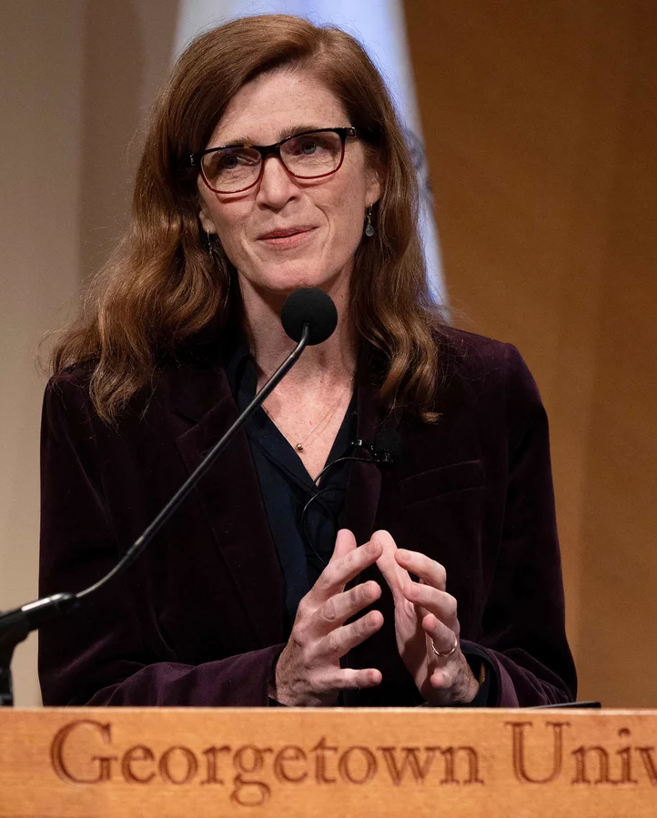
PARI-GDI’s Approach
“Foreign policy is too important to all of us to leave it to the experts and the diplomats.”
– John F. Kennedy
Broaden Participation
Listen to local voices, especially marginalized groups
Respond to partner needs by expanding partnerships
Deploy insights of behavioral and economic sciences
Use innovation and digital technology
Purdue Applied Research Institute
Notes:
Embracing Diversity, Equity, Inclusion and Access
Listening to local voices, especially marginalized groups
Expanding range of partnerships
Promoting transparency, good governance and civic engagement
Using systems analysis
Employing iterative approaches, adapt based on evidence
Using innovation and deploy digital technology

Slide 11
Current Pipeline:
Iraq University of Anbar Faculty Capacity Building (US Embassy; 2 years; $500,000)
Kenya American Schools and Hospitals Abroad (USAID, pending; $2m)
Vietnam USAID Partnership for Higher Education Reform program (USAID; sub to IU)
Algeria Research Hub (US Embassy; sub to Notre Dame)
Worldwide Remote Monitoring of Humanitarian Supply Chain (USAID: 1 year; $1.5m)
Worldwide Programming for Prevention and Peacebuilding (P4P2) IDIQ: (USAID pending; TBD)
Worldwide Research and Evaluation Innovation Fund: Global Trends in Democratic Erosion and Autocracy (Department of State; 24 months; $950,000)
Worldwide Green Recovery Investment Platform (GRIP) RFI (USAID $150 million; 8 years)
8 others in Education in WB/Gaza, Egypt, Bangladesh, C. America, Southeast Asia
Purdue Applied Research Institute
Notes:
Proposal Season is busiest from April – June, so many of our opportunities are either awaiting funder decisions (proposal submitted) or in RFI/forecasted and not yet live.
Since John’s joining in January we’ve spoken to over a dozen potential partners on some of the opportunities you see here on this slide and the next.
A key feature of PARI-GDI’s approach to this work is to contact and coordinate efforts with our esteemed colleagues in IPIA (Gerry/Gary), the CoE equivalent, GEPP Office and others around campus who are notable for their focus on this work including faculty/staff engaged in PUrdue’s country-level relationships (Peru, Colombia, India and Kenya).

Slide 12
John Glover
Executive Director
gloverjr@purdue.edu
571-236-4094
Diana Harbison
Director of Strategy and Operations
dbharbis@purdue.edu
804-338-0262
Dr. Javad Ahmadi
Senior Research Scientist, Education Policy
mahmadi@purdue.edu
202-677-8301
Linda Higbee
Senior Administrative Assistant
lhigbee@purdue.edu
https://www.purdue.edu/research/pari/
Purdue Applied Research Institute
Global Development and Innovation Division

Slide 13
Current Pipeline (Education):
West Bank/Gaza TVET Activity RFI, USAID
West Bank/Gaza Building Regional Economic Bridges (BREB), USAID
Bangladesh Higher Secondary Education USAID
LAC HELIX New Higher Education USAID
Egypt Scholarships and Learning RFI USAID
Southeast Asia Regional Inclusive Digital Economy Activity (RDMA) USAID
University of Lesotho and Timor-Leste Secondary Education, Teacher Training and School Leadership compacts under development, Millennium Challenge Corporation
Purdue Applied Research Institute
Notes:
The United States Agency for International Development in Cairo, Egypt (USAID/Egypt) is contemplating a new eight-year activity to provide undergraduate, postgraduate, and continuing education opportunities that will build a stronger workforce in sectors critical to Egypt’s economic growth.
Lesotho- Agriculture entrepreneurship among other capacity building activities.
Timor Leste: Secondary Education, Teacher Training and School Leadership

