Slide 1
Campus emergency preparedness training series
2022 All Hazards Awareness Training

Slide 2
Overview
All-Hazards Planning
PurdueALERT
Shelter In Place
Evacuation
Resources
What You Can Do To Prepare

Slide 3
Possible Incidents
Human-caused Incidents:
Aircraft crashes; Bomb threat/detonation; Civil disturbances; Epidemic/illnesses; Extended power outages; Fires and Explosions; Hazardous materials releases; Mass casualty events; Terrorism; Search & rescue events; Workplace violence; Active shooter

Slide 4
Possible Incidents
Major Natural Disasters:
Tornados; Earthquakes; Severe weather, Ice and Snow; Floods

Slide 5
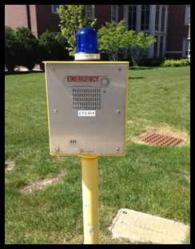
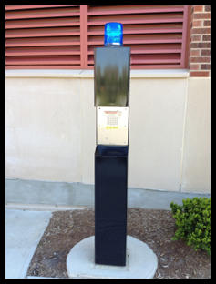
All Campus Emergencies Call/Text 911
Call or Text 911
Emergency Telephone Boxes (ETS)
Over 300 on campus…look for the blue light!

Slide 6
PurdueALERT Emergency Alert System
Basic Concepts:
Simple
Redundant
Quick
Centralized
The PurdueALERT system notifies the campus community of a possible safety threat. Individuals should take immediate action and seek further information by all means possible.

Slide 7
PurdueALERT Emergency Alert System
PurdueALERT Layers:
Outdoor All-Hazards Emergency Warning sirens: (Shelter In Place)
Indoor Fire Alarms: (Evacuate)
Text messaging: Purdue University faculty, staff and students may sign up via the Secure Purdue website to receive an emergency notification text message.

Slide 8
PurdueALERT Emergency Alert System
PurdueALERT Layers:
Twitter: Use your Twitter app to push notifications from @purdueemergency to your smartphone.
Desktop Popup Alerts: Alert will be sent to the majority of University classroom & lab computers and display incident information on computers that are logged in.

Slide 9
PurdueALERT Emergency Alert System
PurdueALERT Layers:
Alert Beacons: Alert will be sent to the beacons that are installed in large classrooms. Beacons alarm audibly for 10 seconds; flash & text alert will be available for 5 minutes.
Digital Signs: Alert will be sent to over 300 signs around campus.

Slide 10
PurdueALERT Emergency Alert System
PurdueALERT Layers:
Email: An email may be sent to all people with a purdue.edu address.
Purdue Campus Safety Status page: www.purdue.edu/ea is the focal point of the most complete information in all campus-related emergencies. Includes an embedded @purdueemergency Twitter Feed.

Slide 11
PurdueALERT Emergency Alert System
PurdueALERT Layers:
Boiler TV: The Boiler Television Emergency Alerting System may also broadcast emergency information.
Local Media: The University works with the news media, radio, TV, newspapers, and Internet, to help spread the word.

Slide 12
All Hazards Outdoor Warning Sirens
7-On Campus & 74 in Tippecanoe Co.
Tornado Warning
Active threat incidents
Major hazardous materials release incidents
When directed by Public Safety Officials

Slide 13
Building Fire Alarms
Fire Alarm Horns, Strobes, and Speakers
Many types of systems in buildings.
Must evacuate the building when the fire alarm is sounding.

Slide 14
PurdueALERT Text Message
Opt-in from Secure Purdue website
Must Opt-in to receive messages:
www.purdue.edu/securepurdue

Slide 15
Twitter
@purdueemergency Twitter Feed
No Purdue Career Account needed.
Will need a Twitter Account.
Simulcasts the PurdueALERT text message.

Slide 16
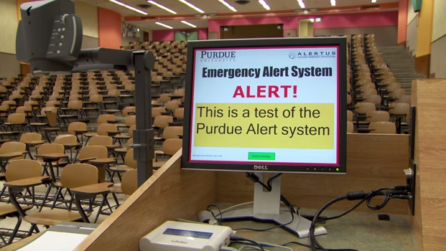
AlertUs Desktop Pop-Up Alert
AlertUs Desktop
“Take over” a Purdue logged in computer and display an alert message.
Clicking the “enter” key to acknowledge receipt (PC) or dismiss (MAC) and return to the normal screen.

Slide 17
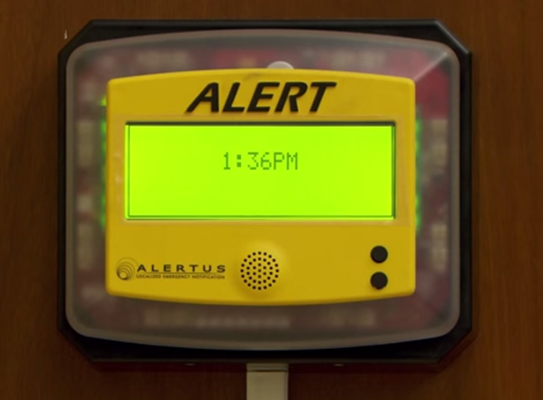
AlertUs Beacons
Wall-Mounted Beacons (large lecture halls)
Alarm for 10 seconds (cannot be muted)
Flash for approximately 5 minutes
Provide incident information (Info available for 5 minutes before it resets)

Slide 18
Digital Signage
Wall, Celling, or Pedestal Mounted Displays
Over 200 digital signs around campus will display the ALERT message for approximately ten minutes.

Slide 19
Purdue Email
Purdue Career Account Email
An email may be sent to all purdue.edu email addresses to supplement text message based on the needs of the incident.

Slide 20
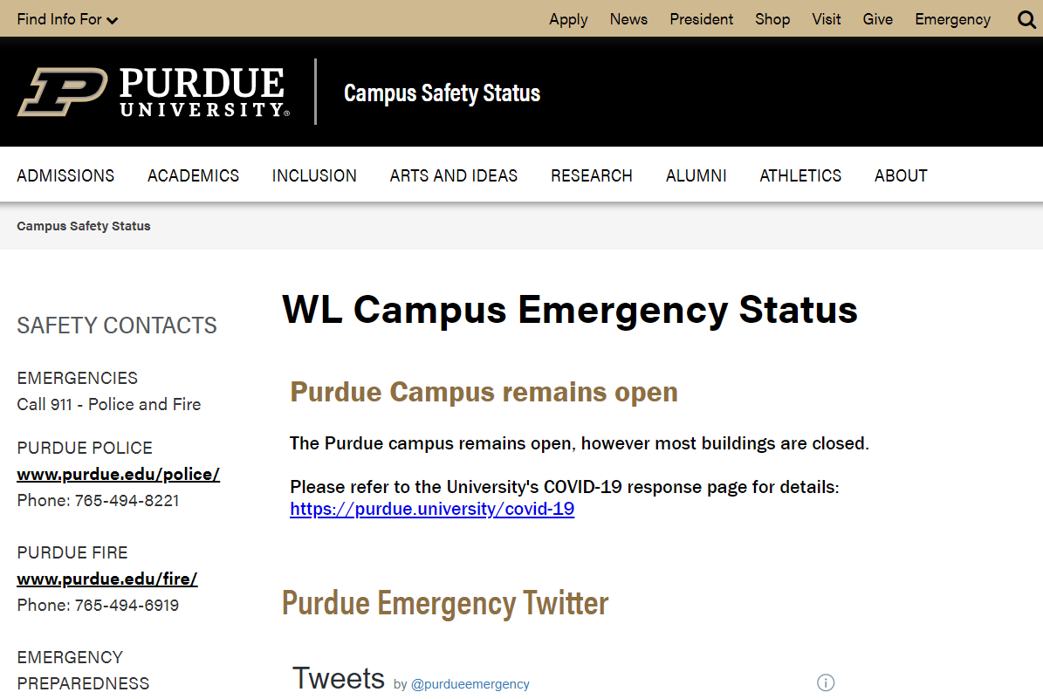
Campus Status Page
WL Campus Emergency Status
www.purdue.edu/ea

Slide 21
Emergency Alert System (EAS)
Boiler TV and Local TV Stations
Boiler Television Emergency Alerting System may also broadcast emergency information.

Slide 22
Simple Message Inside & Outside
When you hear:
ALL-HAZARDS OUTDOOR WARNING SIRENS: immediately seek shelter (Shelter In Place) in a safe location within closest facility
FIRE ALARMS: immediately evacuate the building and move to a safe location
In both cases, you should seek additional clarifying information by all possible means--Text, Campus Safety Status Page, TV, radio, email, etc.

Slide 23
Shelter In Place
To immediately shelter inside a campus building:
This course of action may need to be taken during a tornado, an active threat such as a shooting, or a release of major hazardous materials in the outside air.
When you hear the sirens immediately go inside a building to a safe location and use all communication means available to find out more details about the emergency.
Remain in place until police, fire, or other emergency response personnel provide additional guidance or tell you it is safe to leave.

Slide 24
Shelter In Place—Severe Weather
Thunderstorm Warning & Tornado Warning:
Outdoor All-Hazards Warning Sirens will activate (Tornado Warning).
Text, Twitter, Desktop Popup Alert, BTV EAS, Digital Signs & Alert Beacons will be activated (Text & Twitter for Thunderstorm Warning).
Immediately go inside a campus building to the lowest level away from exterior doors and windows.

Slide 25
Shelter In Place—Active Threat
Active Threats:
Outdoor All-Hazards Warning Sirens will activate.
Normally, all other Purdue ALERT layers will be activated…
Response depends on the type of incident.

Slide 26
Active Threat Survival Strategies
Run—If there is an accessible escape path:
Be sure to:
Have an escape route and plan in mind
Escape regardless of whether others agree to follow
Leave your belongings behind
Help others escape, if possible
Prevent individuals from entering an area where the active shooter may be
Keep your hands visible
Follow the instructions of any police ofﬁcers
Do not attempt to move wounded people
Call 911 when you are safe

Slide 27
Active Threat Survival Strategies
Hide—If escape is not possible:
Your hiding place should:
Be out of the active threat’s view
Provide protection if shots are ﬁred in your direction (i.e., an ofﬁce with a closed and locked door)
Not trap you or restrict your options for movement
To prevent an active threat, such as a shooter from entering your hiding place:
Lock the door if safely possible
Blockade the door with heavy furniture

Slide 28
Active Threat Survival Strategies
Hide—If escape is not possible:
If the active threat is nearby:
Lock the door
Turn off the lights
Close the blinds
Silence your mobile devices
Turn off any source of noise (i.e., radios, televisions)
Hide behind large items (i.e., cabinets, desks)
Remain quiet

Slide 29
Active Threat Survival Strategies
Fight—If escape and hiding are not possible:
As a last resort, and only when your life is in imminent danger, attempt to disrupt and/or incapacitate the active threat by:
Acting as aggressively as possible against him/her
Throwing items and improvising weapons
Yelling
Commit to your actions, then act.

Slide 30
Thank You
Campus Emergency preparedness & planning office

