Slide 1
2023 Mandela Washington Fellowship Participants

Slide 2
Thank you to our sponsor

Slide 3
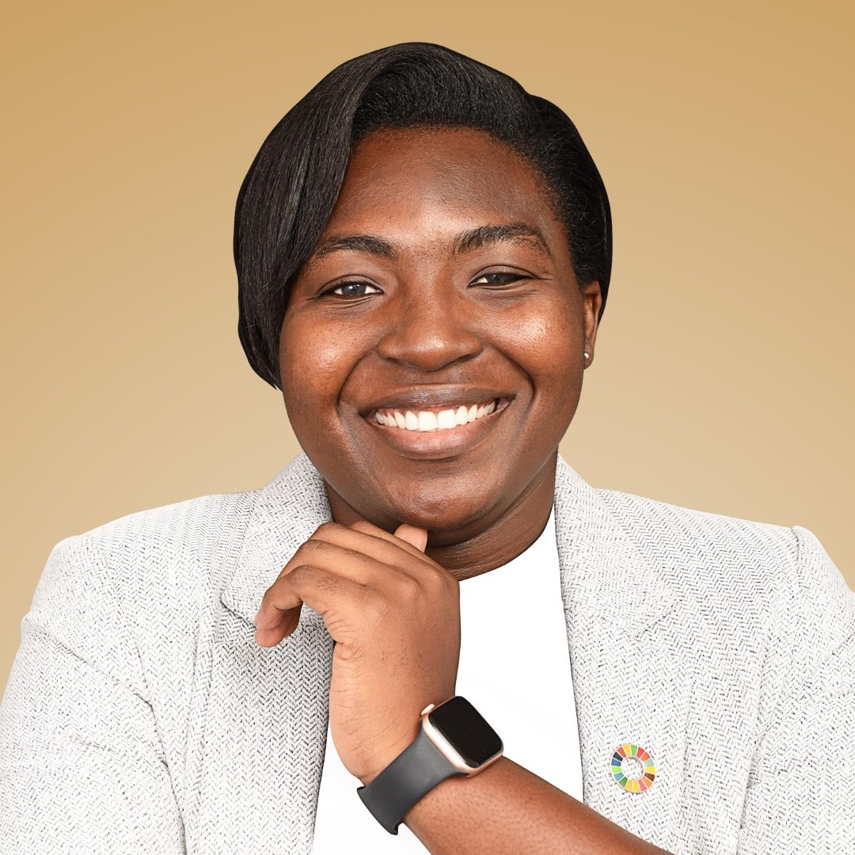
Hillary Widanama Adare
Country: Ghana

Slide 4
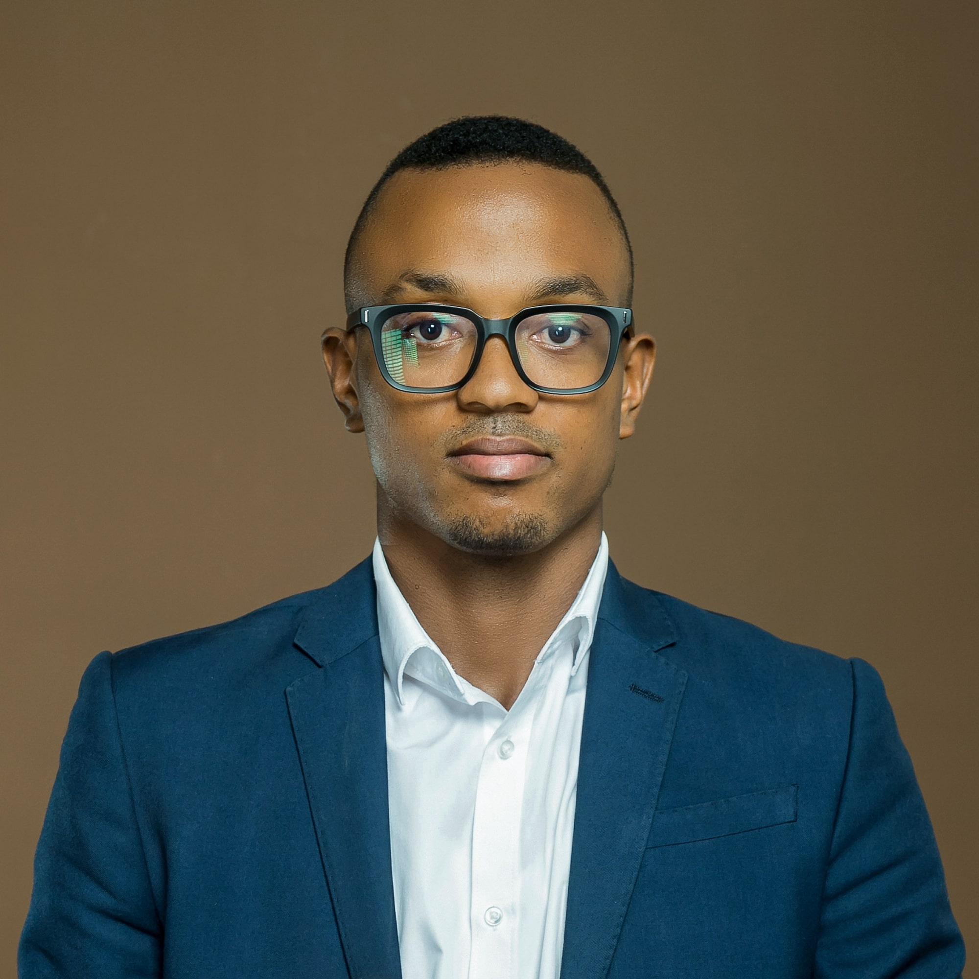
Christian Agbalekpor
Country: Ghana

Slide 5
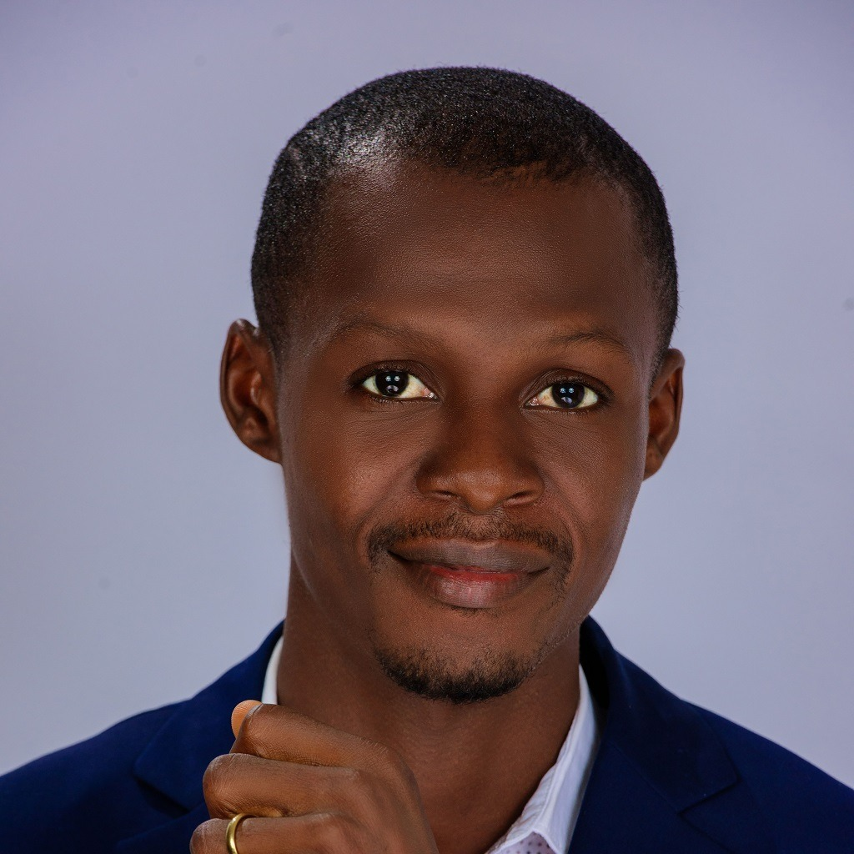
Terese
Shadrach Akpem
Country: Nigeria

Slide 6
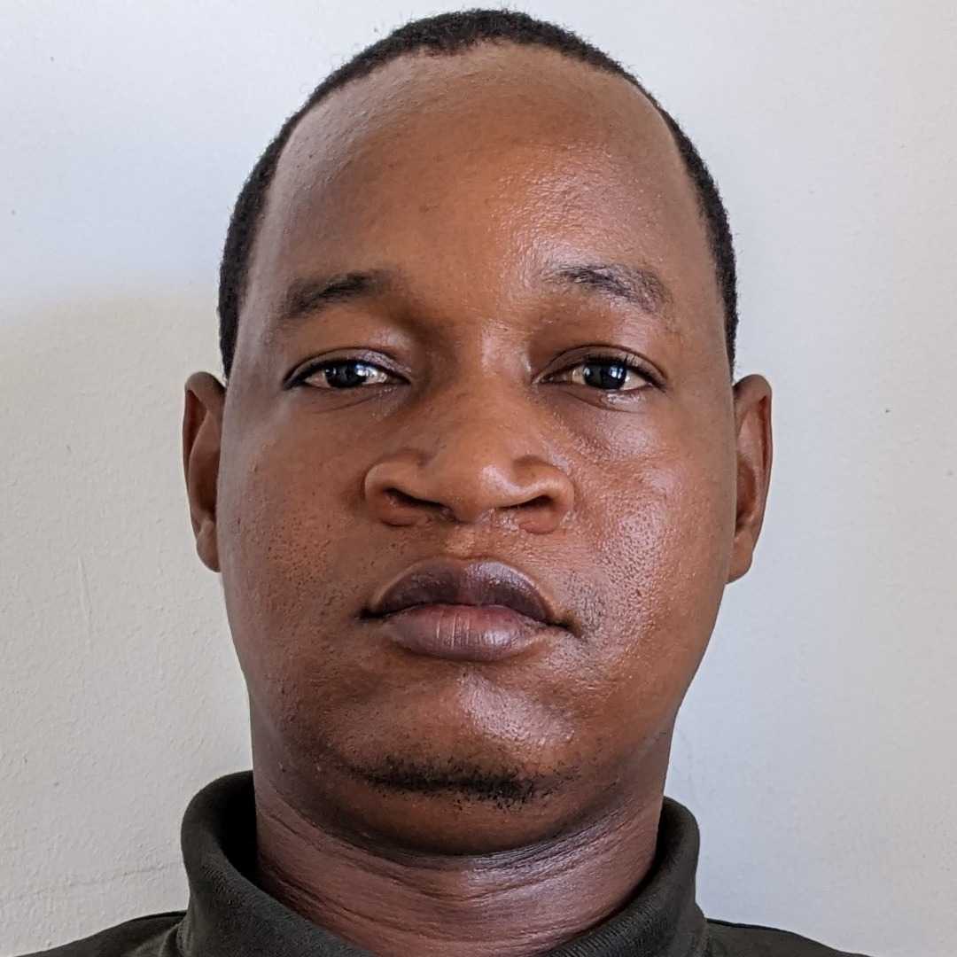
Soume
Bouraima
Country: Togo

Slide 7
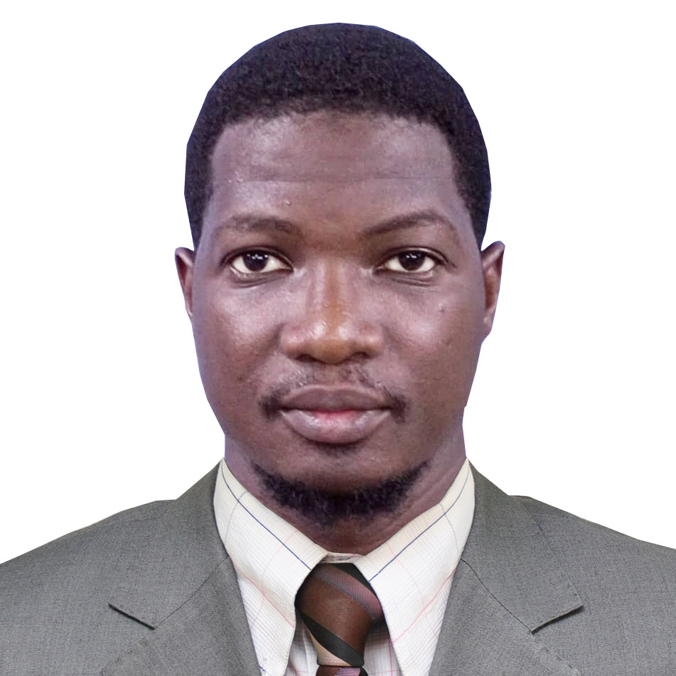
Wenmanegda
Elie 2E Jumeau Dipama
Country: Burkina Faso

Slide 8
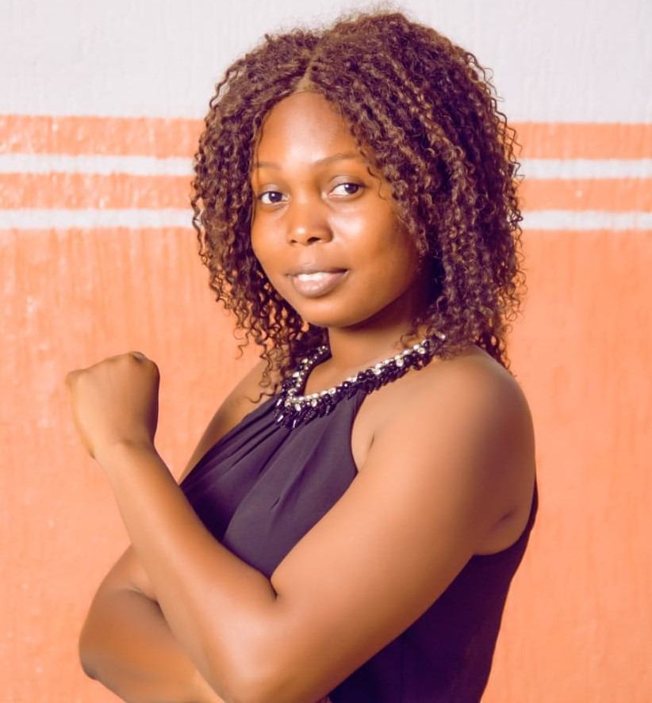
Maya
Mame Fifame
Tertulienne Dohou
Country: Benin

Slide 9
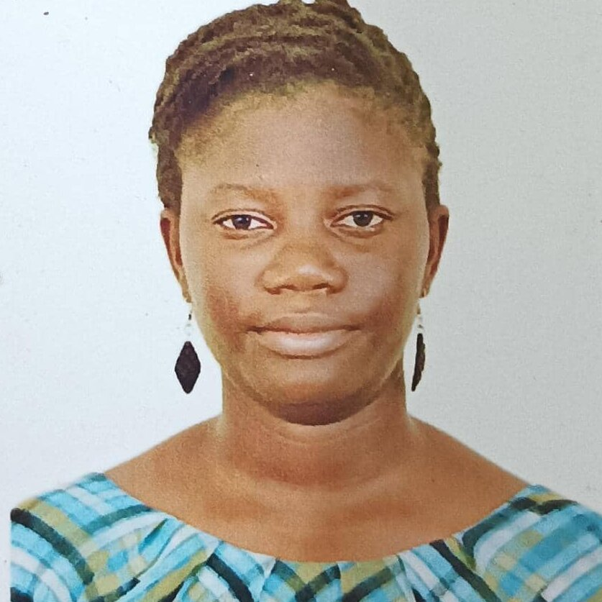
Bignon Priscille Bijou Dossou
Country: Benin

Slide 10
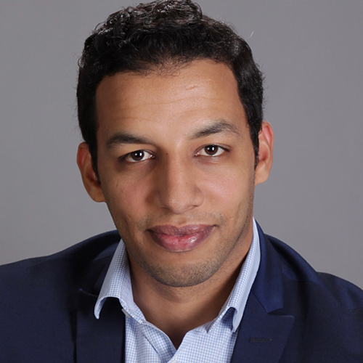
El Moustapha
El Abass
Country: Mauritania

Slide 11
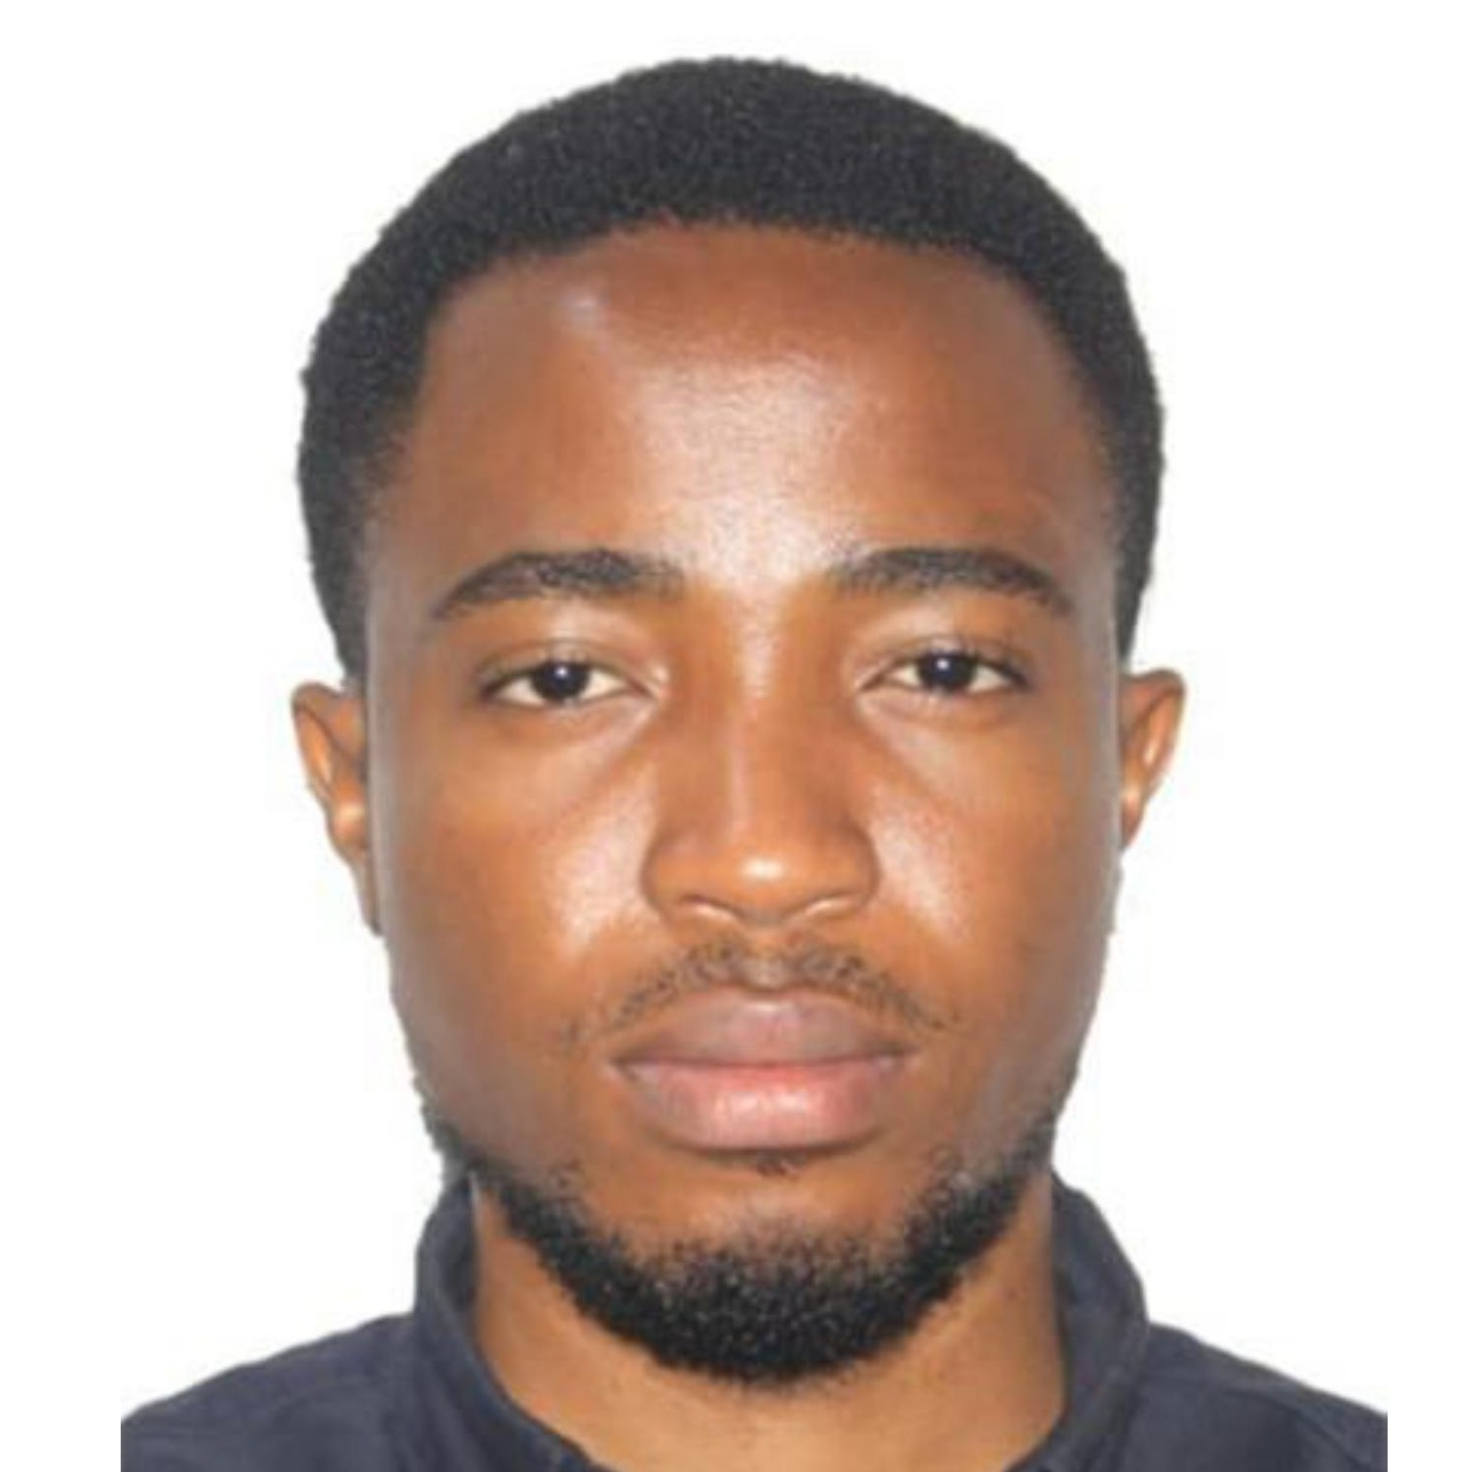
Theodore Junior
Essono Belibi
Country: Cameroon

Slide 12
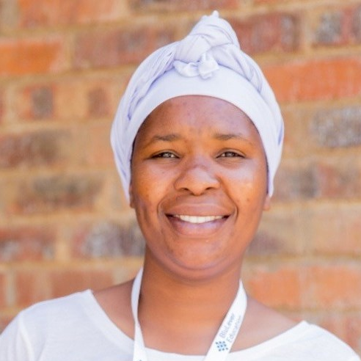
Phindile
Tarnia Gosha
Country: Zimbabwe

Slide 13
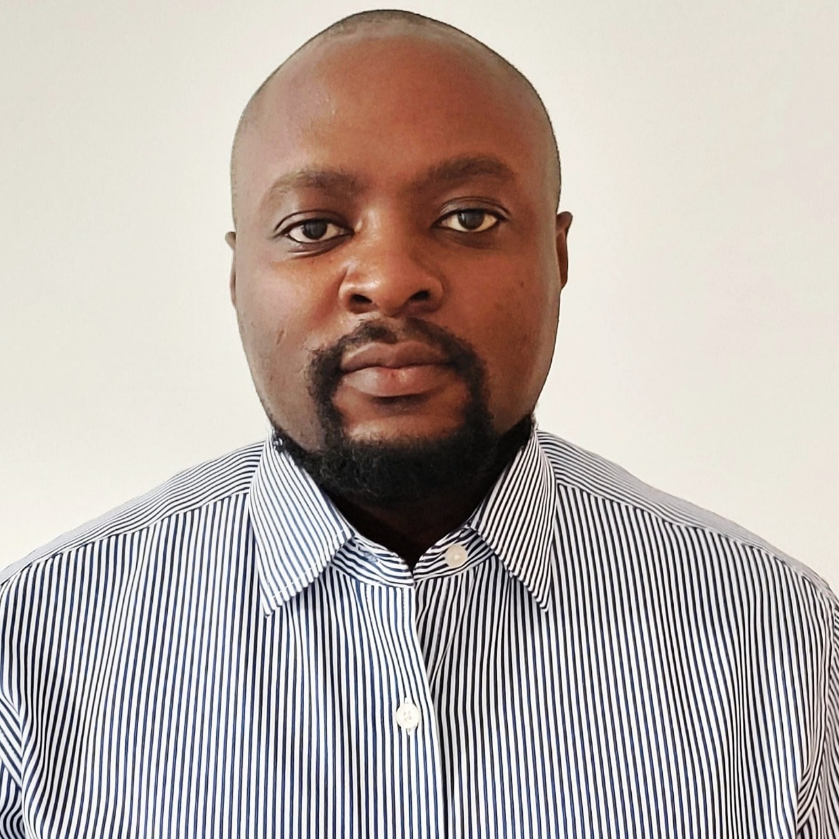
Brian
Kiberenge
Kamasi
Country: Kenya

Slide 14
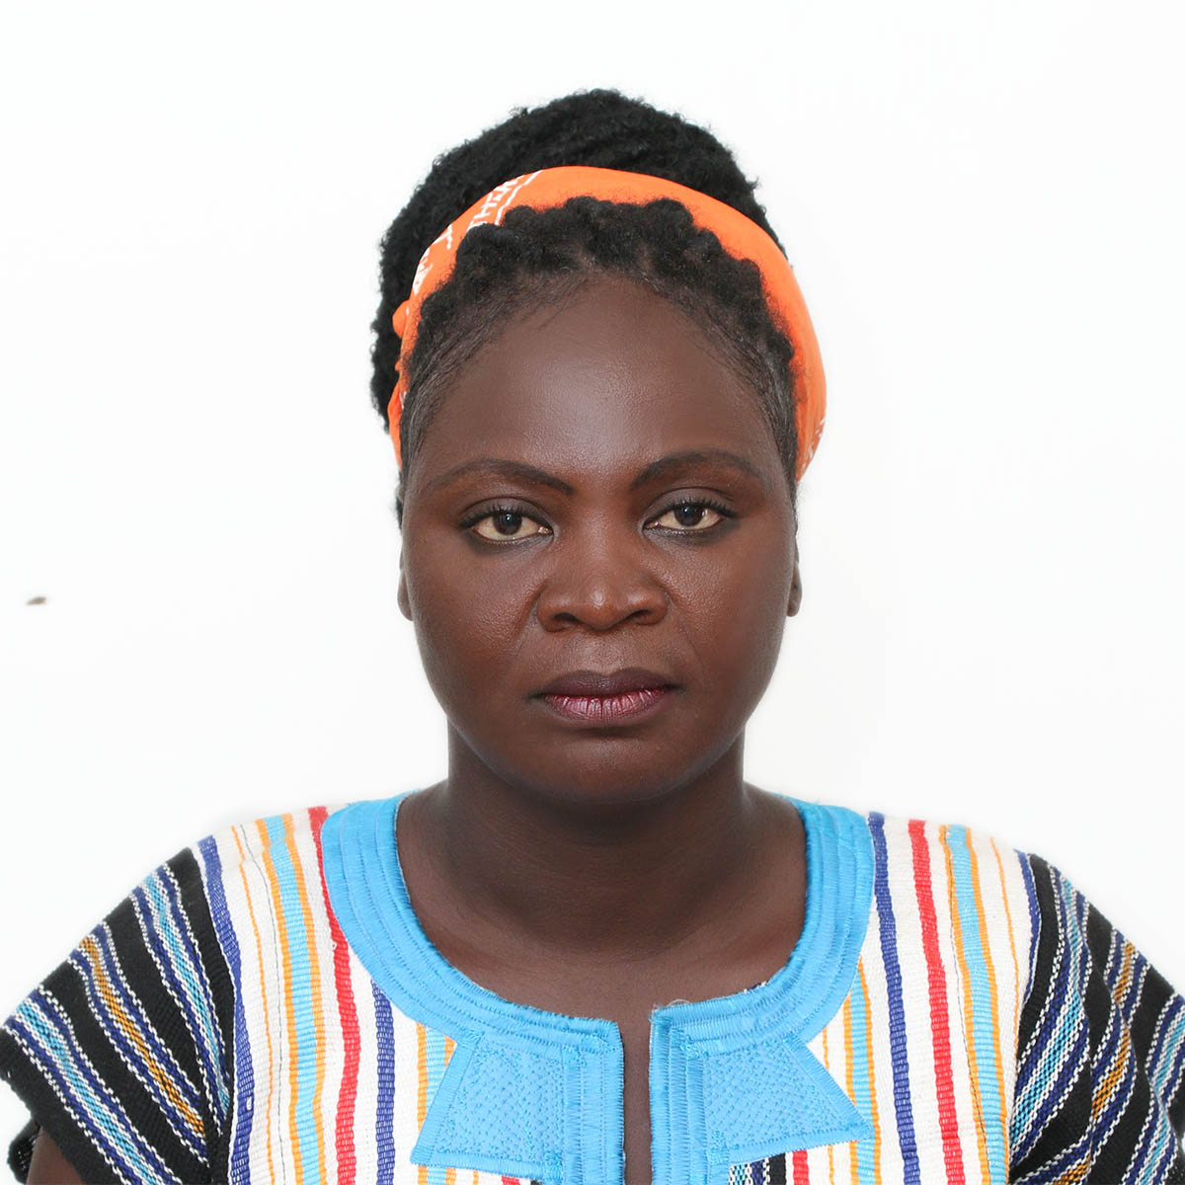
Denise
Litopoe Karway
Country: Liberia

Slide 15
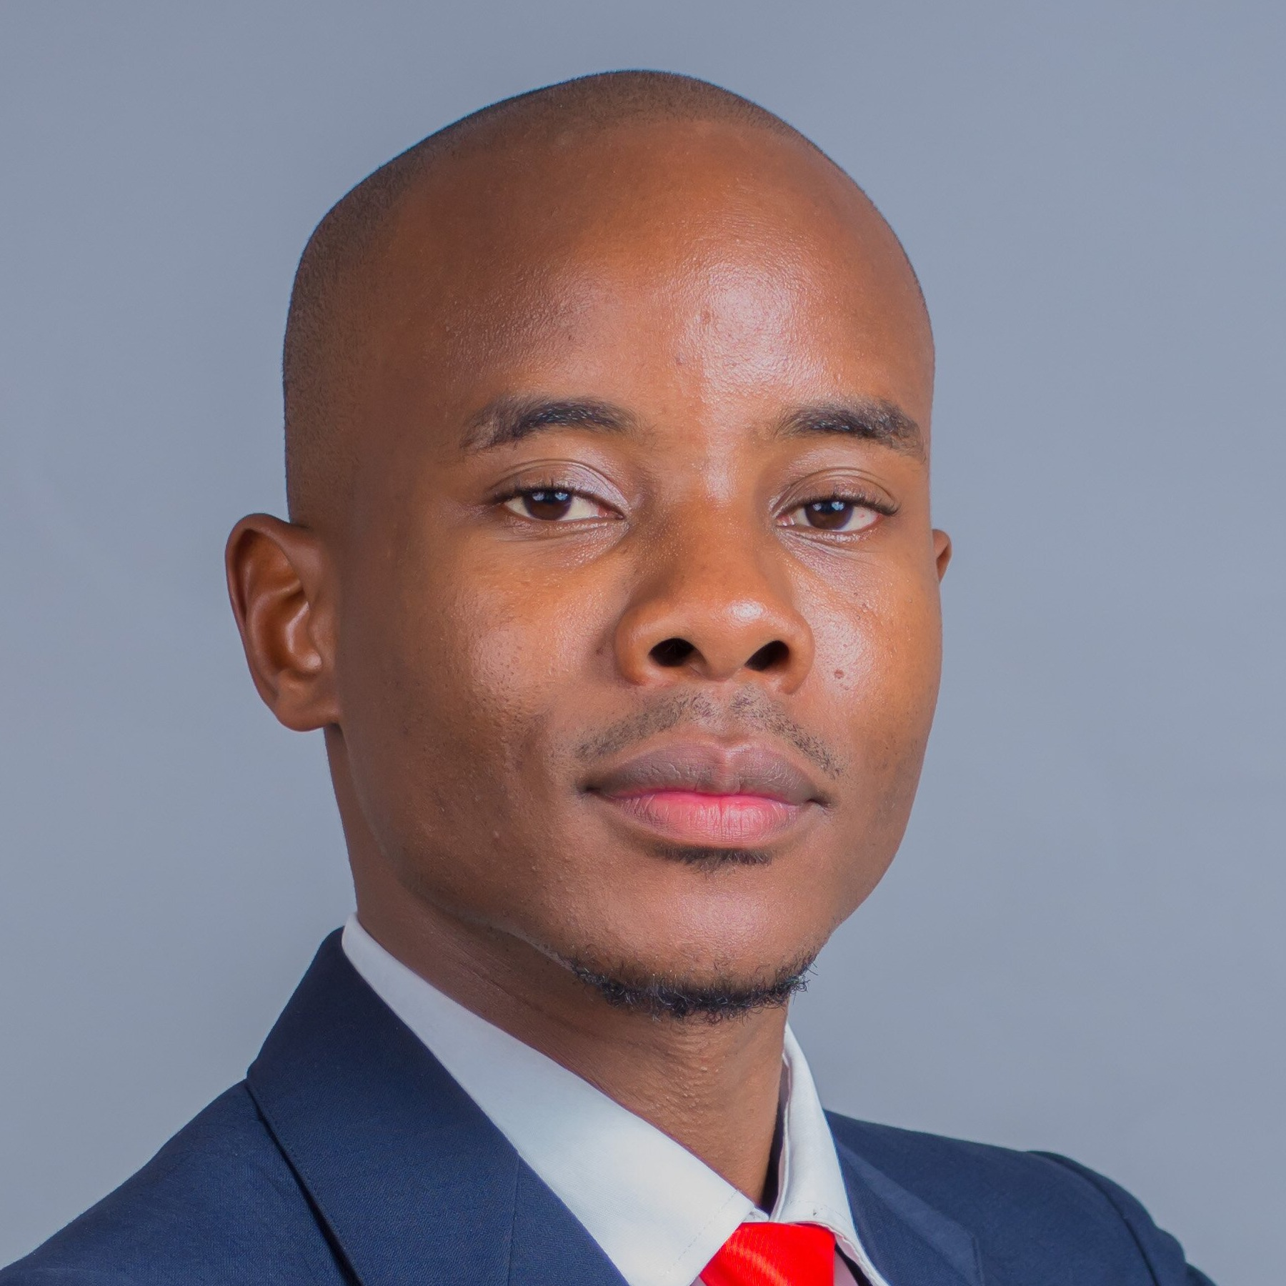
Dumisanie Lawrence Mambiya
Country: Malawi

Slide 16
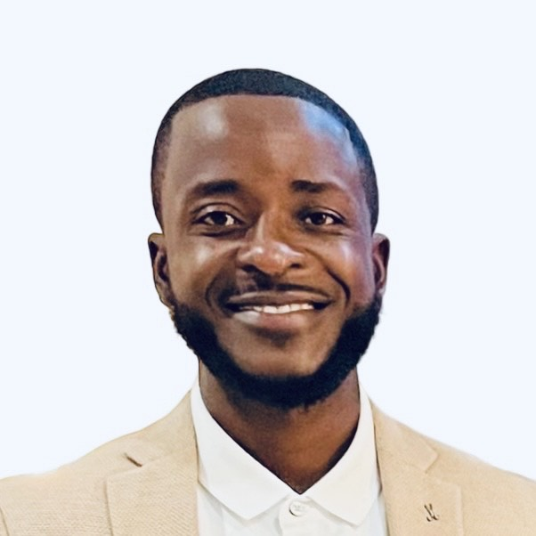
Terence
Maphosa
Country: Zimbabwe

Slide 17
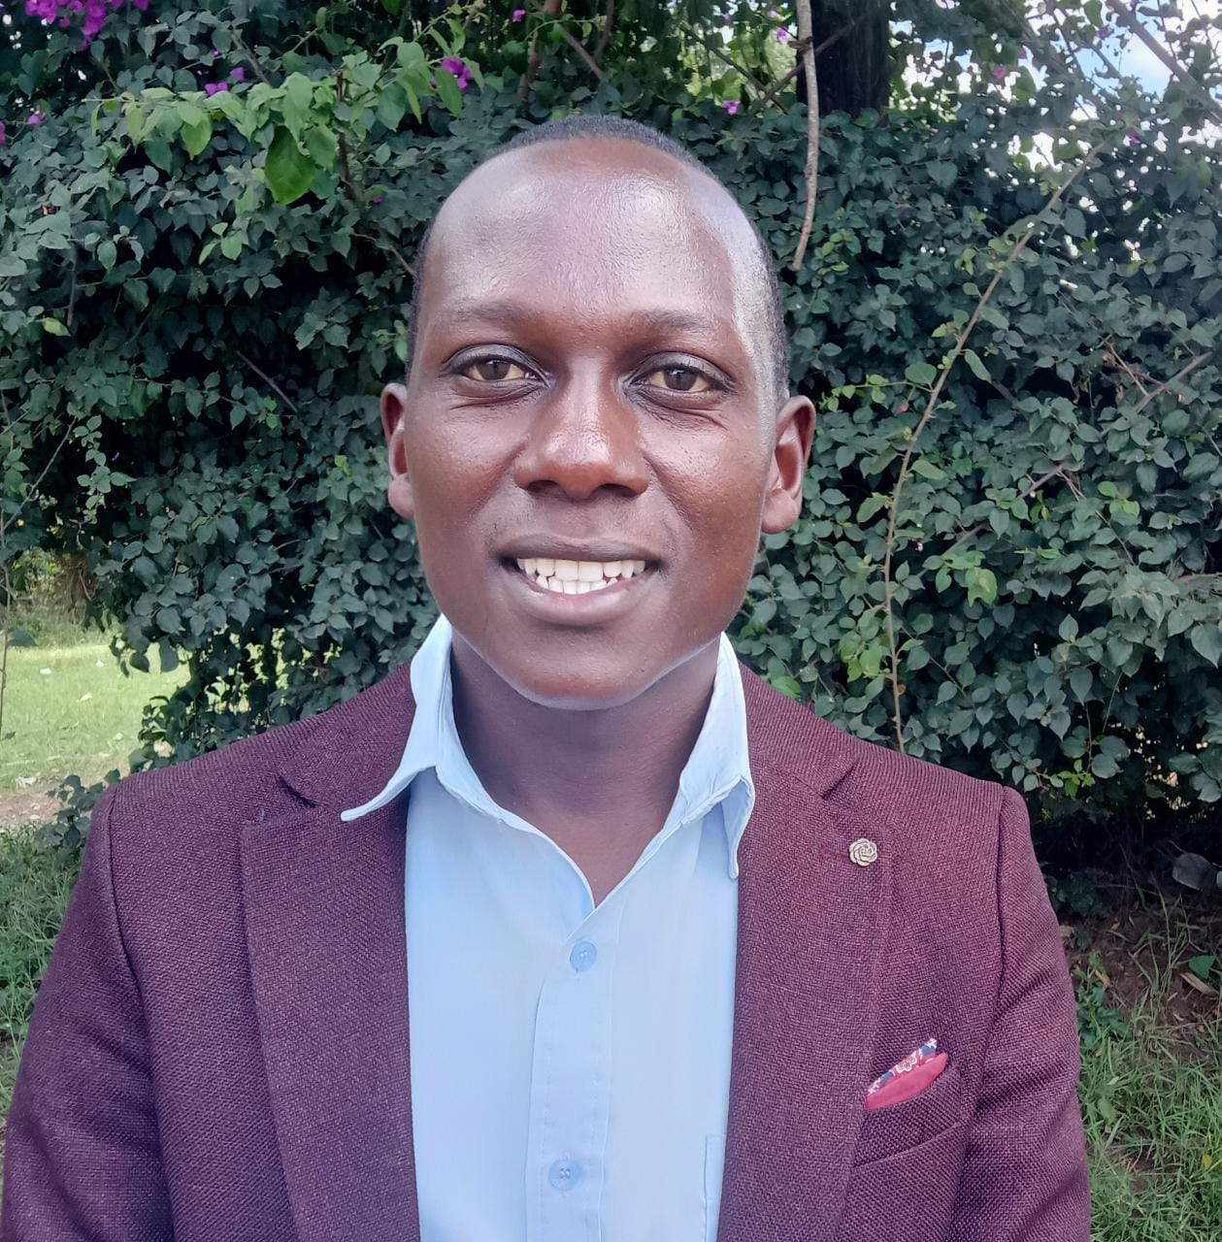
Shadrack
Sune Mulunga
Country: Kenya

Slide 18
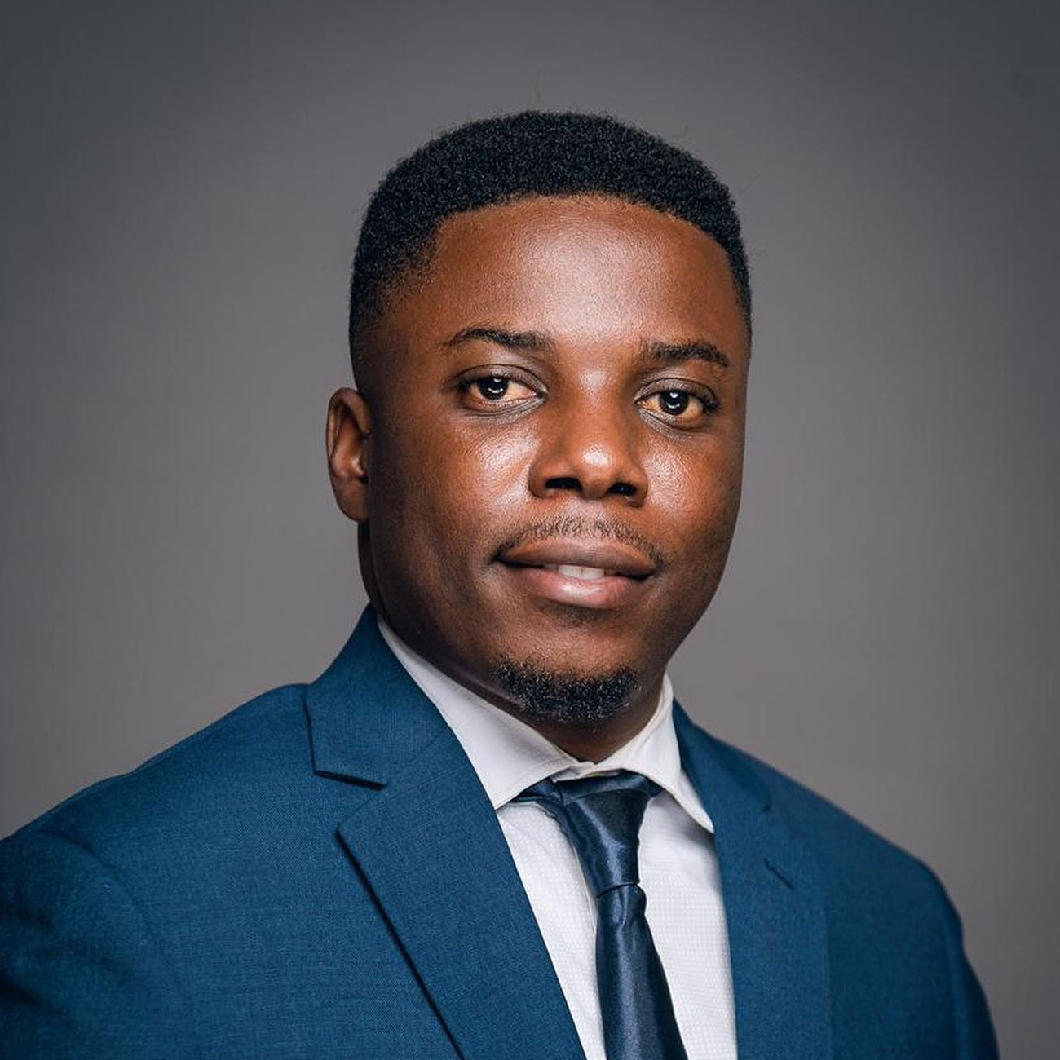
Hilaire Amini Mbogimbogi Muzibao
Country: Democratic
Republic of the Congo (DRC)

Slide 19
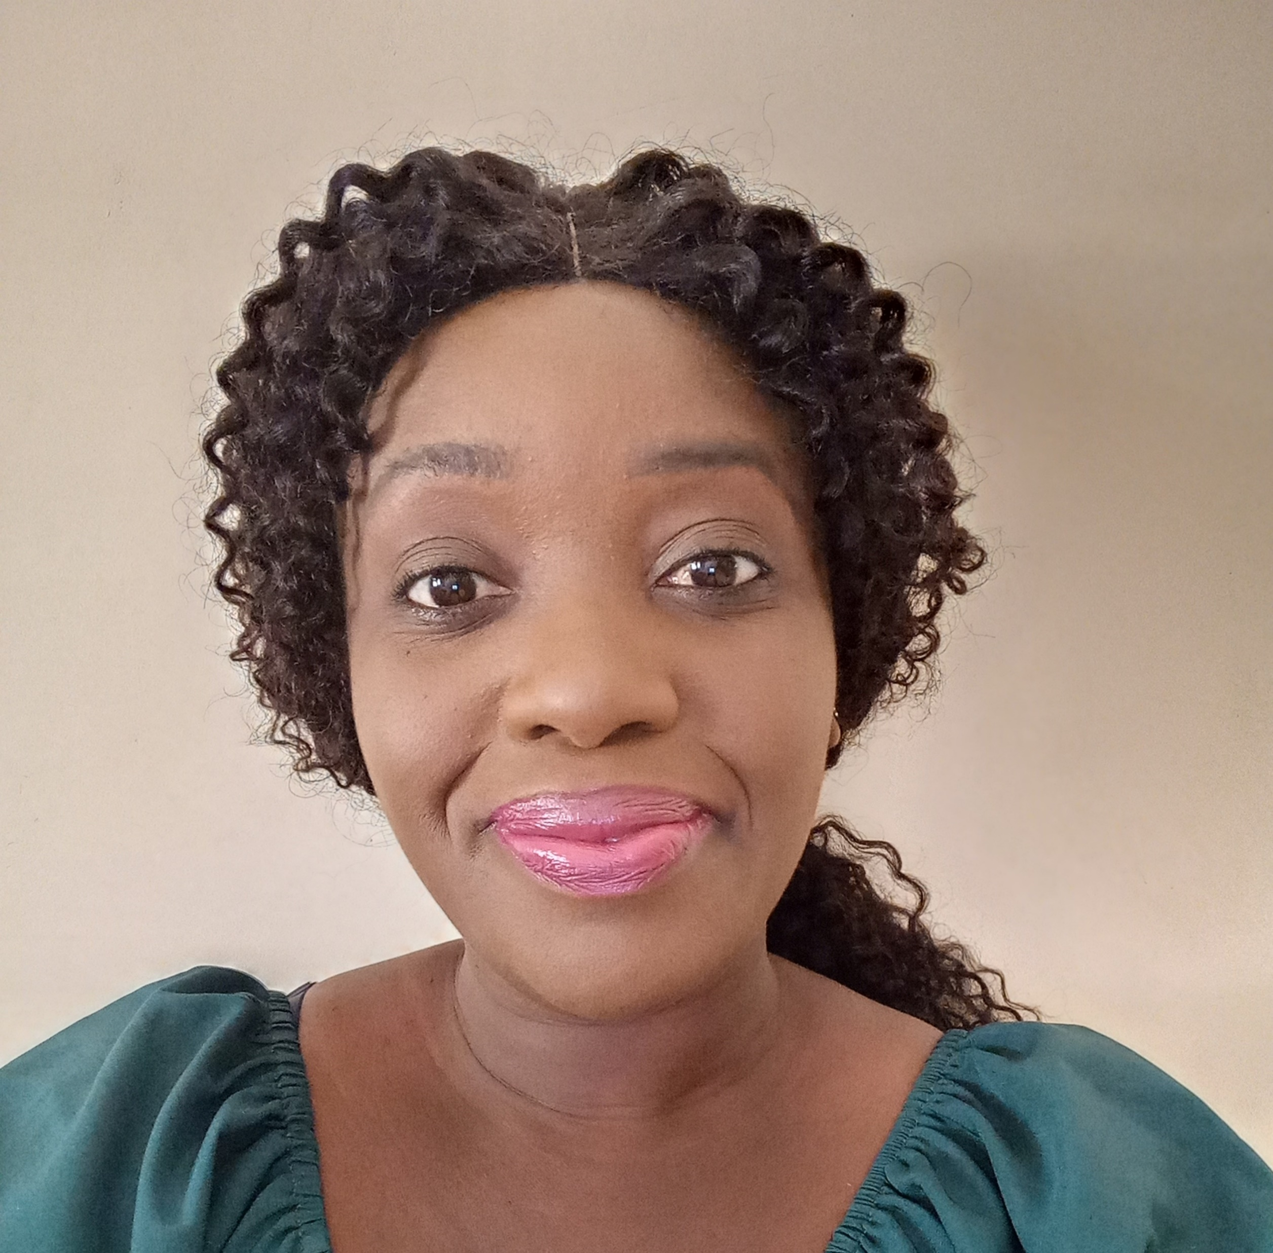
Natasha
Mwansa
Country: Zambia

Slide 20
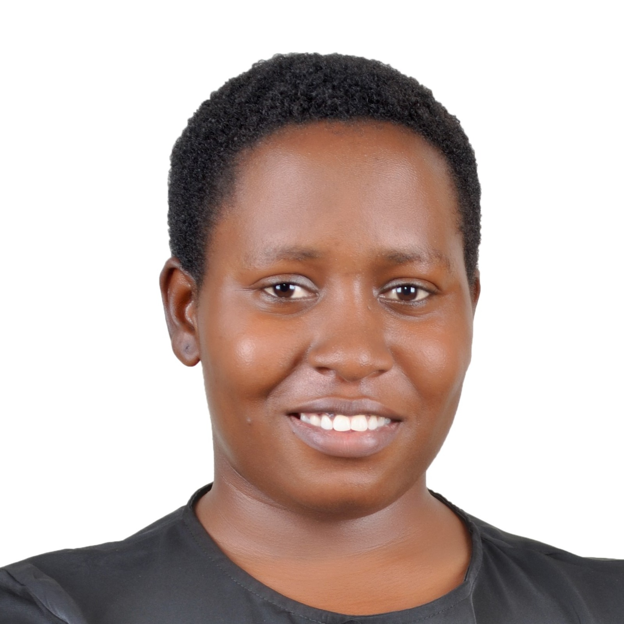
Alicia
Mbalire
Namakula
Country: Uganda

Slide 21
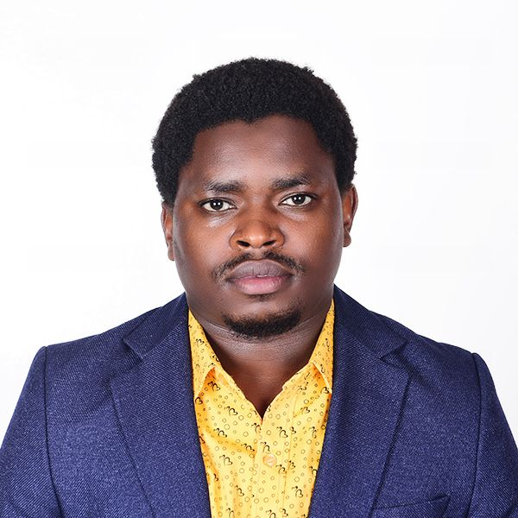
Etienne
Niyigaba
Country: Rwanda

Slide 22
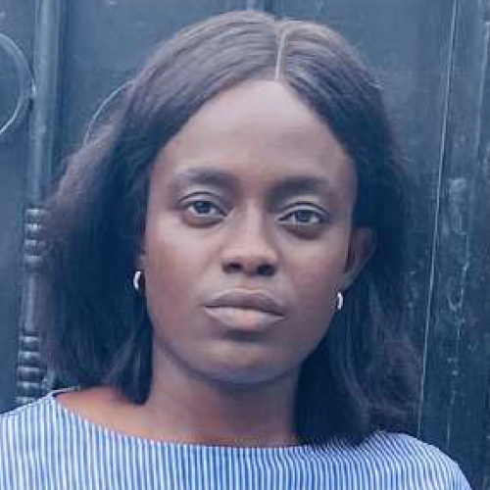
Gislaine
Matiedje
Nkenmayi
Country: Cameroon

Slide 23
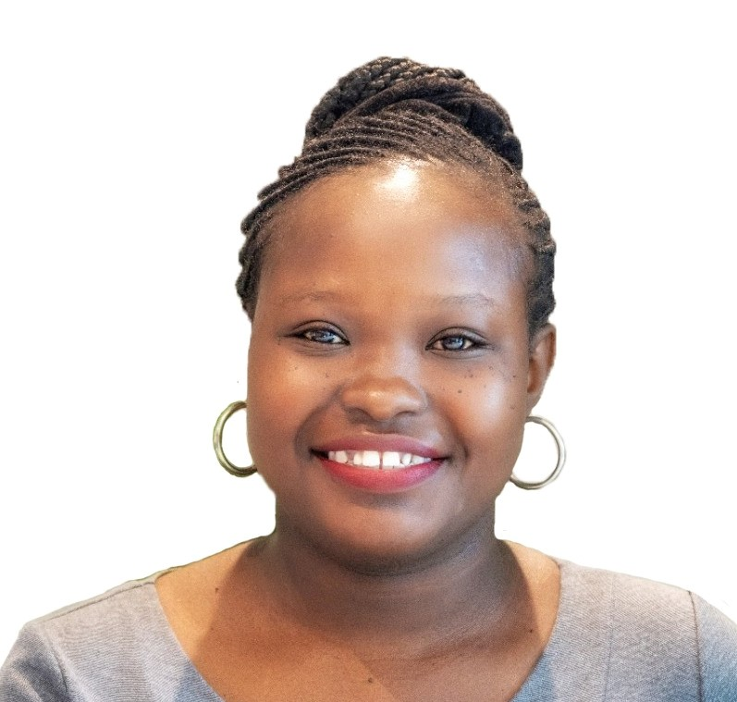
Lavender
Ogada Odeny
Country: Kenya

Slide 24
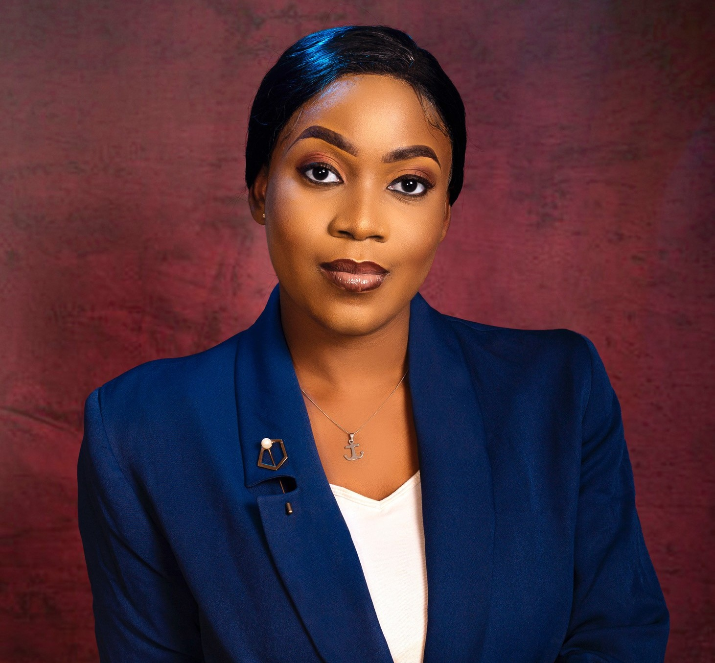
Osato
Omo-Osemwingie
Country: Nigeria

Slide 25
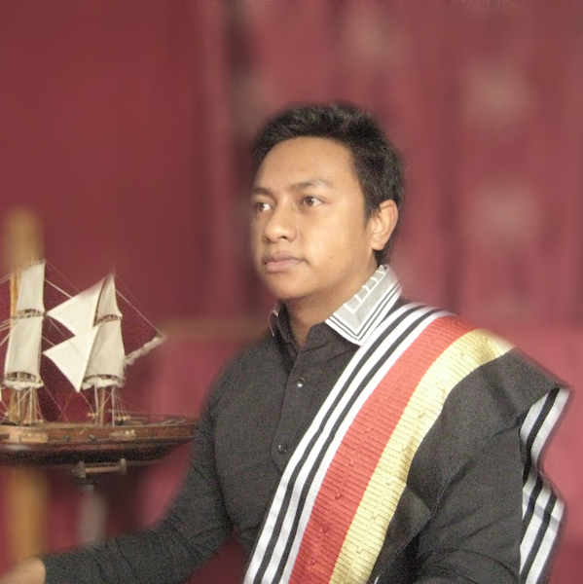
Miarizaka Fabien
Randriamananjara
Country: Zimbabwe

Slide 26
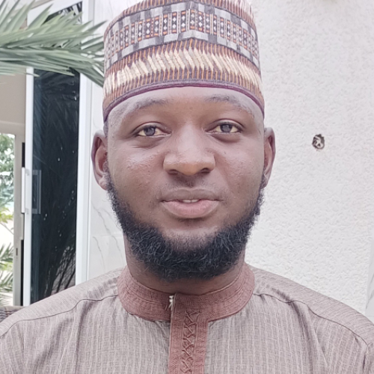
Muhammad
Abdullahi Usman
Country: Nigeria

Slide 27
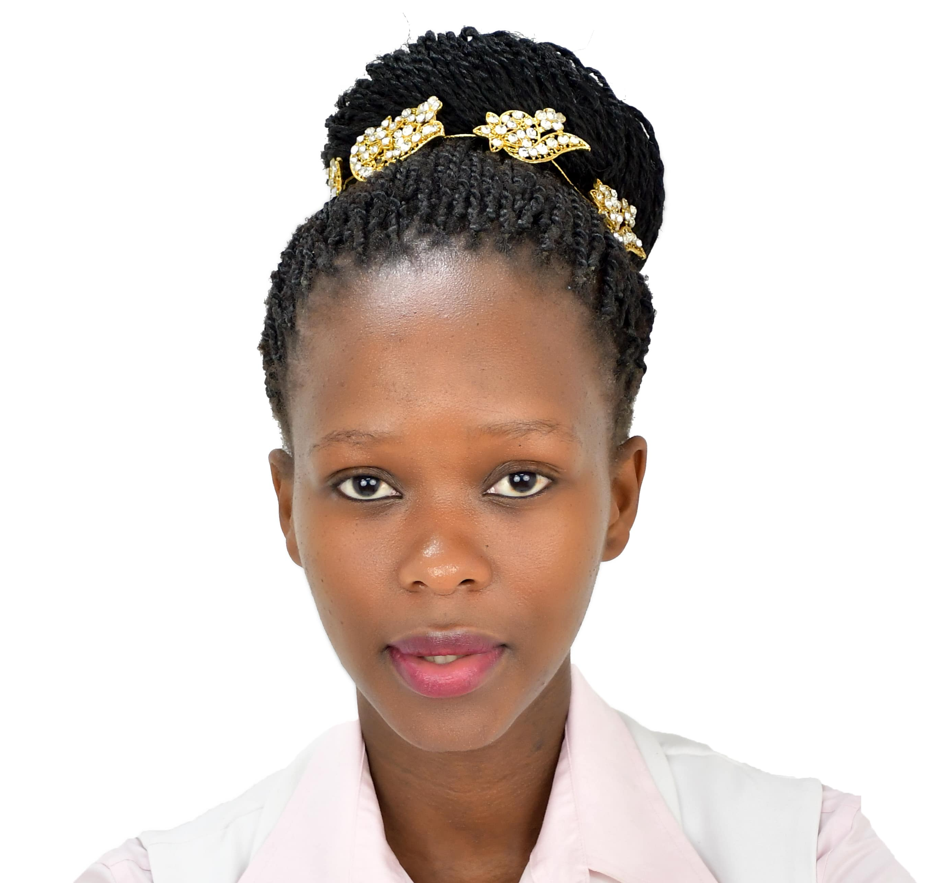
Temangweni
Zwane
Country: Eswatini

