Slide 1
International Trade, Food Security and Environmental Sustainability
Presentation by Thomas Hertel
Department of Agricultural Economics, Purdue University
For the Mandela Washington Fellows Program
June 27, 2023
With contributions by Dr. Kayenat Kabir, Research and Teaching Fellow, Center for Global Trade Analysis
For more details, visit: https://glassnet.net

Slide 2
Outline of the talk
Food security in the context of the UN Sustainable Development Goals
Economic analysis of food system drivers and impacts in the context of globalization of markets
Case study of Niger
Human heat stress and climate impacts in West Africa

Slide 3
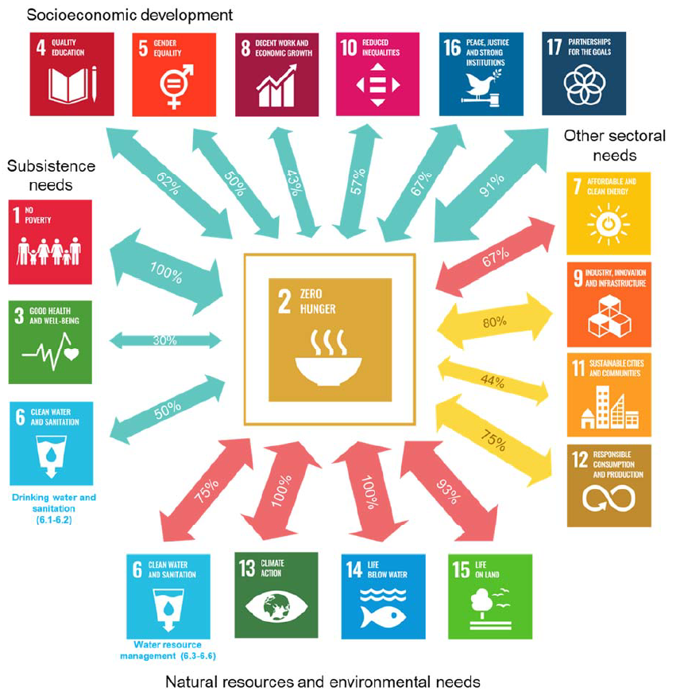
Food Security is inextricably intertwined with the other 16 UN-SDGs
Arrow widths indicate the strength of the relationship calculated as the share of targets in each SDG that are connected to SDG2 main targets. Indicate risks of trade-offs: green = no or limited risk of trade-offs, orange = moderate risk of trade-offs, red = high risk of trade-offs.
Source: Valin, Hertel et al., 2023 (In Review)

Slide 4
Food Security is synergistic with many SDGs. However, it poses Significant Challenges to the Environment
Arrow widths indicate the strength of the relationship calculated as the share of targets in each SDG that are connected to SDG2 main targets. Indicate risks of trade-offs: green = no or limited risk of trade-offs, orange = moderate risk of trade-offs, red = high risk of trade-offs.
Source: Valin, et al., 2023 (In Review)

Slide 5
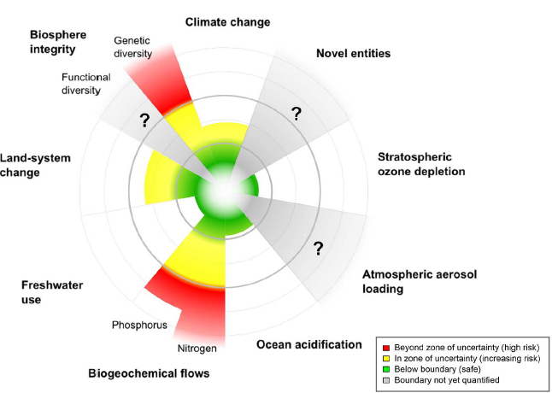
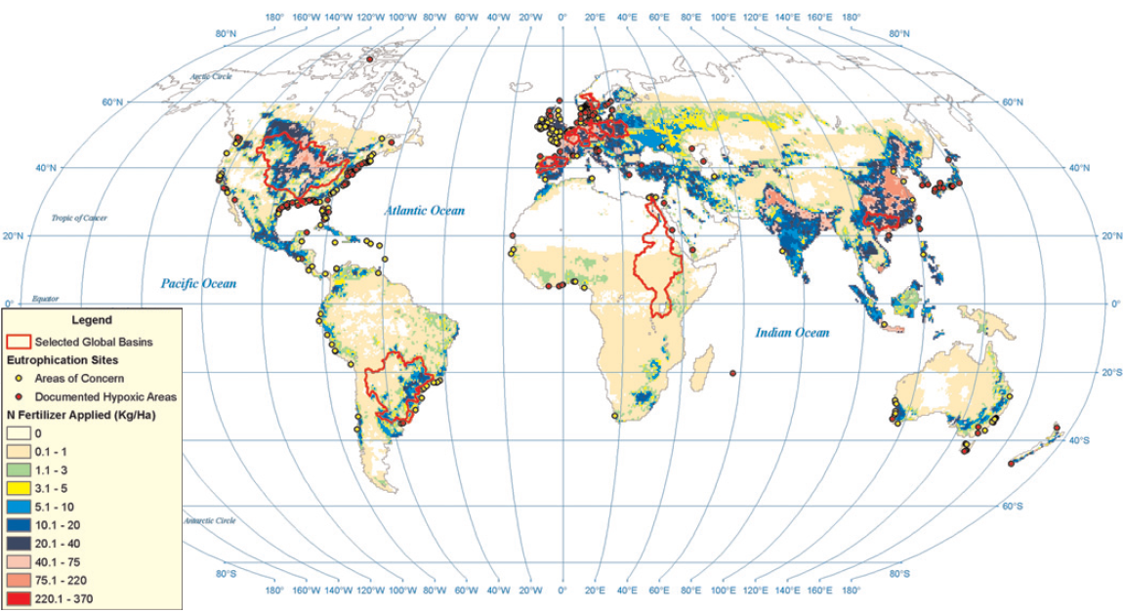
Agriculture is driving us beyond planetary boundaries for Biodiversity, N and P flows
Eutrophication linked to excessive nitrogen fertilizer and phosporous use in river basins
Agriculture is the primary driver of deforestation – leading to biodiversity loss (Busch and Ferretti-Gallon)
Source: Steffen et al. (2015)
Source: Potter et al. (2010)
Notes:
5

Slide 6
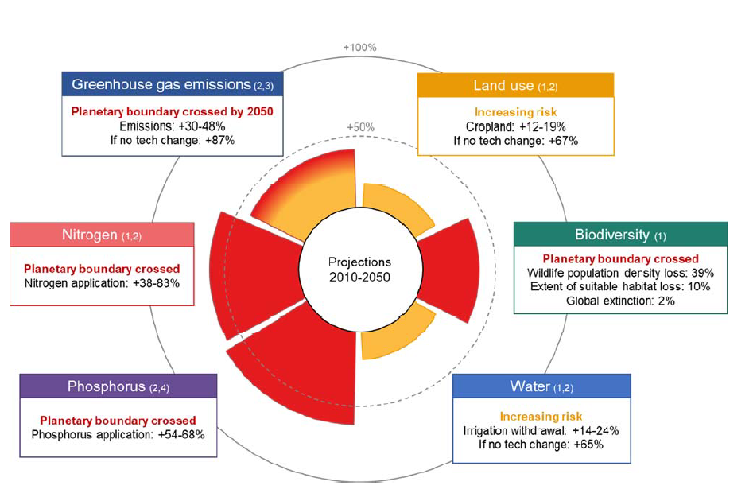
And projections to 2050 show this worsening
Colors of the sectors indicate the status for each planetary boundary: green = no risk (none); orange = at risk of crossing by 2050; red = boundary crossed (plain if crossed already in 2010, gradient if crossed by 2050). Sector size corresponds to the range of values covered by the sources.
Source: Valin, et al., 2023 (In Review)
Notes:
6

Slide 7
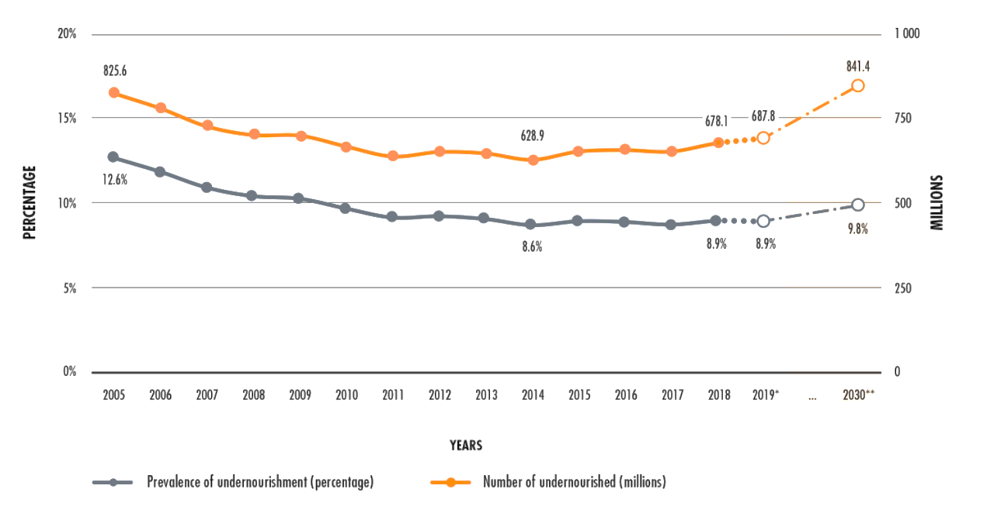
Even so, the food system is not delivering the desired health outcomes
690 million of the world’s population are undernourished
144 million children under five years of age are stunted
47 million children under five years of age are wasted
38 million children under five years of age are overweight
2.1 billion adults are overweight or obese
Development Initiatives: 2020 Global Nutrition Report; WHO/UNICEF/World Bank Group. Joint Malnutrition Estimates 2020; FAO, IFAD, UNICEF, WFP and WHO. 2020. The State of Food Security and Nutrition in the World 2020. Rome, FAO.

Slide 8
The double burden of malnutrition is rising in low- and middle-income countries
Figure 1
Countries with DBM in the 1990s
Countries with DBM in the 2010s
The Lancet 2020 395, 65-74DOI: (10.1016/S0140-6736(19)32497-3)
Popkin, B.M., Corvalan, C. and Grummer-Strawn, L.M., 2020. Dynamics of the double burden of malnutrition and the changing nutrition reality. The Lancet, 395(10217), pp.65-74.
Notes:
The global DBM in low-income and middle-income countries based on weight and height data from the 1990s (A) and 2010s (B)
DBM at the country level was defined as a high prevalence of both undernutrition (wasting and stunting in children aged 0–4 years, and thinness in adult women) and overweight and obesity (defined according to three different overweight prevalence thresholds: 20%, 30%, and 40%) in at least one population group. Data sources are UNICEF, WHO, World Bank, and NCD-RisC estimates, supplemented with selected Demographic and Health Surveys and other country direct measures. DBM=double burden of malnutrition.

Slide 9
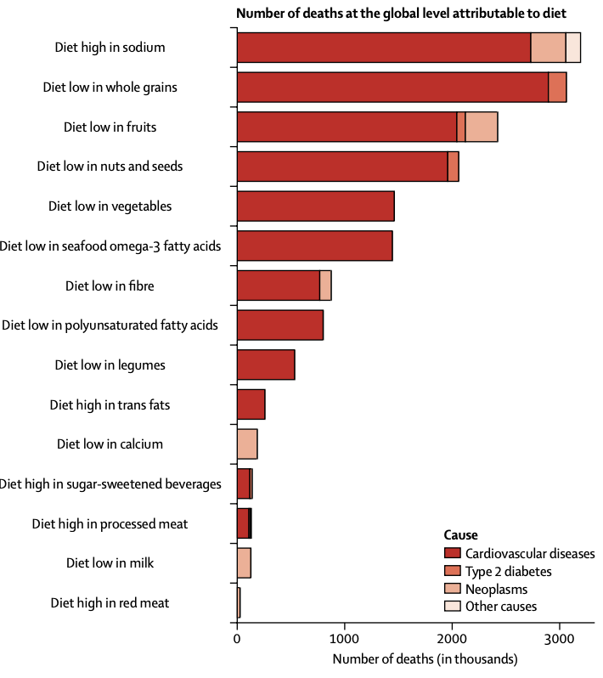
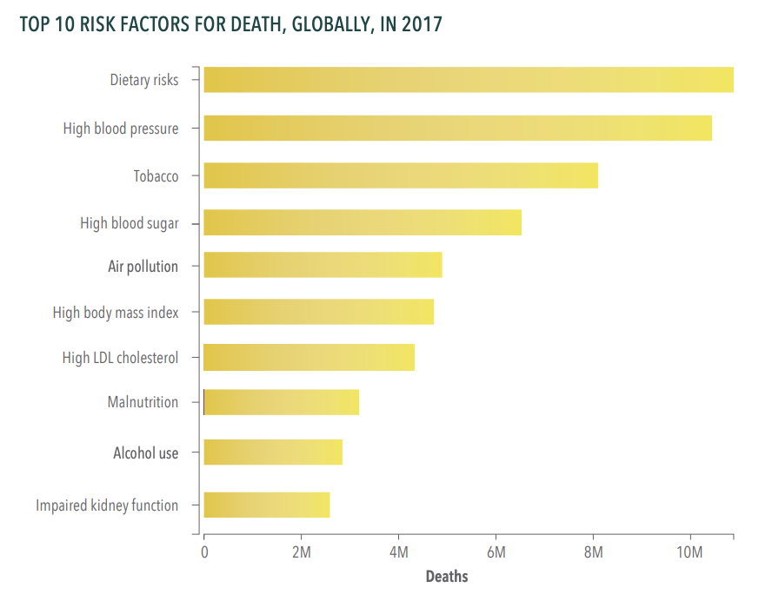
And sub-optimal diets are the top risk factor of disease and death
11 million deaths are attributable to dietary risk factors
Afshin, A., Sur, P.J., Fay, K.A., Cornaby, L., Ferrara, G., Salama, J.S., Mullany, E.C., Abate, K.H., Abbafati, C., Abebe, Z. and Afarideh, M., 2019. Health effects of dietary risks in 195 countries, 1990–2017: a systematic analysis for the Global Burden of Disease Study 2017. The Lancet

Slide 10
What role for International Trade?
‘First-best’ Economics View of Trade and Sustainability
Free and fluid trade encourages production to locate where use of resources is most efficient
This allows consumer demands to be met at lowest prices with the least burden on the planet’s finite resources

Slide 11
How does trade influence environmental sustainability and food security?
‘First-best’ Economics View of Trade and Sustainability
Free and fluid trade encourages production to locate where use of resources is most efficient
This allows consumer demands to be met with the least burden on the planet’s finite resources
But market failures are pervasive in agriculture:
Insecure land tenure
Non-point source pollution (e.g., nitrate leaching)
Lack of protection for biodiversity
Unsustainable extraction of common pool groundwater
Leading to potentially negative consequences from agr production and exports

Slide 12
Outline of the talk
Food security in the context of the UN Sustainable Development Goals
Economic analysis of food system drivers and impacts in the context of globalization of markets
Case study of Niger
Human heat stress and climate impacts in West Africa

Slide 13
Is the global economy becoming more integrated?
Regional trade agreements grew rapidly in early 2000s with agriculture on a slower path than mnfcs
Continental Free Trade Agreement for Africa!
Improvements in trade facilitation have led to greater market integration of Africa into global economy
Large food companies are integrating developing countries into global food supply chains
However, trade tensions have been leading to ‘reshoring’
Some countries have recently been restricting food imports due to environmental concerns (EU ban on deforestation commodities)
Explore here the consequences of mkt segmentation (vs. globalization) for food and environmental security

Slide 14
Analytical Framework: The SIMPLE model of global food and environmental security
Demand
Income per capita
Population
Demand
Response
Per Capita
Demand
Food Consumption
Food Security
Outcomes
Crop Demand
Global
Biofuel Use
Food
Prices
Domestic Markets
Global Market
Crop Supply
Input
Prices
Non Land
Inputs
Input Substitution
Land
Inputs
Non Land Price
Response
Climate: Temp, Precip & CO₂
Productivity Shocks
Land Rent
Response
Investments in Ag. R&D
Supply

Slide 15
Differentiation of domestic and international markets on both demand and supply sides
Demand
Income per capita
Population
Demand
Response
Per Capita
Demand
Food Consumption
Food Security
Outcomes
Crop Demand
Global
Biofuel Use
Food
Prices
Domestic Markets
Global Market
Crop Supply
Input
Prices
Market segmentation leads to incomplete price transmission from global to domestic markets
Non Land
Inputs
Input Substitution
Land
Inputs
Non Land Price
Response
Climate: Temp, Precip & CO₂
Productivity Shocks
Land Rent
Response
Investments in Ag. R&D
Supply

Slide 16
Segmented SIMPLE reproduces historical changes in global food economy: 1961-2006
Source: Hertel and Baldos (2016) under segmented markets and historical data from FAOSTAT (2014) and World Bank GEM Database (2014)

Slide 17
SIMPLE allows for attribution across drivers of global food economy: 1961-2006
Source: Hertel and Baldos (2016) under segmented markets and historical data from FAOSTAT (2014) and World Bank GEM Database (2014)

Slide 18
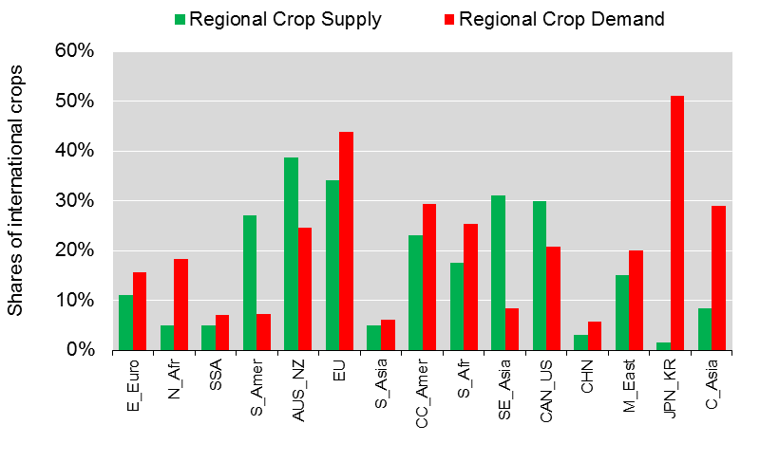
Extent of market penetration varies greatly by region: Very low for SSA region
Source: Authors calculations, as reported in Hertel and Baldos (2016) based on FAO and GTAP data bases circa 2006. Share of supply sold to international markets and share of demand purchased from international markets

Slide 19
Market segmentation means that regional impacts of global drivers can vary greatly depending on local pop and income growth
Demand
Income per capita
Population
Demand
Response
Per Capita
Demand
Food Consumption
Food Security
Outcomes
Crop Demand
Global
Biofuel Use
Food
Prices
Domestic Markets
Global Market
Crop Supply
Regional pop and income growth are closely tied to regional
output growth; particularly when global market penetration is low
Input
Prices
Non Land
Inputs
Input Substitution
Land
Inputs
Non Land Price
Response
Climate: Temp, Precip & CO₂
Productivity Shocks
Land Rent
Response
Investments in Ag. R&D
Supply

Slide 20
Drivers of crop output vary greatly across regions: SSA was driven by pop over historical period

Slide 21
Drivers of crop output vary greatly across regions
In SSA, population growth accounted for nearly all output expansion, whereas in China, this accounted one-third of the total. In World as a whole, it accounted for more than half of total growth.
Thought experiment: How would history have differed if the global agricultural economy had been integrated?

Slide 22
Globalization of commodity and non-land factor markets in SIMPLE
Demand
Income per capita
Population
Global commodity markets become fully integrated: One crop price
Demand
Response
Per Capita
Demand
Food Consumption
Food Security
Outcomes
Crop Demand
Global
Biofuel Use
Domestic Markets
Global Market
Food
Prices
Crop Supply
Input
Prices
Input
Prices
Non Land
Inputs
Input Substitution
Non Land Price
Response
Non Land
Inputs
Land
Inputs
Non Land Price
Response
Climate: Temp, Precip & CO₂
Productivity Shocks
Capital and labor mobility across regions raises nonland input supply
Land Rent
Response
Investments in Ag. R&D
Supply

Slide 23
Rewriting history: With integrated commodity & factor markets (second set of bars) the relative role of demand drivers (pop and income) at the regional level broadly mirrors that at the global level

Slide 24
Rewriting history: With integrated commodity & factor markets, output grows much faster in Canada/US: Why?

Slide 25
Understanding the impact of integrated markets
North America experienced faster than average TFP growth, and slower than
average population growth. Thus, despite somewhat faster income
growth, Therefore, output would have been larger under
integrated markets: (more exports).

Slide 26
Rewriting history: With integrated commodity & factor markets, output would have grown more slowly SSA: Why?

Slide 27
Exploring the impact of integrated markets on SSA: 1961-2006
SSA experienced far slower than average TFP growth; When coupled with far faster than average population growth, imports would have risen faster under integrated markets.
Therefore output growth would have been less rapid under integrated markets

Slide 28
Looking forward to 2050: Demand-side drivers are changing
Impact of higher income growth in developing countries
Global population growth rate drops from 1.7 to 0.8%;
Developed regions’ growth drops from
0.6 to 0.1%/yr
Notes:
Brackets as in MIT talk here again.

Slide 29
Translates into different regional output pattern under market segmentation: 2006-2050
SSA now amongst fastest growing regions due to high rate of pop growth and stronger income growth

Slide 30
Unless markets become more integrated and SSA TFP growth continues to stagnate …. In this case the region would become a huge importer of food
Productivity rules the day in the as trade becomes more integrated!

Slide 31
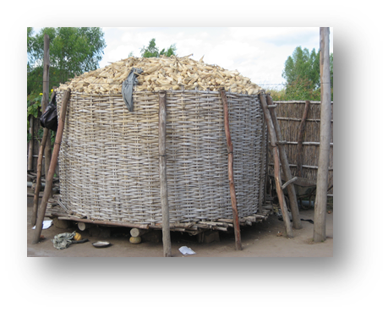
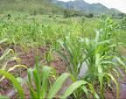
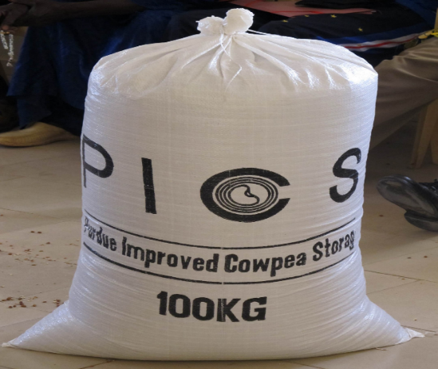
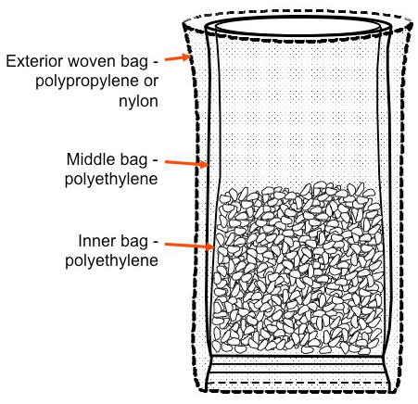
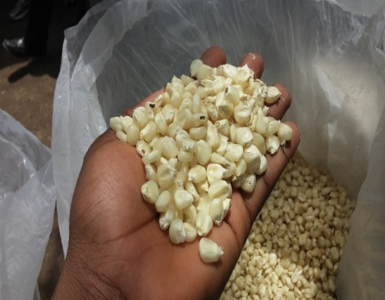
Can Post-Harvest Losses be reduced in SSA? What impact would this have on food security and the environment?

Slide 32
Reducing post-harvest losses in Africa
Examine impact of reducing PHL in SS Africa to the level in Latin America (18%) – so that, at current input levels, 10% more reaches the market

Slide 33
Impact of reducing PHL in SSA: Segmented Markets
Under segmented markets SSA prices fall sharply, non-farm under-nutrition drops and cropland area shrinks

Slide 34
Impact of reducing PHL in SSA: Integrated Markets
Under integrated markets SSA prices barely fall, malnutrition drops very little and cropland area expands strongly; terrestrial carbon fluxes rise

Slide 35
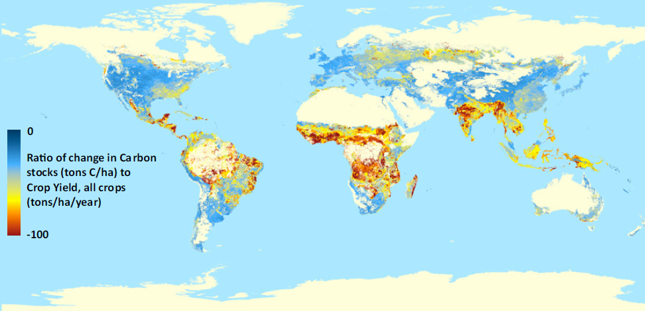
Why do terrestrial GHGs rise?
The conditions leading to a rise in global emissions in the face of a PHL reductions derive from SSA’s low relative emissions efficiency.
Emissions efficiency = tons of output/tons of carbon from land conversion; this figure
plots the inverse of this, i.e. the carbon released/ton of output from the converted land
Source: West et al. PNAS (2010)

Slide 36
Summary (1): Food markets segmented historically – but with globalization / market integration we must think differently about food & environ. security
Globalization allows local consumers greater access to international markets
In a globalized economy: TFP growth rules the day!
Investments in R&D take on greater importance
As do productivity-enhancing economic reforms
Environment can be threatened by productivity growth in regions with low emissions efficiency unless vulnerable areas protected

Slide 37
Outline of the talk
Food security in the context of the UN Sustainable Development Goals
Economic analysis of food system drivers and impacts in the context of globalization of markets
Case study of Niger
Human heat stress and climate impacts in West Africa

Slide 38
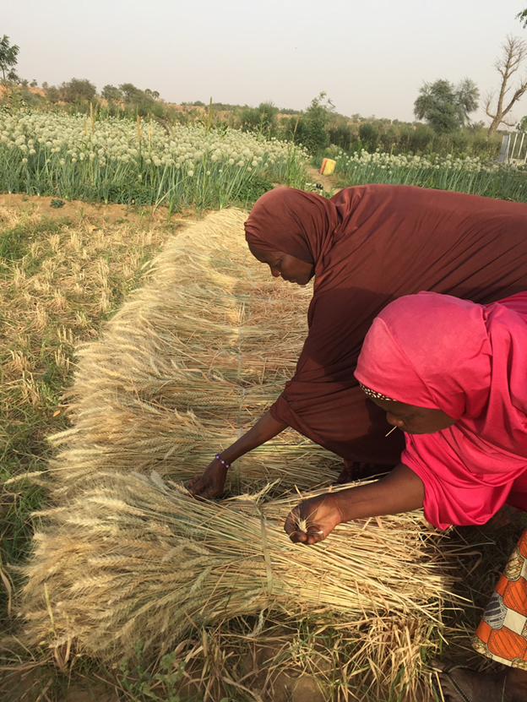
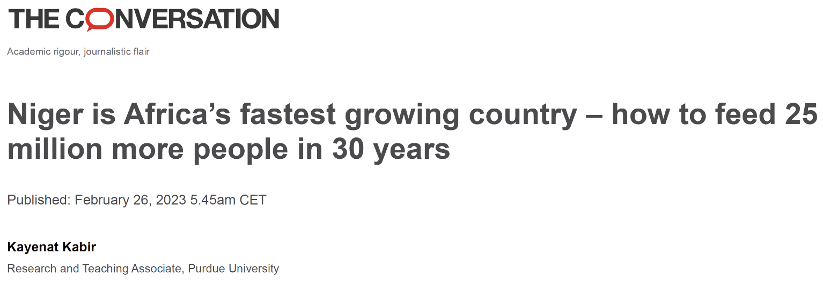
Focus on Niger
Dependent on rainfed agriculture
Very low agricultural productivity
80-90% of labor is employed in agricultural sector
Agriculture contributes to 40% of GDP
Global Health Index in 2017: ranked 99 among 199 countries.
Notes:
Add infographics instead

Slide 39
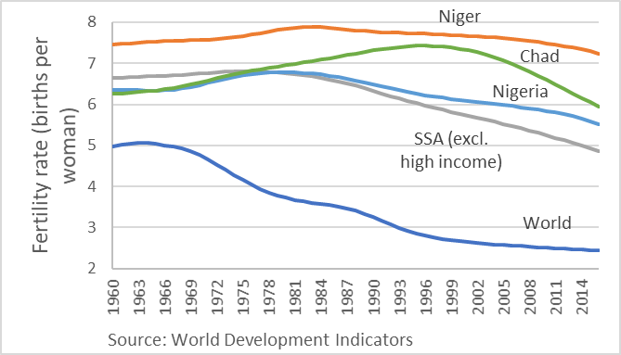
Focus on Niger
Existing vulnerabilities and status in Niger
Highest fertility rate in the world
(~ 7.5 per woman)
Rapid population boom (~annual 4%)
Lowest human development index
An average Nigerien today is poorer than one in 1960
Notes:
Add infographics instead

Slide 40
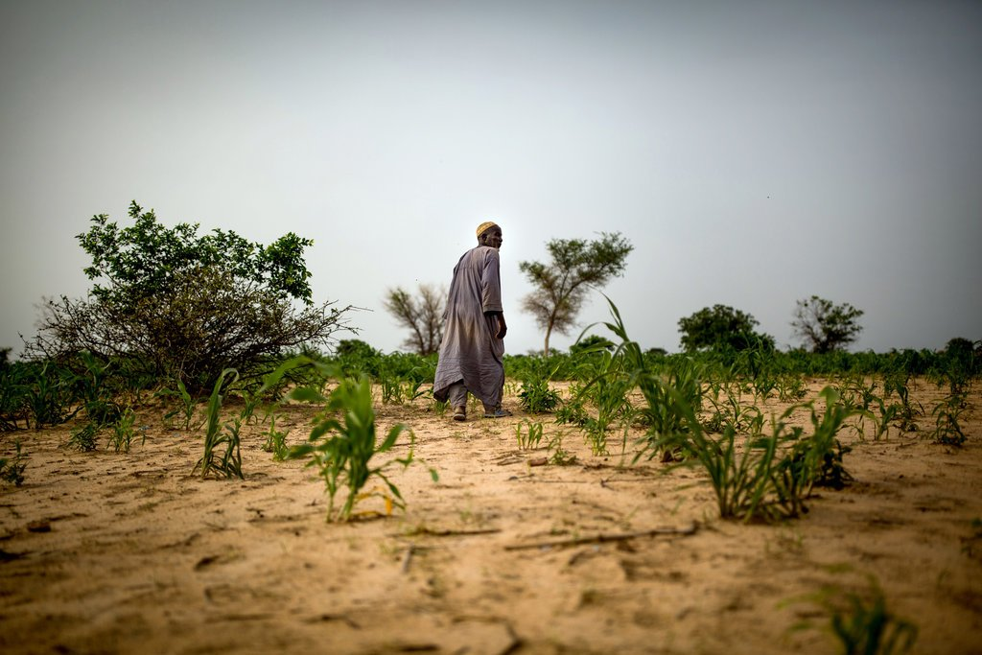
Focus on Niger
Niger’s exposure to climate change
Identified as one of the climate change hotspots. (Niang et al. 2014)
Baseline temperature is already high with little variation.
Increased but extreme and infrequent precipitation with shorter growing season
The desert is encroaching into the south.
Stunted crops in Zinder region, Niger Source: NYTimes/Josh Haner

Slide 41
Focus on Niger
Niger faces the task of feeding and employing a very young and growing population in a harsh climate with limited natural resources and human capital.
And this situation can be amplified by climate change.
Photo: Out of Africa/Thomas Friedman

Slide 42
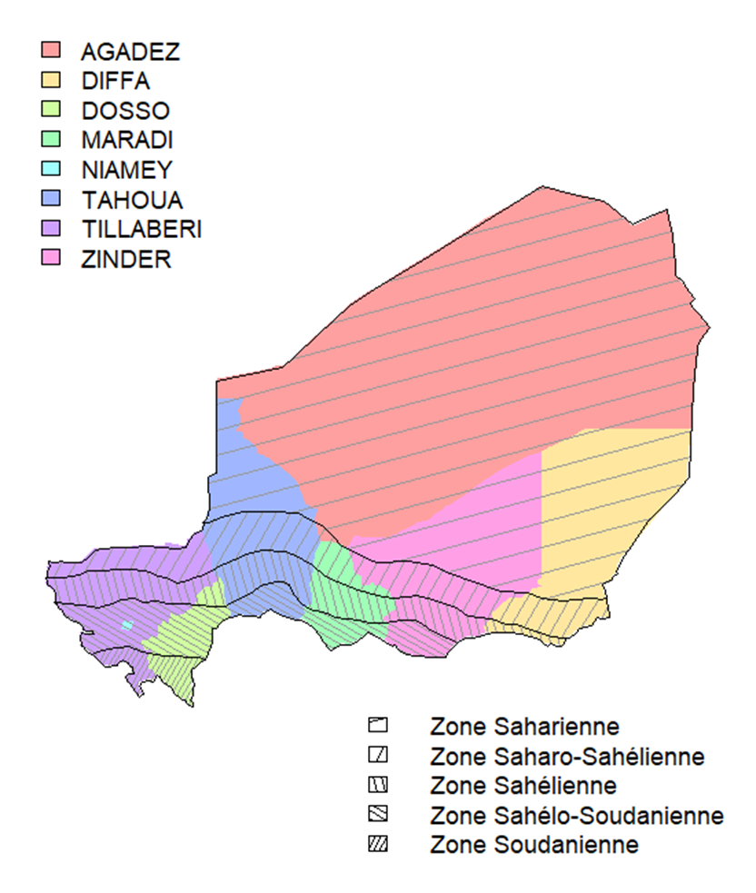
Data
Demand side data: Niger rural & urban population, income, food consumption etc.
Supply side: Niger 5 climate zones i.e. crop production quantity, area etc.
Other regions: national level data aggregated to regions

Slide 43
Population is the main driver of crop production in Niger
Notes:
Insert China

Slide 44
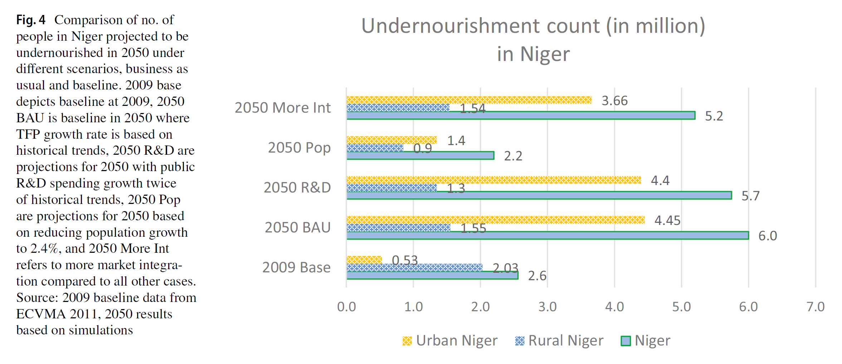
Urban undernourishment rises under BAU scenario in 2050
Notes:
Insert China

Slide 45
Accelerating agr R&D moderates undernourishment a bit
Notes:
Insert China

Slide 46
Reducing population growth is the most effective policy
Women’s empowerment – education and labor force participation
Access to reproductive health rights
Understanding desired vs. current birth rates
Notes:
Insert China

Slide 47
Summary (2): Niger faces a potential food and environmental security crisis
Rapid population growth is placing great stress on resources
Accelerated R&D can help – particularly if allow for climate change adaptation
However, addressing the demographic challenge appears to be critical for future sustainability

Slide 48
Outline of the talk
Food security in the context of the UN Sustainable Development Goals
Economic analysis of food system drivers and impacts in the context of globalization of markets
Case study of Niger
Human heat stress and climate impacts in West Africa

Slide 49
Heat stress arises when humans cannot dissipate internally generated energy
This arises under:
High temperatures
Humid conditions
High solar radiation
Manual labor
This looks a lot like farming and construction work in the tropics!
Source: Buzan and Huber, Annual Review of Earth and Planetary Sciences, 2020

Slide 50
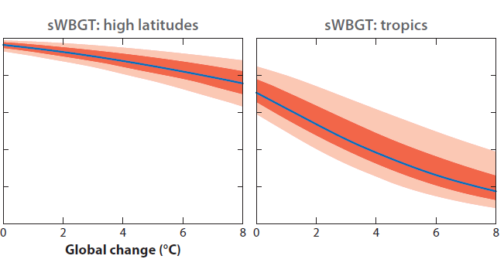
Population-weighted total labor capacity under climate change
The consequences of heat stress are dramatic in the tropics where high humidity combines with high temperatures
Source: Buzan and Huber, Annual Review of Earth and Planetary Sciences, 2020
Notes:
We should show the 3 degrees warming scenario shouldn’t we? That is what is used below.

Slide 51
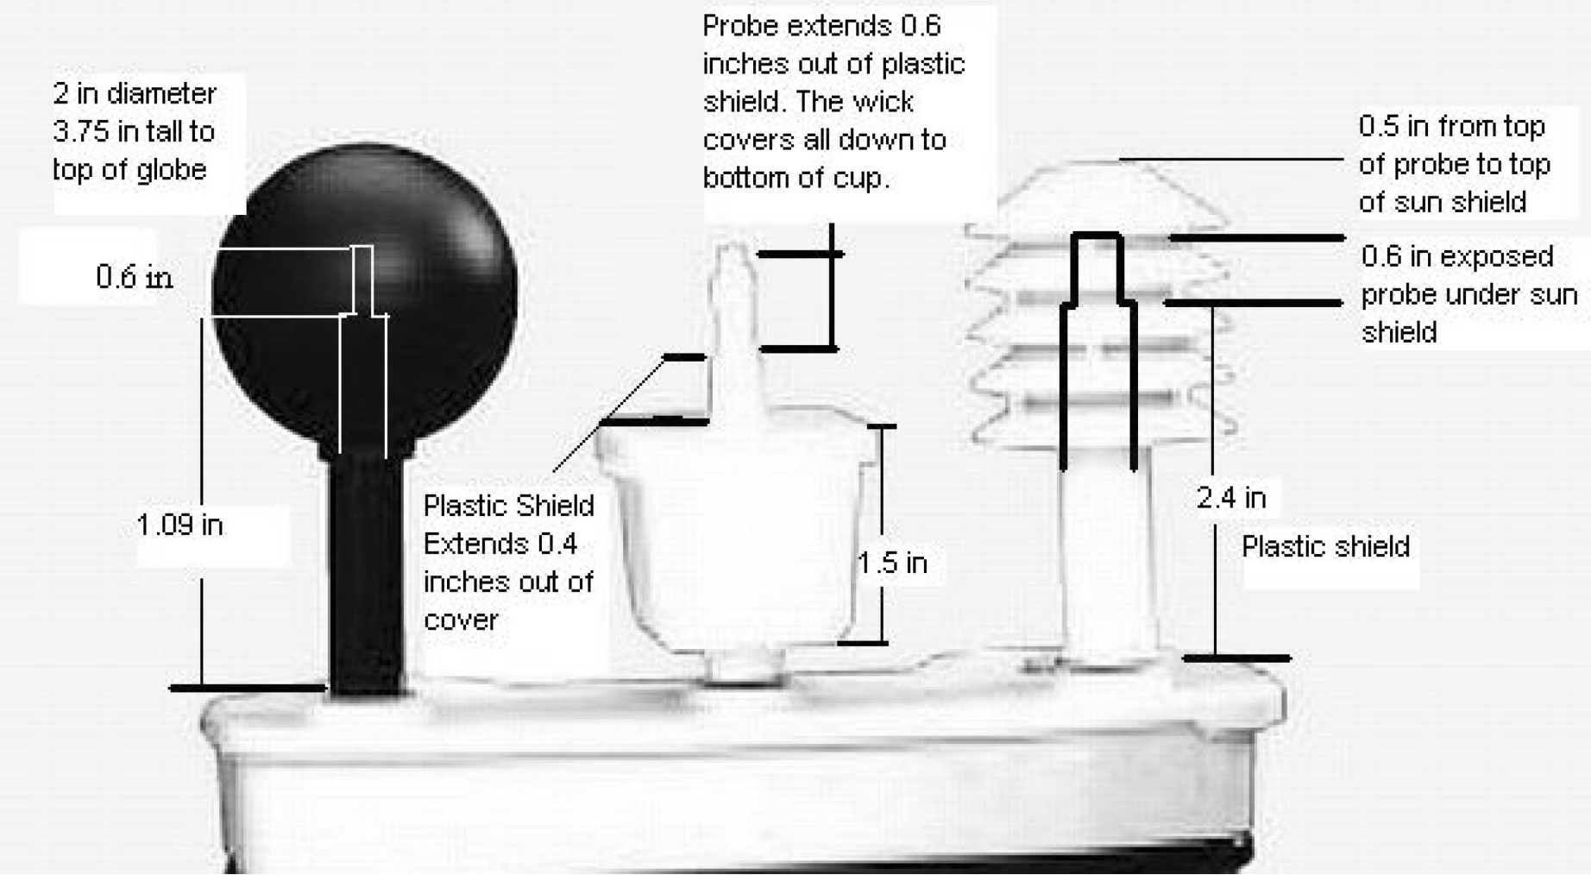
Wet Bulb Globe Temperature (WBGT) is used for assessing heat stress
WBGT factors in:
Temperature
Humidity
Wind speed
Solar radiation
Other radiation
components
Air pressure
Since we cannot conduct these experiments across the world, under future conditions, climate scientists run climate models and approximate these outcomes mathematically: Liljegren et al (2008)
Recent computational advances by our collaborators permit far more accurate approximations to WBGT on an hourly basis, at each grid cell
Kong and Huber, Earth’s Future, 2022

Slide 52
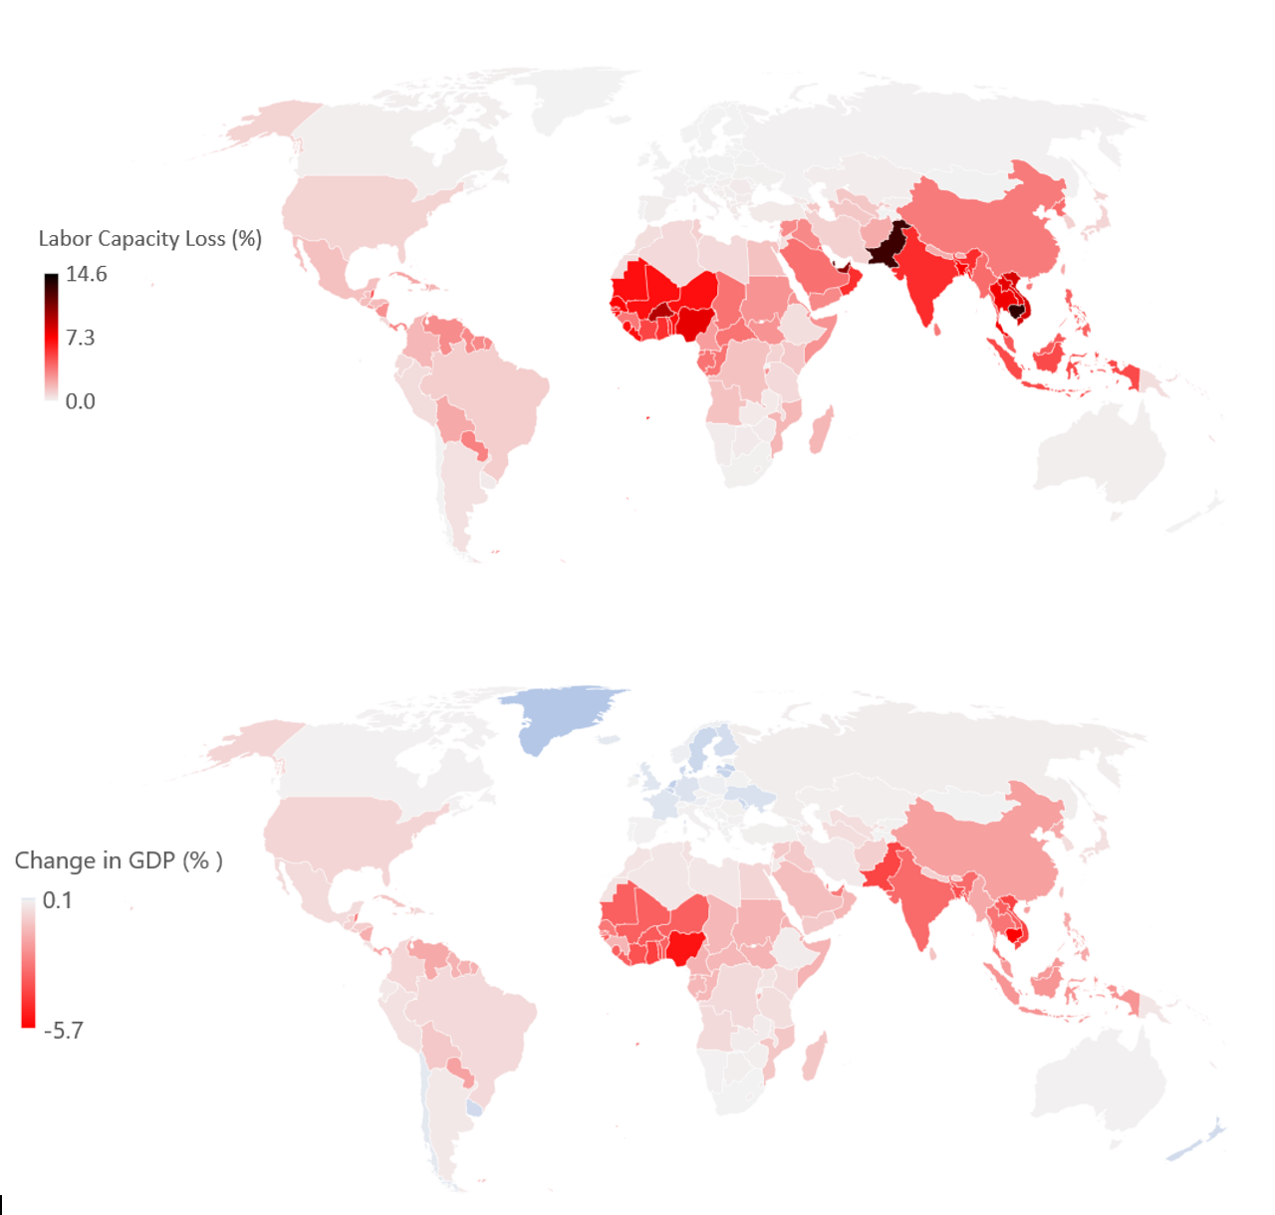
Labor capacity losses greatest in South/SE Asia
But GDP losses largest in West Africa
Source: Saeed et al, Earth’s Future (2022)

Slide 53
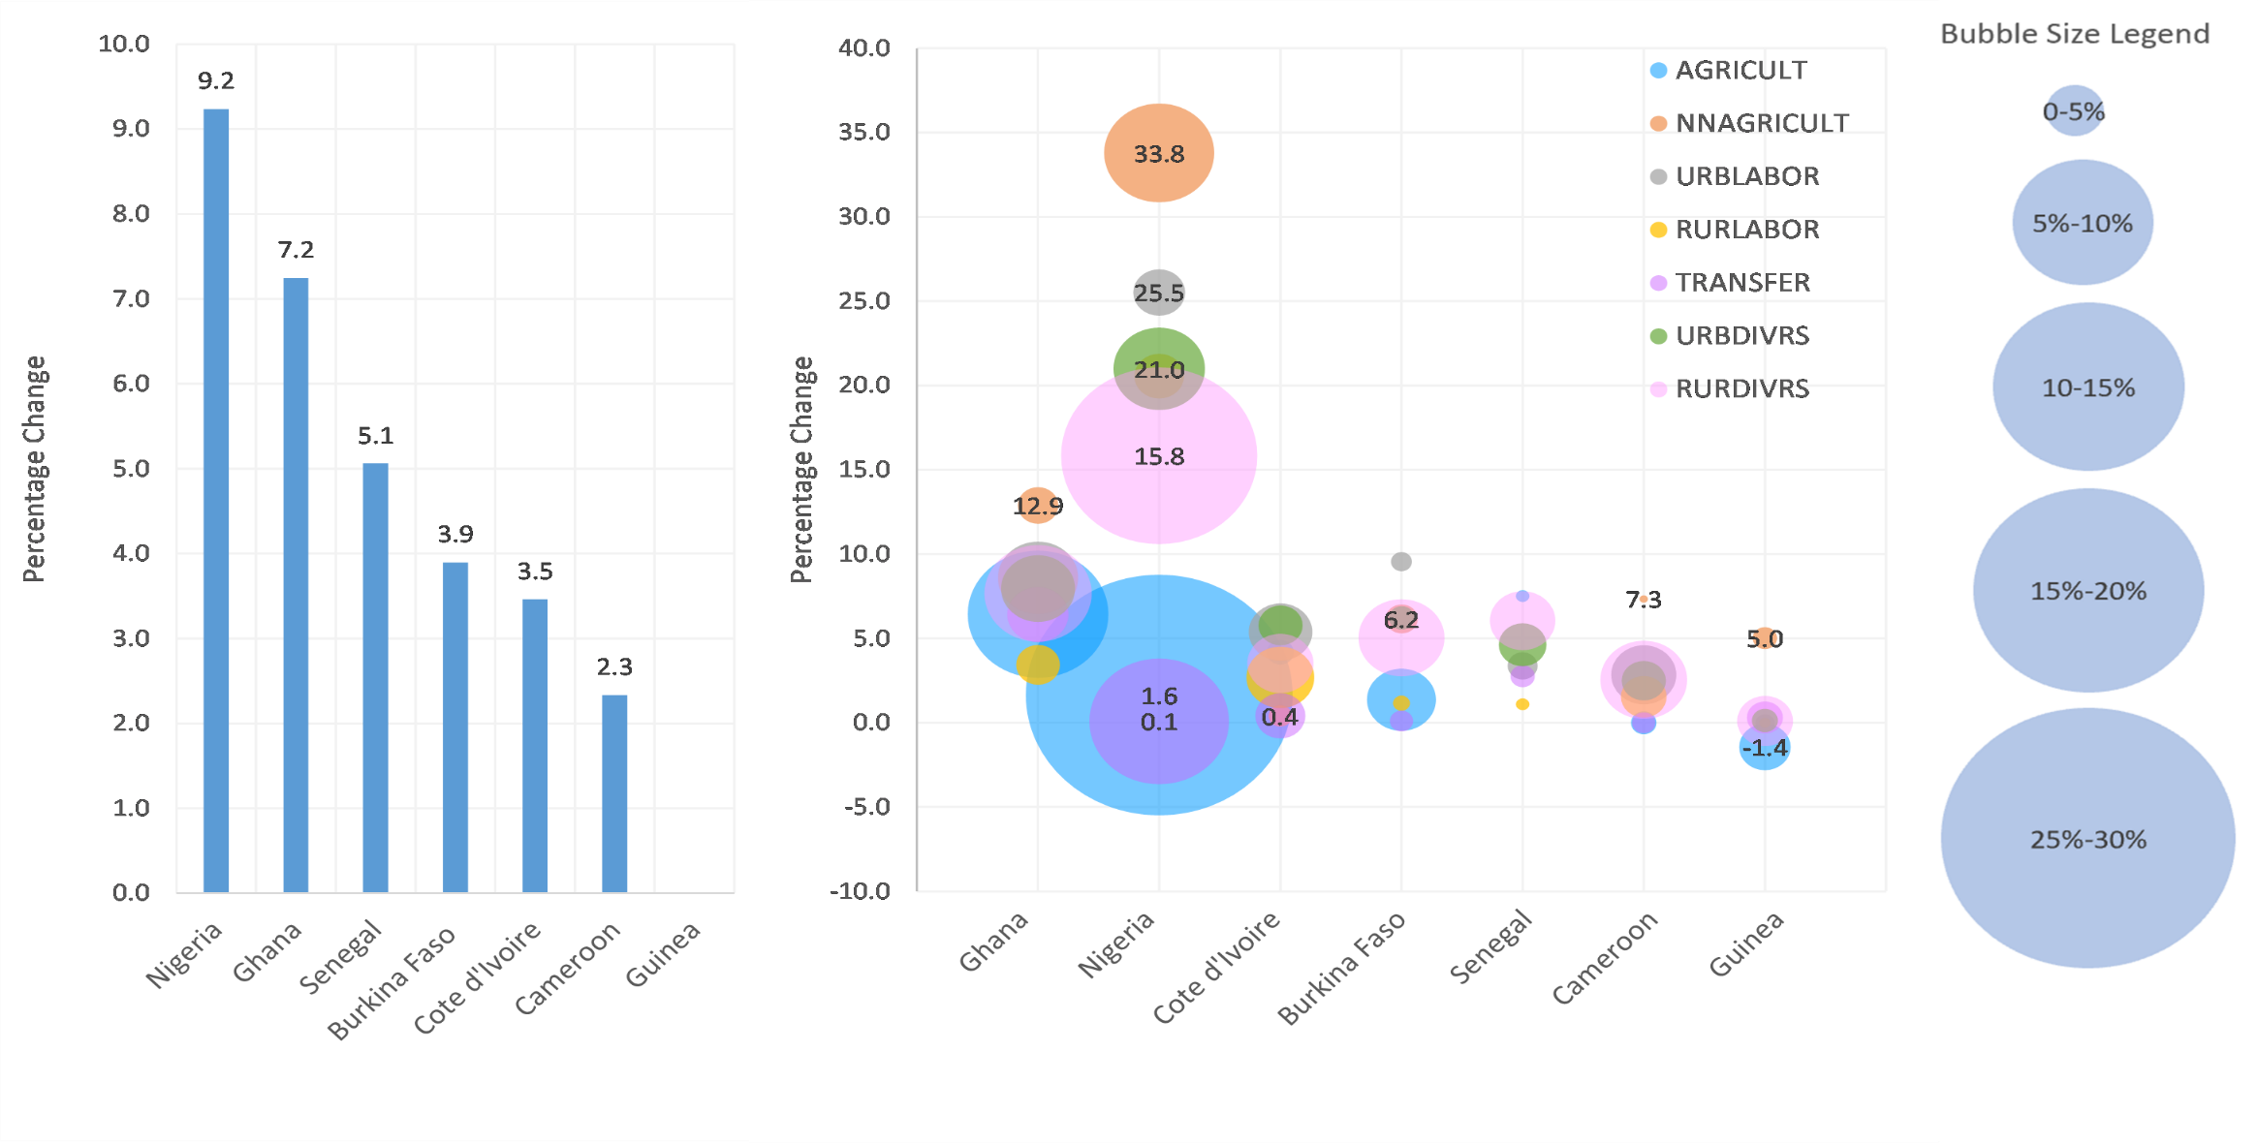
Poverty impacts in West Africa: Headcount by country and stratum (% change)
Source: Saeed et al, Earth’s Future (2022)

Slide 54
Summary (3): Heat stress poses a significant challenge to outdoor work in the humid tropics
Agriculture and construction are most affected sectors
Workers must take frequent breaks and rehydrate or suffer severe long term health consequences
Absent adaptation, we expect that heat stress will result in higher food prices and increased poverty

Slide 55
GLASSNET: An International Network of Networks to tackle global sustainability challenges: https://glassnet.net

