Slide 1
Market and Supply Chain Development
W. Scott Downey
Presentation to
Mandela Scholars

Slide 2
Supply Chain Alignment
Supply management
Procurement
Input Storage
Capacity
Production
Inventory
Demand management
Forecasting
Selling
Distributing
Warehousing
Logistics
Management
Analyze
Plan
Implement
Measure

Slide 3
Marketing Framework
Technological
Product
Place
TARGET
MARKET
Political
Social
Price
People
People
Promotion
Economic and Competitive

Slide 4
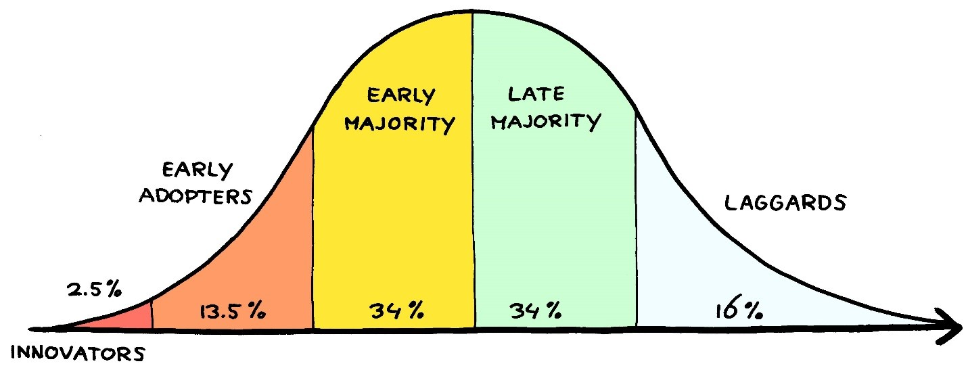
Stages of Adoption
Market Adoption
Market Development
Beta
Education
Emphasize Research
Sales
One-on-one
Relational
Emphasize Benefits
Advertising
Mass communication
Transactional
Emphasize
Price

Slide 5
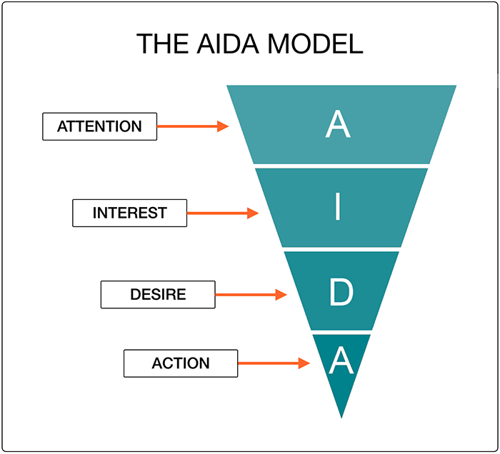
Individual Stages of Adoption
Individual Adoption
Awareness
Interest
Desire
Trial
Confirmation
Adoption
Loyalty
Tell others
Resist Competition
Pay Extra

Slide 6
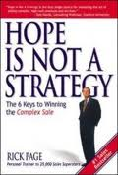
“If you don’t know where you are going, then any old path will get you there”
“If you don’t know where you are going, then any old path will get you there”

Slide 7
Understand others’ strategies through observation over time
How will we use our resources to get there?
Where do we want to be?
Money
Time
Knowledge
NEED
People
Where are we now?
The fastest way to move buyers and distributors through the adoption process is to connect with their existing strategies

Slide 8
Trust is needed in order to have access to understanding others’ strategies
$$\text{T}\text{rust}\text{=}\frac{\text{C}\text{redibility}\text{ +} \text{R}\text{el}\text{i}\text{a}\text{bility}\text{ +} \text{I}\text{ntimacy}}{\text{S}\text{elf} \text{orientation}}$$
Source: “The Trusted Advisor” Authors, David H. Maister, Charles H. Green, and Robert M. Galford
Notes:
Go through the math first, increase and decrease
Then get into the “How”
Ask, of all of these, which one is “easiest” to increase and “hardest” to increase? Why?
Which one is “easiest” to decrease and “hardest” to decrease? Why?

Slide 9
Strategy is Developed at Many Levels
Company Strategy
Territory
Account
Marketing
Call
Sales
Promotion
Sales
strategy is
only one part
of a company’s promotional strategy
Advertising, Public Relations would also have strategies
Each
component
of the marketing
mix has it’s own strategy: Price, Distribution, People and Product
Notes:
Strategy takes place at every level in the firm. The company has a strategy. DAS has a marketing strategy (as well as a financial strategy, probably a production strategy too). Probably the marketing strategies are broken down by products. There are many promotional strategies – probably at the brand and product levels – these would include advertising, public relations, social media, and sales. Within the broad sales strategy, it is likely that there are strategies for many different territories. Each salesperson, in fact, will probably have a strategy for how they intend to accomplish sales objectives within their territory. Those sales strategies will be accomplished account by account, so each account will have it’s own strategy. And those account strategies will be accomplished sales call by sales call, so each sales call will have it’s own strategy.
We can have a conversation about the differences between strategies and tactics, but it’s pretty academic. At the end of the day, each strategy has tactics, but if you are assigned the completion of a tactic, you will likely have a strategy for accomplishing it! So there ultimately become strategies for tactics, which can get really confusing! The main point to make is that accomplishing a future state is done with strategy at many levels.

Slide 10
The Communication Process
Message
Media
Sender
Encode
Receiver
Decodes
Noise
Feedback
Response

Slide 11
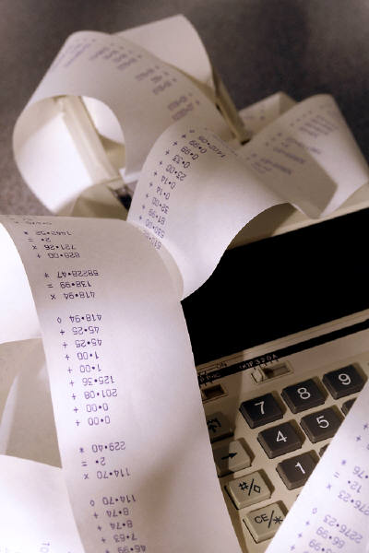
Expectations of Value
Perceived
Benefits
Perceived
Value =
Perceived
Costs
Costs are easily measured,
Benefits may not be!
When times are tight, there is much more focus on measured value

Slide 12
Setting Expectations and Trust

Slide 13
Delight vs. Disappointment
Delight = Actual Value > Perceived Value
Satisfaction = Actual Value = Perceived Value
Disappointment = Actual Value < Perceived Value

Slide 14
Repeated Satisfaction begets Loyalty
Transactional Loyalty
Repeat Purchases
Derived from Tangible Value
Emotional Loyalty
Ownership, Price Premiums
Derived from Intangible
Adapted from Sampson Lee Montgomery Research (2004)

Slide 15
Measure
Steps in AIDA
Buyer perceptions
Satisfaction
Communication Goals
Buyer Feedback
Notes:
Find out what they value
Understand how they measure it
Agree on measures
Monitor progress

Slide 16
Tim’s TargetSorg Challenge

