Slide 1
Center on Global Food and Agriculture
July 13, 2023

Slide 3
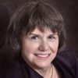
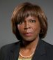
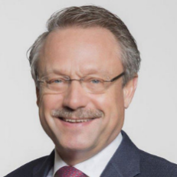
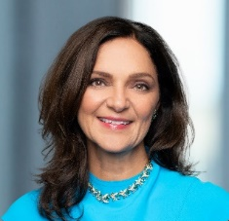
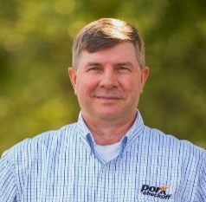
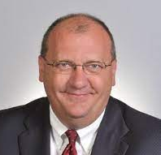
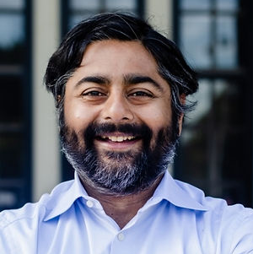
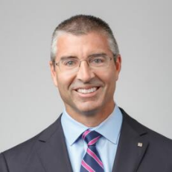
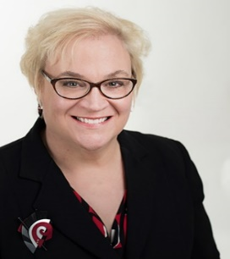
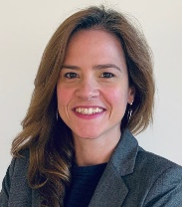
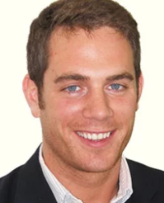
About the Council’s Center on Global Food and Agriculture
Distinguished Fellows
Catherine Bertini 2003 World Food Prize Laureate
Ertharin Cousin Former Exec Dir UN World Food Programme
Dan Glickman Former U.S. Secretary of Agriculture
Advisory Board
Vision
We seek to advance a more sustainable and resilient global food system by addressing challenges facing our planet and the most vulnerable producers and consumers, to find solutions that inform and shape policy, and to provide leadership in America’s heartland and beyond.
Paul Schickler, Chair Former President, DuPont Pioneer
Francesca DeBiase
Former EVP Supply Chain, McDonald’s
Bill Even
CEO, National Pork Board
Tim Hassinger
Former President,
Dow AgroSciences
Sanjeev Krishnan Chief Investment Officer, Seed 2 Growth
Greg Morris Sr VP, Archer Daniels Midland Company
Sally Rockey Former Exec Dir, Fdn
for Food & Ag Research
Natasha Santos VP, Bayer Crop Sciences
Decker Walker Managing Dir & Partner, BCG

Slide 4
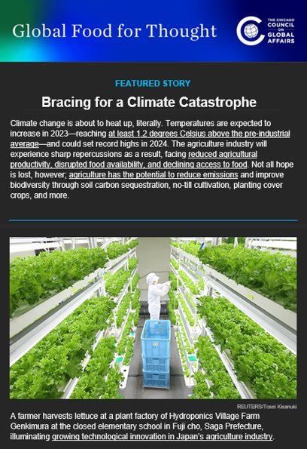
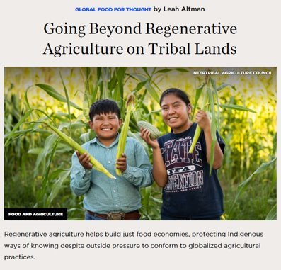
Recent Publications and Activities
Global Food for Thought
Stewardship, Sovereignty, and Solutions blog series
News brief
Limited podcast series

Slide 5
Recent Publications and Activities
Global Food for Thought Blogs
Queering Farming: How LGBTQIA+ Farmers are Reimagining Farming (link)
Agricultural Investment: Foreign Aid for Global Prosperity (link)
Beating the Odds: The Mothers and Children of the 1,000 Days Movement (and accompanying videos; link)

Slide 6
Recent Publications and Activities
Task Force on Hunger, Nutrition, and Health
Informing the 2022 White House Conference on Hunger, Nutrition, and Health
Listening sessions – blog series, policy brief

Slide 7
Recent Publications and Activities
Bridging the Gap: A “Sustainable Food Seal” Needed to Improve Transparency between Farmers and Consumers about Sustainable Food Production (link)

Slide 8
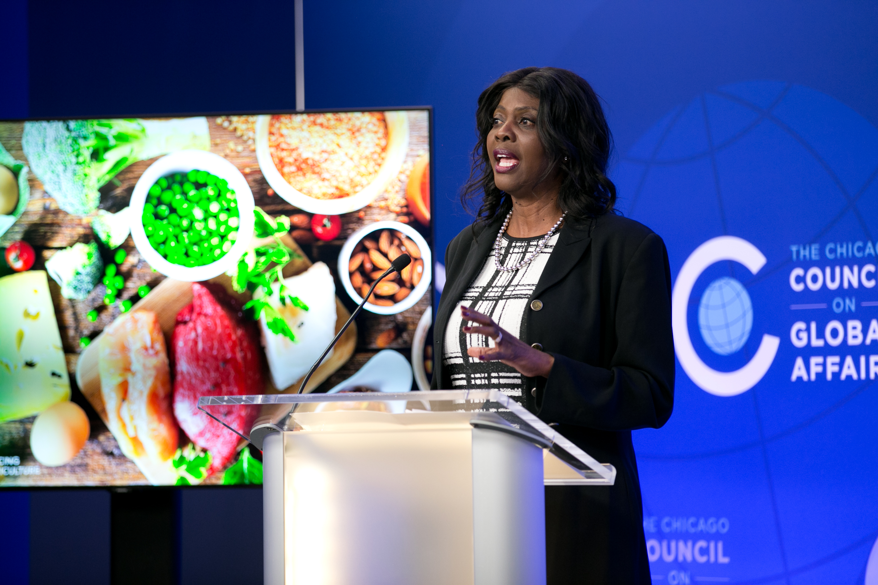
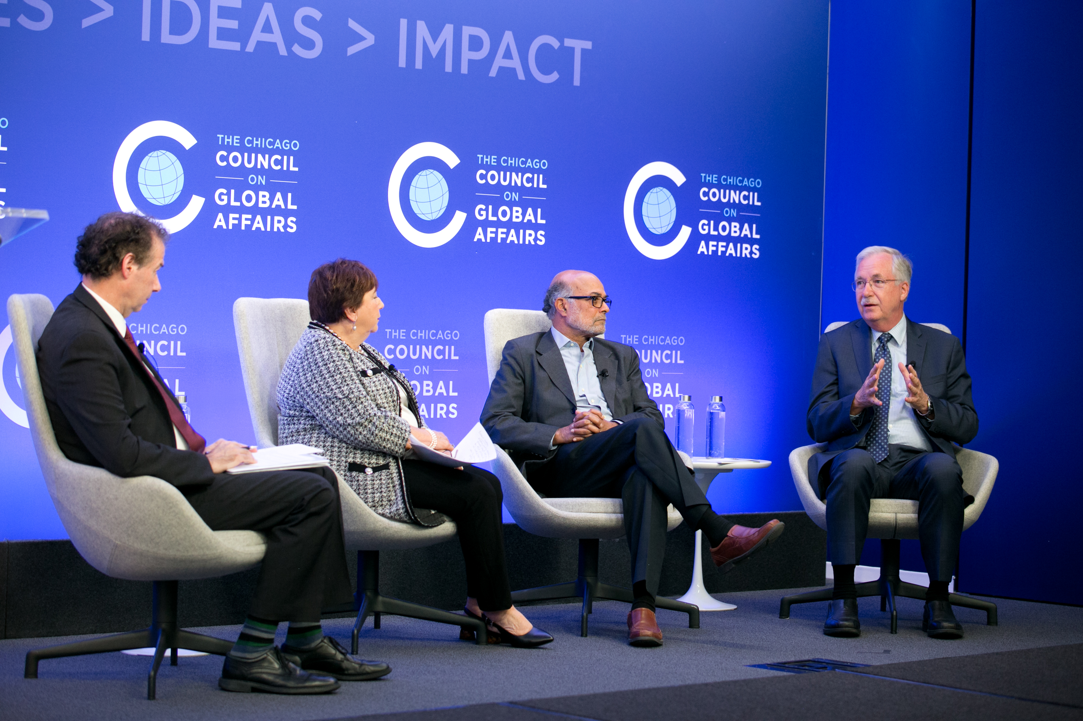
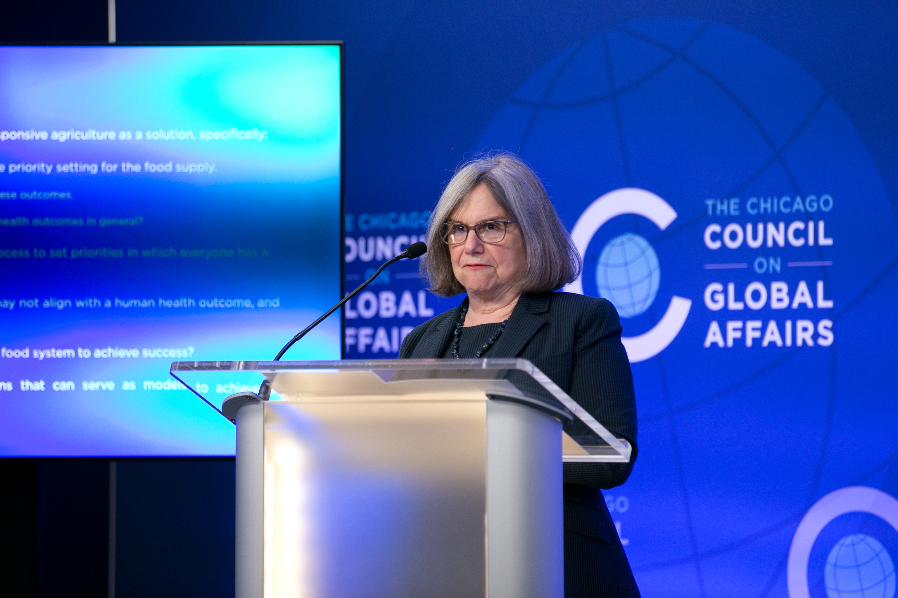
Recent Publications and Activities
Conference on Agriculture for Health: Priority Setting to Solve the Ultimate Grand Challenge

Slide 9
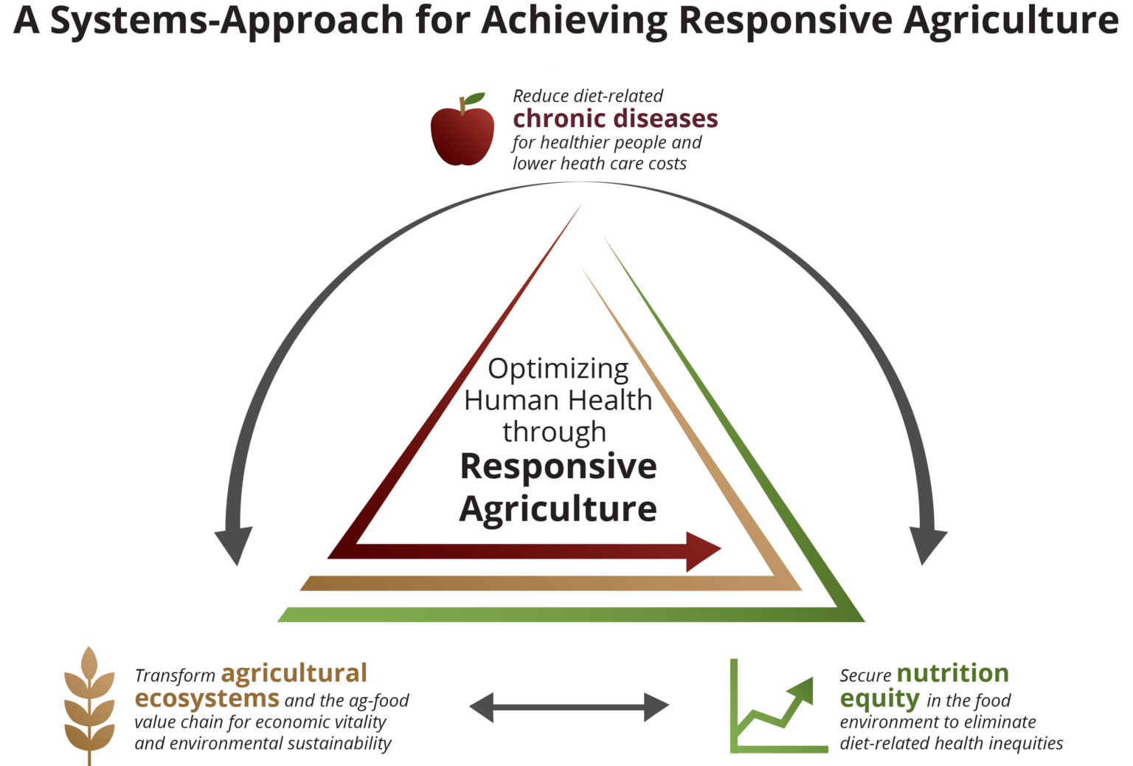
Current Projects and Activities
Regenerative Agriculture Research Project
Sustainability Roundtables
Bridging the gap between farmers and consumers
Responsive Agriculture

Slide 10
Our Funders
Paul & Claudia Schickler

Slide 11
Getting Involved
GFFT newsletter
Blog collaboration
Social media
Connecting with our platforms
Campaigns
Job openings
Ideas? Reach out!

Slide 12
Contact Information
Twitter: @GlobalAgDev
Facebook: Center on Global Food and Agriculture
Instagram: @globalaffairscouncil
LinkedIn: Chicago Council on Global Affairs
Natalie Burdsall
Communications Officer, Center on Global Food and Agriculture
nburdsall@globalaffairs.org
+1 (312) 821 – 7522

Slide 13
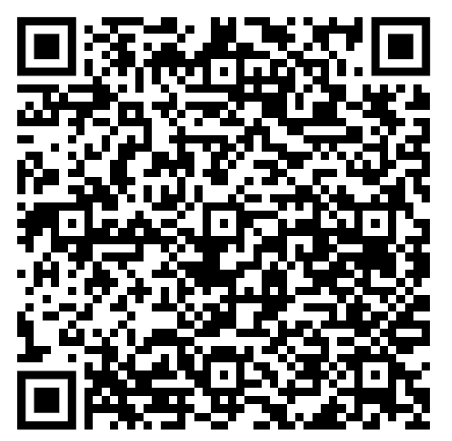
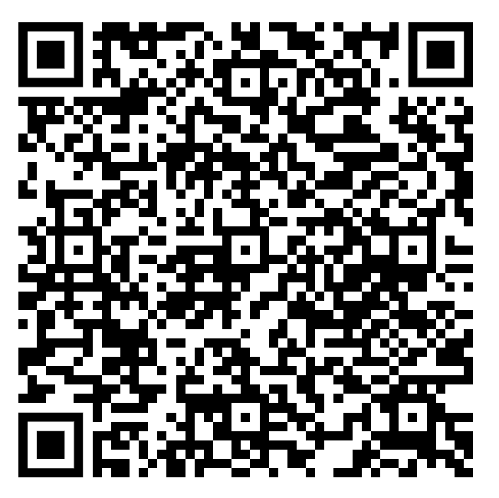
Newsletter Sign-Up
Ask a Question

Slide 14
Transforming Agricultural Productivity, Technology, and Inputs in Africa
Discussion

Slide 15
Discussion
What challenges do smallholder farmers in Africa face in accessing and implementing agricultural research findings and innovations?
How can technology access be expanded to smallholder farmers so they can experience productivity benefits without erasing or abusing cultural or traditional knowledge?
How can investing in the health, safety, and development of rural girls contribute to the overall advancement of rural economies and productivity in Africa?
Climate-resistant technologies are a significant component of increasing agricultural productivity, but often disproportionately benefit men because of gendered access issues. How can local, national, and international actors overcome gender inequity when enhancing climate-resistant technologies in Africa?
The gap in funding for African social enterprises constrains their ability to reach their programmatic goals, consequently limiting productivity. What innovative solutions can overcome funding restrictions to enhance economic development?

