Slide 1
Orientation for FPL Subrecipients
Laura Bergdoll
Heather Fabriès
July 2015

Slide 2
FPL Basics
Full Title: Feed the Future Innovation Lab for Food Processing and Post-Harvest Handling
Prime Sponsor: United States Agency for International Development (USAID)
Program Dates: May 19, 2014 – May 18, 2019
Two main focuses:
  Food Processing & Nutrition
  Post-Harvest Handling (Drying and Storage)
1 US-based partner, 6 African-based partners (3 in Kenya, 2 in Senegal, 1 in South Africa)

Slide 3
Purchasing Rules/Regulations

Slide 4
Purchasing Rules/Regulations
Sourcing
Geographic Code 937: Whenever possible, commodities and services should be procured in the US, Senegal, Kenya, and USAID-defined “Developing Countries”
  This list can be found here: http://www.usaid.gov/sites/default/files/documents/1876/310maa.pdf

Slide 5
Purchasing Rules/Regulations
Sourcing
Prohibited Sources
African countries currently under US sanctions: Central African Republic, Ivory Coast, Democratic Republic of the Congo, Libya, Somalia, Sudan, Zimbabwe
  Also of interest: Former Liberian Regime of Charles Taylor
  If you want to purchase anything from these countries, please let the FPL Management Team know ASAP.

Slide 6
Purchasing Rules/Regulations
Sourcing
Terrorist Financing
You must not engage in transactions with, or provide resources or support to, individuals and organizations associated with terrorism – including those individuals/entities that appear on the Specially Designated Nations and Blocked Persons list (SDN—US Treasury) or the UN Security Council Designation List.
  If you would like an individual or business screened against these lists, please send their name, address, and nationality (if known) to Laura.
    Businesses—will also need name(s) of top executive(s)

Slide 7
Purchasing Rules/Regulations
Restricted Goods: can only be purchased if preapproval obtained
  Agricultural Commodities
  Motor Vehicles
  Pharmaceuticals
  Pesticides
  Used equipment
  USG-owned excess property
  Fertilizer

Slide 8
Purchasing Rules/Regulations
Ineligible Goods: can NEVER be purchased
  Military equipment
  Surveillance equipment
  Commodities/services for support of police or other law enforcement activities
  Abortion equipment and services
  Luxury goods and gambling equipment
  Weather modification equipment

Slide 9
Purchasing Rules/Regulations
Capital Equipment
  Any supply that costs $5,000+ USD per unit AND has a useful lifespan of 1+ year(s)
  These purchases require preapproval by USAID and Purdue before they can be made
  Will need three written quotes AND a strong justification for why it is necessary

Slide 10
Purchasing Rules/Regulations
  Prohibited Sources
    Any supply that costs $5,000+ USD per unit AND has a useful lifespan of 1+ year(s)
    These purchases require preapproval by USAID and Purdue before they can be made
    Will need three written quotes AND a strong justification for why it is necessary

Slide 11
Purchasing Rules/Regulations
  Expenditures should match line item budget.
    If any rebudget is desired or required, any shift between line items MUST be preapproved by Purdue University.
    Official budget is one included in subagreement and any subsequent amendments
      Please be sure to check these BEFORE your institution signs the subagreement/amendment.

Slide 12
Travel Rules/Regulations

Slide 13
Travel Rules/Regulations
Domestic travel = Travel within your base country
  Example: ISRA traveling from Dakar to Kolda
  This does not require preapproval if budgeted.
  Travel must be related to FPL and done to further your statement of work objectives.
  All allowances (lodging, per diem) are in accordance with home institution BUT cannot exceed US Department of State rates
    Can be found here: https://aoprals.state.gov/web920/per_diem.asp
    If there are security concerns which prevent the lodging rate from being met, please let us know.

Slide 14
Travel Rules/Regulations
International Travel = Any travel where country borders are crossed
  Example: ITA personnel (based in Senegal) traveling to visit University of Eldoret (based in Kenya)
  All international travel requires USAID and Purdue preapproval
    If no preapproval, these costs will NOT be reimbursed
  All allowances (lodging, per diem) are in accordance with home institution BUT cannot exceed US Department of State rates
    Can be found here: https://aoprals.state.gov/web920/per_diem.asp
    If there are security concerns which prevent the lodging rate from being met, please let us know.

Slide 15
Travel Rules/Regulations
International Travel Continued
  Purdue needs at least three weeks advanced notice to obtain USAID preapproval
    Name of traveler(s)
    Estimated dates of travel
    Itinerary of travel
    Estimated Total Cost
    Short SOW (why the travel is necessary)
    Send request to Betty, Heather, and Laura.

Slide 16
Travel Rules/Regulations
Airfare
  Fly America Act
    Whenever available, a US-flagged carrier MUST be used for airfare
      These include Delta (DL), United (UA), American (AA), US Airways (US)
      DL via Kenya Airways flights available between Dakar and Nairobi
      Not usually available for domestic flights
  Class of travel
    Must be economy class or will not be reimbursed

Slide 17
Branding/Marking

Slide 18
Branding/Marking
Branding: How a program or project is named/positioned
Marking: Applying graphic identities or logos to program materials or program signage to acknowledge contributors.
Both USAID and Purdue have strict rules and regulations regarding this.

Slide 19
Branding/Marking
USAID has strict requirements on how program materials and supplies (among other things) are to be marked.
    Programs, projects, activities, public communications, and commodities partially or fully funded by USAID;
    Program, project, or activity sites funded by USAID (including any visible infrastructure projects or other physical sites);
    Technical assistance, studies, reports, papers, publications, audio-visual productions, public service announcements, websites/internet activities, promotional/informational/media/communications products funded by USAID;
    Commodities, equipment, supplies, or other materials funded by USAID;
    Events financed by USAID, such as training courses, conferences, seminars, exhibitions, fairs, workshops, press conferences, and other public activities.

Slide 20
Branding/Marking
There is a specific FPL, Purdue, and USAID logo that should be used for all necessary marking.
  Please contact Betty or Heather for any questions or concerns regarding this
Subrecipients are not authorized to act as an agent for Purdue – and cannot enter into any contract, warranty, or representation as to any matter.
  This is also true for Purdue

Slide 21
Required Reporting

Slide 22
Required Reporting
Technical Reports
  Year 1: As required by milestone schedule
  Year 2 onward: Quarterly + as requested by PI.
Financial Reporting
  Year 1: As required by milestone schedule
  Year 2 onward: Whenever requesting reimbursement/cash advance
    Template will be provided

Slide 23
New Reporting Template
Beginning in Year 2 (October 2015)

Slide 24
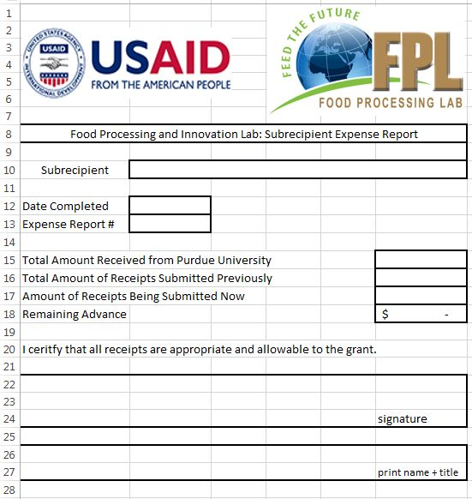
Tab 1: Reconciliation Page
Goal: Provide high-level overview of current financial situation; provide certification that expenses are appropriate/allowable.
Must be signed by someone authorized by your institution
Must be completed before the next payment will be issued

Slide 25
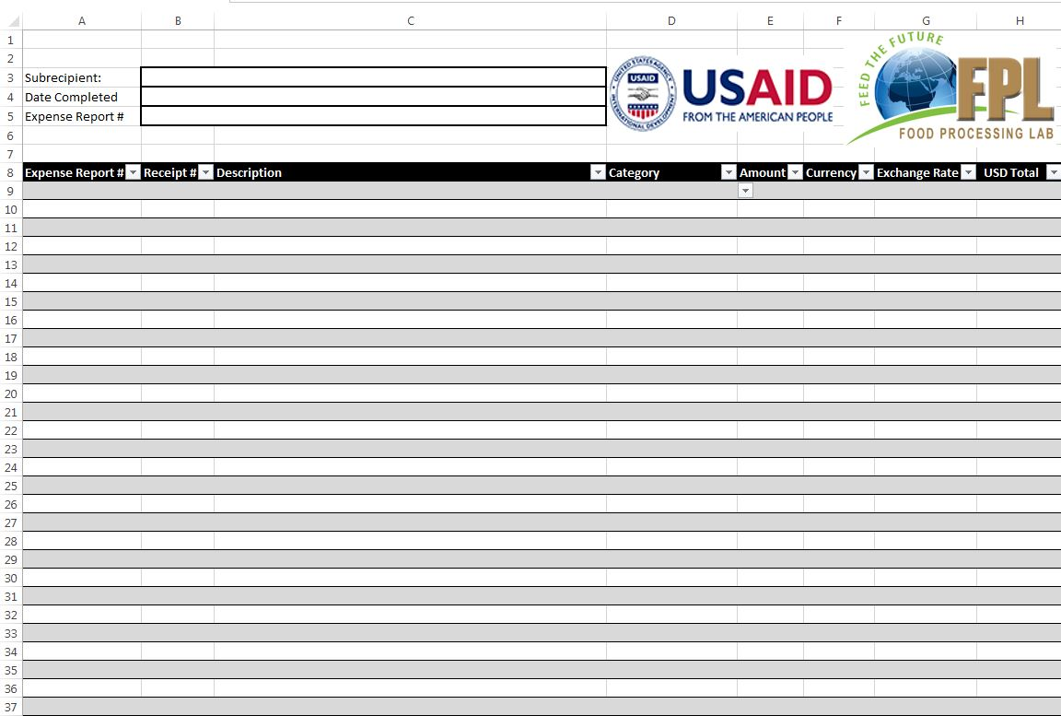
Tab 2: Line Item Report

Slide 26
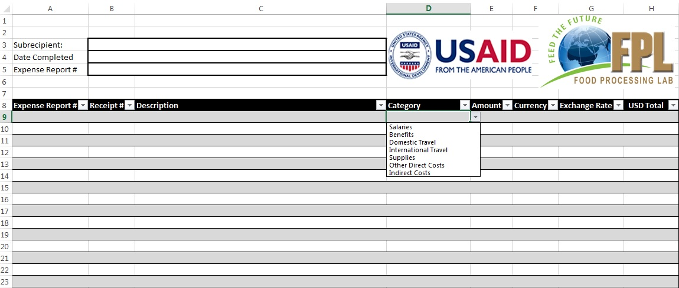
Tab 2: Line Item Report – Category Selection

Slide 27
New Reporting Template
Beginning in Year 2 (October 2015)
One advance payment will be given upon the signing of the Year 2 Amendment
  Percentage will be determined by Purdue in consultation with you and your needs
All subsequent payments will be paid with each submission of financial reports

