Slide 1
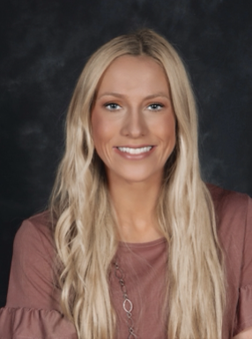
The Department of Animal Sciences
presents
McKeeley Stansberry
Tuesday, July 9, 2024
1:00 p.m. CRTN 1042
Or Join Zoom Meeting
https://purdue-edu.zoom.us/u/92604743302
Meeting ID: 926 0474 3302
“Investigating the Impact of Cooling Pads and Moringa Oleifera Supplementation on Sow Production and Milk Lipidome During Late Gestation and Lactation Under Heat Stress Conditions.”
Final Defense Seminar
Major Advisor: Dr. Allan Schinckel
Partial Fulfillment of the Master of Science Degree

