Slide 1
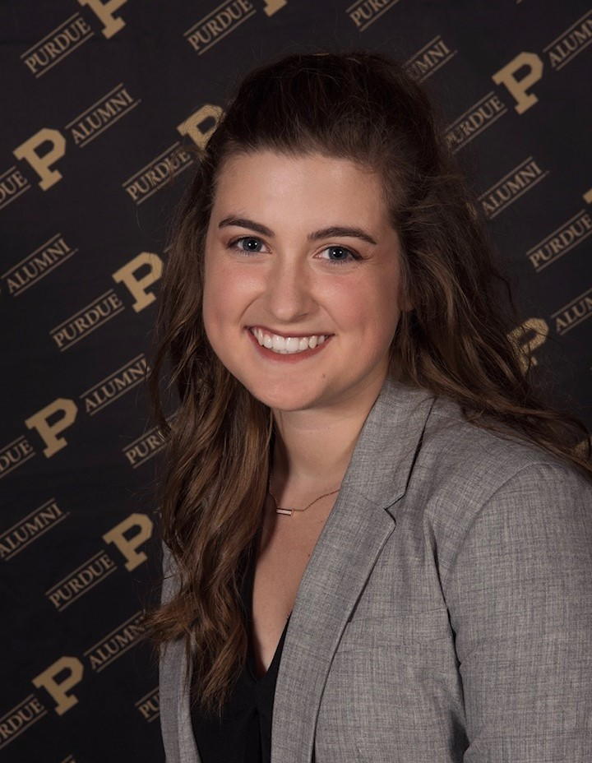
The Department of Animal Sciences
presents
McKinley Flinders
Wednesday, June 12, 2024
9:00 a.m. CRTN 1042
Or Join Zoom Meeting
https://purdue-edu.zoom.us/j/99524065947
Meeting ID: 995 2406 5947
“Validation of a Stereo Vision System to Estimate Total Mixed Ration Volume and Feeding Behavior of Dairy Cattle.”
Final Defense Seminar
Major Advisor: Dr. Jacquelyn Boerman
Partial Fulfillment of the Master of Science Degree

