Slide 1
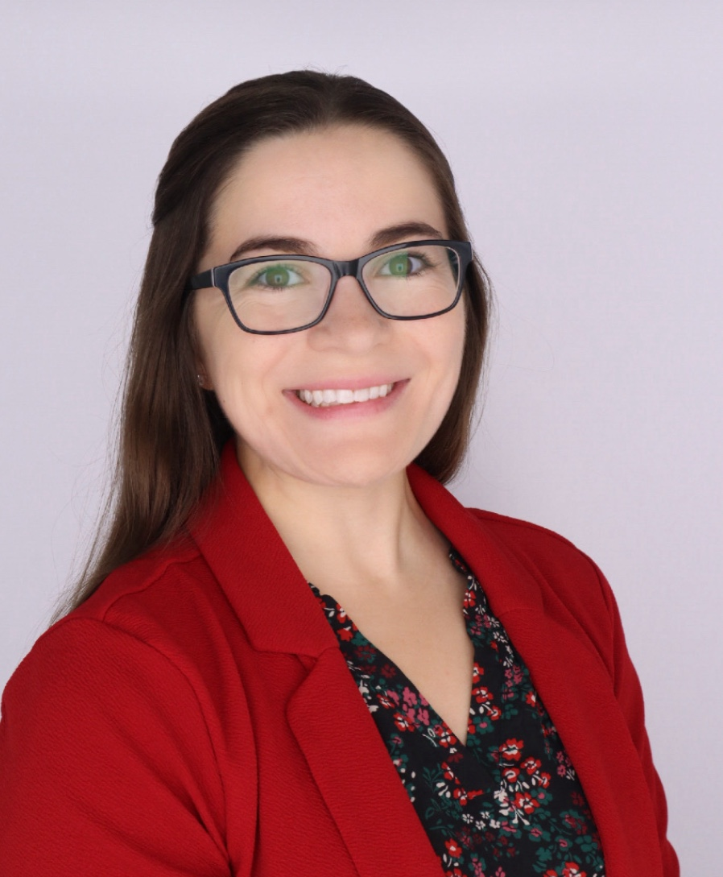
The Department of Animal Sciences
presents
Katherine Klassen
Wednesday, July 10, 2024
9:00 a.m. CRTN 1042
Or Join Zoom Meeting
https://purdue-edu.zoom.us/j/94483150340
Meeting ID: 944 8315 0340
“Does Location Matter? Investigating the Impact of Environmental Enrichment Location on the Welfare, Behavior, and Performance of Sows and Piglets in Farrowing Crates.”
Final Defense Seminar
Major Advisors: Drs. Marisa Erasmus and Jess Pempek
Partial Fulfillment of the Doctor of Philosophy Degree

