Slide 1
Hoosiers’ Health in a Changing Climate
A report from the
Indiana Climate Change Impacts Assessment
Add presenters name, event location and title, etc.

Slide 2
Hoosiers’ Health in a Changing Climate
Health Working Group
Gabriel Filippelli, lead, IUPUI
Karen Corner, IUPUI
Gebisa Ejeta, Purdue University
William Field, Purdue University
Jennifer Freeman, Purdue University
Joseph Gibson, Marion County Public Health Department
Stephen Jay, IUPUI
Daniel Johnson, IUPUI
Max Jacobo Moreno-Madrinan, IUPUI
Richard Mattes, Purdue University
Igor Ogashawara, IUPUI
Jeremy Prather, Mesh Coalition
Frank Rosenthal, Purdue University
Jeries Smirat, IUPUI
Yi Wang, IUPUI
Ellen Wells, Purdue University

Slide 3
Heat-Related Illnesses and Impacts
Key finding: Injuries and deaths caused by extreme heat are projected to increase, while injuries and deaths caused by extreme cold are projected to decrease. Overall, the annual number of temperature-related deaths in Indiana is expected to increase, and potentially even double, by mid-century. Children, the elderly, those in low-income households and those with pre-existing conditions will be at the greatest risk.
#INCCIA

Slide 4
Notes:
Extreme heat days per year for three representative Indiana counties. An extreme heat day occurs when the daily high temperature is above 95°F. “Historical” is the average for the period from 1915 to 2013. For future projections, “2020s” represents the average 30-year period from 2011 to 2040, “2050s” represents the average from 2041 to 2070, and “2080s” represents the average from 2071 to 2100. Data for other locations available. Source: Hamlet et al. 2019 and Widhalm et al. (2018a).
Hamlet, A., Byun, K., Robeson, S., Widhalm, M., and M. Baldwin. (2019). Impacts of Climate Change on the State of Indiana: Ensemble future projections based on statistical downscaling. Climatic Change. https://doi.org/10.1007/s10584-018-2309-9

Slide 5
Notes:
Uncomfortable nights per year for three representative Indiana counties. An uncomfortable night occurs when the daily low temperature is above 68°F. “Historical” is the average for the period from 1915 to 2013. For future projections, “2020s” represents the average 30-year period from 2011 to 2040, “2050s” represents the average from 2041 to 2070, and “2080s” represents the average from 2071 to 2100. Data for other locations available. Source: Hamlet et al. 2019 and Widhalm et al. (2018a).
Hamlet, A., Byun, K., Robeson, S., Widhalm, M., and M. Baldwin. (2019). Impacts of Climate Change on the State of Indiana: Ensemble future projections based on statistical downscaling. Climatic Change. https://doi.org/10.1007/s10584-018-2309-9

Slide 6
Heat-related illness and death: Who is at greatest risk?
Elderly
Infants
Low income
Obese, diabetic, hypertensive, people with other respiratory or cardiovascular diseases
Pets & pigs
Notes:
Kenny, Glen P., Jane Yardley, Candice Brown, Ronald J. Sigal, and Ollie Jay. “Heat Stress in Older Individuals and Patients with Common Chronic Diseases.” CMAJ : Canadian Medical Association Journal 182, no. 10 (July 13, 2010): 1053–60. https://doi.org/10.1503/cmaj.081050.

Slide 7
Notes:
Projected number of premature temperature-related deaths per year for three Indiana cities. Red arrows show warm-season deaths (April to September). Blue arrows show cold-season deaths (October to March). Darker shades on arrow tips depict range of model results. Black bars show range of net annual temperature-related deaths. Data are based on research published by Schwartz et al. (2015) for a medium-high emissions scenario (RCP 6.0) using two climate models while holding population constant at 2010 levels. Future reporting years are based on 30-year average periods, with the exception of 2100, as follows: 2030 (2016 to 2045), 2050 (2036 to 2065), 2100 (2086 to 2100). These results are based on historical relationships between temperature and mortality, which have changed over time. Efforts to help the most vulnerable Hoosiers avoid exposure to dangerous heat and treat heat-related symptoms could reduce or prevent the projected rise in warm-season deaths.

Slide 8
Air Quality-Ozone and Fine Particulates
Key finding: Higher temperatures and stagnant air will increase ground-level ozone production, worsening air quality. Reduced air quality can trigger asthma attacks or heart attacks, and cause or worsen respiratory and cardiovascular illnesses such as asthma, emphysema, chronic obstructive pulmonary disease (COPD), high blood pressure, diabetes and heart failure. These then cause premature deaths.
#INCCIA

Slide 9
Air Quality-Allergens
Key finding: Indiana's allergy season is projected to lengthen by a month by mid-century, due to a longer growing season. Ragweed and other plants will produce more pollen as the rising carbon dioxide in the air increases their growth.
#INCCIA

Slide 10
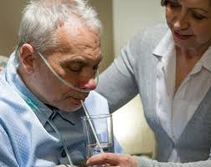
Air quality illness and death: Who is at greatest risk?
Ozone, air quality, allergens → breathing problems
Asthmatics
Asthma attacks, from disruptive to deadly
Lung disease
Chronic Obstructive Pulmonary Disease (COPD)
Bronchitis
Emphysema
Notes:
https://ephtracking.cdc.gov/showAirContaminants.action
https://www.epa.gov/ozone-pollution-and-your-patients-health/health-effects-ozone-general-population

Slide 11
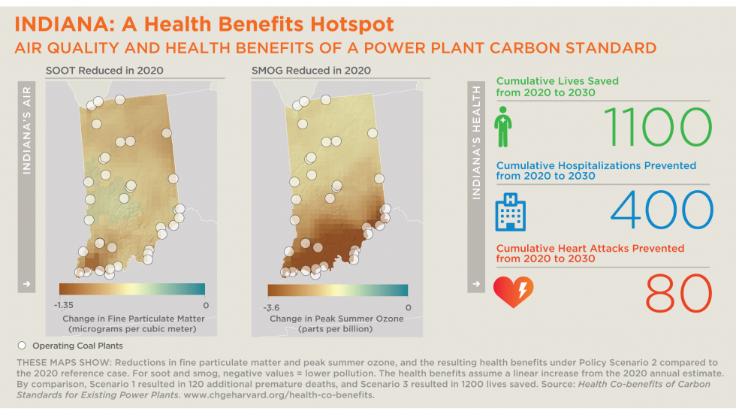
\
#INCCIA
Notes:
Health Benefits of Cleaner Air
Reducing carbon emissions from power plants can slow the planet’s rate of warming. At the same time, reduced power plant emissions would provide measurable and meaningful benefits to our health, including fewer hospital admissions and premature deaths from air pollution.
One study found that reducing carbon pollution by the amount proposed in the 2014 EPA Clean Power Plan would also eliminate the emission of other pollutants that would otherwise cause 3,500 premature deaths per year in the U.S. and result in 1,000 hospitalizations (Schwartz et al., 2014). Indiana ranks in the top 12 states with the highest potential number of lives saved if emissions were reduced.
Above: With stringent reductions in carbon pollution from power plants, Indiana would see fewer deaths and injuries due to air pollution. Source: Harvard School of Public Health and Schwartz et al. (2014).

Slide 12
Insect-Borne Illnesses
Key finding: Ticks have expanded their range and increased reproduction rates across Indiana as temperatures have warmed in recent decades. As a result, the number of tick-borne illnesses such as Lyme disease has increased. This trend will continue and intensify as the warming continues.
#INCCIA

Slide 13
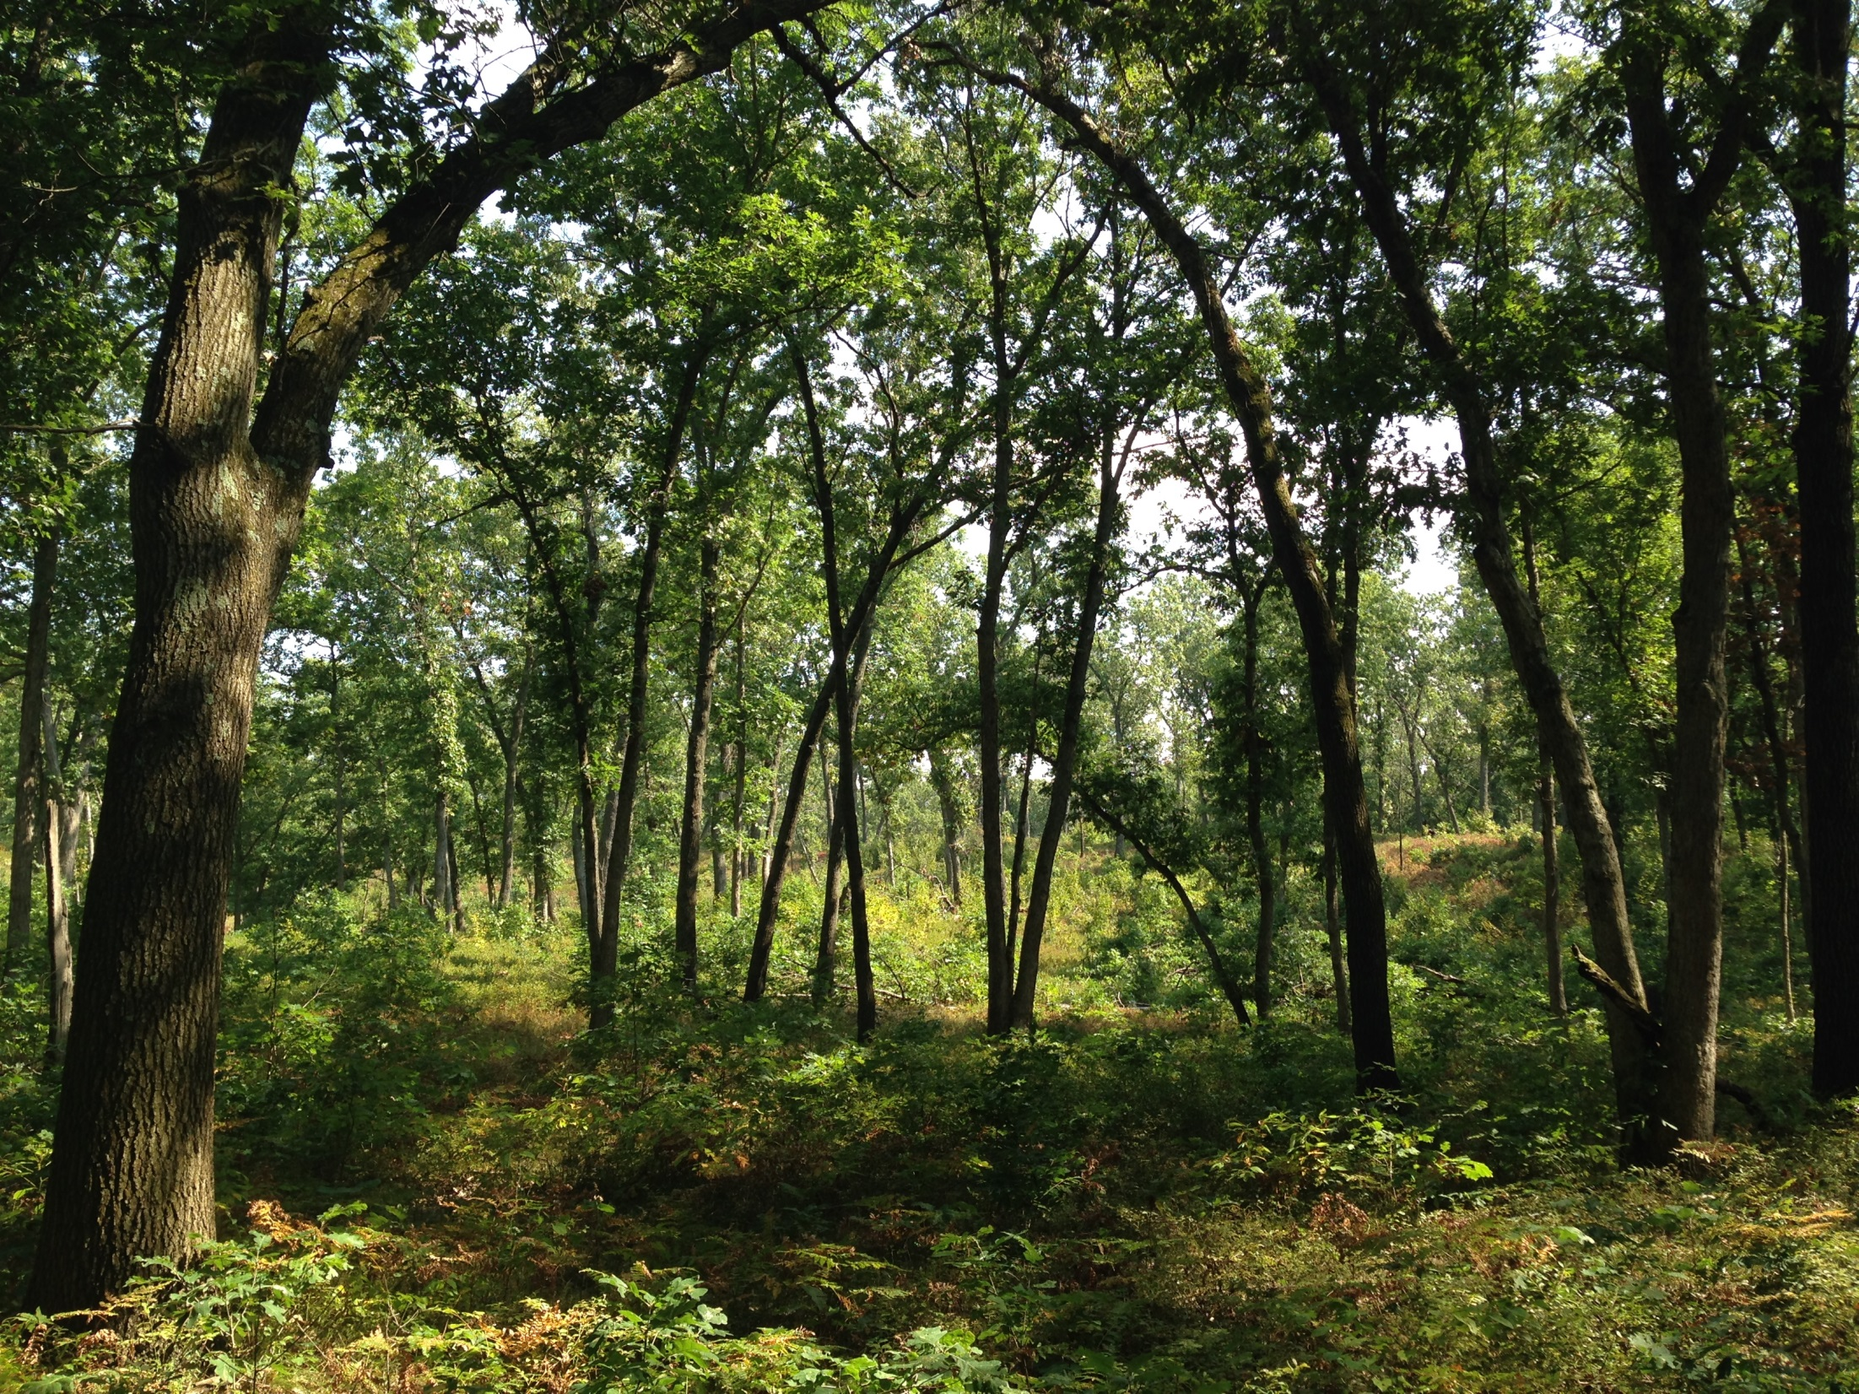
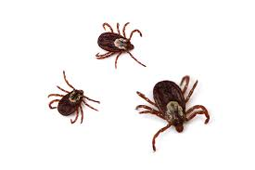
More Lyme Disease
1996
2014

Slide 14
Insect-Borne Illnesses
Key finding: In the past 30 years, increased precipitation and flooding may have contributed to the increase in Indiana's mosquito population. Greater spring rainfall and warmer temperatures are projected to continue this trend and will provide living conditions for the more "tropical" types of mosquitoes that carry diseases such as malaria, dengue fever, and Zika.
#INCCIA

Slide 15
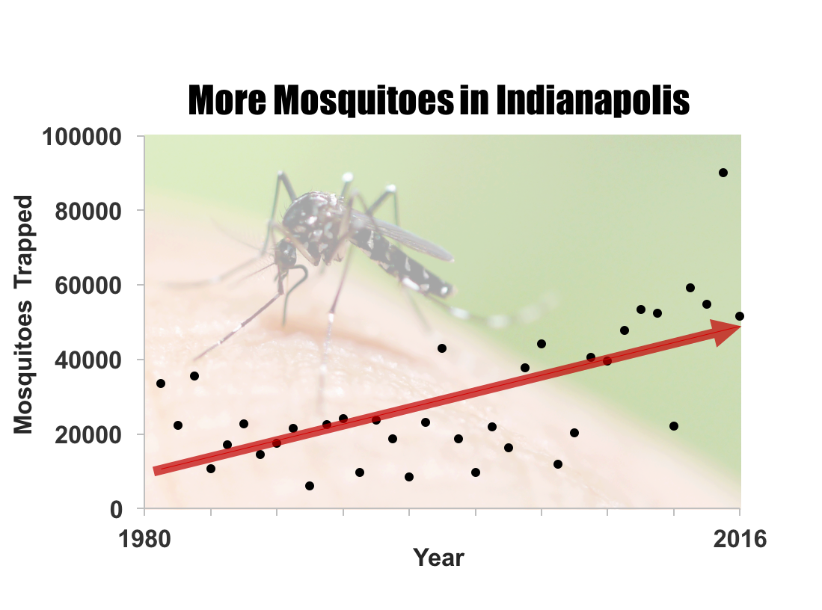
#INCCIA
Notes:
Mosquitoes trapped in 20 light traps in Marion County, Indiana, from 1981 to 2016. Black dots show annual counts. Red line is the linear trend over the period of record. Source: Marion County Public Health Department and Filippelli et al. (in review).

Slide 16
Notes:
Extremely cold nights per year in three representative Indiana counties. An extremely cold night occurs when the daily low temperature is lower than 5°F. “Historical” is the average for the period from 1915 to 2013. For the future projections, “2020s” represents the average 30-year period from 2011 to 2040, “2050s” represents the average from 2041 to 2070, and “2080s” represents the period from 2071 to 2100. Data for other locations available. Source: Hamlet et al. 2019 and Widhalm et al. (2018a).
Hamlet, A., Byun, K., Robeson, S., Widhalm, M., and M. Baldwin. (2019). Impacts of Climate Change on the State of Indiana: Ensemble future projections based on statistical downscaling. Climatic Change. https://doi.org/10.1007/s10584-018-2309-9

Slide 17
Water-Based Problems
Key finding: Increased precipitation, especially in winter and spring, will heighten flooding risks. Floods directly impact human health through physical injuries, displacement, property loss, and post-flood mold and fungus growth.
#INCCIA

Slide 18
#INCCIA
Notes:
Projected annual and seasonal percent change in precipitation for Indiana compared to the historical period (1971 to 2000). Values represent state-level averages from 10 climate model projections. For the future projections, “2050s” represents the average from 2041 to 2070, and “2080s” represents the period from 2071 to 2100. Source: Hamlet et al. 2019
Hamlet, A., Byun, K., Robeson, S., Widhalm, M., and M. Baldwin. (2019). Impacts of Climate Change on the State of Indiana: Ensemble future projections based on statistical downscaling. Climatic Change. https://doi.org/10.1007/s10584-018-2309-9

Slide 19
Urban Impacts
Key finding: Cities like Indianapolis will be particularly vulnerable to health risks since urban areas create "heat islands" that can intensify temperature and precipitation impacts, and also contain more sources of harmful ozone.
#INCCIA

Slide 20
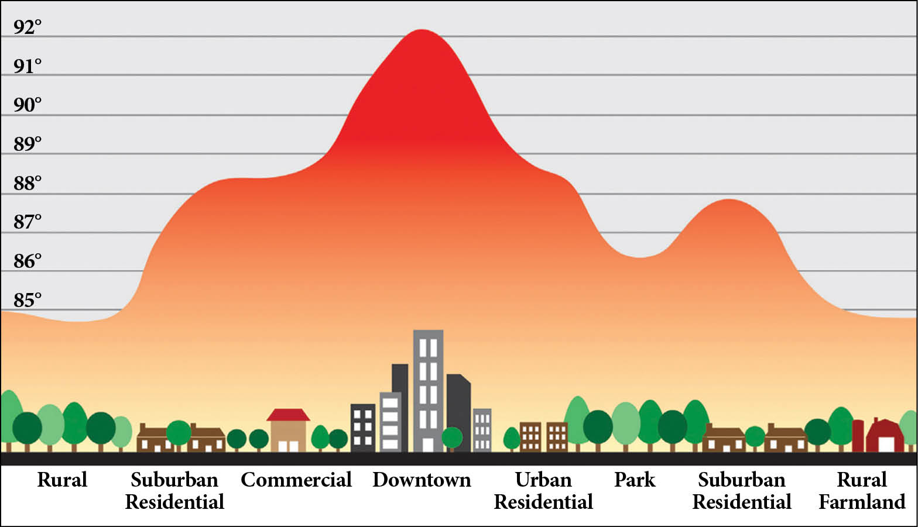
Urban Heat Islands & Ozone

Slide 21
Urban Heat Islands & Ozone
Ozone is a strong lung irritant
Ozone is caused by fuel emissions
High temperatures increases ozone
Effect greater in downtown areas
Emission sources
Urban heat island effect
100
90
80
70
60
50
40
30
20
Ozone (ppb)
50 60 70 80 90
Temperature (deg F)

Slide 22
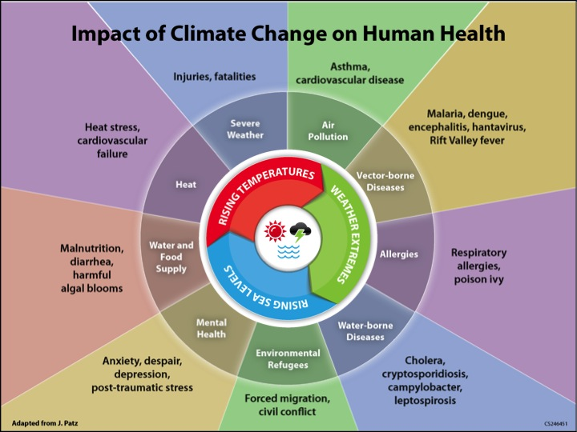
Notes:
This diagram describes how disruptions in the climate translate to impacts on human health. Source: Monika Dutt, Medical Officer of Health (Cape Breton, Guysborough, Antigonish), adapted from National Center for Environmental Health, Centers for Disease Control and Prevention (CDC).

Slide 23
Summary of Key Findings
More heat-related injuries & death
Reduced air quality from ozone
Longer, more intense allergy season
More vector-borne disease pests
Algal blooms & toxic algae
Increase in flood-related injuries & disease
Stress and other metal health impacts
Vulnerable populations at greatest risk
#INCCIA

Slide 24
Hoosiers’ Health in a Changing Climate
Recommended Citation
Filippelli, G.M., Widhalm, M., Filley, R., Comer, K., Ejeta, G., Field, W., Freeman, J., Gibson, J., Jay, S., Johnson, D., Mattes, R., Moreno-Madriñán, M.J., Ogashawara, I., Prather, J., Rosenthal, F., Smirat, J., Wang, Y., Wells, E., and J.S. Dukes. 2018. Hoosiers’ Health in a Changing Climate: A Report from the Indiana Climate Change Impacts Assessment. Purdue Climate Change Research Center, Purdue University. West Lafayette, Indiana. https://bit.ly/2IvumFC
Read the Full Report
https://ag.purdue.edu/indianaclimate/hoosier-health-report/
#INCCIA

Slide 25
Stay informed, stay connected
Jeffrey Dukes
PCCRC Director
jsdukes@purdue.edu
@DukesJeff
http://IndianaClimate.org
@PurdueCCRC
Melissa Widhalm
IN CCIA Coordinator
mwidhalm@purdue.edu

Slide 26
Heat, Humidity and Health
Notes:
Heat, Humidity and Health
As Midwesterners, we know that hot, humid weather can be dangerous, and even deadly. Together, heat and humidity make it difficult for the body to keep cool, increasing the risk of heat exhaustion and heat stroke. Dangerous humidity is especially problematic for the very young and elderly, and those people with underlying health conditions. However, even healthy individuals can succumb to heat extremes when the physical limits of the body are pushed too far.
Scientists use what is known as the “wet-bulb temperature”—a combined measure of heat and humidity—to determine risk of heat-related illness. The higher the wet-bulb temperature, which is measured in degrees Fahrenheit (°F), the more difficult it will be to maintain a safe body temperature. Wet-bulb temperatures above 80°F are considered dangerous, and exposure to wet-bulb temperatures above 95°F for more than a few hours is lethal.
In a warming world, dangerous humidity is expected to happen more frequently. Historically, Indiana has had about 1 to 10 days per year with wet-bulb temperatures between 80°F and 86°F. These conditions are much like the hottest summer months in the most humid parts of the Southern U.S. By mid-century, we are expected to have about 10 to 30 dangerous days per year, with far southern areas of the state reaching up to 50 days per year.
(Sources: Hsiang et al., 2014; Sherwood and Huber, 2010)

Slide 27
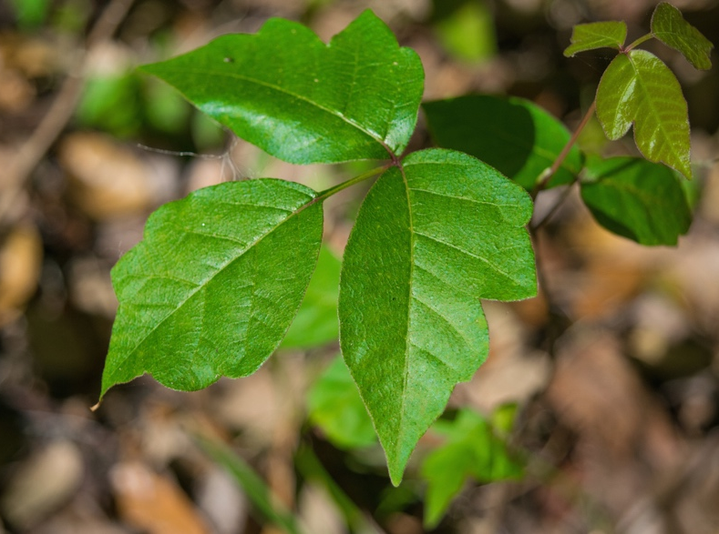
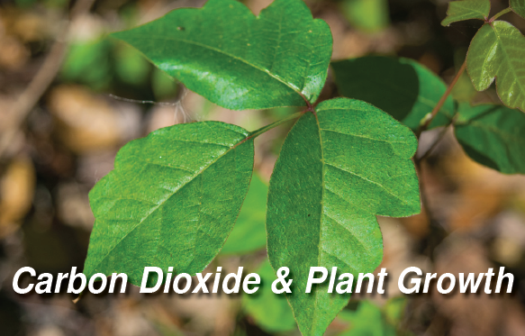
Notes:
Carbon Dioxide & Plant Growth
Did you know that some plants, like ragweed and poison ivy, thrive with higher concentrations of carbon dioxide (CO₂) in the atmosphere? Researchers have found that poison ivy plants, for example, grow faster and produce more toxic oil per plant in high-CO₂ environments. Poison ivy toxicity could double by the year 2050 if CO₂ emissions continue unabated. Ragweed has also been shown to grow faster, with increased pollen production, when grown in warmer conditions with higher levels of CO₂. Grass pollen also grows in abundance as CO₂ concentrations rise. With more than 50 million Americans suffering from seasonal allergies, at a cost of $18 billion annually, these changes threaten to reduce the health and well-being of many Hoosiers.
(Sources: Ziska et al. (2007), Ziska and Caulfield (2000), Albertine et al. (2014))

Slide 28
Now what?
Addressing the root causes of climate change will reduce health impacts in Indiana
Increase the dialogue
Adopt policies & personal practices to address impacts
Actions to limit climate change

Slide 29
Ways to Decrease the Impact
Limit warming & exposure (mitigation)
Reduce emissions of heat-trapping gases
Urban greening
Reduce heat island effect
Air & water quality standards (policy)

Slide 30
Ways to Decrease the Impact
Prepare for impacts (adaptation)
Emergency response planning
Heatwaves → Cooling centers
Increase community resilience
Infrastructure improvements
Flood control, water management
Surveillance and remediation
Algal blooms, pest habitat

