Slide 1
Using the Community Capitals Framework to Measure Program Impacts
January 25, 2022
Abigail Borron | Scott Chazdon | Abigail Condie | Mary Emery

Slide 2
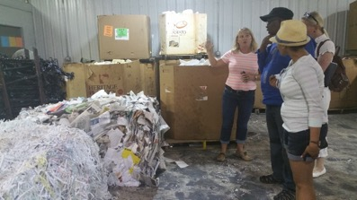
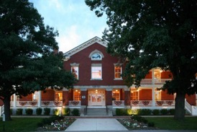
National CRED* Indicators Working Group -- What’s Driving Us?
The need tell compelling stories at state, local, and national levels about the collective impact of our community and economic development work
Improve our ability to:
Gather and assess collective impacts and leverage each other’s strengths
Develop support for CRED programming
Make strategic decisions regarding the importance, value, and potential of CRED programs
*Community Resource and Economic Development
Notes:
Our group is an informal working group that has met for ten years to build evaluation capacity across the country.

Slide 3
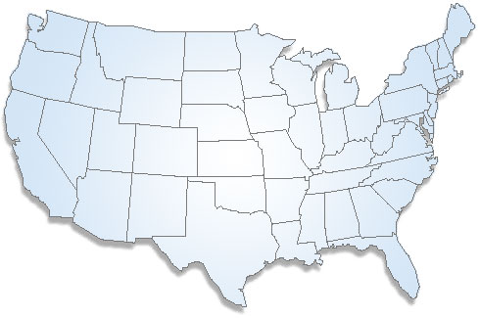
National CRED Indicators Working Group
Scott Chazdon
Josset Gauley
Walt Whitmer
Cheryl Burkhart-Kriesel
Vikram Koundinya
Michael Dougherty
Susan Jakes
Sreedhar Upendram
Russ Garner
Michele Walsh
Rachel Welborn
John Diaz
Notes:
Our current group has people from across the nation and we are always interested in having more people join us. We meet every other month and we try to offer two webinars per year as well as sessions at the NACDEP and CDS conferences.

Slide 4
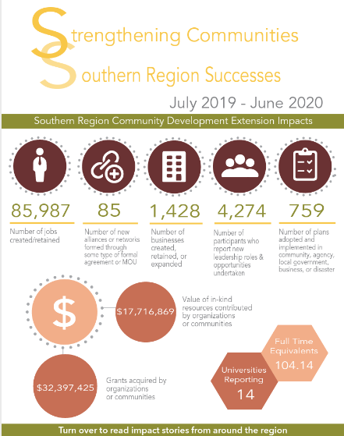
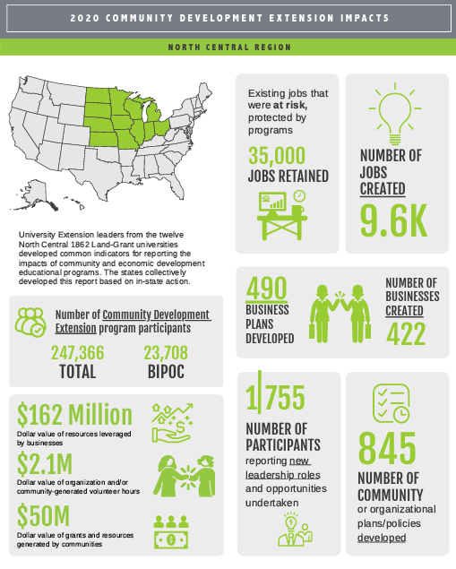
CRED Reporting
Reported since 2010 in North Central region!
Southern region of U.S. also does reporting
CRED programming and staffing in Northeast and West regions more sparse, harder to report impacts

Slide 5
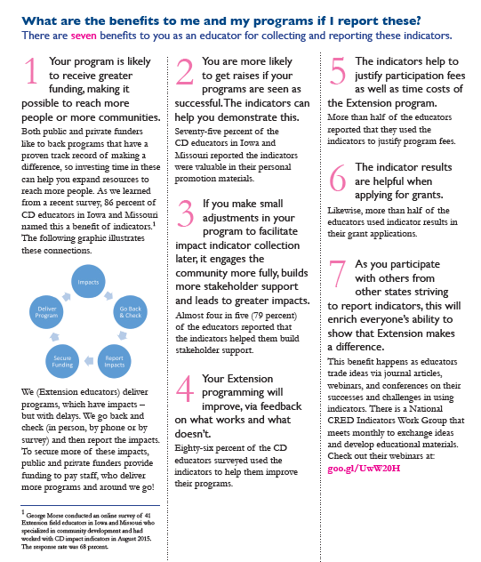
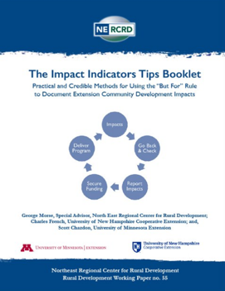
Benefits of collecting indicator data
Need to convince state and federal funders that Extension programs are a good investment
Data collection can also be used for scholarship and program improvement
“Is Extension making a difference?” “ If so, how much?”
Notes:
There are actually eight benefits listed in the Impact Indicators Tips Booklet

Slide 6
Mary Emery
Using CCF to plan for long-term change

Slide 7
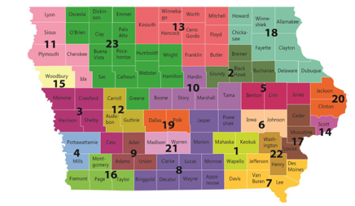
The setting
Iowa State Public Health 2007: Opportunity and Challenge
How do we invest in Community Wellness leading to long-term changes in indicators of community health?
Pilot study raised concerns about lasting impact.

Slide 8
The Strategy: Integrating Community Coaching and the Community Capitals Framework
1. Shaping the call for proposals
2. Training for Public Health professionals in community coaching
3. Orientation for grantees
4. interim and final reporting protocols using CCF

Slide 9
Challenges
Public health professionals often have issues with the coaching models
Tell me again, What exactly is political capital?
2008 downturn - lost funding, staffing, and support before we could finalize the reporting

Slide 10
Lessons learned
Projects that accessed assets across the capitals created assets across the capitals
These projects were also more successful in reaching goals, engaging others, and raising funds.
The least successful were focused on one capital - human capital and were designed as expert solutions.
Those forced on the expert model accessed fewer assets across the capitals.

Slide 11
Abigail Condie
Literature Review: Creating Program Indicators based on the Community Capitals Framework

Slide 12
Methods
Review of 19 different studies, mostly identified using Google Scholar
Primarily focused on the “Community Capitals Framework,” but also branched out into related studies on community well-being and resilience using many of the same capitals
Much of the research was connected to Extension, with some expansion into other disciplines

Slide 13
Observations
Studies made use of primary or secondary data sources, or sometimes a combination
Useful since collecting primary data isn’t always feasible given time or resource constraints, and more longitudinal data may be available with secondary data sources.
The CCF has been combined with other frameworks, assessments, and concepts
Example: asset-based community development, personal agency, sustainable livelihoods approach
Used widely across a variety of industries
Example: Extension, energy plant consulting, rural demographic studies, international development.

Slide 14
Overview of the Capitals-Based Indicators

Slide 15
Built & Financial Capital Indicators Examples
Built Capital indicators for some studies tended to focus on suitability of built capital for the business environment. Others prioritized housing and transportation. In some cases built and financial capitals were combined.
Financial Capital indicators focused on employment and businesses with a focus on the local or community level. Some studies paid attention to poverty levels and the affordability of assets like housing.
Notes:
Built
Primary Data indicators: Affordable and accessible housing, Transportation and connectivity, Growth of existing assets
Secondary Data indicators: Market Access, Broadband access, Infrastructure (availability)
Financial
Primary: Help to create or save local jobs, Apply for grants to support business development, Community wealth building
Secondary: Median household income, Individuals in poverty (%), Unemployment (%)

Slide 16
Natural & Cultural Capital Indicators Examples
Natural capital indicators focused on cataloging natural resources; quality of water, soil, and air; access and quality of outdoor spaces; and reduction of environmental impacts.
Cultural capital indicators included activities, events, and spaces dedicated to the arts, culture, philosophical or religious beliefs, history, and heritage, etc.
Notes:
Natural Capital
Primary:Amount and condition of open space in the community, Amount of protected land in the community, Efforts to preserve and restore historic buildings, monuments, etc.
Secondary: Market Access, Broadband access, Infrastructure (availability)
Cultural Capital
Primary: 1. Participate in one or more social movements, 2. Access culturally relevant products, 3. Develop a personal connection to the place I live
Secondary: The number of free or affordable classes in the arts and other subjects for adults, Number of ethnic and religious festivals and other such multi-cultural events, Number of National Historic Landmarks

Slide 17
Human & Social Capital Indicators Examples
Human capital indicators for these studies varied notably. Some studies focused on physical and mental health indicators, whereas others focused on education. Other studies focused on individuals’ community engagement or the availability/accessibility of social services. Still others collected more standard demographic data at the community level.
Social capital indicators for some studies aimed to get a sense at the quantity and diversity of groups, clubs, organizations, and more within a given community. These studies sometimes included additional demographic indicators or more specific indicators about ongoing community efforts.
Notes:
Human Capital
Primary: Education cost, Number of children, Access/use of health and social services
Secondary: % uninsured, College graduates (%), Population 65+ years
Social Capital
Primary: Feel part of the community, Join others to support local change efforts, Expenditure on social events
Secondary: White residents (%), Number of domestically-focused non-profit organizations, Income inequality (Gini Index)

Slide 18
Political Capital Indicators Examples
Political capital indicators for studies tended to focus on civic engagement of community members or the roles and preparedness of local government. Some studies were concerned with demographic data as it related to these topics, such as voting behavior (median income and education) and racial/ethnic makeup of law enforcement (in comparison to the community.)
Notes:
Political Capital
Primary: Communicate with government leaders (local, county/state, federal), Join advocacy coalitions that address local issues, Mobilize resources for community change.
Secondary: General election turnout, Crime rate by neighborhood, Existence of emergency management plans

Slide 19
Conclusion
Indicator selection was diverse based on varying interpretations of the capitals
Likely influenced by the discipline of the researchers, along with the broader focus of a particular study or project
Financial and business indicators regularly popped up in other capitals
Studies incorporated “standard” demographic data at various points within the CCF framework

Slide 20
Abigail Borron
Developing the Community Diagnostics + Social Impact Toolkit

Slide 21
Implying an Inside-Out Perspective
Proposed Model (using a two-part assumption):
Regardless of the presence or absence of university programming, the community profile must first be considered
Local perceptions are critical to shifts – positive or negative – related to community development and vitality.

Slide 22
The Modified CCF Model
The Scale
Designed to address how an individual operationalizes each capital from two points of view:
Perceived community
Perceived internal agency (personal ability)
Borron, A., Lamm, K., & Atkins, K. (2021). Perceptions of personal agency within communities: Validation of a diagnostic instrument. Community Development. doi: 10.1080/15575330.2021.1946577
Lamm, K. W., Borron, A. & Atkins, K. (2021). The development and validation of an empirical scale to inform community diagnostics and change. Journal of Agricultural Education and Extension, 27(3), 287-306. https://doi.org/10.1080/1389224X.2020.1851270

Slide 23
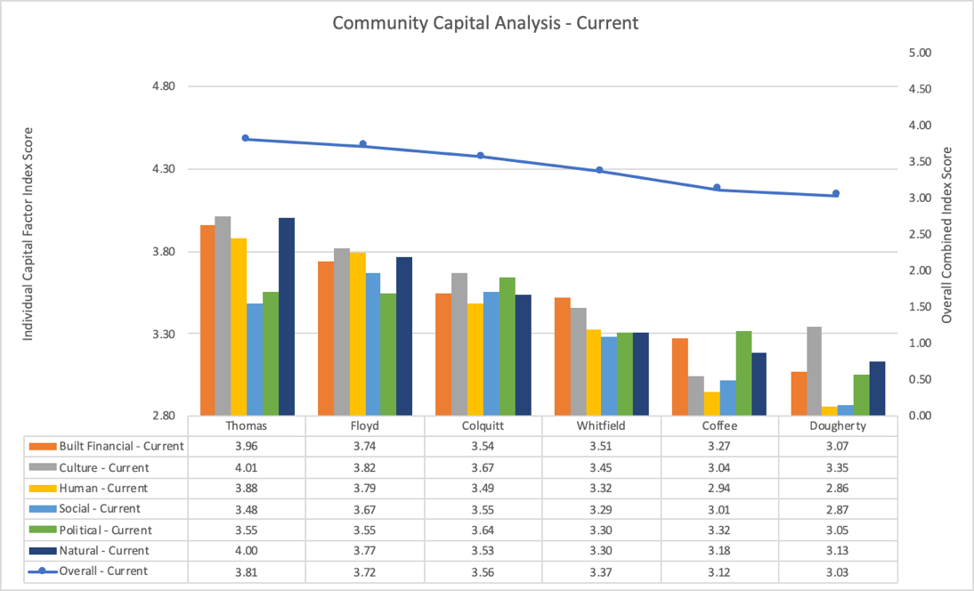
Pilot Study
Perceived Community

Slide 24
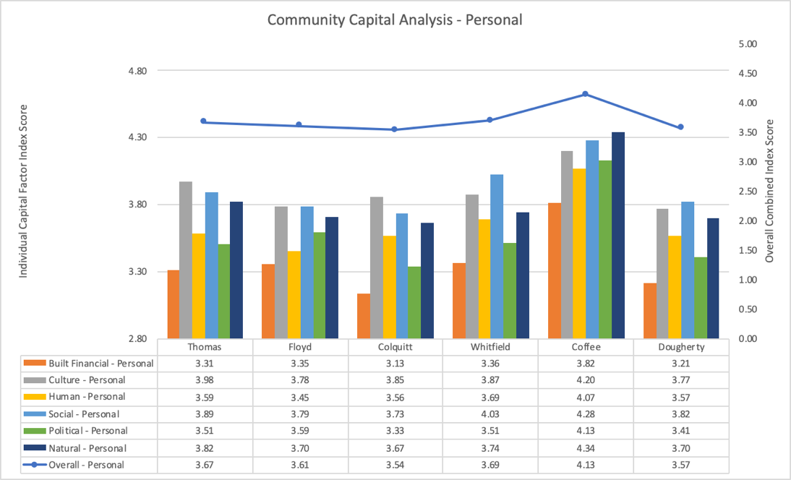
Pilot Study
Perceived Personal Agency

Slide 25
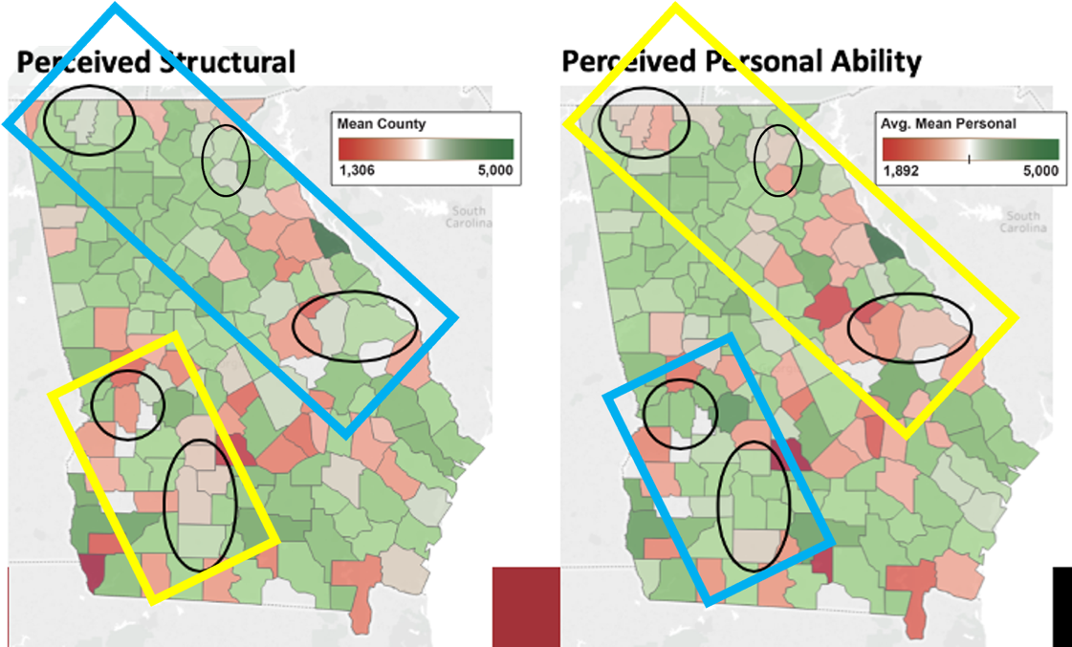
Statewide Data Collection
Perceived Community
Perceived Personal Agency

Slide 26
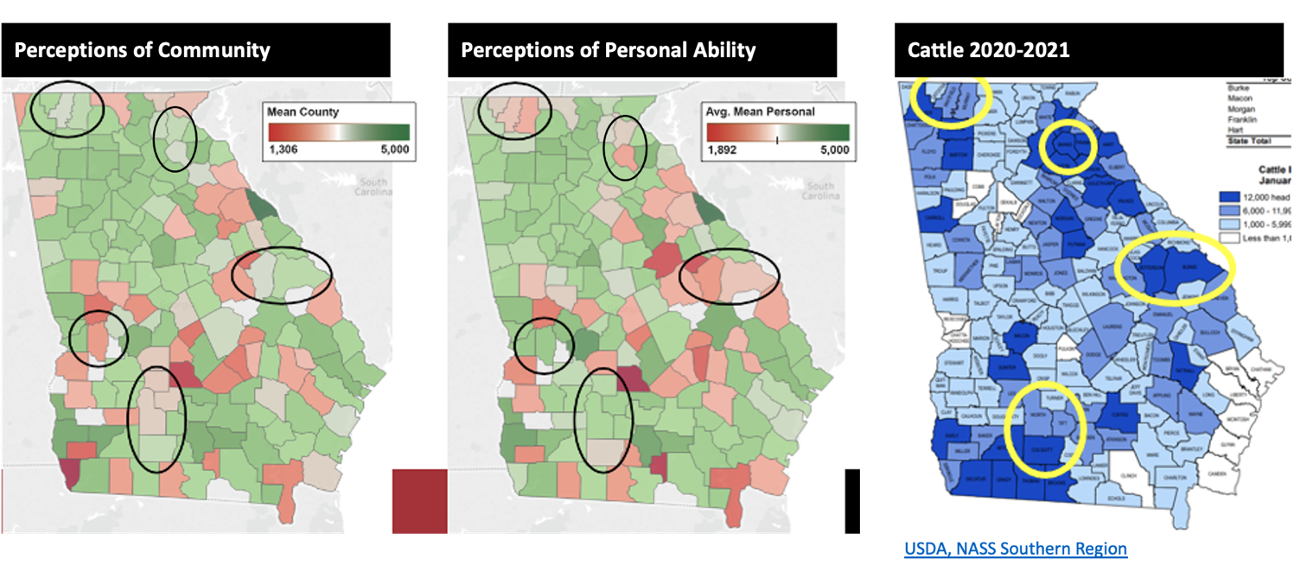
Livestock Production

Slide 27
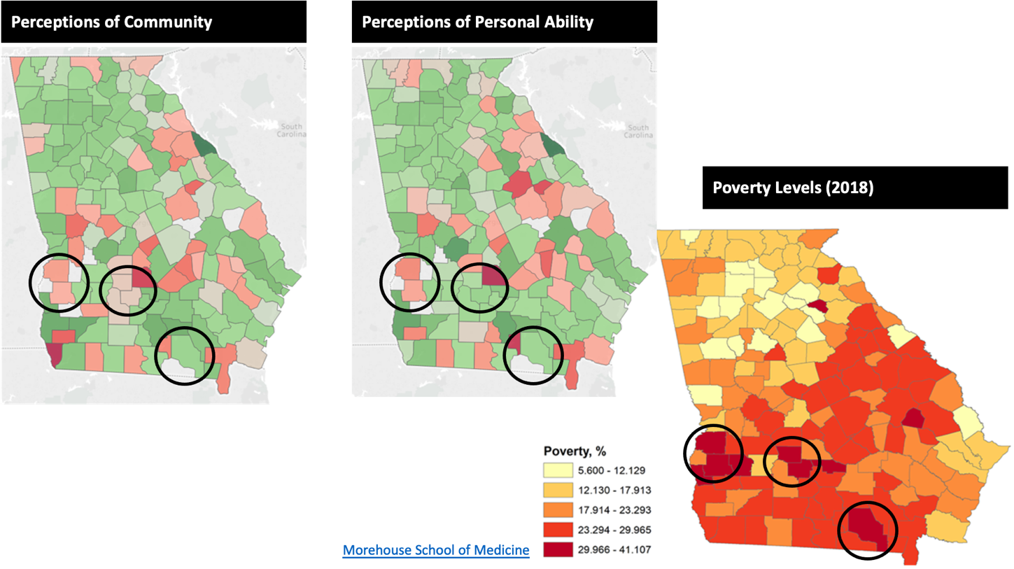
Poverty Levels

Slide 28
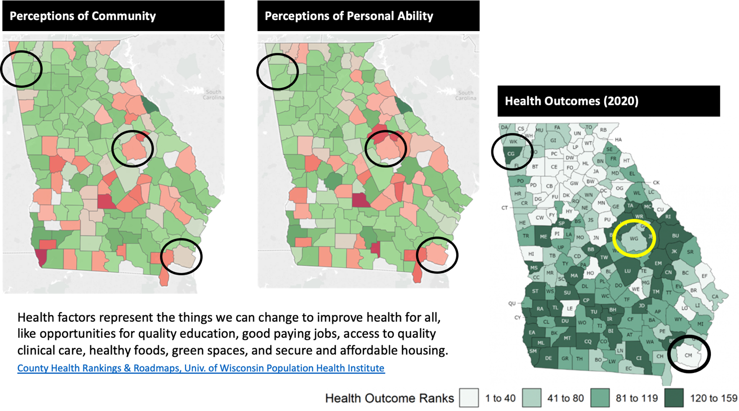
Health Outcomes

Slide 29
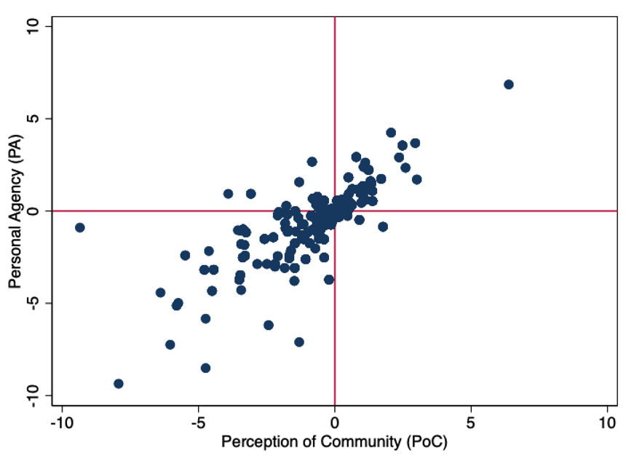
Synthesis of Both Scales

Slide 30
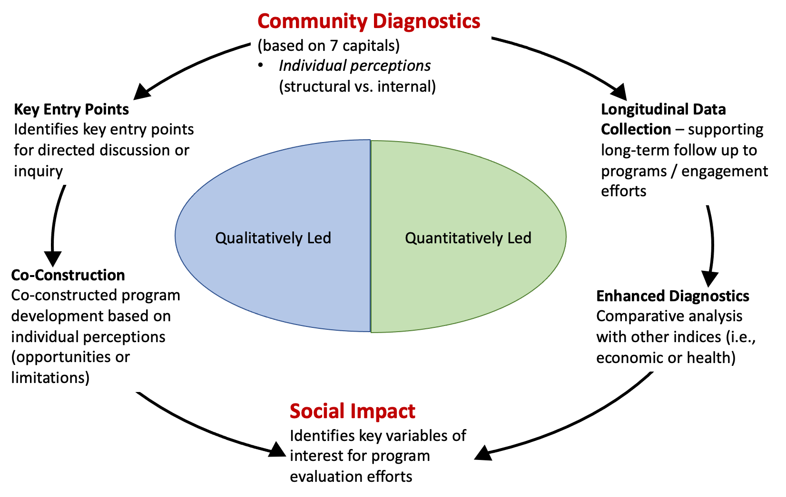

Slide 31
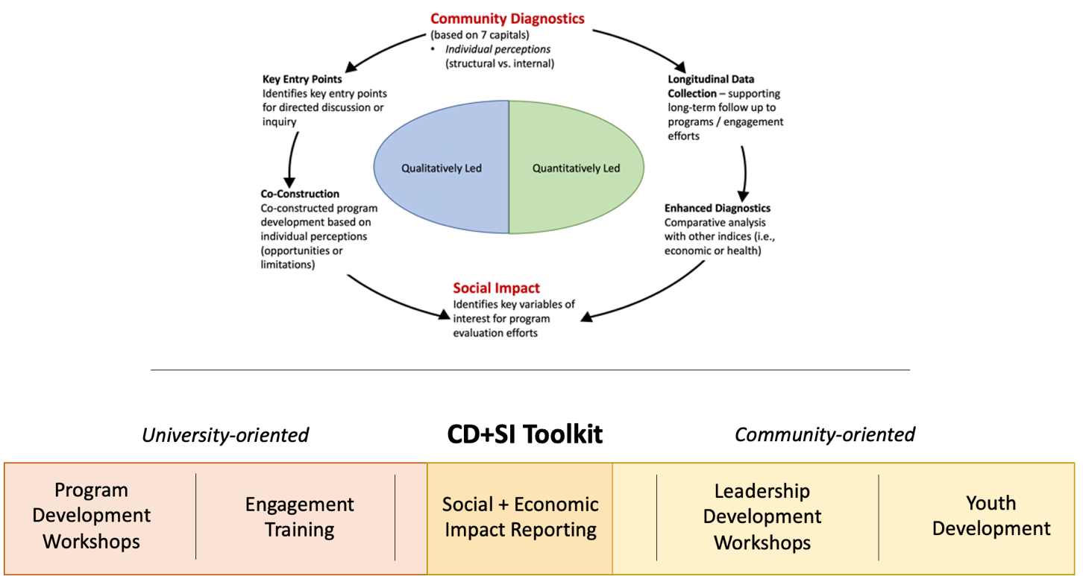

Slide 32
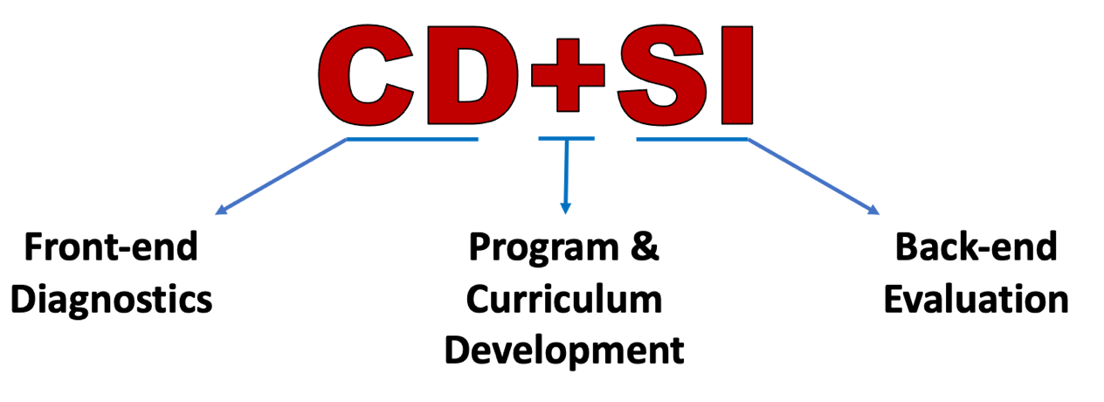
Community Diagnostics + Social Impact ToolkitTM

Slide 33
Scott Chazdon
Reporting using the CCF

Slide 34
Offering | Social | Civic | Cultural | Financial | Built | Natural | Number of capitals impacted
COVID-19 and Tourism | (d) | (d) | (d) | (d) | (d) | (d) | 6
Growing Community Project | (b) | (b) | (b) | (b) | (b) | (b) | 6
Anti-racism book clubs in Grand Marais | (c)(d) | (c) | (c)(d) | (c) |  |  | 4
Business Retention and Expansion online course | (d) | (d) | (d) |  | (d) |  | 4
Changemaker Retreats | (d)(e) | (d)(e) | (e) | (d)(e) |  |  | 4
Economic decision tools: Making Wise Decisions for your community | (d) | (d) | (d) | (d) |  |  | 4
Fall Leadership Refresher Series | (d) | (d) | (d) | (d) |  |  | 4
Red River Valley Emerging Leaders | (d) | (d) | (d) |  | (d) |  | 4
Data sources:
Business Retention & Recovery focus group
Growing Community Project - individual interviews with participants in Northome and Bovey
End of program surveys
Federal report survey
Changemaker report from Family Development
Notes:
Last year for the first time, I organized all of our federal report data collection around the CCF. I used multiple data collection strategies and in some years I also have Ripple Effects Mapping I’ve done for our programs. The point is to make sure that each method employs the CCF so you can fill out a table like this and actually document the effects in each capital. Note that we did a focus group, an interview project, end of program surveys, annual survey, and data collection for a federal grant, so I looked at all of it It is very interesting when you see programs of offerings impacting so many capitals. Note about human capital - we don’t focus on this as much because we are an educational organization and knowledge change is baked into everything we do.
Note: this isn’t the whole table. If you want to see the whole table, send me an email!

Slide 35
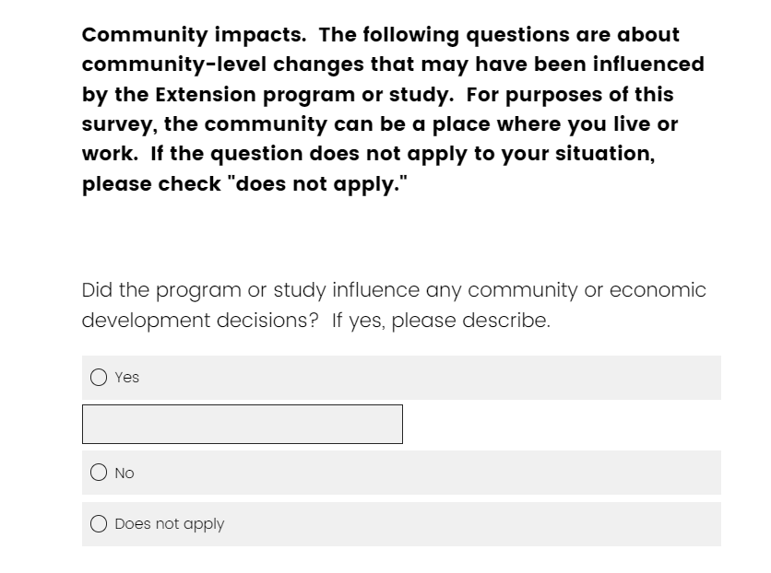
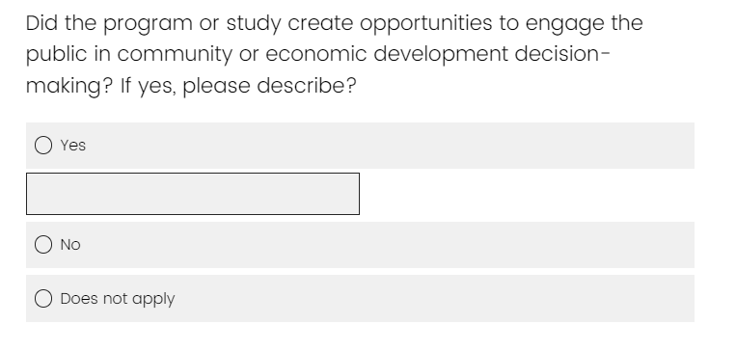
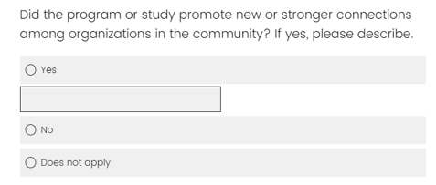
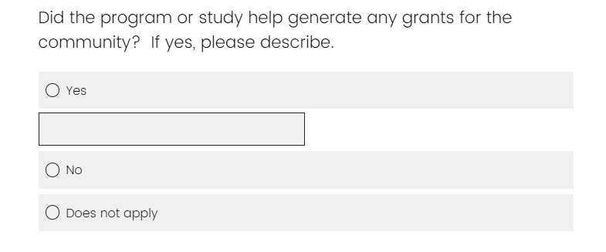
End of year follow-up survey (sent to community stakeholders)
Notes:
This is what our annual federal report survey looks like - it is sent to participants in high engagement programs such as leadership cohorts.

Slide 36
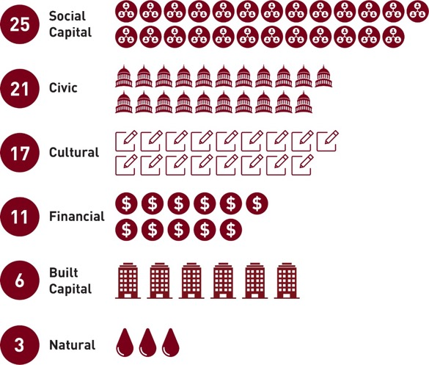
Positive effects on community capitals
Number of positive effects on community capitals (other than human capital) that were influenced by applied research or education in communities (out of 29 offerings)
Notes:
Our Extension communications staff created this infographic and it was featured in an Extension email blast.

Slide 37
Examples
Capital | Data points
Social | Growing Community Northome -- kickoff meeting had attendance of 59 people from a community of 200 (that 200 figure doesn’t include outlying areas, but still!) Project creating working groups around the community capitals and brought in new leaders.
Social | Meeker in Motion - Because of this program, I was able to reach out to a connection I'd made with someone who works in county social services for information for my organization. It has been incredibly helpful during the pandemic to have made connections in the program with 2 city clerks I interact with for my organization. That was an immediate and clear benefit of the program for me.
Civic | Working Out Loud: Becoming Anti-racist St. James - facilitating antiracism community ed offering . . .
Civic | Welcoming Communities - The city of Springfield has added a committee to address some of the issues that may arise in a variety of areas. . . will make the city council be more willing to accept responsibility
Notes:
I kept all the data in a big worksheet with examples. This also was great for follow-up to write deeper stories for Extension publications and newsletters - and for vignettes for our North Central regional indicators reporting.

Slide 38
Examples
Capital | Data points
Cultural | BRR cohort - It's really important to have that foundation and have people on the same page about why we should value racial and social socio economic inequality is and what we're going to do about it as we recover from that pandemic. . . having the topic of racial and social economic inequities kind of woven through, for the city of Northfield, and that's this is really top of mind.
Cultural | Growing Community Northome - cultural capital group working on several projects as a result of Growing Community - arts shows, dance night, genealogy group, expand “History on Tap” programming through Koochiching County Historical Society
Built | BRE online course - Our 5 county region has been conducting research/initiatives because of a remotely rural area in which connectivity is an issue.
Financial | Webinar- Supporting Minority-owned businesses during a global pandemic - This was part of many trainings we've done to create and implement strategy around providing more beneficial and impactful services and capital to BIPOC entrepreneurs.

Slide 39
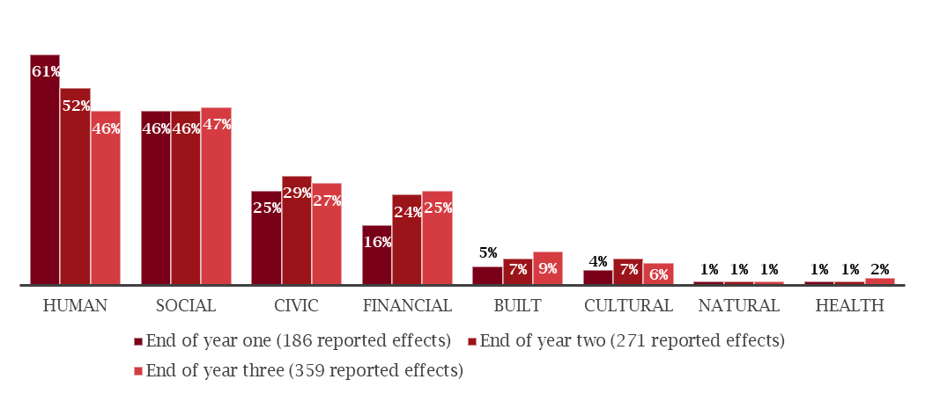
Changing proportions of REV community accomplishments from year one through year three
(Combined results across communities)

Slide 40
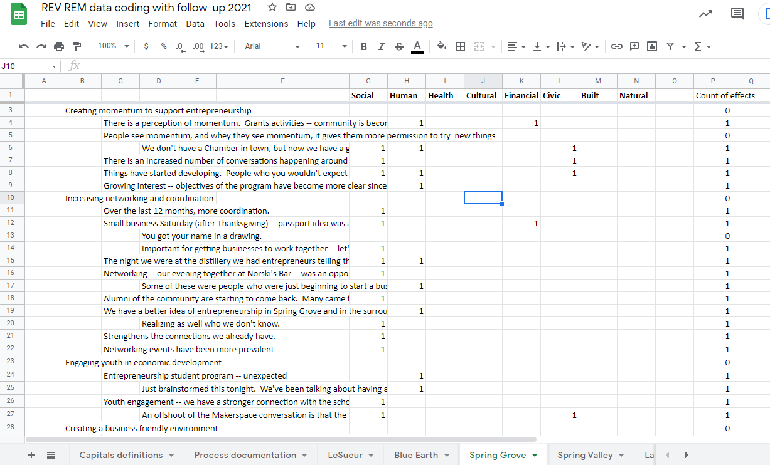
Coding a ripple map with the CCF

Slide 41
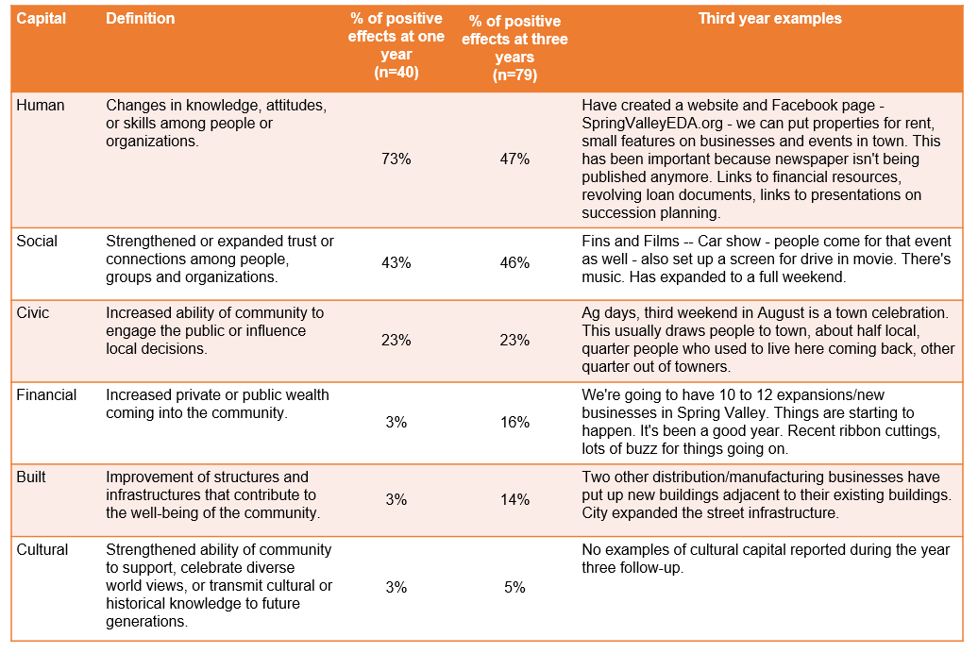

Slide 42
Proposal for North Central Indicators
Capital | Data points
Human | Number of participants reporting new leadership roles and opportunities undertaken as a result of Extension CRED programming. Dollar value of volunteer hours (based on Independent Sector hr value) to deliver programs or implement community projects initiated by Extension CRED programmings. Racial parity of CRED program participation (percent of participants who are BIPOC compared with state population)
Social | Number of cross-sector collaborations built or strengthened by Extension CRED programming. Number of regional collaborations built or strengthened by Extension CRED programming.
Civic/Political | Number of community or organizational plans/policies developed as a result of Extension CRED programming. Number of community or organizational, plans/policies adopted and/or implemented as a result of Extension CRED programming. Number of community development program participants holding or running for elected public office.
Cultural | Number of cultural heritage efforts developed or strengthened by Extension CRED programming. Number of DEI (diversity, equity, inclusion) efforts developed or strengthened by Extension CRED programming.
Financial (too many here) | Dollar value of grants and resources leveraged/generated by communities as a result of Extension CRED programming. Number of business plans created Number of businesses created Number of jobs created Number of jobs retained
Built | Number of building or infrastructure plans developed as a result of Extension CRED programming.
Natural | Number of natural resource/greenhouse gas reduction projects developed or strengthened as a result of Extension CRED programming.
Notes:
There are several North Central Indicators beyond these, for which we don’t usually report data – New jobs, retained jobs, for example. Scott has written a proposal for the North Central Program Leaders to consider to revisit these indicators for the future and perhaps organize them around the Community Capitals. I’d be happy if we just gave the states instructions to count impacts for each capital using a method like I used for our federal report data collection - with multiple data sources and a clear sense of how the data was collected - using the but for principle and using external data sources.

Slide 43
Q&A and discussion Thank you for attending!
Mary Emery: memery105@gmail.com
Abigail Condie: condi036@umn.edu
Abigail Borron: aborron@uga.edu
Scott Chazdon: schazdon@umn.edu

