Slide 1
Creating Effective Posters: B.O.A.S.T.ing Better Posters
Neil Knobloch, Ph.D.
Department of Youth Development
& Agricultural Education
3.9.15
Creating Posters to Share
PK-12 Engagement Outcomes

Slide 2
Objectives
Identify characteristics of effective posters
Discuss 5 strategies to create effective posters
Demonstrate how to present a poster
Provide peer feedback of each others posters

Slide 3
Game Plan
Time | Activity
12:00 | Lunch & Social
12:10 | Presentation
12:30 | Demonstrations of 30-second Sound Bites Melissa Voigt Megan Anderson Missy Welsh Lindsay Myers Bekah Nortrup
12:40 | Questions
12:45 | Peer Feedback
1:30 | Dismiss

Slide 4
What is an effective poster?
Visual presentation of the poster (41%)
Large print within the body of the report
High-quality graphics
Use of color
Large title
Effectiveness with which the ideas were communicated (37%)
Brevity
Clarity of writing
Supportive graphs and charts
Highlighted main points
(Welch & Waehler, 1996)

Slide 5
How do you create an effective poster?

Slide 6
B.O.A.S.T.
Billboard Design
Optically Pleasing
Audience Interaction
Say it with Fewer Words
Thirty-Second Sound Bites

Slide 7
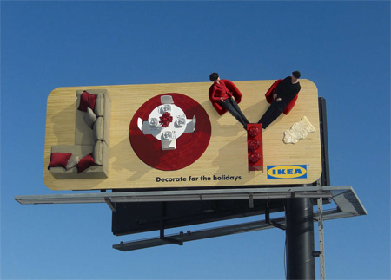
Billboard Design
What is the purpose of a billboard?
How do you focus a poster?
How do you pitch the message?
Who is your audience?

Slide 8
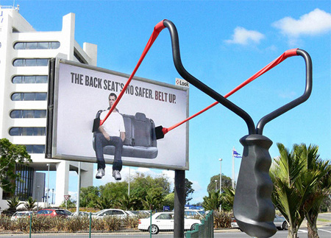
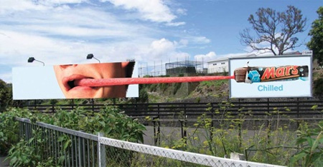
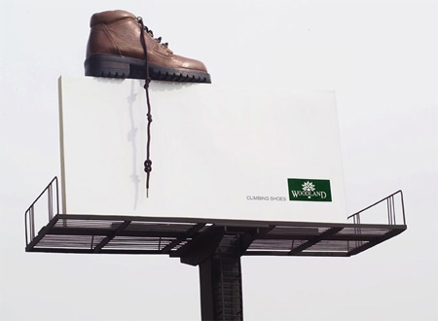
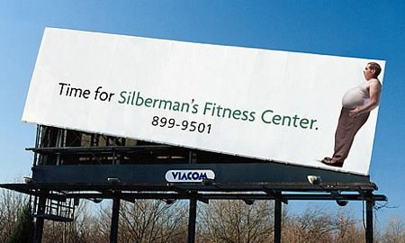
What do these billboards say?
A
B
D
C

Slide 9
Exercise: Think…be creative
Think of your poster…
What is a creative way to communicate the main point?

Slide 10
Optically Pleasing
What are some ways to make your poster eye-catching?
What are some design features of a poster?
Balance
Creativity
Font Size
Visuals

Slide 11
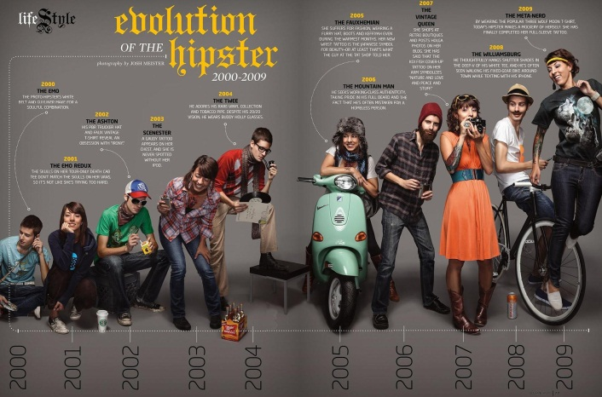
Audience Interaction
Who is your audience?
How do you create interaction?
How do you make your poster interesting?
How do you present your poster in a way that invites discussion?

Slide 12
Say it with Fewer Words
What needs to be on a poster?
Requirements?
How much text is enough text? How much text is too much?
How do you use visuals, tables, charts, or graphics to say a paragraph?

Slide 13
Thirty-Second Sound Bites
How long is a 30-second sound bite? [hint: 3 sentences]
What should be in your 30-second
Introduction?
What should be in your 30-second comment on
Methods?
Results?
“So What?”

Slide 14
Just a reminder…

Slide 15
Examples
Application: B.O.A.S.T.

Slide 16
Demonstration Notes
Poster | Bulletin Board Design (Focus) | Optically Pleasing | Audience Interaction | Say It With Fewer Words | Thirty-Second Sound Bite
Melissa Voigt (Hippology)
Megan Anderson (Nature of Science)
Missy Welsh (Plant Science Outreach)
Lindsay Myers (4-H Science)
Bekah Nortrup (State Fair)

Slide 17
Melissa Voigt

Slide 18
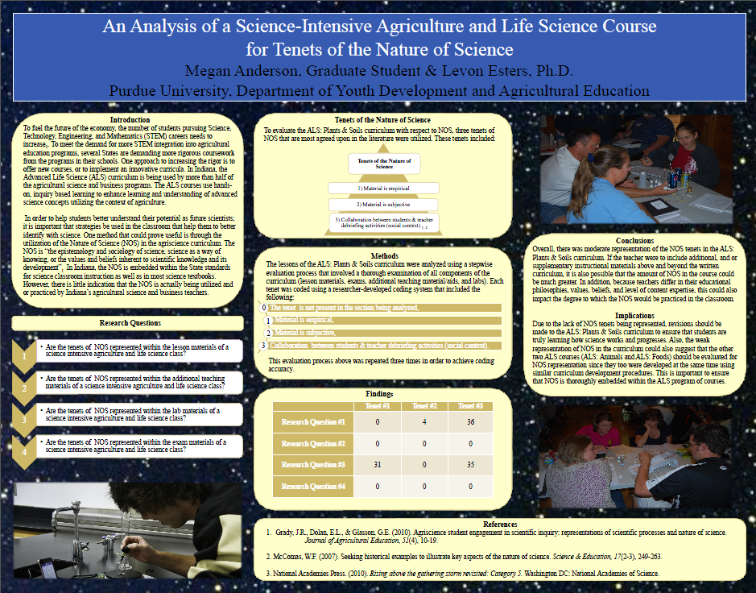
Megan Anderson

Slide 19
Missy Welsh

Slide 20
Lindsay Myers

Slide 21
Bekah Nortrup

Slide 22
Additional Resources
http://www.soe.uoguelph.ca/webfiles/agalvez/poster/
http://library.buffalo.edu/libraries/asl/guides/bio/posters.html
http://www.aaaeonline.org/posters/PosterFiles/AAAE%20Western%20Region%20Poster.htm
http://www.ncsu.edu/project/posters/
http://www.hsl.unc.edu/services/tutorials/poster_design/Elements_pages/elements_content.htm
http://www.kumc.edu/SAH/OTEd/jradel/Poster_Presentations/PstrStart.html
http://go.hrw.com/resources/go_ss/teacher99/toolkit/TOOLKT07.pdf

Slide 23
“Education is not filling a bucket but lighting a fire.”
-William Butler
Neil Knobloch, Ph.D.
Purdue University
Dept. of Youth Development & Ag. Education
West Lafayette, IN 47907-2053
v (765) 494-8439
f (765) 496-1152
Email nknobloc@purdue.edu
Thank You!

