Slide 1
Youth Assessment Strategies
Purdue Agriculture PK-12 Engagement Workshop
Dr. Hui-Hui Wang & Dr. Neil Knobloch
11/10/15

Slide 2
Agenda
Review the previous workshop
“Public Audiences / Youth Learning Outcomes”
Assessment Strategies
Resources

Slide 3
Activity: Putting The Puzzle Together
Try to put the cards into order from broadest to most specific and decide where learning outcomes fit
Unit Objectives
Syllabus
Learning Objectives
K-12 Curriculum
Unit Plan
Lesson Plan
Course Goals
Learning Standards
Learning Outcomes
Notes:
5 minutes

Slide 4
Where do learning outcomes fit?
Years
Months
Weeks
Days
K-12 Curriculum
Learning Standards
Syllabus
Course Goals
Learning Outcomes
Unit Plan
Unit Objectives
Lesson Plan
Learning Objectives

Slide 5
Assessing Learning Outcomes
Levels of learning outcomes and assessment
Institution
Program
Course
Learner
This workshop focuses on learner learning outcomes and assessment

Slide 6
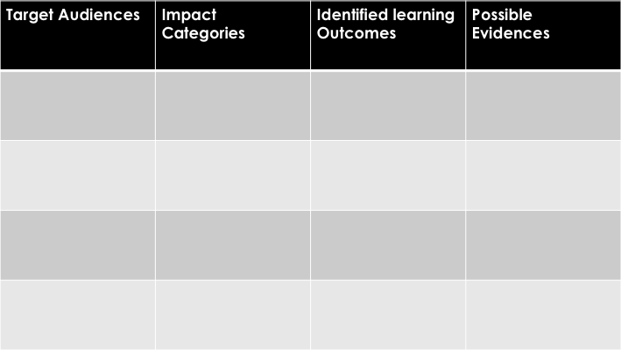
Learning Outcomes
What are potential learning outcomes?
How to write a good potential learning outcomes statement?
When do you write your public audiences (youth) learning outcomes?
Review from previous workshop
Notes:
In general, public audiences (youth) learning outcomes are actions by learners that could be observable, measurable and able to be documented!
Framework for evaluating impacts of informal science (The National Science Foundation)
In order to measure learning outcomes, designing activities and assessments should occur simultaneously. It is important to do cross-checking to ensure that the learning activities are designed to address the learning outcomes.

Slide 7
Backward Design
Learning Activities
Evidences
Learning Outcomes
Notes:
Define what learners must know, think and do and understand as a result of instruction.
Instruction must match these expectations.
Assessment must be aligned with learning outcomes. It is an integral part of your program design. It is not an afterthought!

Slide 8
Activity: Identify outcomes
Watch the video, brainstorm with your team and come up with your strategies to assess learning outcomes.
Target Audience
Outcome Category
Learning Outcome
https://www.youtube.com/watch?v=yGxSFbhtjZo
Target Audience | Outcome Category | Learning Outcome | Possible Evidences | Strategies (Methods)
Notes:
15 minutes

Slide 9
Activity: What are your strategies?
Using the provided resources, work with your team to come up with specific strategies (methods) to assess engagement and interest
Target Audiences | Identify Learning Outcomes | Possible Evidences | Strategies (Methods)
12~18 years old youth | Engagement & Interest | Time spent in activity | Time & Tracking Observation Log
Notes:
20 minutes

Slide 10
What Strategies Did You Choose? Why?
Questions
How would you make the assessment meaningful and assess what matters?
What assessments are appropriate for the targeted outcome and audience, and would provide evidences of learning?
How much time do you have?
What resource and support do you have?

Slide 11
Types of Assessment Methods
 | Survey (one shot) | Pre-post test | Observation | Interview | Work sample (written materials)
Advantages
Disadvantages
Others
Notes:
5 minutes

Slide 12
Assessment Methods
 | Quantitative | Qualitative | Multiple Methods
Definition | Numerical data collection | Descriptive data collection | Use both quantitative and qualitative
Advantages | Findings can possibly be generalized to broader populations | Focus more on an in-depth understanding that individual have constructed about their experiences in a particular context and point in time | Can be useful to triangulate and provide more than one perspective
Disadvantages | May not tell you “why”; Subjects may misinterpreted questions | May not be generalizing findings beyond the original inquiry | How the two methods work separately and together?
Examples | Surveys, questionnaires, standardized pre-and post-test instruments | Interviews, focus groups, observations, analysis of written materials | Observation protocol and rubric

Slide 13
Questionnaire (Survey)
Tips
What questionnaire already exists? Can a questionnaire be modified to measure targeted outcomes in this context?
Keep it simple and manageable.
At the beginning of the questionnaire, briefly tell the purpose of the study.
How the language in a questionnaire is phrased can influence the responses of the subject.
Test your questions beforehand.

Slide 14
Observation Checklists
An observation checklist identifies learning objectives and behaviors, and are used to determine whether a learner exhibits the behaviors or skills listed at a specific moment of time.
Tips
Listing target behaviors.
Arranging the desired actions.
Creating procedures for checking each action as it occurs.

Slide 15
Interview
The goal of a well-conducted interview is to elicit a participant’s responses in ways that avoid the imposition of bias on the part of the interviewer.
Tips
Don’t ask things unless you are sure you require the answers.
Arrange your questions that the most personal (sensitive) questions come last.
Ask about only one item at a time
Notes:
You can use category (range) to ask sensitive questions.
How big is your wildlife management area? What is your target species? Why?

Slide 16
Work Samples and Portfolios
A systematic collection of authentic learner’s work placed in portfolio. It can create a “timeline” of progress that reflects learners’ success.
Tips
Determine big ideas and concepts that you like to monitor and analyze over time.
Determine type of a learner’s work that will be collected, such as journal, drawing, videotapes, and/or photos.

Slide 17
Limitations of this Workshop (…possible topics for Future Workshops)
Direct- and indirect-measures
Validity and reliability
Data analysis
Quantitative
Qualitative
How to conduct observations & interviews
Best practices & pitfalls
Specific protocols
Others? ___________, ___________, ___________
Please share on the workshop evaluation

Slide 18
Resources
From soft skills to hard data
http://forumfyi.org/content/soft-skills-hard-data-
Assessment Tools in Informal Science
http://www.pearweb.org/atis/dashboard/index
Informal Science Evaluation Resources
http://informalscience.org/evaluation
Dimensions of Success
http://www.pearweb.org/tools/dos.html
Dimensions of Success Video
https://www.youtube.com/watch?v=Gy7Vl5ZrvKw&feature=youtu.be
Youth Involvement and Engagement Assessment Tool
http://youth.gov/docs/pyd_AssessmentTool.pdf
Defining Youth Outcomes for STEM Learning in Afterschool
http://www.afterschoolalliance.org/STEM_Outcomes_2013.pdf
A shared Vision for Youth: Common Outcomes and Indicators
http://www.nationalassembly.org/Knowledge/documents/NCYCommonOutcomes.pdf

Slide 19
Choosing Assessment Tools
Don’t get overwhelmed by the process! Keep things feasible and manageable.
An assessment tool may be used to assess more than one learning outcome.
 | Amount of data | Subjects’ comfort | Ease of transcription | Affordability
Check sheets | Medium | High | High | High
Event recorder | High | Medium to low | Medium to high | Low to medium
Audio tape | High | Medium | Medium | Medium
Videotape | Highest | Low | Low | Low
Diamond, J. (1982). Ethology in museums: Understanding the learning process. Roundtable Reports, 7(4), 13-15.

