Slide 1
Public Audiences (Youth) Learning Outcomes
Dr. Hui-Hui Wang & Dr. Neil Knobloch

Slide 2
Agenda
What are potential learning outcomes?
How to write a good learning outcome statement?

Slide 3
What are learning outcomes (LO) and learning outcome statements?
Learning outcomes are the impacts intended for your project/program.
In general, public audiences (youth) learning outcomes are actions by learners that could be observable, measurable and able to be documented!
A learning outcome statement is a brief statement of what a learner will know and be able to do.
At the end of a class
At the end of a course
At the end of a program
Notes:
2 minutes
What you want students to know and be able to do

Slide 4
Activity
If you are the program manager, what could be your intended public audiences (youth) learning outcomes?
https://www.youtube.com/watch?v=qXO5NYV6bCc
Notes:
13 minutes

Slide 5
Where might you find learning outcomes?
Logic models & evaluation plans in Grant proposals
Lesson plans & Syllabi
Educational program plans
University curriculum (e.g. Educational Outcomes of the Purdue University College of Agriculture)
Learning standards
Evaluation report/Impact statements
Journal articles of educational research studies
Notes:
2 minutes

Slide 6
Categories of learning outcomes
Outcomes are usually expressed as knowledge, skills, attitudes or values.
In order to measure learning outcomes, designing activities and assessments should occur simultaneously. It is important to do cross-checking to ensure that the learning activities are designed to address the learning outcomes.
Framework for evaluating impacts of informal science (The National Science Foundation)
Notes:
P.21 Table 3-1 Impact categories as they relate to public audiences
5 minutes

Slide 7
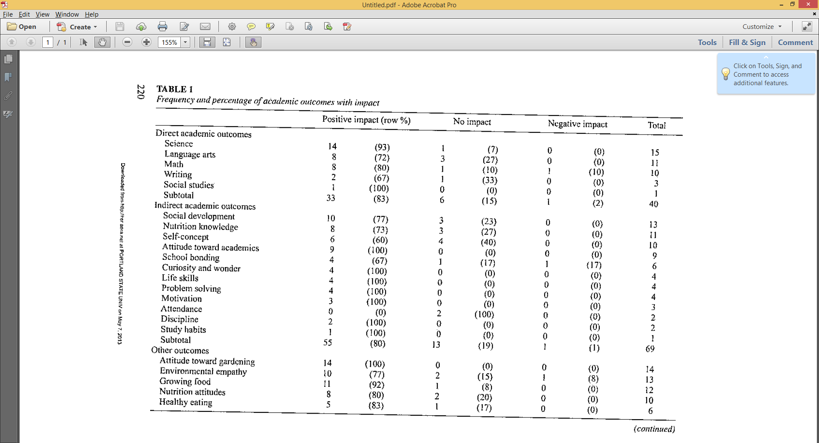
Williams, D.R., & Dixon, P.S. (2013). Impact of garden-based learning on academic outcomes in schools: Synthesis of research between 1990 and 2010. Review of Educational Research, 83(2), 211-235

Slide 8
Developing impact categories, intended learning outcomes & evidences
Target Audiences | Impact Categories | Identified learning Outcomes | Possible Evidences
Notes:
15 minutes

Slide 9
How to write a good learning outcome statement?
How to get started?
Ask yourself: What are the most important things learners should know, be able to do, or demonstrate after completing my program.
Make a list

Slide 10
Ask two simple questions
Can it be measured?
Is learning (changes) being demonstrated? How?

Slide 11
Write your learning outcome statements
Using your table, try to write two or three learning outcome statements.
Notes:
10 minutes

Slide 12
When writing learning outcome statements…
Focus on a smaller number of high priority outcomes.
Make outcomes as specific, focused and clear as possible (general outcomes will be hard to measure).
…will appreciate the benefit of teamwork.
…will learn the coding system of a library to find books.

Slide 13
When writing learning outcome statements…
Use action verbs that can be observed and measured.
Action verbs that are easy to measure: Categorize, compare, describe, explain, illustrate, list, report, and so on.
Action verbs that are not that easy to measure: apply, become aware of, create, develop, know, learn, understand, and so on.

Slide 14
When writing learning outcome statements…
Content knowledge gain is easier to be measured than skills.
Heat energy transfer, 3+3=6, H2O + B- = OH- + HB ,and so on.
Problem solving, critical thinking, communication, apply knowledge, and so on.

Slide 15
Examples
…will be able to list type of renewable energy.
…will be able to calculate soybean production costs, yields, and returns.
…will demonstrate critical thinking skills.
…will become aware of the importance of eating vegetables.
…will develop problem-solving skills.

Slide 16
Activity
Check your learning outcome statements, do you feel confidence about your learning outcome statements? If not, how can you improve your writing?
Notes:
10 minutes

Slide 17
Resources
Framework for Evaluating Impacts of Informal Science (The National Science Foundation, 2008)
http://www.informalscience.org/documents/Eval_Framework.pdf
University of Connecticut: how to write outcome statement
http://www.assessment.uconn.edu/docs/HowToWriteObjectivesOutcomes.pdf
Big Brothers Big Sisters Report to America: 2013 Youth Outcomes Report
http://www.bbbs.org/atf/cf/%7B8778D05C-7CCB-4DEE-9D6E-70F27C016CC9%7D/20130425_BBBSA_YOS2013.pdf
Defining Youth Outcomes for STEM Learning in Afterschool
http://www.afterschoolalliance.org/STEM_Outcomes_2013.pdf
A shared Vision for Youth: Common Outcomes and Indicators
http://www.nationalassembly.org/Knowledge/documents/NCYCommonOutcomes.pdf

Slide 18
Questions?

