Slide 1
Student Instructions
Earning Passport Badges for the Leadership Development Certificate Program

Slide 2
Signing In
Open a browser and enter “openpassport.org” into the address bar.

Slide 3
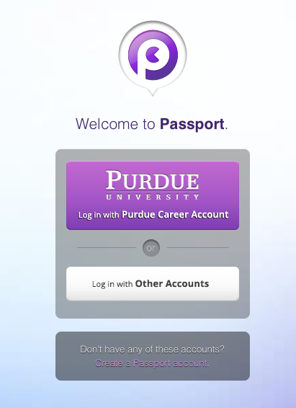
Signing In
1
2
Log in with your Purdue Career Account

Slide 4
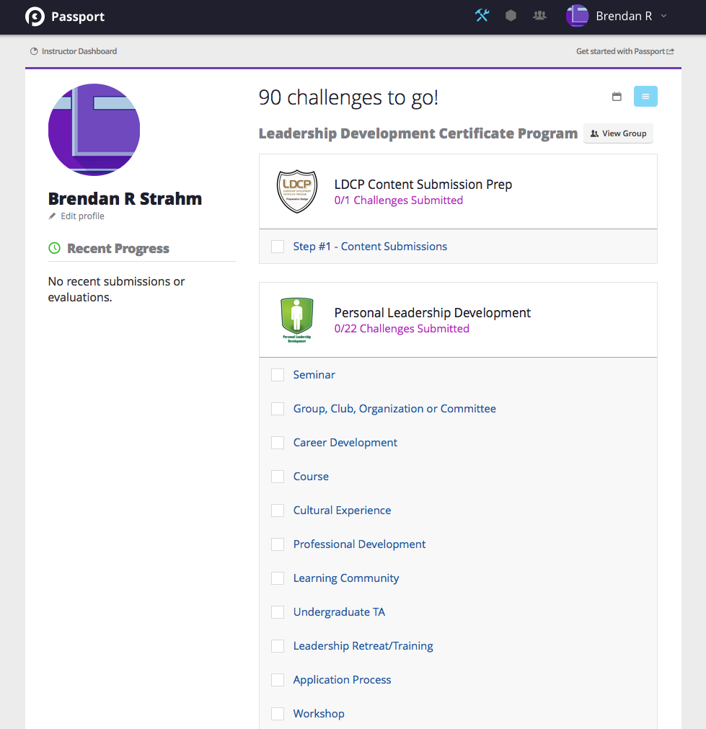
Student Dashboard
See what challenges you have to complete on the right, and get updates on your submissions under “Recent Progress” on the left.

Slide 5
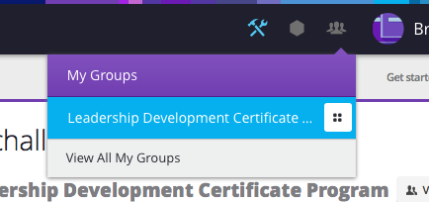
Getting to a Group
1
Hover over the groups icon in the top bar and click a group from the dropdown to go to that group’s page.
2

Slide 6
This is a Group Page

Slide 7
Finding Challenges
Look for LDCP challenges in the group description. Find the challenge you want to complete and click on a badge to count its points toward.
1

Slide 8
Completing Challenges
Clicking on a challenge takes you to its description screen. Click on “Complete this challenge!” to continue.
1

Slide 9
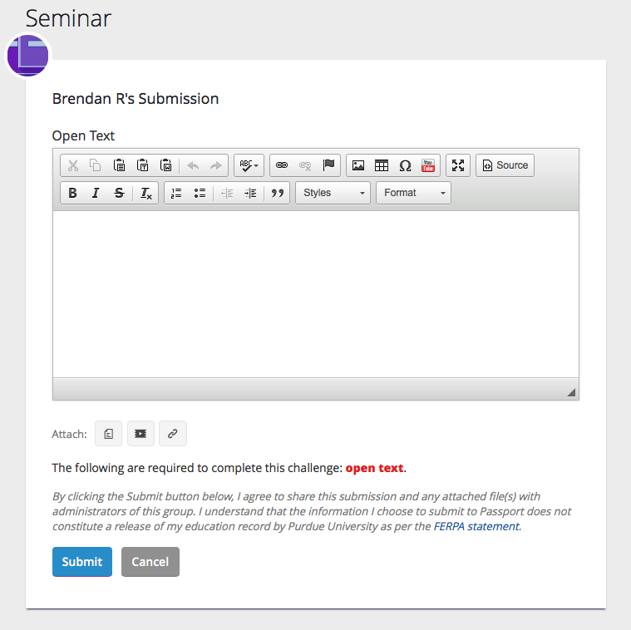
Completing Challenges
1
Open text challenges require a written submission. Some open text challenges also accept attachments. Click Submit when you’re done.
2

Slide 10
Questions?
Contact Studio help at studiohelp@purdue.edu!

